Slide 1
AI Capability 2.0 Modules – 6 & 7
Building AI Applications with LangChain
Enterprise-Grade RAG
Presenter: Priya Ranjan (pranjan@aziro.com)
Date: 6-April-2026

Slide 2
Today’s Topics
LangChain detailed understanding and walkthrough
Prompt engineering
Multi-step chains
Tools & Agents
Memory
Custom tools
Hands-on Demo
Enterprise-Grade RAG
Hands-on Demo – Resume Parser RAG

Slide 3
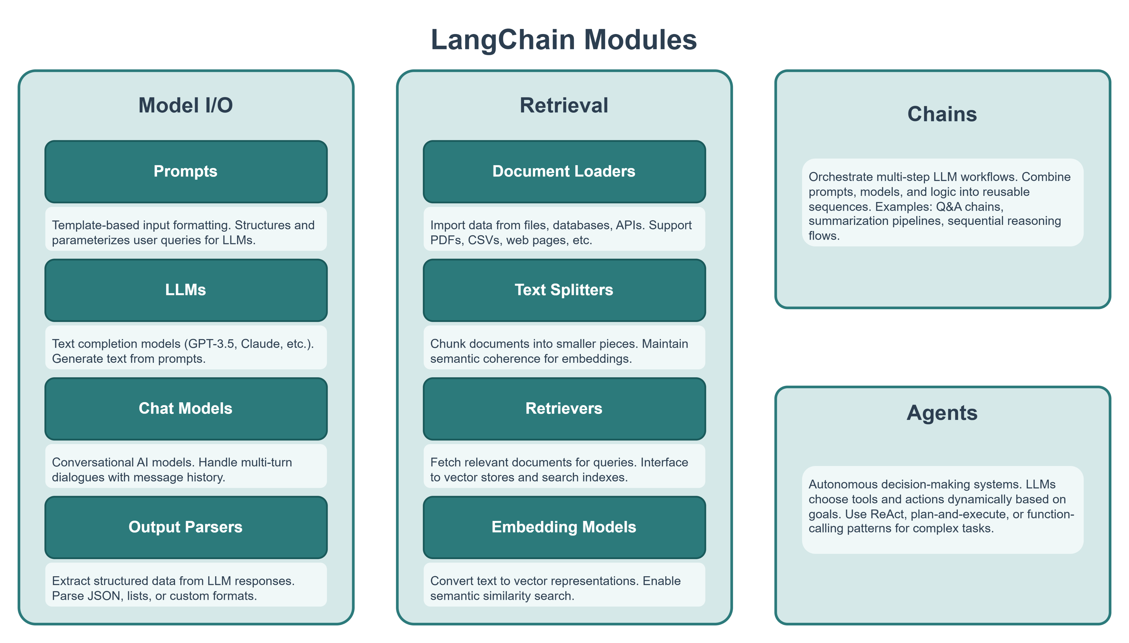
Langchain
LangChain is an open-source Python (and JavaScript) framework for building applications powered by Large Language Models.
Rather than wiring LLM APIs from scratch, LangChain gives you modular, composable building blocks –
prompts
retrievers
chains
memory
agents
that plug together cleanly and follow a single unified interface called LCEL (LangChain Expression Language).

Slide 4
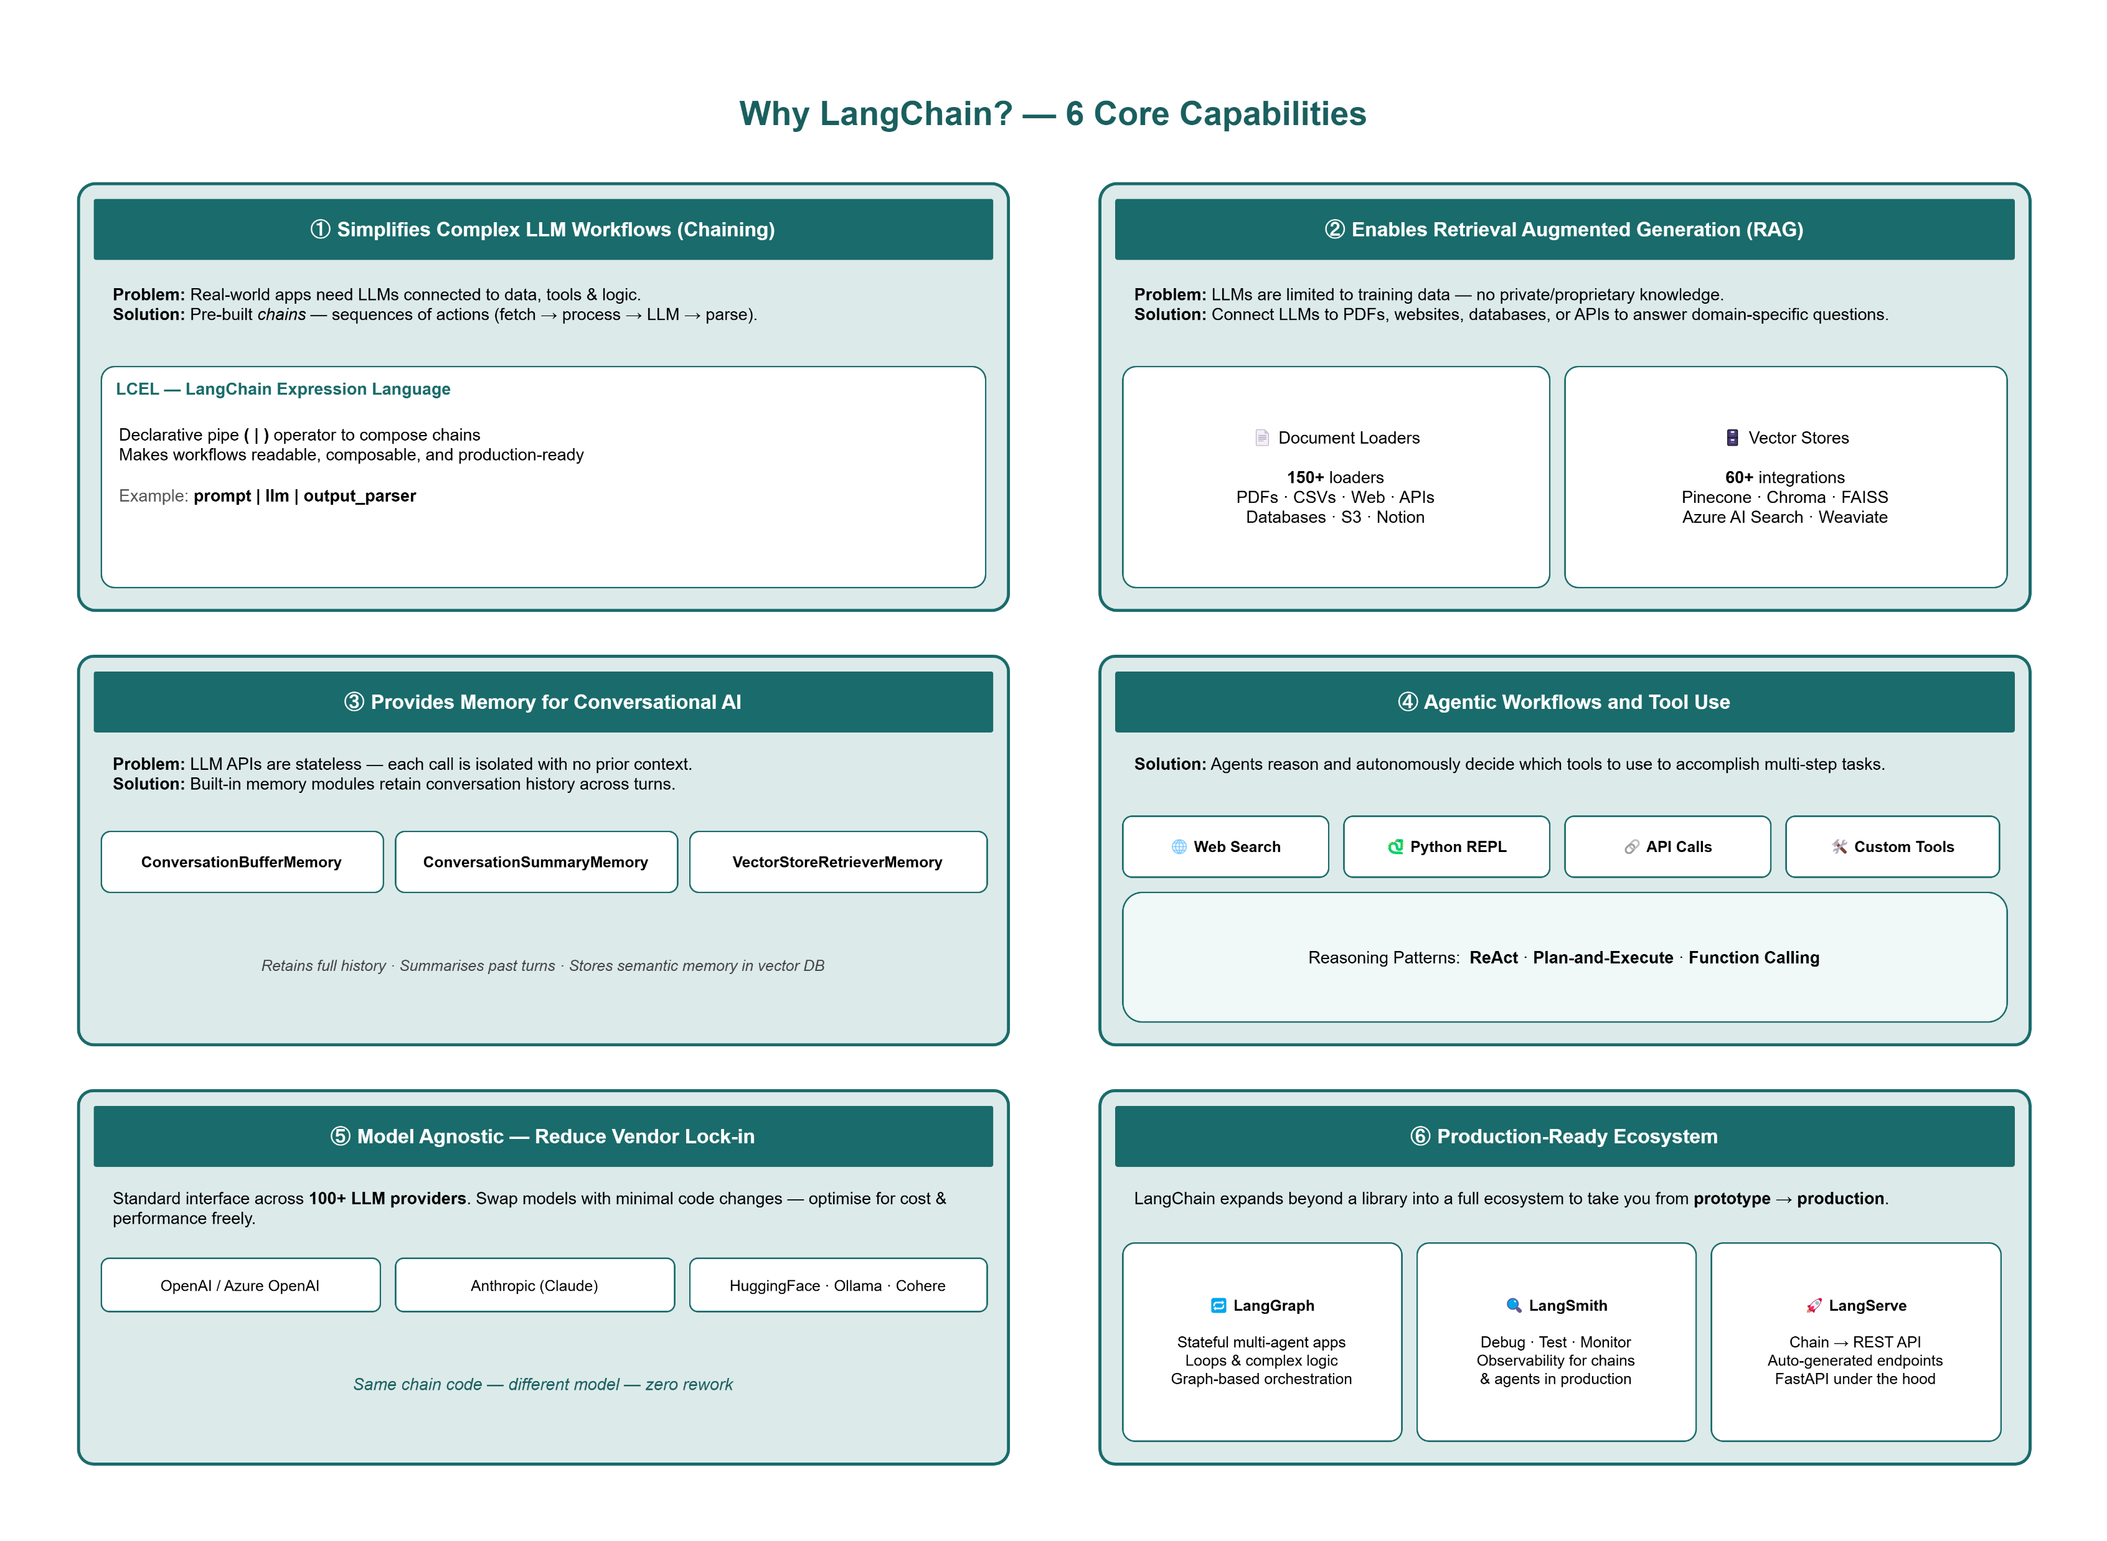
Langchain Capabilities

Slide 5
Model I/O
01_prompts.py
The interface between your application and language models—
prompts in
structured output out
Prompts
Prompt templates are reusable, parameterised text skeletons. You define variables with {curly braces} and fill them at runtime.
LangChain ships three main types:
basic PromptTemplate
Chat aware ChatPromptTemplate
FewShotPromptTemplate
from langchain_core.prompts import PromptTemplate, ChatPromptTemplate, FewShotPromptTemplate
# ── Basic PromptTemplate ───────────────────────────────────────
template = PromptTemplate(
input_variables=["topic", "audience"],
template="Explain {topic} to a {audience} in 2 sentences."
)
print(template.format(topic="RAG pipelines", audience="product manager"))
# ── ChatPromptTemplate ─────────────────────────────────────────
chat_prompt = ChatPromptTemplate.from_messages([
("system", "You are an expert in {domain}."),
("human", "Give me 3 best practices for {task}."),
])
msgs = chat_prompt.format_messages(domain="RAG", task="chunking documents")
for m in msgs:
print(f"[{m.type}] {m.content}")
# ── FewShotPromptTemplate ──────────────────────────────────────
examples = [
{"input": "happy", "output": "sad"},
{"input": "fast", "output": "slow"},
]
example_prompt = PromptTemplate(
input_variables=["input", "output"],
template="Word: {input}\nAntonym: {output}"
)
few_shot = FewShotPromptTemplate(
examples=examples,
example_prompt=example_prompt,
prefix="Give the antonym of every word.\n",
suffix="Word: {input}\nAntonym:",
input_variables=["input"]
)
print(few_shot.format(input="bright"))
This is your training-like examples inside the prompt.
These are the sample Q&A pairs.
This decides how each example should be printed.
This tells LangChain how to convert each example into text.
This is the instruction shown before the examples.
This combines everything.
It builds the final prompt in this order:
prefix → instruction at the top
examples → formatted using example_prompt
suffix → new question to solve!
This is the final unsolved example.
This tells LangChain that the final prompt needs one variable from the user: input.

Slide 6
LLMs
The LLM class wraps text-completion endpoints (e.g. gpt-3.5-turbo-instruct or meta-llama-3.1-8b-instruct running locally etc).
You control creativity via temperature, response length via max_tokens, and can call in batch or stream token-by-token.
02_llms.py
from langchain_openai import ChatOpenAI
llm = ChatOpenAI(
model="meta-llama-3.1-8b-instruct",
base_url="http://192.168.37.1:1234/v1",
api_key="lm-studio",
temperature=0.7,
max_tokens=512,
)
# ── Single call ────────────────────────────────────────────────
response = llm.invoke("List 3 use cases of LangChain:")
print(response.content)
# ── Batch ──────────────────────────────────────────────────────
responses = llm.batch(["Capital of France?", "Capital of Japan?"])
for r in responses:
print(r.content.strip())
# ── Streaming ──────────────────────────────────────────────────
for chunk in llm.stream("Explain embeddings in one paragraph:"):
if chunk.content:
print(chunk.content, end="", flush=True)
print()
Lower temperature → more predictable, focused, repeatable
Higher temperature → more varied, creative, less predictable.

Slide 7
Chat Models
Chat models accept a list of typed messages (System / Human / AI) and return an AIMessage.
This maps directly to the conversational interface of modern models like GPT-4o, Claude, or Gemini.
03_chat_models.py
from langchain_openai import ChatOpenAI
from langchain_core.messages import SystemMessage, HumanMessage, AIMessage
chat = ChatOpenAI(
model="meta-llama-3.1-8b-instruct",
base_url="http://192.168.37.1:1234/v1",
api_key="lm-studio",
temperature=0.7, #lower value like 0.0 → more deterministic, stable, direct
max_tokens=512,
)
messages = [
SystemMessage(content="You are a concise technical assistant."),
HumanMessage(content="What is LangChain?"),
AIMessage(content="LangChain is a framework for building LLM apps."),
HumanMessage(content="Name its 3 core modules."),
]
response = chat.invoke(messages)
print(response.content)
With AIMessage
Model understands:
topic = LangChain
“its” means LangChain
Without AIMessage
Model may be less clear about:
what “its” refers to
Here AI message is supplied as fake history manually, just for demo purpose!

Slide 8
Output Parsers
Raw LLM output is a string. Output parsers transform it into structured Python types — a plain string, a list, or a validated Pydantic model — making downstream processing reliable.
04_output_parsers.py
from langchain_openai import ChatOpenAI
from langchain_core.prompts import PromptTemplate
from langchain_core.output_parsers import StrOutputParser, CommaSeparatedListOutputParser
# Create connection to local LLM
llm = ChatOpenAI(
model="meta-llama-3.1-8b-instruct",
base_url="http://192.168.37.1:1234/v1",
api_key="lm-studio",
temperature=0.0,
max_tokens=256,
)
# Example 1: String output
print("\n--- Example 1: StrOutputParser ---")
# Create prompt
prompt1 = PromptTemplate.from_template(
"What is {item}? Explain in 1 simple sentence."
) # Build chain: Prompt -> LLM -> Output Parser
chain1 = prompt1 | llm | StrOutputParser()
# Run chain
output1 = chain1.invoke({"item": "Vector Database"})
# Print result
print(output1)
# Example 2: List output
print("\n--- Example 2: CommaSeparatedListOutputParser ---")
# Create list parser
list_parser = CommaSeparatedListOutputParser()
# Create prompt with parser instructions
prompt2 = PromptTemplate(
template=(
"Name 5 cloud platforms.\n"
"{format_instructions}"
),
input_variables=[],
partial_variables={
"format_instructions": list_parser.get_format_instructions()
},
)
# Build chain
chain2 = prompt2 | llm | list_parser
# Run chain
output2 = chain2.invoke({})
# Print result
print(output2)
asking the model a question
telling the model how the answer should be formatted

Slide 9
Prompt Engineering
Prompt engineering is the practice of designing prompts so an LLM gives more reliable, clear, and useful output.
It means writing inputs in a way that helps the model respond in the style, format, and quality you want.
Beyond simple templates, advanced techniques like Chain-of-Thought, role assignment, format instructions, and few-shot examples can greatly improve response quality, consistency, and structure.

Slide 10
Role Prompting
Assign a persona via the system message. The model adopts that expertise level, tone, and vocabulary for the entire conversation — a simple but highly effective technique.
from langchain_openai import ChatOpenAI
from langchain_core.prompts import ChatPromptTemplate
from langchain_core.output_parsers import StrOutputParser
# ── Local LLM Configuration ────────────────────────────────────
llm = ChatOpenAI(
model="meta-llama-3.1-8b-instruct",
base_url="http://192.168.37.1:1234/v1",
api_key="lm-studio",
temperature=0.0,
max_tokens=512,
)
# ── Role: Senior Security Auditor ──────────────────────────────
prompt = ChatPromptTemplate.from_messages([
(
"system",
"You are a senior cybersecurity auditor with 15 years of experience. "
"Respond with precise, actionable findings only. No fluff."
),
(
"human",
"Review this practice: {practice}"
),
])
chain = prompt | llm | StrOutputParser()
print("\n--- Security Auditor Output ---")
print(chain.invoke({
"practice": "We store API keys in environment variables on a shared dev server."
}))
pe_01_role_prompting.py
# ── Role: Friendly Explainer ───────────────────────────────────
simple_prompt = ChatPromptTemplate.from_messages([
(
"system",
"You are a patient teacher explaining complex topics to a 10-year-old. "
"Use simple words and fun analogies."
),
(
"human",
"Explain: {topic}"
),
])
simple_chain = simple_prompt | llm | StrOutputParser()
print("\n--- Friendly Explainer Output ---")
print(simple_chain.invoke({
"topic": "How does a RAG pipeline work?"
}))

Slide 11
Chain-of-Thought(CoT) Prompting
Instructing the model to "think step by step" before giving the final answer dramatically improves accuracy on reasoning tasks — math, logic, multi-hop questions.
CoT makes the reasoning explicit and auditable.
pe_02_chain_of_thought.py
from langchain_openai import ChatOpenAI
from langchain_core.prompts import ChatPromptTemplate
from langchain_core.output_parsers import StrOutputParser
# ── Local LLM Configuration ────────────────────────────────────
llm = ChatOpenAI(
model="meta-llama-3.1-8b-instruct",
base_url="http://192.168.37.1:1234/v1",
api_key="lm-studio",
temperature=0.0,
max_tokens=512,
)
# ── Example 1: Zero-shot Step-by-Step Prompting ────────────────
print("\n--- Example 1: Zero-shot CoT ---")
cot_prompt = ChatPromptTemplate.from_messages([
("system", "Think step by step and keep the answer simple."),
("human", "Solve this problem: {problem}"),
])
cot_chain = cot_prompt | llm | StrOutputParser()
problems = [
"If a car travels 60 km in 2 hours, what is its speed per hour?",
"What is 15 + 27?",
]
for p in problems:
print(f"\nProblem: {p}")
print(cot_chain.invoke({"problem": p}))
# ── Example 2: Few-shot Prompting ──────────────────────────────
print("\n--- Example 2: Few-shot CoT ---")
few_shot_prompt = ChatPromptTemplate.from_messages([
("system", "Solve the problem step by step like the example."),
(
"human",
"Example:\n"
"Q: 10 mangoes cost 50 rupees. What is the cost of 1 mango?\n"
"A: 1 mango costs 50 / 10 = 5 rupees. Final Answer: 5 rupees."
),
("ai", "Okay, I will follow the same style."),
("human", "Now solve this:\nQ: {question}"),
])
few_shot_chain = few_shot_prompt | llm | StrOutputParser()
result = few_shot_chain.invoke({
"question": "6 notebooks cost 120 rupees. What is the cost of 1 notebook?"
})
print(result)

Slide 12
Format Instructions & Structured Output
pe_03_format_instructions.py
Tell the model the exact output format you want, such as specific JSON keys and even a sample JSON structure.
In this example, the prompt clearly asks the local LLM to return only valid JSON with product, pros, cons, score, and verdict, which makes the response more predictable and easier to use in Python.
If you also combine this kind of format instruction with a parser like PydanticOutputParser, you can convert the LLM response into validated Python objects instead of handling raw text manually.
from langchain_openai import ChatOpenAI
from langchain_core.prompts import PromptTemplate
llm = ChatOpenAI(
model="meta-llama-3.1-8b-instruct",
base_url="http://192.168.224.1:1234/v1",
api_key="lm-studio",
temperature=0
)
prompt = PromptTemplate.from_template(
"""
Review this product: {product}
Return only valid JSON with keys:
product, pros, cons, score, verdict
Example format:
{{
"product": "some product",
"pros": ["pro1", "pro2"],
"cons": ["con1", "con2"],
"score": 8.5,
"verdict": "Short final opinion"
}}
"""
)
chain = prompt | llm
result = chain.invoke(
{"product": "LangChain for building RAG applications"}
)
print(result.content)

Slide 13
Prompt Composition Patterns
pe_04_composition.py
Real prompts often mix several prompting methods together.
This demo shows a practical prompt that combines role assignment, clear output formatting, and few-shot examples to generate more consistent and reliable results from the local LLM
from langchain_openai import ChatOpenAI
from langchain_core.prompts import ChatPromptTemplate, FewShotChatMessagePromptTemplate
from langchain_core.output_parsers import StrOutputParser
llm = ChatOpenAI(
model="meta-llama-3.1-8b-instruct",
base_url="http://192.168.224.1:1234/v1",
api_key="lm-studio",
temperature=0
)
# Few-shot examples
examples = [
{
"input": "The server is down and users can't login.",
"output": "SEVERITY: High | CATEGORY: Availability | ACTION: Escalate to on-call engineer"
},
{
"input": "The dashboard loads 2 seconds slower than last week.",
"output": "SEVERITY: Medium | CATEGORY: Performance | ACTION: Check DB queries"
},
]
example_prompt = ChatPromptTemplate.from_messages([
("human", "{input}"),
("ai", "{output}")
])
few_shot_prompt = FewShotChatMessagePromptTemplate(
examples=examples,
example_prompt=example_prompt
)
# Main prompt
final_prompt = ChatPromptTemplate.from_messages([
(
"system",
"You are an SRE assistant. "
"Classify the incident and return only this format:\n"
"SEVERITY: <Low|Medium|High> | CATEGORY: <type> | ACTION: <next step>"
),
few_shot_prompt,
("human", "{incident}")
])
# Chain
chain = final_prompt | llm | StrOutputParser()
# Test incidents
incidents = [
"Memory usage at 95% on prod database for the past 10 minutes.",
"A button label is misspelled on the settings page."
]
for incident in incidents:
result = chain.invoke({"incident": incident})
print("Incident :", incident)
print("Decision :", result)
print("-" * 60)

Slide 14
Retrieval
Retrieval is the process of finding the most relevant information from your data before sending it to the LLM. Instead of asking the model to rely only on its built-in knowledge, you first fetch related content from documents, PDFs, websites, databases, or other sources and then provide that context to the model.
This is the core foundation of RAG (Retrieval-Augmented Generation).
A typical retrieval pipeline follows these steps:
Load → Split → Embed → Store → Retrieve
Load: collect documents from files, PDFs, web pages, databases, or APIs
Split: break large documents into smaller chunks so retrieval becomes more precise
Embed: convert each chunk into vector form so meaning can be compared mathematically
Store: save those vectors in a vector database such as Qdrant, FAISS, or Chroma
Retrieve: when a user asks a question, find the chunks whose meaning is closest to the query
In simple terms, retrieval helps the LLM get the right context at the right time, which improves answer accuracy and reduces hallucination.

Slide 15
Document Loaders
Loaders bring data into LangChain and convert it into Document objects with:
page_content → actual text
metadata → source details
In this demo:
TextLoader loads a text file
CSVLoader loads CSV rows as documents
WebBaseLoader loads content from a web page
05_document_loaders.py
from langchain_community.document_loaders import TextLoader, CSVLoader, WebBaseLoader
# -----------------------------
# 1. Load text file
# -----------------------------
text_docs = TextLoader("notes.txt").load()
print("=== TEXT LOADER ===")
print("Content preview:")
print(text_docs[0].page_content[:200])
print("Metadata:")
print(text_docs[0].metadata)
print("-" * 50)
# -----------------------------
# 2. Load CSV file
# -----------------------------
csv_docs = CSVLoader("data.csv").load()
print("=== CSV LOADER ===")
print("Total rows loaded:", len(csv_docs))
print("First row content:")
print(csv_docs[0].page_content)
print("First row metadata:")
print(csv_docs[0].metadata)
print("-" * 50)
# -----------------------------
# 3. Load web page
# -----------------------------
web_docs = WebBaseLoader("https://python.langchain.com/docs/introduction/").load()
print("=== WEB LOADER ===")
print("Web content preview:")
print(web_docs[0].page_content[:300])
print("Metadata:")
print(web_docs[0].metadata)
print("-" * 50)

Slide 16
Text Splitters
06_text_splitters.py
LLMs cannot handle very large text at once, so long documents are split into smaller chunks before processing. Chunking also helps vector databases store and retrieve relevant pieces more accurately. To avoid losing meaning between chunks, a small overlap is usually kept.
The most commonly used splitter is RecursiveCharacterTextSplitter, which breaks text into manageable chunks while trying to preserve natural boundaries.
from langchain_text_splitters import RecursiveCharacterTextSplitter, TokenTextSplitter
# Sample long text
text = "LangChain helps split large text into smaller chunks for LLM processing. " * 20
# 1. RecursiveCharacterTextSplitter
char_splitter = RecursiveCharacterTextSplitter(
chunk_size=120,
chunk_overlap=20
)
char_chunks = char_splitter.create_documents([text])
print("=== CHARACTER SPLITTER ===")
print("Total chunks:", len(char_chunks))
print("First chunk:")
print(char_chunks[0].page_content)
print("-" * 50)
# 2. TokenTextSplitter
token_splitter = TokenTextSplitter(
chunk_size=30,
chunk_overlap=5
)
token_chunks = token_splitter.create_documents([text])
print("=== TOKEN SPLITTER ===")
print("Total chunks:", len(token_chunks))
print("First chunk:")
print(token_chunks[0].page_content)
print("-" * 50)

Slide 17
Embedding Models
07_embeddings.py
Embeddings convert text into numeric vectors. Texts with similar meaning get similar vectors, which helps in semantic search.
LangChain supports OpenAI, Cohere, HuggingFace, and many other embedding providers.
In this demo, embeddings are created using the local SentenceTransformer model (all-MiniLM-L6-v2) instead of a cloud provider.
import numpy as np
from sentence_transformers import SentenceTransformer
# Load local embedding model
model = SentenceTransformer("all-MiniLM-L6-v2")
texts = [
"LangChain is a framework for building LLM applications.",
"Vector databases store embeddings for semantic search.",
"Paris is the capital of France."
]
query = "What is LangChain?"
# Create embeddings
doc_vectors = model.encode(texts)
query_vector = model.encode(query)
print("Vector dimension:", len(doc_vectors[0]))
print("-" * 50)
# Cosine similarity
def cosine_similarity(a, b):
a = np.array(a)
b = np.array(b)
return np.dot(a, b) / (np.linalg.norm(a) * np.linalg.norm(b))
print("Query:", query)
print("\nSimilarity scores:")
for text, vector in zip(texts, doc_vectors):
score = cosine_similarity(query_vector, vector)
print(f"{score:.3f} -> {text}")
[ [0.21, -0.44, 0.17, ...], # vector for first text [0.09, 0.51, -0.22, ...], # vector for second text [0.77, -0.10, 0.03, ...] # vector for third text ]
[0.20, -0.40, 0.11, ...]
a = np.array(a)
Converts a into a NumPy array.
b = np.array(b)
Converts b into a NumPy array.
np.dot(a, b)
Dot product of the two vectors.
np.linalg.norm(a)
Length of vector a
np.linalg.norm(b)
Length of vector b
all-MiniLM-L6-v2, this is usually 384
np.dot(a, b) / (np.linalg.norm(a) * np.linalg.norm(b))
This is the cosine similarity formula.

Slide 18
Retrievers
This demo uses a local embedding model to convert text into vectors and stores them in FAISS.
When the user asks a query, the same model converts the query into a vector.
FAISS then finds the text chunks that are closest in meaning to that query.
This is the basic retrieval step used in semantic search and RAG.
08_retrievers.py
from langchain_huggingface import HuggingFaceEmbeddings
from langchain_community.vectorstores import FAISS
# Local embedding model
embeddings = HuggingFaceEmbeddings(
model_name="sentence-transformers/all-MiniLM-L6-v2"
)
# Sample texts
texts = [
"LangChain provides modular components for LLM applications.",
"RAG combines retrieval with generation to produce grounded answers.",
"FAISS is a vector store used for semantic search.",
"Agents can use tools to complete tasks automatically."
]
# Create FAISS vector store
vector_store = FAISS.from_texts(texts, embeddings)
# Query
query = "What is RAG?"
results = vector_store.similarity_search(query, k=2)
print("=== FAISS RETRIEVER DEMO ===")
print("Query:", query)
print("-" * 50)
print("Top matching texts:")
for i, doc in enumerate(results, 1): #loop through results and also keep a count starting from 1
print(f"{i}. {doc.page_content}")

Slide 19
Chains
Chains are used to connect multiple steps together into one complete workflow.
Instead of calling each part manually, you link them so the output of one step becomes the input of the next step.
A chain can combine things like:
a prompt to tell the model what to do
an LLM to generate the response
a retriever to fetch relevant information
an output parser to format or clean the result
other processing steps such as transformation or filtering
In simple terms, a chain helps you build an end-to-end pipeline for an AI task.

Slide 20
LCEL — LangChain Expression Language
This example shows how LangChain chains connect a prompt, local LLM, and parser into one simple workflow.
The same chain can run once, on multiple inputs, or in streaming mode. This makes LLM applications more modular and reusable.
09_lcel.py
from langchain_openai import ChatOpenAI
from langchain_core.prompts import ChatPromptTemplate
from langchain_core.output_parsers import StrOutputParser
# Local LLM
llm = ChatOpenAI(
model="meta-llama-3.1-8b-instruct",
base_url="http://192.168.224.1:1234/v1",
api_key="lm-studio",
temperature=0
)
parser = StrOutputParser()
# 1. Simple chain
chain = (
ChatPromptTemplate.from_template(
"Translate the following text to French. Return only the translated text.\n\n{text}"
)
| llm
| parser
)
print("=== SINGLE INVOKE ===")
print(chain.invoke({"text": "LangChain makes AI apps easy."}))
print("-" * 50)
# 2. Batch
print("=== BATCH ===")
results = chain.batch([
{"text": "Hello"},
{"text": "Goodbye"}
])
for r in results:
print(r)
print("-" * 50)
# 3. Stream
print("=== STREAM ===")
for chunk in chain.stream({"text": "Streaming is powerful."}):
print(chunk, end="")
print("\n" + "-" * 50)
# 4. Paragraph chain
paragraph_chain = (
ChatPromptTemplate.from_template(
"Write a short paragraph in 4 lines about {topic}. Return only the paragraph."
)
| llm
| parser
)
print("=== PARAGRAPH CHAIN ===")
print(paragraph_chain.invoke({"topic": "AI agents"}))
Instead of waiting for the full final response, it prints the result piece by piece as it is generated.

Slide 21
Sequential Flow
A sequential flow is a multi-step pipeline where the output of one step is passed to the next step.
This demo uses the modern LangChain runnable style (prompt | llm | parser)
10_sequential_chain.py
from langchain_openai import ChatOpenAI
from langchain_core.prompts import PromptTemplate
from langchain_core.output_parsers import StrOutputParser
# Local LLM
llm = ChatOpenAI(
model="meta-llama-3.1-8b-instruct",
base_url="http://192.168.224.1:1234/v1",
api_key="lm-studio",
temperature=0
)
parser = StrOutputParser()
# Step 1: generate product idea
step1 = (
PromptTemplate.from_template(
"Suggest one simple AI product idea for {industry}. Return only one sentence."
)
| llm
| parser
)
# Step 2: generate short investor pitch
step2 = (
PromptTemplate.from_template(
"Write a short 3-sentence investor pitch for this product idea:\n\n{idea}\n\nReturn only the pitch."
)
| llm
| parser
)
# Run sequentially
industry = "healthcare"
idea = step1.invoke({"industry": industry})
pitch = step2.invoke({"idea": idea})
print("=== PRODUCT IDEA ===")
print(idea)
print("-" * 50)
print("=== INVESTOR PITCH ===")
print(pitch)

Slide 22
Memory
Memory helps chat applications maintain context across multiple interactions, so the model can remember earlier user inputs and respond more naturally in later turns.
By default, each LLM call is stateless. To create continuity, previous messages or stored context are passed back to the model in each new request.
In simple uasges, this can be done by maintaining chat history manually, while in production LangChain-based applications typically use LangGraph short-term memory with persistent checkpointers and long-term memory stores.
LangChain memory classes such as ConversationBufferMemory and ConversationBufferWindowMemory are now deprecated.

Slide 23
Conversation Memory
Conversation memory keeps a chat stateful by preserving previous messages.
In this demo, memory is handled by storing all user and AI messages in a history list and sending that history back to the model on each turn.
Because of this, the model can remember earlier details like the user’s name and role, and use that context in later responses.
LangChain memory classes such as ConversationBufferMemory and ConversationBufferWindowMemory are now deprecated.
In production-grade applications, the preferred approach is to use LangGraph memory, typically with persistent checkpointers for short-term memory and store-based designs for long-term memory.
11_conversation_memory.py
from langchain_openai import ChatOpenAI
from langchain_core.messages import HumanMessage, AIMessage, SystemMessage
llm = ChatOpenAI(
model="meta-llama-3.1-8b-instruct",
base_url="http://192.168.224.1:1234/v1",
api_key="lm-studio",
temperature=0
)
history = [
SystemMessage(content="You are a helpful assistant. Give short and direct answers.")
]
turns = [
"My name is Mohan and I am a GenAI Architect.",
"What role do I work in?",
"What skills does someone in my role need?",
]
for turn in turns:
history.append(HumanMessage(content=turn))
response = llm.invoke(history)
history.append(AIMessage(content=response.content))
print(f"Human: {turn}")
print(f"AI : {response.content}\n")

Slide 24
Agents
Agents allow an LLM to solve tasks in a more flexible and intelligent way.
Instead of following one fixed sequence of steps, an agent can decide which tool to use, when to use it, and how many steps are needed to complete the task.
This makes agents useful for open-ended problems where the model may need to search for information, perform calculations, query documents, or call external APIs before giving a final answer.
LLM – understands the task and reasons about what to do next
Tools – functions or services the agent can use, such as search, calculator, retriever, or APIs
Loop – the agent repeatedly reasons, selects a tool, observes the result, and decides whether to continue or stop
Dynamic flow – unlike a fixed chain, the sequence of actions can change based on the task and tool results
Use case – useful for multi-step, tool-based, and open-ended tasks

Slide 25
Defining Tools
Tools are Python functions that an LLM or agent can call to perform specific tasks.
The simplest way to create them in LangChain is with the @tool decorator, which automatically uses the function name as the tool name and the docstring as the tool description the model can read to decide when to use it.
import math
import datetime
from langchain_core.tools import tool
# 1. Current date and time
@tool
def get_datetime() -> str:
"""Return the current date and time."""
return datetime.datetime.now().strftime("%Y-%m-%d %H:%M")
# 2. Simple calculator
@tool
def calculate(expression: str) -> str:
"""Evaluate a math expression."""
return str(eval(expression, {"__builtins__": {}}, {"math": math}))
# 3. Word count
@tool
def word_count(text: str) -> str:
"""Count words in the given text."""
return str(len(text.split()))
14_tools.py
# -----------------------------------
# Test tools directly
# -----------------------------------
print("=== DATETIME TOOL ===")
print("Output :", get_datetime.invoke({}))
print("Name :", get_datetime.name)
print("Description :", get_datetime.description)
print("-" * 50)
print("=== CALCULATOR TOOL ===")
print("Output :", calculate.invoke({"expression": "math.sqrt(144) + 10"}))
print("Name :", calculate.name)
print("Description :", calculate.description)
print("-" * 50)
print("=== WORD COUNT TOOL ===")
print("Output :", word_count.invoke({"text": "Hello world from LangChain tools"}))
print("Name :", word_count.name)
print("Description :", word_count.description)
print("-" * 50)

Slide 26
ReAct Agent
ReAct (Reason + Act) is a classic agent pattern where the model solves a task step by step by combining reasoning with tool usage.
Instead of giving the final answer immediately, it follows a loop such as Thought → Action → Observation → Final Answer, where it first thinks about what to do, then calls a tool, reads the result, and continues until it can produce the answer.
15_react_agent.py
Remark: With smaller locally running LLMs, especially lower-parameter models, agentic tool calling may be unreliable.
In this example, the expected output was:
“Today’s date is <current date>, and the square root of 2025 is 45.0.”
However, the model returned:
“The current date is 2024-07-26 and math.sqrt(2025) equals 45.0.”
This indicates that the model likely did not actually call the date tool and instead guessed the date from its internal knowledge, while still producing the correct math result.
from langchain_openai import ChatOpenAI
from langchain.agents import create_agent
from langchain_core.tools import tool
import math
import datetime
llm = ChatOpenAI(
model="meta-llama-3.1-8b-instruct",
base_url="http://192.168.224.1:1234/v1",
api_key="lm-studio",
temperature=0
)
@tool
def calculate(expression: str) -> str:
"""Evaluate a math expression."""
return str(eval(expression, {"__builtins__": {}}, {"math": math}))
@tool
def get_date() -> str:
"""Return today's date."""
return datetime.date.today().isoformat()
agent = create_agent(
model=llm,
tools=[calculate, get_date],
system_prompt=(
"You are a helpful assistant. "
"For date questions, always use the get_date tool. "
"For math questions, always use the calculate tool. "
"Do not guess."
)
)
result = agent.invoke({
"messages": [
{
"role": "user",
"content": "What is today's date and what is math.sqrt(2025)?"
}
]
})
print(result["messages"][-1].content)

Slide 27
Built-in Community Tools [1/2]
18_builtin_tools.py
LangChain ships dozens of pre-built tools for search, Wikipedia, Python execution, file I/O, databases, and APIs.
This demo shows how LangChain tools can fetch external information from public sources.
DuckDuckGoSearchRun performs web search, while WikipediaQueryRun fetches topic summaries from Wikipedia.
from langchain_community.tools import DuckDuckGoSearchRun, WikipediaQueryRun
from langchain_community.utilities import WikipediaAPIWrapper
# 1. DuckDuckGo Search
search = DuckDuckGoSearchRun()
print("=== DUCKDUCKGO SEARCH ===")
try:
result = search.invoke("What is LangChain?")
print(result[:300])
except Exception as e:
print("Search error:", e)
print("-" * 50)
# 2. Wikipedia Search
wiki = WikipediaQueryRun(
api_wrapper=WikipediaAPIWrapper(top_k_results=1)
)
print("=== WIKIPEDIA SEARCH ===")
try:
result = wiki.invoke("Retrieval-Augmented Generation")
print(result[:300])
except Exception as e:
print("Wikipedia error:", e)

Slide 28
Built-in Community Tools [2/2]
YouTube Loader This code uses LangChain’s YoutubeLoader to load transcript text from a YouTube video URL.
The video content is converted into Document objects, and the transcript text can then be used for summarization, QnA, search, or RAG workflows.
Loads transcript text from a YouTube video
Converts it into LangChain Document format
Useful for summarization, search, and question answering
Helps bring video content into LLM applications
19_builtin_tools.py
from langchain_community.document_loaders import YoutubeLoader
loader = YoutubeLoader.from_youtube_url(
"https://www.youtube.com/watch?v=UTMeTvlG7Nc",
add_video_info=False
)
docs = loader.load()
print(docs[0].page_content[:4000])

Slide 29
Hands-on Demo – Resume Parser RAG

Slide 30
Important Note
We have covered a wide range of LangChain concepts and hands-on demos, including a detailed practical walkthrough of a RAG-based resume parser.
All cohort members can continue learning the remaining topics in Module 7—such as scalable/distributed vector stores, content moderation and safety, latency optimization, RAG evaluation using Ragas and DeepEval, and monitoring/observability—through self-study, and gradually try implementing them in their own POCs with guidance from SMEs.

Slide 31


Slide 32
References
https://upstash.com/blog/langchain-explained
https://github.com/langchain-ai/langchain
https://docs.langchain.com/langsmith/prompt-template-format
https://smith.langchain.com/hub
https://docs.langchain.com/oss/python/langchain/overview
https://docs.langchain.com/oss/python/integrations/chat/openai
https://python-client.qdrant.tech/
https://qdrant.tech/documentation/tutorials-search-engineering/retrieval-quality/
https://qdrant.tech/documentation/search/search/
https://github.com/facebookresearch/faiss
https://huggingface.co/sentence-transformers/all-MiniLM-L6-v2
https://www.sbert.net/docs/sentence_transformer/usage/usage.html
https://fastapi.tiangolo.com/tutorial/request-files/
https://pypdf.readthedocs.io/en/latest/user/extract-text.html
https://docs.ragas.io/en/latest/

