Slide 1
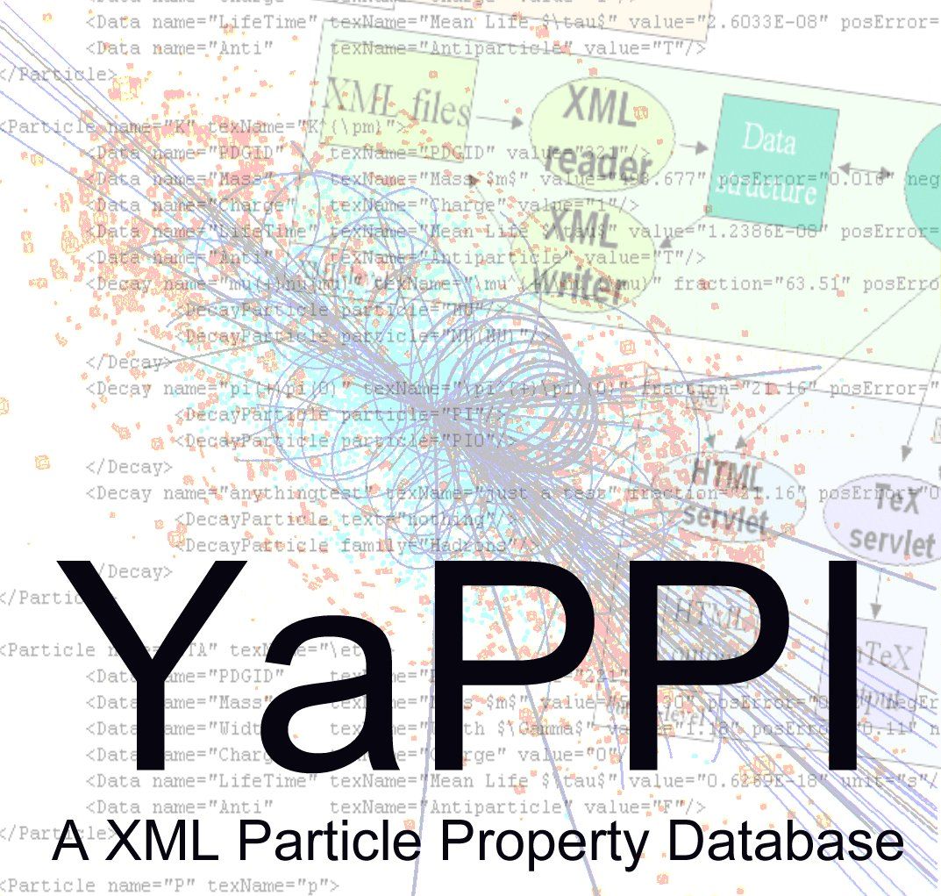

Slide 2
Particle Properties in XML
Patrick Hellwig
Universität Kaiserslautern, Germany
Department of Physics
Hellwig@physik.uni-kl.de
CERN Summer Student@EP/ALC, IP/API

Slide 3
Particle Properties in XML
XML technology
particles and properties
data modeling
Conclusion Part 1
Java implementation
JAS – Java Analysis Studio
Conclusion Part 2

Slide 4
XML Technology http://www.w3.org
Multiple parts:
  Data-file (XML)
  Schema-file (XSD/DTD)
  Style-file (XSL)
Elements
Attributes
XML:
<Particle Name="Proton">
<ID>2212</ID>
<Mass Unit="MeV">
938.272
</Mass>
</Particle>

Slide 5
Particles and Properties
Properties of Particles are needed for analysis
Standard source of data: Particle Data Group (PDG)
  But no database !
  Each software has its own database
Two areas:
  Particles
    General Information (Mass, Width, etc.)
    Decay Modes
  Family structure

Slide 6
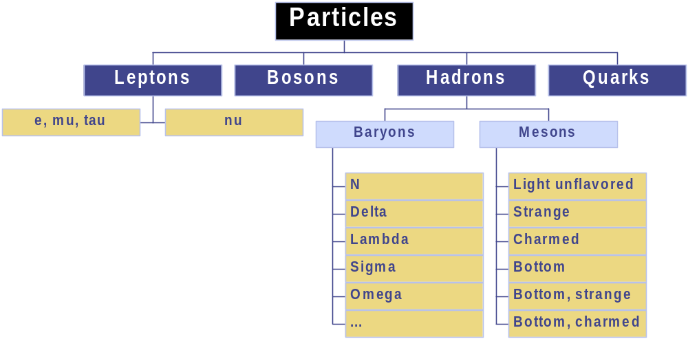
Data Model: Particle-Families

Slide 7
XML-file:
Family entry
<FamilyStructure name=".s.">
<FamilyStructure name=".s.">
<FamilyStructure name=".s.">
...
</FamilyStructure>
<Particle name=".s."/>
....
</FamilyStructure>
....
<FamilyStructure name=".s.">
...
</FamilyStructure>
...
</FamilyStructure>

Slide 8
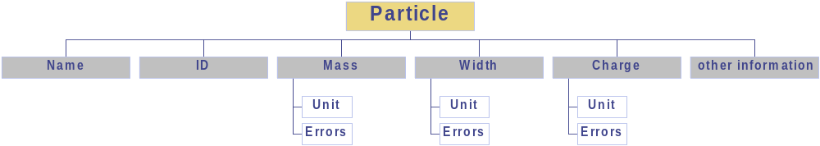
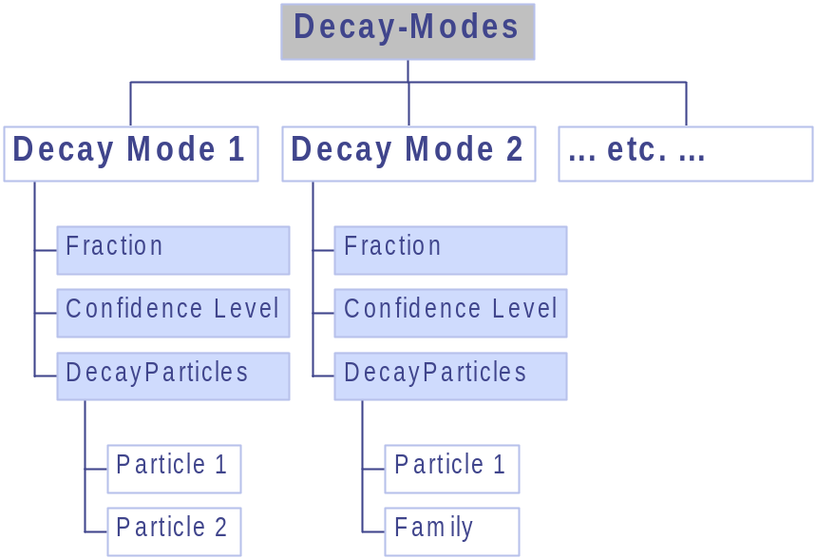
Data Model: Particle

Slide 9
<Particle name=".s." texname=".s.">
name: ASCII-Name of the Particle
texname: Name of the Particle in LaTeX2e form
<Data ... />
<Data ... />
<Data ... />
<Decay ... />
<Comment>
… some remarks for the
physicists …
</Comment>
</Particle>
XML-file: Particle Entry
} }
}
As many as needed

Slide 10

Java: XML Loading Procedure
XML-file
SAX2
found Particle
found Data
found Decay
etc …
YaPPI – API
datastructure

Slide 11
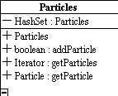
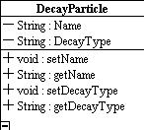
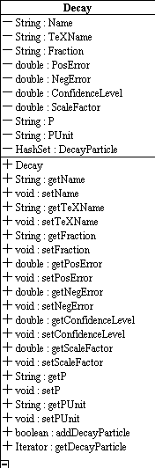
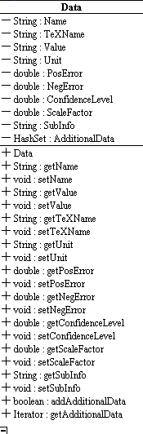
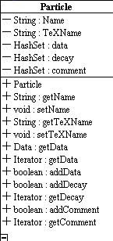

Class Structure
*
1
1
*
*
1
*
1
1
*

Slide 12
PDG MC
file
Converter
PS file
database
Converter
UI
Converter
converter-level
XML files
XML
reader
Data
structure
API
XML
writer
API-level
URL
URL
user
HTML
servlet
TeX
servlet
User PRG
(f.e.JAS)
HTML
output
LaTeX
output
API
output
output-level

Slide 13
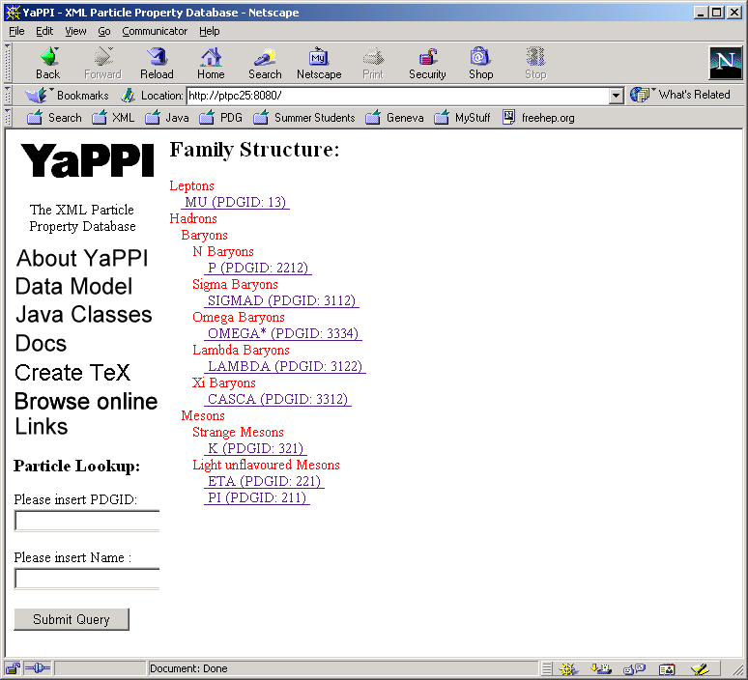
Demonstration: HTML servlet

Slide 14
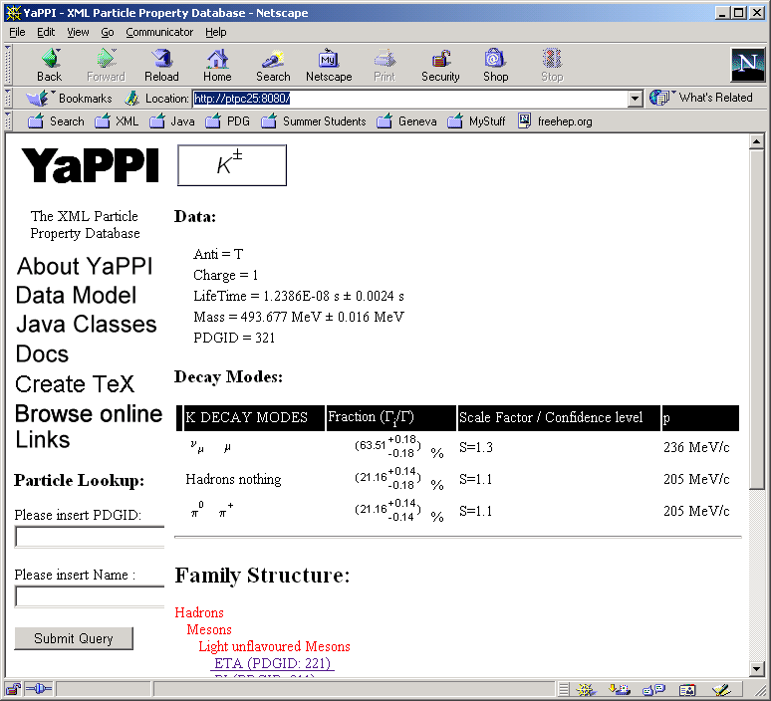
Demonstration HTML-Servlet

Slide 15
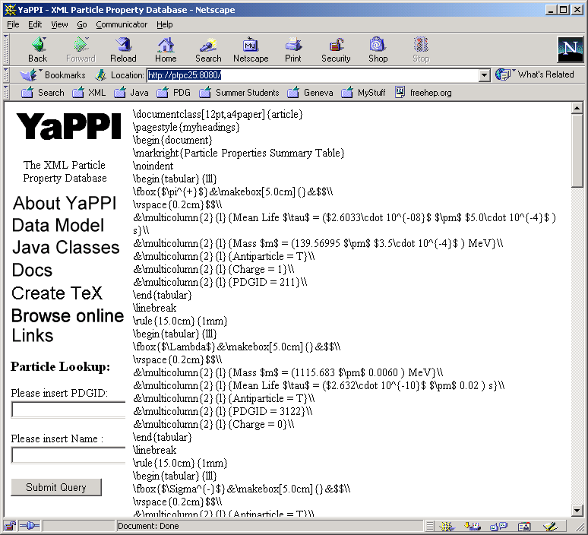
Demonstration TeXServlet

Slide 16
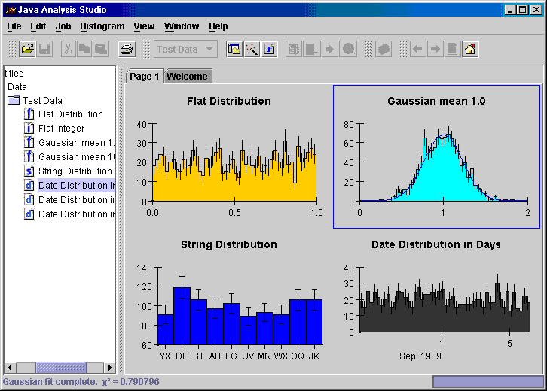
JAS – Java Analysis Studio http://jas.freehep.org
Analysis software for high energy physics
Access to XML-database via Java Interface
ParticleProperties.setParticlePropertyProvider(new XMLParticlePropertyProvider(file));
ParticleType pp = ParticleProperties.get( Particle_ID_Number);
pp.getMass();
pp.getWidth(); etc.

Slide 17
Conclusions
XML
  very open
  platform independent
  Ability to publish on the Web
  Easy accessible in many languages: Java, C++, …
Could be: one PDG data source for many
But: difficult to get data out of PDG-book

Slide 18
Particle Data Group Database
A PDG Oracle database exists
  But: A Database for printing the book
  No average values (like Mass, Width, etc.) without special Fortran calculation programs
http://pdg.lbl.gov: Postscript files generated by the database
  Possibility to analyze the Postscript

Slide 19
Conclusions – Part 2
Status: Until today no reply from PDG, if we can get the actual database
ToDo:
  Documentation
  PDG database import, if possible
  PS import otherwise
  (Option: Frontend Editor for Particle administration)
  WEB-Page with all information

