Slide 1
Particle Properties in XML
Patrick Hellwig
CERN Summer Student 2000

Slide 2
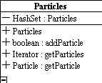
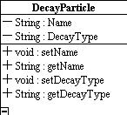
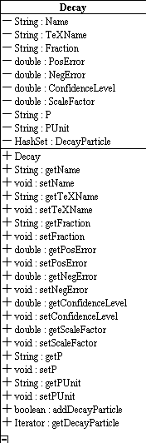
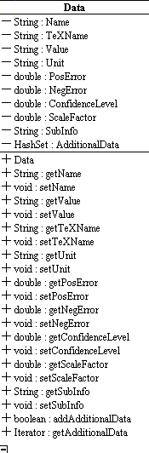
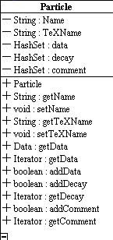

Particles
*
1
1
*
*
1
*
1
1
*

Slide 3
Specifications
Particle
<Particle name=".s." texname=".s.">
name: ASCII-Name of the Particle
texname: Name of the Particle in LaTeX2e form
<Data ... />
<Data ... />
<Data ... />
<Decay ... />
<Comment>
… some remarks for the
physicists …
</Comment>
</Particle>
}
As many as needed

Slide 4
Specifications
Data
<Data name=".s." texname=".s."
value=".s." unit=".s."
poserror=".d." negerror=".d.“
confidencelevel=".d.“
scalefactor=".d." subinfo=".s.">
name: ASCII-Name of the Property
texName: Name of the Property in LaTeX2e form
value: Value of the Property
unit: Physical Unit (see Appendix)
posError: positive Error
negError: negative Error
confidenceLevel: Confidence level
scaleFactor: Scale factor
subInfo: f.e. "Width (full)", "Width (hadrons)", etc.
<AdditionalData Name=".s." Value=".s."/>
</Data>

Slide 5
Specifications
Decay
<Decay name=".s." texName=".s." fraction=".s.“
posError=".d." negError=".d."
confidenceLevel=".d." scaleFactor=".d."
P=".s." PUnit=".s.“ >
name: ASCII-Name of the decay
texName: Name of the decay in LaTeX2e form
fraction: Fraction (value, < , > , seen, …)
posError: positive Error
negError: negative Error
confidenceLevel:Confidence level
scaleFactor: Scale factor
P: p
PUnit: Unit of p
<DecayParticle particle=".s."/>
<DecayParticle family=".s."/>
<DecayParticle text=".s."/>
</Decay>

Slide 6
Specifications
FamilyStructure
<FamilyStructure name=".s.">
<FamilyStructure name=".s.">
<FamilyStructure name=".s.">
...
</FamilyStructure>
<Particle name=".s."/>
....
</FamilyStructure>
....
<FamilyStructure name=".s.">
...
</FamilyStructure>
...
</FamilyStructure>

Slide 7
Specifications
FamilyStructure (Expl.)
<FamilyStructure name="Particles">
<FamilyStructure name="Leptons">
<Particle name="mu"/>
<Particle name="nu"/>
<Particle name="tau"/>
</FamilyStructure>
<FamilyStructure name="Bosons"/>
<FamilyStructure name="Hadrons">
<FamilyStructure name="Baryons">
<Particle name="N"/>
<Particle name="Delta"/>
...
</FamilyStructure>
<FamilyStructure name="Mesons">
<FamilyStructure name="Strange"/>
<Particle name="..."/>
<Particle name="..."/>
</FamilyStructure>
</FamilyStructure>
<FamilyStructure name="Quarks"/>
</FamilyStructure>

Slide 8
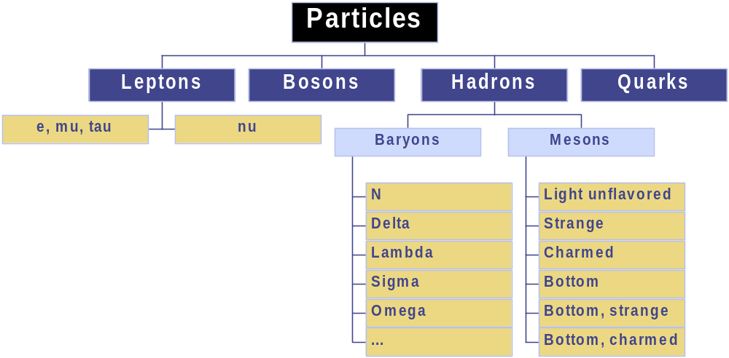
Specifications
FamilyStructure (Expl.)

Slide 9
Specification
Source
<Source name=".s.">
<Author>.s.</Author>
<Name>.s.</Name>
<Link>.s.</Link>
<Date>.s.</Date>
<Type>.s.</Type>
<Reliability>.d.</Reliability>
author: Author of the data (f.e. PDG)
name: Name of the source
link: Link to the source (f.e. http://pdg.lbl.gov)
date: Date of information source
Type: Type of source (database,book, testdata)
reliability: How reliable the data is (subjective field !)
</Source>

Slide 10
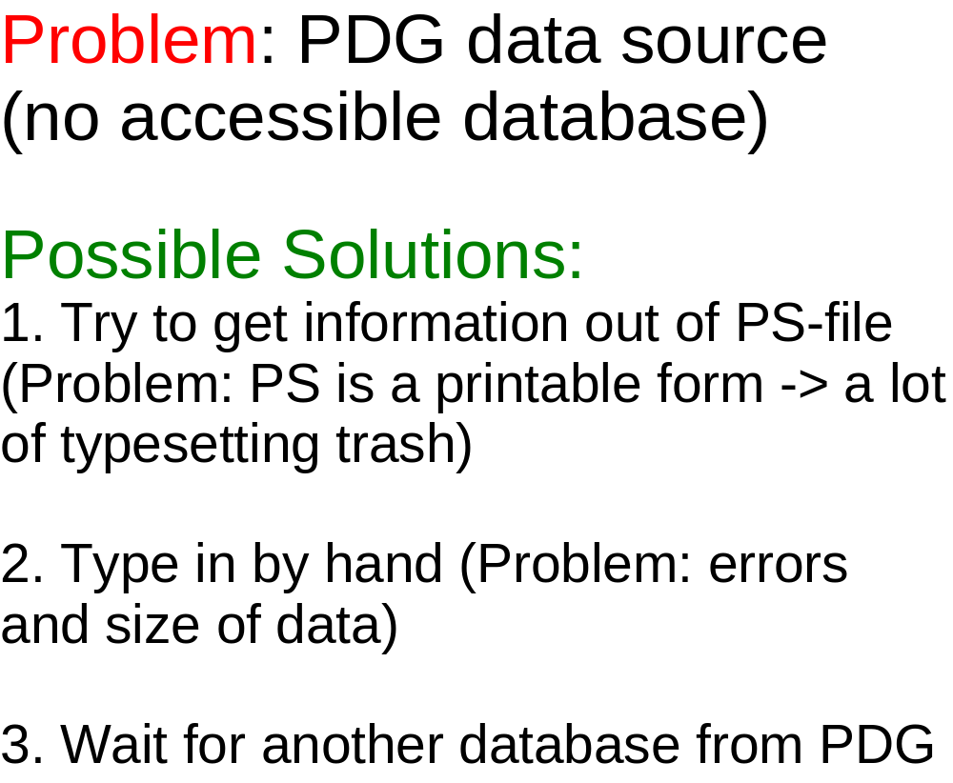
Problems & Solutions

Slide 11
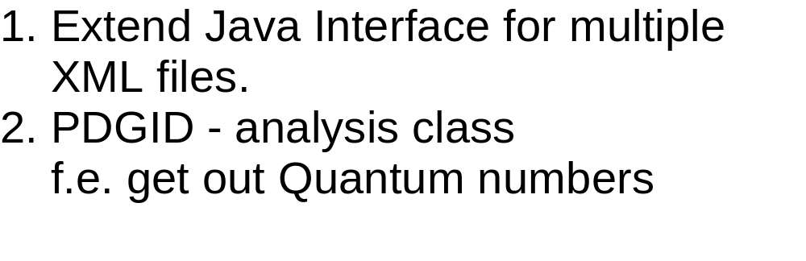
ToDo

