Slide 1

Unit Testing
Building Rock-Solid Software
SoftUni Team
Technical Trainers
Software University
https://softuni.bg

Slide 2
Table of Contents
What is Testing?
What is Unit Testing?
Unit Testing Basics
3A Pattern
Good Practices
Unit Testing Framework – unittest
Mocking
2
Notes:
2

Slide 3
Questions
sli.do #python-advanced

Slide 4

Testing
What is Testing

Slide 5
What is Testing?
The first level of software testing
The smallest testable parts of a software are tested
Validates that each unit of the software performs as designed
Types of testing:
Manual testing
Automated testing
Unit testing
Integration testing
Many more types of testing

Slide 6
What is manual testing?
Manually test the code as a standard user
Go to each page of a web application
Test every behavior and functionality
And this happens every time
A new feature is introduced
A bug is fixed
A requirement is changed

Slide 7
Drawbacks from Manual Testing
Not repeatable
Automatically. Changing part of the code
Hard to structure
Depends on the manual tester
Less accuracy
The possibility of "human error" is applicable here
Not as easy as it should be
Requires more time and resources

Slide 8
Automated testing (1)
Automated testing represents business requirements in code
i.e., code that verifies code
Types of automated tests
Unit tests
Integration tests
Functional/UI/E2E tests
System tests
Regression tests
etc..

Slide 9
Automated testing (2)
Done through an automation tool
Higher accuracy
Better reporting capabilities
Increased coverage
Improved bug detection
Increased reusability
Stability

Slide 10
Benefits of automated testing
Automated tests:
are automatically repeatable
fail as early as possible
enable the presentation of business requirements in code
reduce the cost of change
decrease the number of defects in the code
Bonus:
Improve design

Slide 11
Code conventions while testing
While writing tests, different conventions and practices are used
Less abstract, more concrete
Test specific cases
Triple A pattern:
Arrange
Act
Assert

Slide 12

What is Unit Testing?

Slide 13
What is Unit Testing?
Unit Testing is a type of software testing where individual units or components of a software are tested
The purpose is to validate that each unit of the software code performs as expected
Unit Testing is done during the development (coding phase) of an application by the developers

Slide 14

Unit Testing Framework

Slide 15
Unit Testing Framework
Individual units or components are being tested
Validate each unit to perform as expected
A unit may be an individual:
Function
Method
Procedure
Modules
Object

Slide 16
Concepts Behind unittest (1)
Test fixture
A baseline for running tests to ensure there is a fixed environment in which tests are run so that results are repeatable
Test case
A set of conditions used to determine if a system works correctly
Test suite
A collection of testcases used to test a software if it has some specified set of behaviors

Slide 17
Concepts Behind unittest (2)
Test runner
A component which sets up the execution of tests and provides the outcome to the user
import unittest
class SimpleTest(unittest.TestCase):
def test_upper(self):
result = 'foo'.upper()
expected_result = 'FOO'
self.assertEqual(result, expected_result)
if __name__ == '__main__':
unittest.main()

Slide 18
Running the Tests (1)
Run by the following block of code
Results printed on the console
if __name__ == '__main__':
unittest.main()
----------------------
Ran 1 test in 0.00s
OK
Test outcome

Slide 19
Running the Tests (2)
The possible outcomes are
OK – all tests passed
FAIL – one or many tests failed and an AssertionError exception is raised
ERROR – the tests raised an exception other than AssertionError

Slide 20
Basic Unittest Terms (1)
unittest.TestCase – create test cases by subclassing it
assertEqual() / assertNotEqual() – tests that the two arguments are equal/unequal in value
assertTrue() / assertFalse() – tests that the argument has a Boolean value of True/False
assertIn() / assertNotIn() – tests that the first argument is in / is not in the second

Slide 21
Basic Unittest Terms (2)
assertRaises() – raises a specific exception
unittest.main() – provides a command-line interface to the test script
setUp() – prepares the test fixture
The method is called immediately before the test method

Slide 22
Test Example (1)
If we have a class Person with methods get_full_name() and get_info():
class Person:
def __init__(self, first_name, last_name, age):
self.first_name = first_name
self.last_name = last_name
self.age = age
def get_full_name(self):
return f'{self.first_name} {self.last_name}'
def get_info(self):
return f'{self.first_name} {self.last_name} is {self.age} years old'

Slide 23
Test Example (2)
We can test both methods using the code below:
import unittest
class PersonTests(unittest.TestCase):
def setUp(self):
self.person = Person("Luc", "Peterson", 25)
def test_get_full_name(self):
result = self.person.get_full_name()
expected_result = "Luc Peterson"
self.assertEqual(result, expected_result)
def test_get_info(self):
result = self.person.get_info()
expected_result = "Luc Peterson is 25 years old"
self.assertEqual(result, expected_result)
if __name__ == "__main__":
unittest.main()

Slide 24
Unittest Modules
Advantages to placing the test code in a separate module:
The test module can be run standalone from the command line
The test code can more easily be separated from shipped code
Tested code can be refactored more easily
If the testing strategy changes, there is no need to change the source code

Slide 25
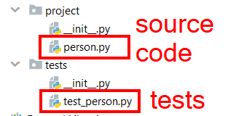

Unittest Modules Example
Testing the class Person from previous example:
Create the tests in a separate module
Include them in a package in order to be able to make proper imports from the modules

Slide 26

Mocking

Slide 27
What is Mocking?
In plain English, mocking means "making a replica or imitation of something"
Mocking is the way to test benefiting from isolation
isolate related logic into SRP modules
simulate the behavior of these modules

Slide 28
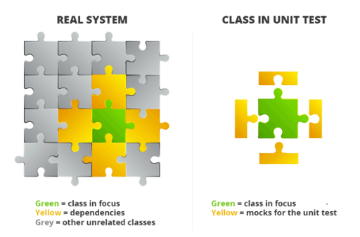
Mocking Example
In unit testing we want to test methods of one class in isolation, but classes are not isolated
They are using services and methods from other classes
We mock the services and methods from other classes and simulate the real behavior

Slide 29
Mocking in Python
To use mocking in python, the built-in way is unittest.mock:
@patch('app.hotel.RoomsManager')
def test_rent_room__when_no_free_rooms__should_raise(self, mock):
RoomsManagerMock = mock.return_value
RoomsManagerMock.has_free_rooms.return_value = False
hotel = Hotel('At Joe\'s', 3, 2, 1)
with self.assertRaises(NoFreeRoomError) as context:
hotel.rent_room([], RoomTypes.APARTMENT)
self.assertIsNotNone(context.exception)

Slide 30

How to Write Good Tests
Unit Testing Best Practices

Slide 31
Assertion Messages
Assertions can show messages
Helps with diagnostics
def test_get_info(self):
result = self.person.get_info()
expected_result = "Luc Peterson is 25 years old"
self.assertEqual(result, expected_result)
Assertion message

Slide 32


Naming Tests
Test names
Should use business domain terminology
Should be descriptive and readable
test_increment_Number(self): …
test_Test1(self): …
testTransfer(self): …
test_deposit_Xleva_should_increase_balance_with_Xleva(self): …
test_deposit_negativeLeva__should_not_increase_balance(self): …

Slide 33

Seven Testing Principles

Slide 34
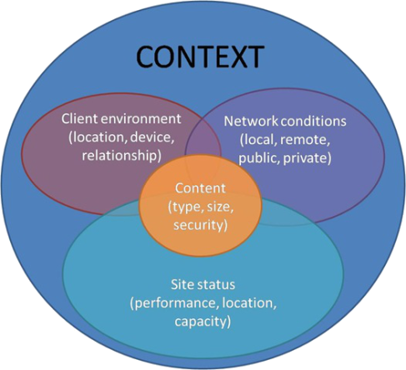
Seven Testing Principles (1)
Testing is context dependent
Testing is done differently in different contexts
Example:
Safety-critical software is tested differently from an e-commerce site

Slide 35
Seven Testing Principles (2)
Exhaustive testing is impossible
All combinations of inputs and preconditions are usually almost infinite number
Testing everything is not feasible
Except for trivial cases
Risk analysis and priorities should be used to focus testing efforts

Slide 36
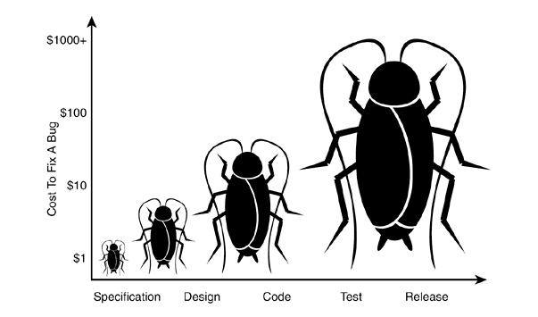
Seven Testing Principles (3)
Early testing is always preferred
Testing activities shall be started as early as possible
And shall be focused on defined objectives
The later a bug is found – the more it costs!

Slide 37
Seven Testing Principles (4)
Defect clustering
Testing effort shall be focused proportionally
To the expected and later observed defect density of modules
A small number of modules usually contains most of the defects discovered
Responsible for most of the operational failures
Notes:
In your opinion which operation is most likely to cause your Operation system to fail?
- Opening Microsoft Word
- Open IE
- Opening 10 different application all at the same time

Slide 38
Seven Testing Principles (5)
Pesticide paradox
Same tests repeated over and over again tend to lose their effectiveness
Previously undetected defects remain undiscovered
New and modified test cases should be developed

Slide 39
Seven Testing Principles (6)
Testing shows presence of defects
Testing can show that defects are present
Cannot prove that there are no defects
Appropriate testing reduces the probability for defects

Slide 40
Seven Testing Principles (7)
Absence-of-errors fallacy
Finding and fixing defects itself does not help in these cases:
The system built is unusable
Does not fulfill the user needs and expectations

Slide 41

Summary
Unit Testing helps us build solid code
Structure your unit tests – 3A Pattern
Use different assertions depending on the situation
Concepts behind the unittest framework
…
…
…

Slide 42
Questions?
Notes:
42

Slide 43












SoftUni Diamond Partners

Slide 44


Educational Partners

Slide 45
Trainings @ Software University (SoftUni)
Software University – High-Quality Education, Profession and Job for Software Developers
softuni.bg, softuni.org
Software University Foundation
softuni.foundation
Software University @ Facebook
facebook.com/SoftwareUniversity
Software University Forums
forum.softuni.bg
Notes:
45

Slide 46

License
This course (slides, examples, demos, exercises, homework, documents, videos and other assets) is copyrighted content
Unauthorized copy, reproduction or use is illegal
© SoftUni – https://about.softuni.bg
© Software University – https://softuni.bg
Notes:
46

