Slide 1
Title: Credit Risk Classification Model for Loan Approval
Subtitle: Leveraging Data to Optimize Loan Approvals and Reduce Risks Presented by: Kartik Ukhalkar

Slide 2
Business Problem
Objective: Develop a classification model to differentiate loan applicants into approved and rejected categories.
Key Questions:
How to leverage trade-level information from Credit Bureaus?
Which application or payment behavior factors significantly influence borrower behavior?
How can these factors inform decision-making strategies?

Slide 3
Dataset Overview
Datasets Used:
Application Data: Information about applicants (e.g., income, credit amount).
Bureau Data: Trade-level credit bureau records.
Initial Observations:
Application Data: 307,511 rows, 43 features after preprocessing.
Bureau Data: Aggregated to applicant level with key statistics like active loans, overdue amounts.

Slide 4
Data Preprocessing and Feature Engineering
Steps Taken:
Dropped features with >40% missing values.
Imputed missing values with mean/median (numerical) or mode (categorical).
Aggregated bureau data to applicant level using statistical metrics (e.g., mean, max, count).
Removed features with very low correlation to the target variable.

Slide 5
Exploratory Data Analysis (EDA)
Insights:
Negative DAYS variables: Indicate days before the loan application date (e.g., DAYS_CREDIT).
Significant predictors:
External Sources (EXT_SOURCE_2 and EXT_SOURCE_3) have strong correlation with TARGET.
Number of credit bureau inquiries (AMT_REQ_CREDIT_BUREAU_YEAR).
Class imbalance observed in TARGET: ~92% approved, ~8% rejected.

Slide 6
Models Developed
Classification Models:
Logistic Regression
Decision Tree
Random Forest
Class Imbalance Handling:
Oversampling using SMOTE (Synthetic Minority Oversampling Technique).

Slide 7
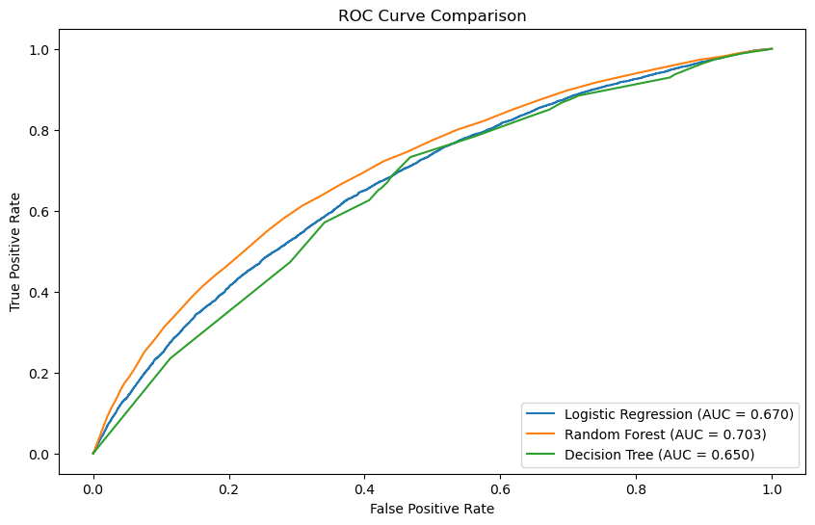
Model Performance
Evaluation Metric: ROC-AUC Score
Results: Logistic Regression: 0.670
Random Forest: 0.703 (Best Model)
Decision Tree: 0.658
Reason for Selection: Random Forest
offers the best trade-off between
performance and interpretability.

Slide 8
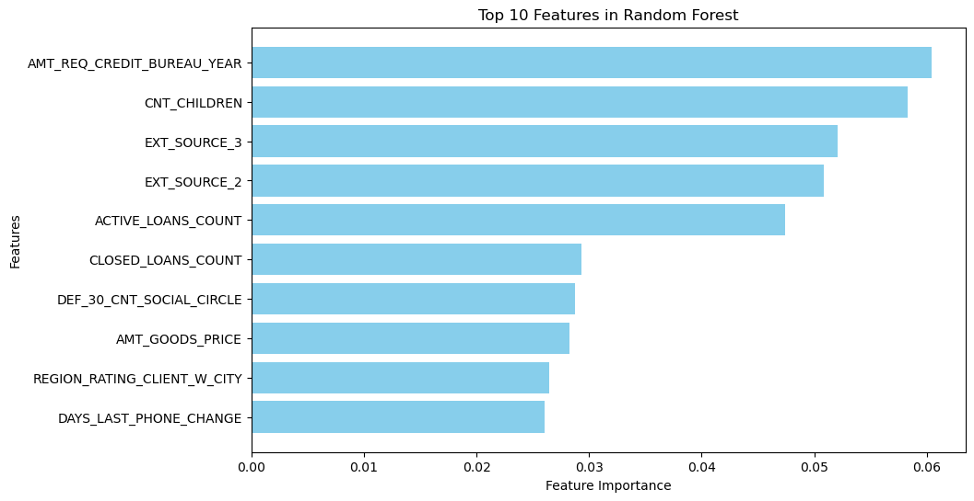
Top Influential Features
Key Features Identified (Top 10):
AMT_REQ_CREDIT_BUREAU_YEAR
CNT_CHILDREN
EXT_SOURCE_3
EXT_SOURCE_2
ACTIVE_LOANS_COUNT
CLOSED_LOANS_COUNT
DEF_30_CNT_SOCIAL_CIRCLE
AMT_GOODS_PRICE
REGION_RATING_CLIENT_W_CITY
DAYS_LAST_PHONE_CHANGE
Business Insight: These features highlight critical behavioral and financial traits of applicants.

Slide 9
Business Strategies
High-Risk Applicants:
Stricter lending terms (e.g., higher interest rates, smaller loan amounts).
Increased scrutiny on payment history and income stability.
Low-Risk Applicants:
Proactive targeting with larger loan amounts or longer terms.
Incentives like lower interest rates.
Threshold-Based Decisioning:
Approve: Probability > 0.8
Manual Review: 0.5 – 0.8
Reject: Probability < 0.5

Slide 10
Visualization of Insights
Feature Importance: Bar chart of top features.
ROC Curve: Model’s ability to differentiate between classes.
Risk Score Distribution: Histogram showing segmentation of applicants into low, medium, and high risk.

Slide 11
Business Implications
Enhanced Risk Management: Identify high-risk applicants early to mitigate loan defaults.
Optimized Loan Approvals: Increase approval rates for low-risk applicants while maintaining profitability.
Data-Driven Decisioning: Use model insights to guide policy adjustments and product offerings.

Slide 12
Next Steps
Deploy Model: Integrate into the bank’s decision-making process.
Monitor Performance: Continuously evaluate and retrain the model as needed.
Refine Strategies: Use insights to develop new financial products or adjust lending policies.
Stakeholder Training: Ensure teams understand how to interpret and act on model outputs.

