Slide 1
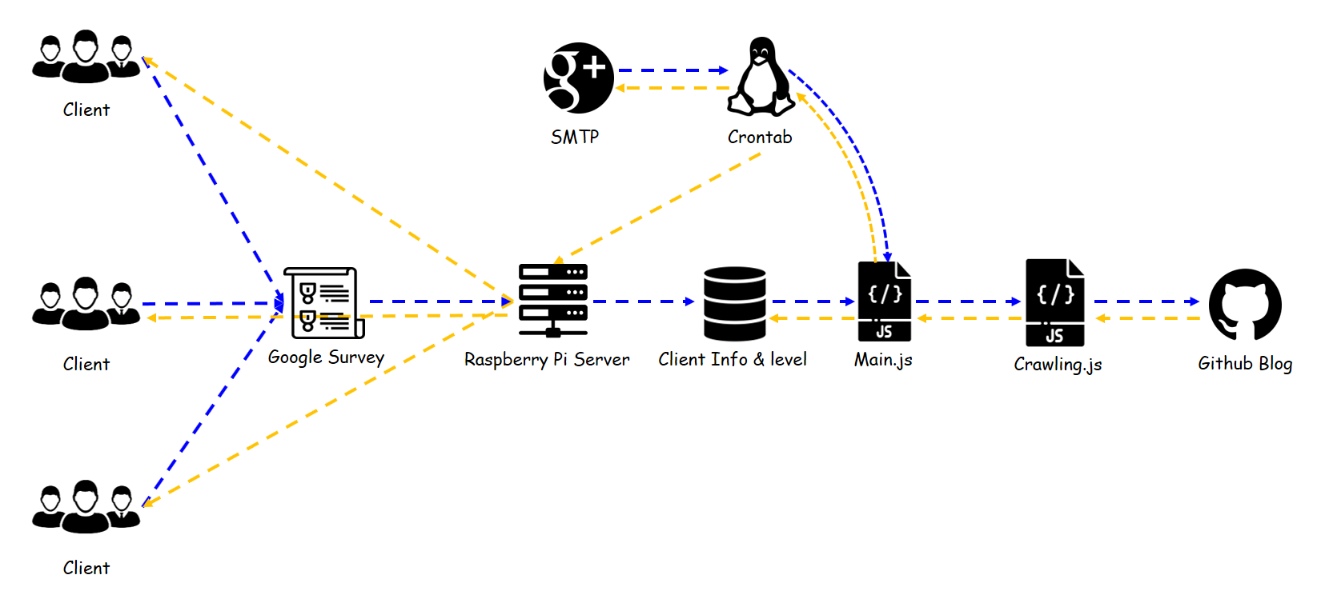




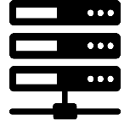



Client
SMTP
Crontab
Client
Google Survey
Raspberry Pi Server
Client Info & level
Main.js
Crawling.js
Github Blog
Client

