Slide 1
Spring Cloud
Addressing the issues found in cloud-native applications

Slide 2
Module Outline
I. Intro to Spring Cloud
Spring/ Spring IO/ Spring Cloud
Spring Cloud Netflix
Common Concepts

Slide 3
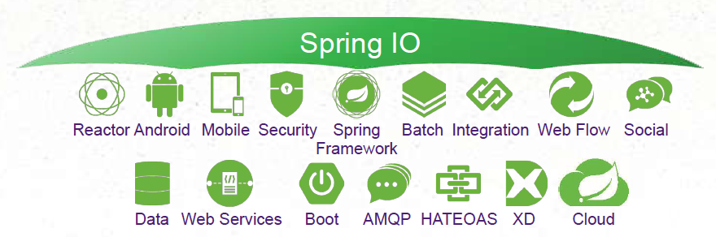
Spring Cloud Origins
First, there was the Spring Framework (2004)
Alternative to low-level JEE approches
Next, Spring sub-projects emerged (2006 - present)
Spring Security, Web Flow, Integration, Batch, Web Services, XD, Social, Data, Boot, Session, etc.
Organized under Spring IO umbrella:

Slide 4
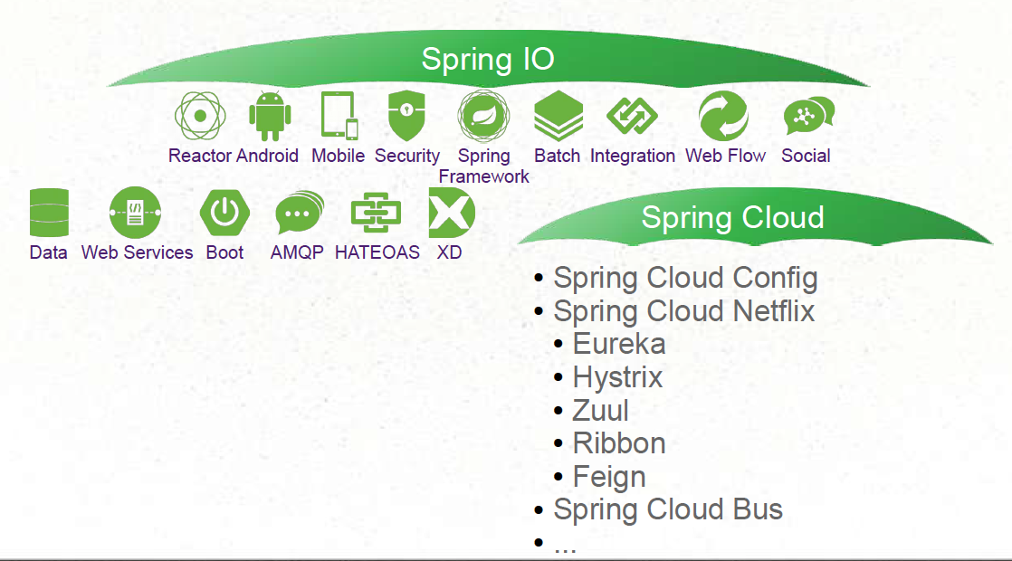
Spring Cloud Subproject
“Sub-Umbrella” Project within Spring IO Platform

Slide 5
Goal of Spring Cloud
Provide libraries to apply common patterns needed in distributed applications
Distributed/ Versioned/ Centralized Configuration Management
Service Registration and Discovery
Load Balancing
Service-to-service Calls
Circuit Breakers
Routing
…

Slide 6
Module Outline
I. Intro to Spring Cloud
Spring/ Spring IO/ Spring Cloud
Spring Cloud Netflix
Common Concepts

Slide 7

Where does Fit into All of This ?
Netflix reinvented itself since 2007
Moved from DVD mailing to video-on-demand
Once USPS largest first-class customer
Now biggest source of North American Internet traffic in evenings.
Became Trailblazers in Cloud Computing
All running on Amazon Web Services
Chose to publish many general-use technologies as Open-Source projects
Proprietary video-streaming technologies are still secret.

Slide 8
Spring and .
The Spring Team has always been forward looking
Trying to Focus on Applications of Tomorrow
Netflix OSS Mature and Battle-Tested; Why Reinvent?
Netflix OSS Not Necessarily Easy and Convenient
Spring Cloud provides easy interaction
Dependencies
Annotations

Slide 9
Module Outline
I. Intro to Spring Cloud
Spring/ Spring IO/ Spring Cloud
Spring Cloud Netflix
Common Concepts

Slide 10
Spring Cloud Setup
Spring Cloud Projects are all based on Spring Boot
Difficult to employ using only core Spring Framework
Dependency management based on Boot
ApplicationContext startup process modified

Slide 11
Server vs. Client
“Client” and “Server” are relative terms
Based on the role in a relationship
A Microservice is often a client and a server
Don’t get lost on the terminology!

Slide 12
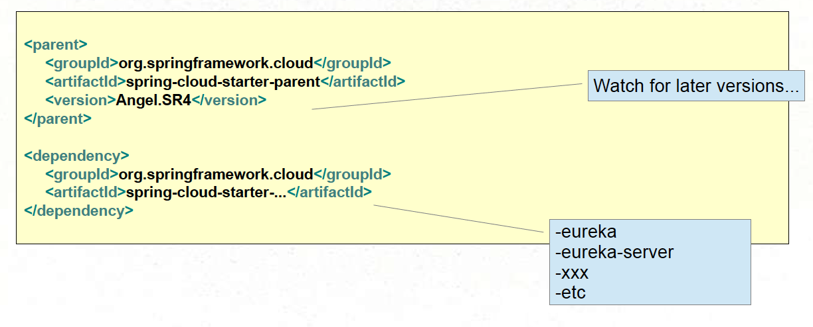
Required Dependencies
Replace Spring Boot Parent
Spring Cloud projects are based on Spring Boot

Slide 13
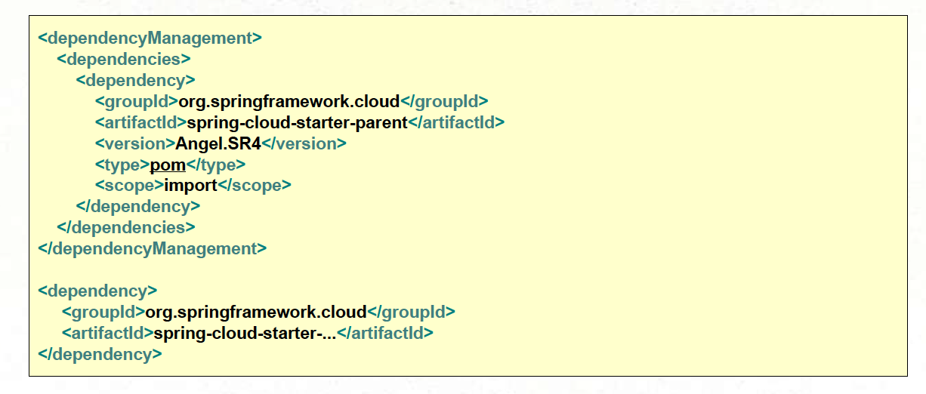
Required Dependencies
… OR Use Dependency Management Section

Slide 14
Section Summary
Spring Cloud is a sub-project within Spring IO Umbrella
And is itself an umbrella project.
Spring Cloud addresses common patterns in distributed computing
Spring Cloud enables easy use of Netflix libraries
Spring Cloud is based on Spring Boot

