Slide 1
Spring Cloud Config
Centralized, versioned configuration management for distributed applications

Slide 2
Objectives
At the end of this module, you will be able to
Explain what Spring Cloud Config is
Build and Run a Spring Cloud Config Server
Establish a Repository
Build, Run, and Configure a Client

Slide 3
Module Outline
II. Spring Cloud Config
Configuration Management
Challenges
Desired Solution
Spring Cloud Config
Server Side
Client Side
Repository Organization

Slide 4
What is Application Configuration
Application are more than just code
Connections to resources, other applications
Usually use external configuration to adjust software behavior
Where resources are located
How to connect to the DB
Etc.

Slide 5
Configuration Options
Package configuration files with application
Requires rebuild, restart
Configuration files in common file system
Unavailable in cloud
Use environment variables
Done differently on different platforms
Large # of individual variables to manage/ duplicate
Use a cloud-vendor specific solution
Coupling application to specific environment

Slide 6
Other Challenges
Microservices —> large # of dependent services
Dynamic updates
Changes to services or environment variables require restage or restart
Version Control
Manual Work, Brittle
Deployment Activities
Traceability

Slide 7
Desired Solution for Configuration
Platform/Cloud-Independent solution
Language-independent too
Centralized
Or a few discrete sources of our choosing
Dynamic
Ability to update settings while an application is running
Controllable
Same SCM choices we use with software
Passive
Services (Applications) should do most of the work themselves by self-registering

Slide 8
Solution:
Spring Cloud Config
Provides centralized, externalized, secured, easy-to-reach source of application configuration
Spring Cloud Bus
Provides simple way to notify clients to config changes
Spring Cloud Netflix Eureka
Service Discovery - Allows applications to register themselves as clients

Slide 9
Module Outline
II. Spring Cloud Config
Configuration Management
Challenges
Desired Solution
Spring Cloud Config
Server Side
Client Side
Repository Organization

Slide 10
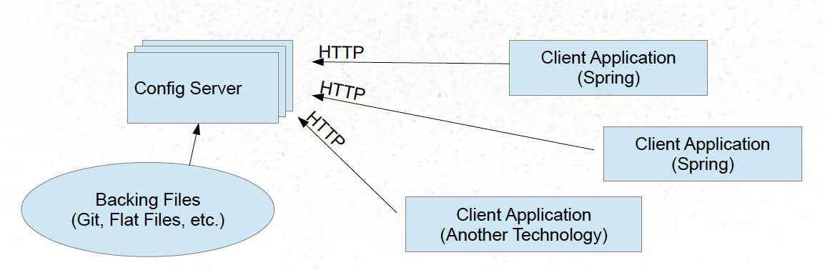
Spring Cloud Config
Designates a centralized server to serve-up configuration information
Configuration itself can be backed by source control
Clients connect over HTTP and retrieve their configuration settings
In addition to their own, internal sources of configuration

Slide 11
Spring Cloud Config Server
Source available at Github
https://github.com/spring-cloud-samples/configserver
Or, it is reasonably easy to build your own

Slide 12
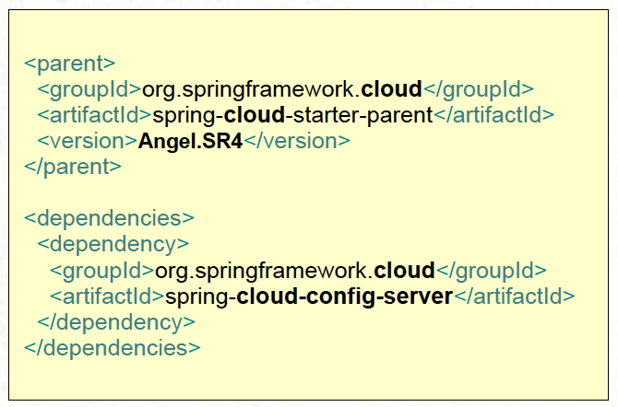
Spring Cloud Config Server - Building, part 1
Include minimal dependencies in you POM (or Gradle)
Spring Cloud Starter Parent
Spring Cloud Config Server

Slide 13
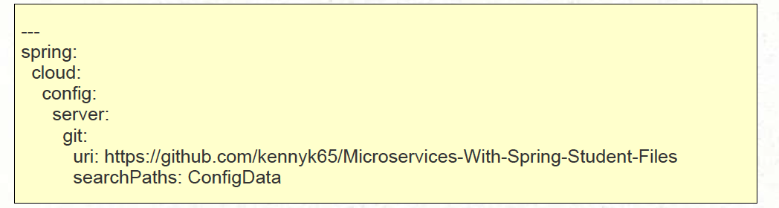
Spring Cloud Config Server - Building, part 2
application.yml - indicates location of configuration repository
… or application.properties

Slide 14
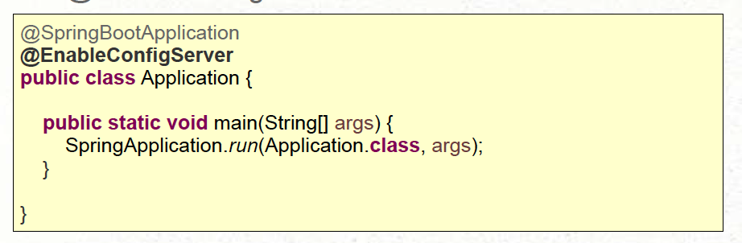
Spring Cloud Config Server - Building, part 3
Add @EnableConfigServer
That’s it!

Slide 15
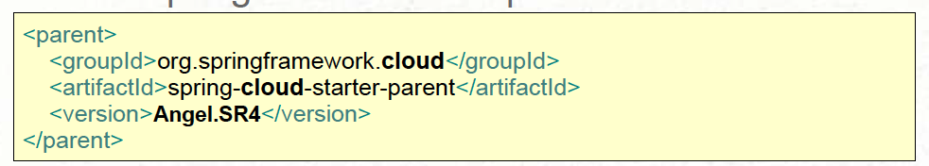
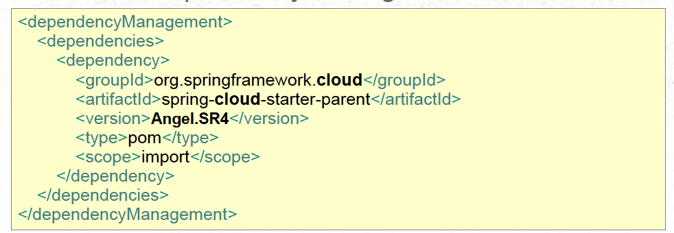
The Client Side - Building part 1
Use the Spring Cloud Starter parent as Parent POM:
… OR use a Dependency management section:

Slide 16
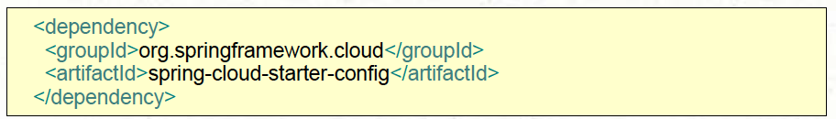
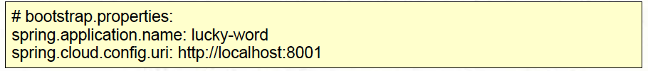
The Client Side - Building part 2
Include the Spring Cloud Starter for config:
Configure application name and server location in bootstrap.properties/yml
So it is examined early in the startup process
That’s it!
Client connects at startup for additional configuration settings.

Slide 17
The Client Side
How Properties work in Spring Applications
Spring apps have an Environment object
Environment object contains multiple PropertySources
Typically populated from environment variables, system properties, JNDI, developer-specific property files, etc.
Spring Cloud Config Client library simply adds another PropertySource
By connecting to server over HTTP
http://<server>:<port>/<spring.application.name>/<profile>
Result: Properties described by server become part of client application’s environment

Slide 18
Module Outline
II. Spring Cloud Config
Configuration Management
Challenges
Desired Solution
Spring Cloud Config
Server Side
Client Side
Repository Organization

Slide 19
EnvironmentRepository - Choices
Spring Cloud Config Server uses an EnvironmentRepository
Two implementations available: Git and Native (local files)
Implement EnvironmentRepository to use other sources.

Slide 20
Environment Repository - Organization
Configuration file naming convention:
<spring.application.name>-<profile>.yml
Or .properties (yml takes precedence)
spring.application.name - set by client application’s bootstrap.yml (or .properties)
profile - Client’s spring.profiles.active
(set various ways)
Obtain settings from server:
http://<server>:<port>/<spring.application.name>/<profile>
Spring Cloud clients do this automatically on startup

Slide 21
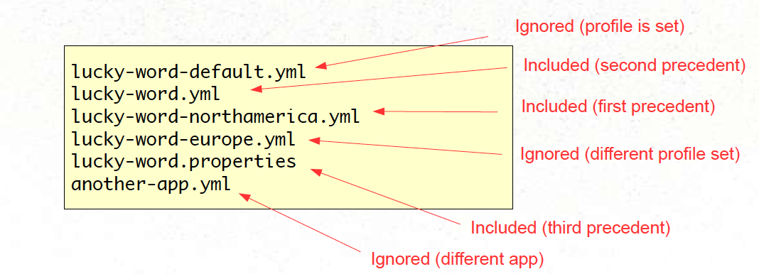
Environment Repository - Organization Example
Assume client application named “lucky-word” and profile set to “northamerica”
Spring client (automatically) requests
/lucky-word/northamerica

Slide 22
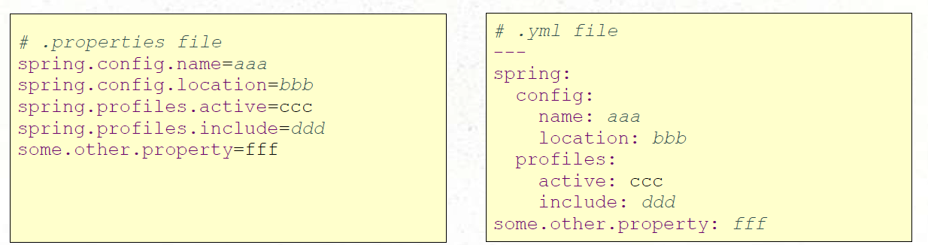
.yml vs .properties
Settings can be stored in either YAML or standard Java properties files
Both have advantages
Config server will favor .yml over .properties

Slide 23
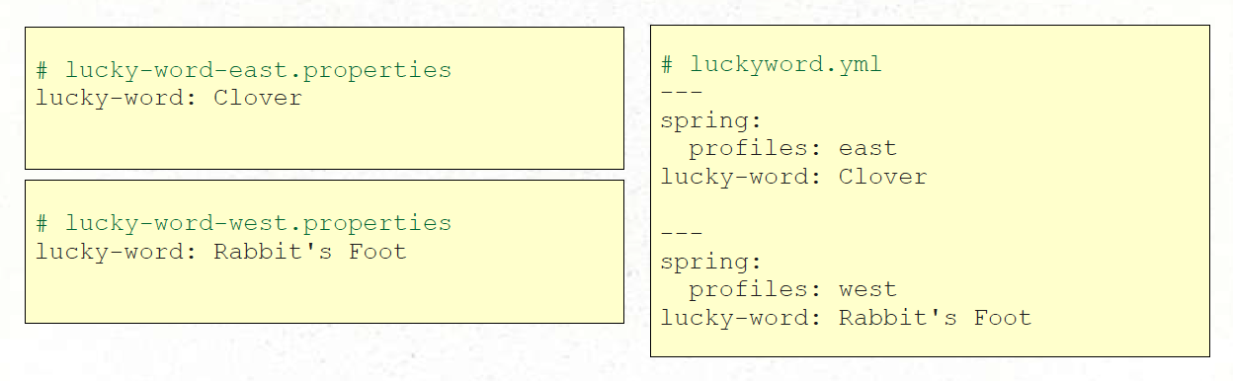
Profiles
YAML Format can hold multiple profiles in a single file

Slide 24
What about non-Java / non-Spring Clients?
Spring Cloud Server exposes properties over simple HTTP interface
http://<server>:<port>/<spring.application.name>/<profile>
Reasonably easy to call server from any application
Just not as automated as Spring

Slide 25
What if the Config Server is Down?
Spring Cloud Config Server should typically run on several instances
So downtime should be a non-issue
Client application can control policy of how to handle missing config serve
spring.cloud.config.failFast=true
Default is false
Config Server settings override local settings
Strategy: provide local fallback settings.

Slide 26
Section Summary
Spring Cloud Config offers centralized, versioned configuration for distributed applications
Spring Cloud Config Server - Easy to build
Backed by repository (Git or native) with .yml or .properties
Spring Cloud Config Client -
Accesses Server, adds another PropertySource

Slide 27
Exercise
TODO

