Slide 1
Service Discovery with Spring Cloud Eureka
Implementing Passive Service Discovery

Slide 2
Objectives
At the end of this module, you will be able to
Explain what Passive Service Discovery is
Build and Run a Spring Cloud Eureka Server
Build, Run, and Configure a Eureka Client

Slide 3
Module Outline
III. Spring Cloud Eureka
Service Discovery
Eureka Server
Discovery Client
Service Discovery Considerations

Slide 4
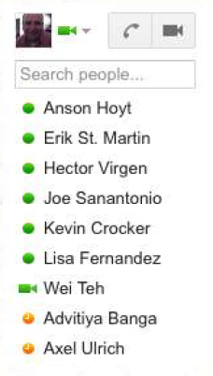
Service Discovery - Analogy
When you sign into a chat client, what happens?
Client ‘registers’ itself with the server - server knows you are online.
The server provides you with a list of all the other known clients
In essence, you client has “discovered” the other clients
… and has itself been “discovered” by others

Slide 5
Service Discovery
Microservice architectures result in large numbers of inter-service calls
Very challenging to configure
How can one application easily find all of the other runtime dependencies?
Manual configuration - Impractical, brittle
Service Discovery provides a single ‘lookup’ service.
Clients register themselves, discover other registrants.
Solutions: Eureka, Consul, Etcd, Zookeeper, SmartStack, etc.

Slide 6
Eureka - Service Discovery Server and Client
Part of Spring Cloud Netflix
Battle-tested by Netflix
Eureka provides a ‘lookup’ server.
Generally made highly available by running multiple copies
Copies replicate state of registered services
“Client” Services register with Eureka
Provide metadata on host, port, health indicator URL, etc.
Client Services send heartbeats to Eureka
Eureka removes services without heartbeats.

Slide 7
Module Outline
III. Spring Cloud Eureka
Service Discovery
Eureka Server
Discovery Client
Service Discovery Considerations

Slide 8
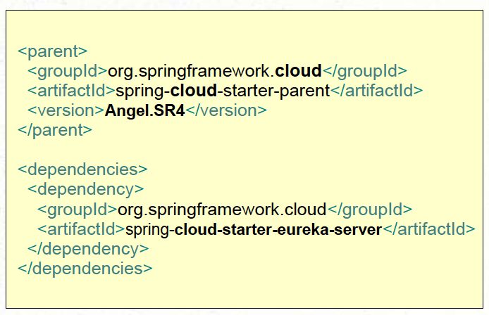
Making a Eureka Server - Building, part 1
Include minimal dependencies in you POM (or gradle)
Spring Cloud Starter Parent
Spring Cloud Starter Eureka Server
Does this look familiar?
Same parent as config server
“cloud-starter-eureka-server” instead of “cloud-config-server”

Slide 9
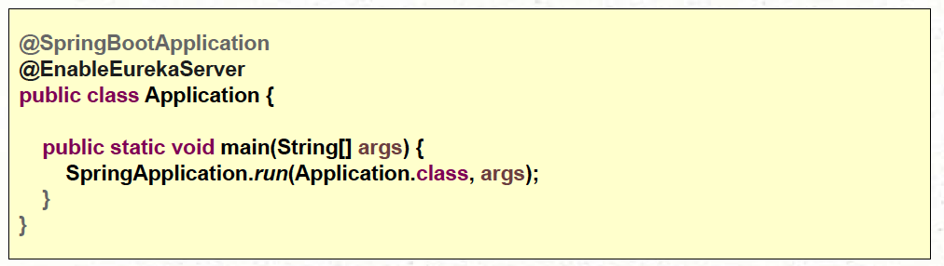
Making a Eureka Server - Building, part 2
Switch Eureka on with @EnableEurekaServer:
That’s it!

Slide 10
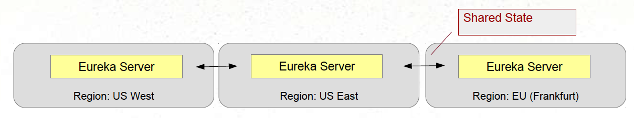
Multiple Servers
Typically, multiple Eureka servers should be run simultaneously
Otherwise, you’ll get many warnings in the log
Eureka servers communicate with each other to share state
Provides High Availability
Each server should know URL to the others
Can be provided by Config Server
One server (JAR), multiple profiles

Slide 11
Module Outline
III. Spring Cloud Eureka
Service Discovery
Eureka Server
Discovery Client
Service Discovery Considerations

Slide 12
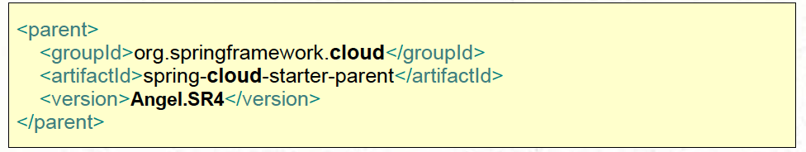
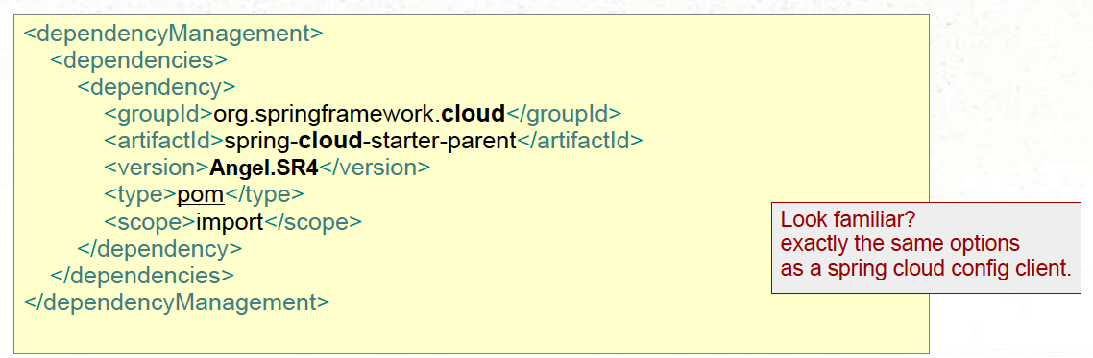
Registering with Eureka - Part 1
Use the Spring Cloud Starter parent as Parent POM:
… OR use a Dependency management section:

Slide 13
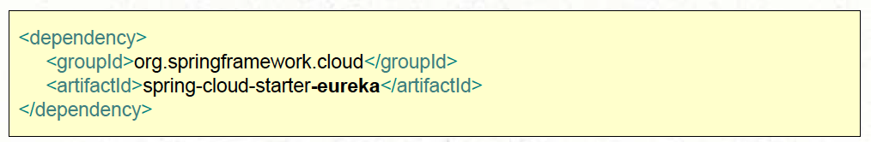
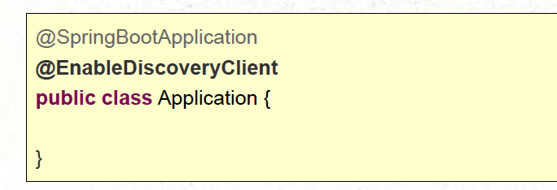
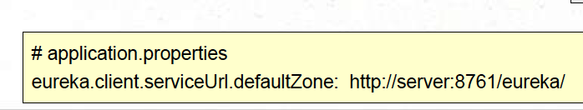
Registering with Eureka - Part 2
Add Dependency
… enable
… and specify the location of the Eureka server:

Slide 14
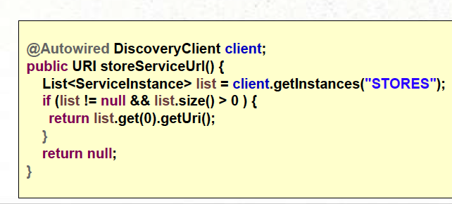
@EnableDiscoveryClient
Automatically registers client with Eureka server
Registers the application name, host, and port
Using values from the Spring Environment
But can be overriden.
Give you applicaton a spring.application.name
Makes this app an “instance” and a “client”
It can locate other services

Slide 15
Module Outline
III. Spring Cloud Eureka
Service Discovery
Eureka Server
Discovery Client
Service Discovery Considerations

Slide 16
What is a Zone?
Eureka server designed for multi-instance use
Single instance will actually warn you when it runs without any peers!
Eureka server does not persist service registrations
Relies on client registrations; always up to date, always in memory
Stateful application
Typical production usage - many Eureka server instances running in different availability zones/ regions
Connected to each other as “peers”

Slide 17
Which Comes First?
Eureka or Config Server?
Config First Bootstrap (default) - Use Config Server to configure location of Eureka server
Implies spring.cloud.config.uri configured on each app
Eureka First Bootstrap - Use Eureka to expose location to config server
Config server is just another client
Implies spring.cloud.config.discovery.enabled=true and eureka.client.serviceUrl.defaultZone configured on each app
Client makes two network trips to obtain configuration

Slide 18
Summary
Passive Service Discovery -
Having services register themselves and find others automatically
Spring Cloud Eureka Server
Convenient wrapper around Netflix Eureka libraries
Holds registrations, shares information on other registrants
Synchronizes itself with other servers
Spring Cloud Eureka Client
Connects to server to register, and obtain information on other clients.

Slide 19
Exercise

