Slide 1
Spring Cloud Ribbon
Understanding and Using Ribbon, The client side load balancer

Slide 2
Objectives
At the end of this module, you will be able to
Understand the purpose of Client-side Load Balancing
Use Spring Cloud Ribbon to implement Client-side Load Balancing

Slide 3
Module Outline
IV. Spring Cloud Ribbon
Client Side Load Balancing
Spring Cloud Netflix Ribbon

Slide 4
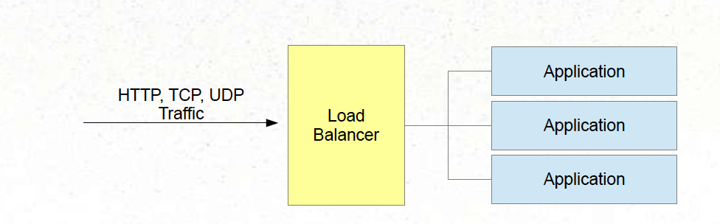
What is Load Balancer?
Traditional load balancers are server-side components
Distribute incoming traffic among several servers
Software (Apache, Nginx, HA Proxy) or Hardware (F5, NSX, BigIP)

Slide 5
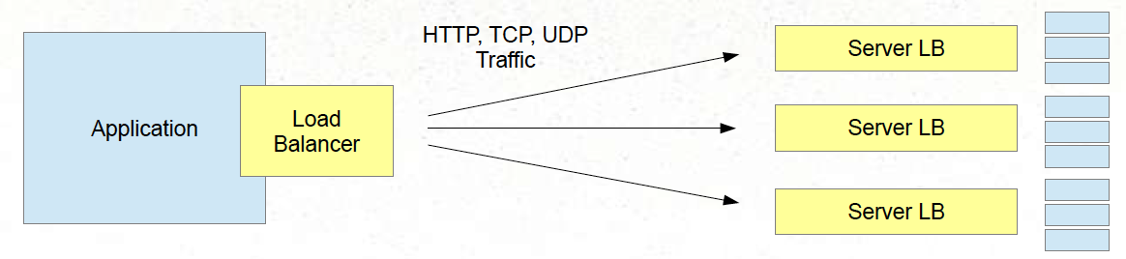
Client-side Load Balancer
Client-side Load Balancer selects which server to call
Based on some criteria
Part of client software
Server can still employ its own load balancer

Slide 6
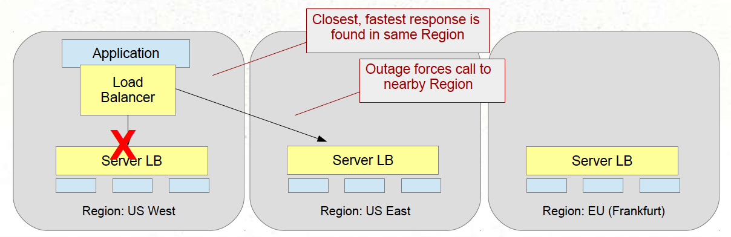
Why?
Not all servers are the same
Some may be unavailable (faults)
Some may be slower than others (performance)
Some may be further away than others (regions)

Slide 7
Module Outline
IV. Spring Cloud Ribbon
Client Side Load Balancing
Spring Cloud Netflix Ribbon

Slide 8
Spring Cloud Netflix Ribbon
Ribbon - Another part of the Netflix OSS family
Client-side load balancer
Automatically integrates with service discovery (Eureka)
Built-in failure resiliency (Hystrix)
Caching / Batching
Multiple protocols (HTTP, TCP, UDP)
Spring Cloud provides an easy API Wrapper for using Ribbon

Slide 9
Key Ribbon Concepts
List of Servers
Filtered List of Servers
Load Balancer
Ping

Slide 10
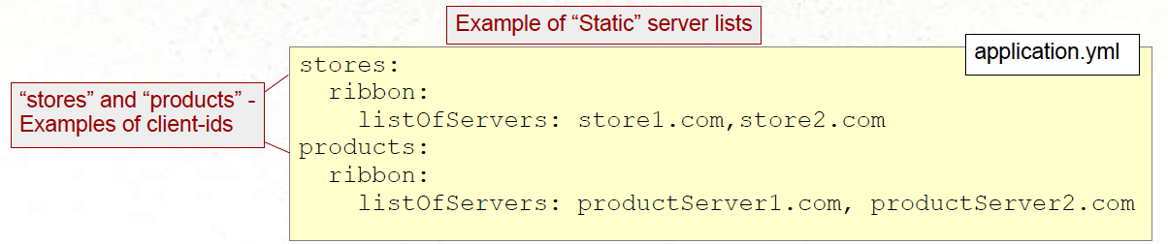
List of Servers
Determines what the list of possible servers are (for a given service (client))
Static - Populated via configuration
Dynamic - Populated via Service Discovery (Eureka)
Spring Cloud default - Use Eureka when present on the classpath.

Slide 11
Filtered List of Servers
Criteria by which you wish to limit the total list
Spring Cloud default - Filter servers in the same zone

Slide 12
Ping
Used to test if the server is up or down
Spring Cloud default - delegate to Eureka to determine if server is up or down

Slide 13
Load Balancer
The Load Balancer is the actual component that routes the calls to the servers in the filtered list
Several strategies available, but they usually defer to a Rule component to make the actual decisions
Spring Cloud’s Default: ZoneAwareLoadBalancer

Slide 14
Rule
The Rule is a single module of intelligence that makes the decisions on whether to call or not.
Spring Cloud’s Default: ZoneAvoidanceRule

Slide 15
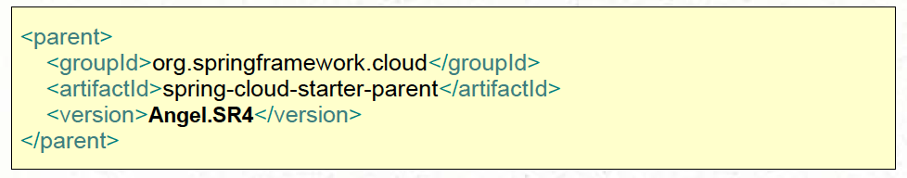
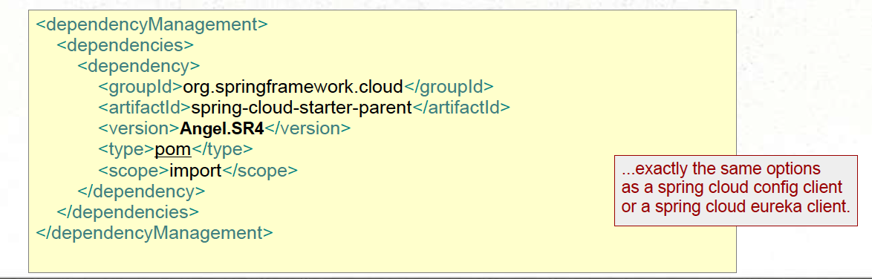
Using Ribbon with Spring Cloud - part 1
Use the Spring Cloud Starter parent as a Parent POM:
… OR use a Dependency management section:

Slide 16
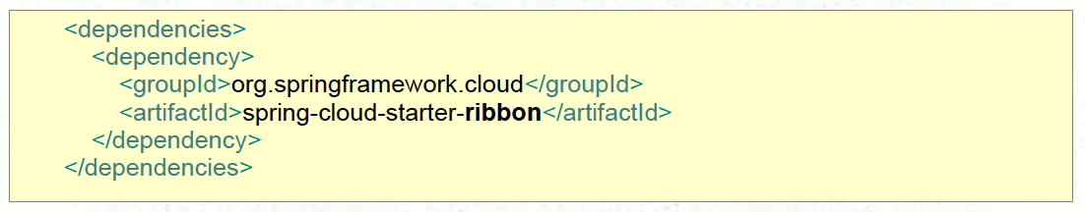
Using Ribbon with Spring Cloud - part 2
Include dependency:

Slide 17
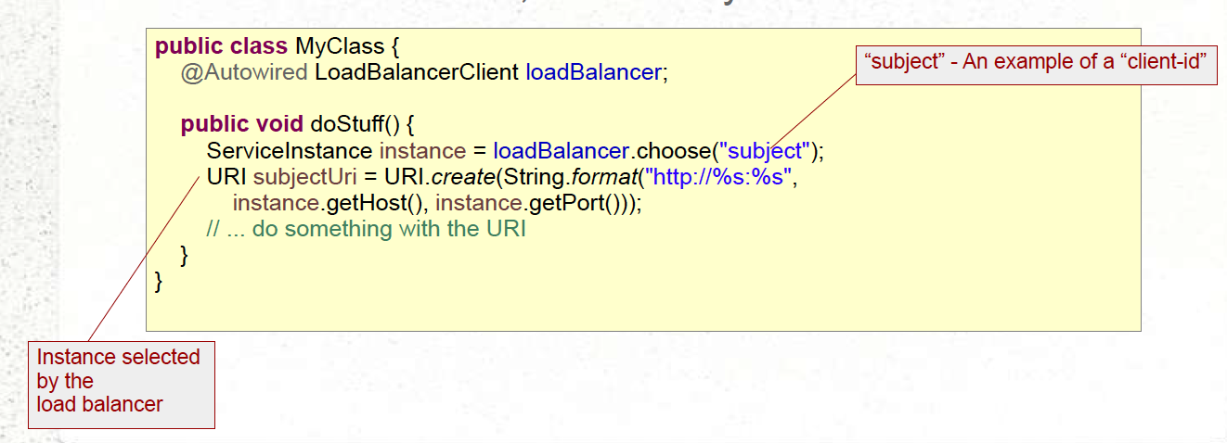
Using Ribbon with Spring Cloud - part 3
Low-level technique
Access LoadBalancer, use directly:

Slide 18
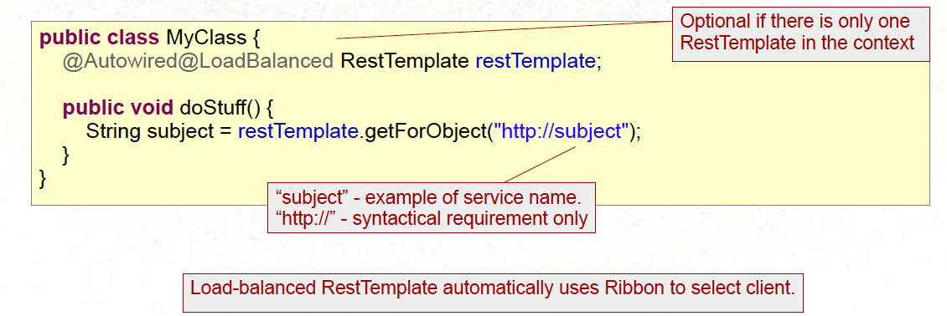
RestTemplate as Ribbon Client
Spring Cloud automatically provides a RestTemplate
Assuming LoadBalancerClient Bean is present, and RestTemplate on classpath.
To use:
@Autowire the RestTemplate, qualify with @LoadBalanced if multiple
Specify service to call using syntax “http://<service-name>”

Slide 19
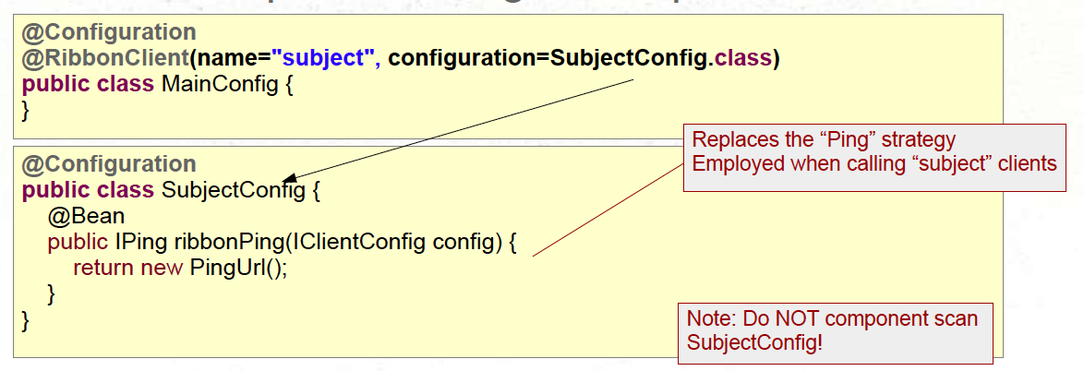
Customizing
Previously we described the defaults. What if you want to change them?
Declare a separate config with replacement bean.

Slide 20
What Customizing Choices are available
Quite a Few!
Recommend looking at the JavaDoc or Github code
http://netflix.github.io/ribbon/ribbon-core-javadoc/index.html?com/netflix/loadbalancer/package-summary.html

Slide 21
Section Summary
Client-side Load Balancing augments regular load balancing by allowing the client to select a server based on some criteria.
Spring Cloud Ribbon is an easy-to-use implementation of client-side load balancing.

Slide 22
Exercise

