Slide 1
Voice Emotion
Analyzer
AI-Powered Emotion Detection from Voice & Text
using Google Gemini · LangGraph · Supabase
Built by Shaun Mendis · March 2026
Notes:
Welcome to the Voice Emotion Analyzer — a project that combines AI, voice technology, and social-emotional learning to understand how people feel. In this presentation, we'll walk through what was built, how it works, and where it's going next.

Slide 2
PROBLEM
The Problem
Emotional intelligence is critical for mental wellness, education, and human-computer interaction.
Most apps process WHAT people say — not HOW they feel when saying it.
No simple open tool connects voice input → emotion detection → a learning framework.
Mental health professionals, educators, and coaches lack real-time emotional data from voice.
2 / 10
Notes:
The core challenge this project addresses is the gap between what is said and what is felt. While speech recognition has become widely available, the emotional layer — the tone, the stress, the underlying feeling — is rarely captured and mapped to something actionable. This project aims to close that gap.

Slide 3
OVERVIEW
What Was Built
A Python application that records voice input, transcribes speech, detects the underlying emotion using Google Gemini AI, maps it to a CASEL SEL competency, and saves every conversation to a cloud database.
Dual input modes
7 emotion classes
Voice recording + typed text
joy · sadness · anger · fear · surprise · disgust · neutral
CASEL mapping
Cloud persistence
5 SEL competency categories
Supabase PostgreSQL — every session saved
LangGraph workflow
Clean, extensible multi-node pipeline
3 / 10
Notes:
The Voice Emotion Analyzer was built in two weeks, starting with a text-based prototype and evolving into a full voice pipeline. It supports both voice and text input, runs locally on macOS, and stores every analyzed conversation in a Supabase cloud database for future review and pattern analysis.

Slide 4
TECH STACK
Technology Stack
🤖
Google Gemini 2.5-flash
🎙️
sounddevice + soundfile
Transcription, emotion detection, and empathetic AI responses in one API call
Microphone recording at 44,100 Hz and WAV file encoding / I/O
🔗
LangGraph
🐍
Python + python-dotenv
Workflow orchestration — manages the step-by-step analysis pipeline graph
Core language and secure API key management via .env files
🗄️
Supabase
PostgreSQL cloud database — stores all conversation history with session IDs
4 / 10
Notes:
The stack was chosen for its modern capabilities and developer-friendliness. Google Gemini 2.5-flash handles both audio transcription and emotion analysis in a single API call. LangGraph provides a clean, extensible workflow graph. Supabase offers a managed PostgreSQL backend with a simple Python client.

Slide 5
ARCHITECTURE
Text Pipeline
User Input
main.py
LangGraph
text_graph
analyze_node
(Gemini API)
save_node
(Supabase)
›
›
›
›
Types text
in CLI
Starts session
+ UUID
Orchestrates
workflow
Returns emotion
+ CASEL + reply
Persists row
to DB
Key Details analyze_emotion() sends a structured JSON prompt to Gemini · Returns: emotion, casel_competency, response · All data saved with session_id for history tracking
Output → Emotion · CASEL Competency · AI Response
5 / 10
Notes:
The text pipeline is the foundation of the app. The user types a message, LangGraph routes it through the analyze node where Gemini reads it and returns structured JSON containing the detected emotion, the corresponding CASEL competency, and an empathetic response. The save node then writes everything to Supabase.

Slide 6
ARCHITECTURE
Voice Pipeline
Microphone
audio_recorder
.py
LangGraph
audio_graph
Gemini
Files API
save_node
(Supabase)
›
›
›
›
User speaks
5 sec
WAV file
44.1kHz mono
record_node
orchestrated
Transcribe +
Emotion in 1 call
Transcript +
analysis saved
Key Details Records at 44,100 Hz · mono · float32 · Gemini transcribes AND analyses emotion in one API call · Temp WAV file auto-deleted after processing
Output → Transcript · Emotion · CASEL Competency · AI Response
6 / 10
Notes:
The voice pipeline extends the text pipeline by adding a recording step. The microphone captures 5 seconds of audio, which is saved as a temporary WAV file and uploaded to the Gemini Files API. In a single prompt, Gemini both transcribes the speech and analyzes its emotional content — returning all four fields: transcript, emotion, CASEL competency, and response.

Slide 7
CASEL
Emotion → CASEL Competency Mapping
7 EMOTIONS
1
Self-Awareness
Recognising one's own emotions and thoughts
joy
2
Self-Management
sadness
Regulating emotions and behaviours
anger
3
Social Awareness
›
fear
Understanding others' perspectives
Gemini
maps
4
surprise
Relationship Skills
Communicating and working with others
disgust
5
Responsible Decision-Making
neutral
Making ethical, constructive choices
7 / 10
Notes:
CASEL — the Collaborative for Academic, Social, and Emotional Learning — provides a research-backed framework for social-emotional development. By mapping detected emotions to one of five competencies, the app transforms raw AI output into something educationally meaningful and actionable. A student, coach, or clinician can use this mapping to guide reflection and growth.

Slide 8
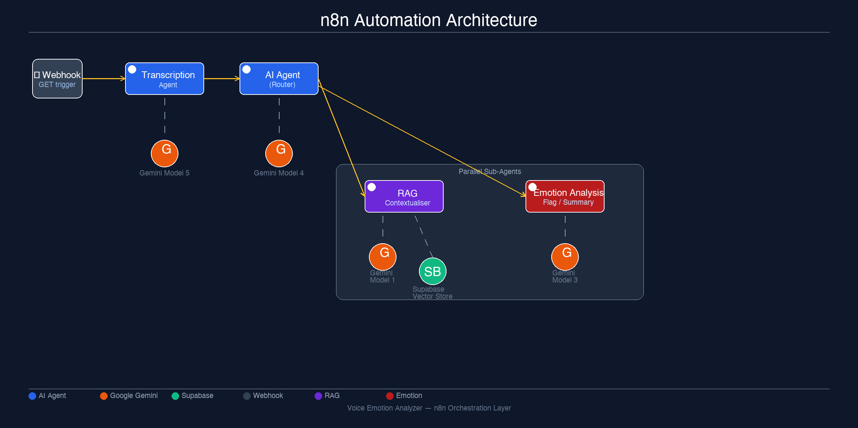
ADVANCED
Advanced Pipeline: n8n Workflow Integration
⚡ Webhook
Trigger (GET)
🤖 Transcription
Agent
🤖 AI Agent
›
›
Google Gemini
Chat Model
Google Gemini
Chat Model
🔍 RAG
Contextualiser
🎯 Emotion Analysis
/ Flag / Summary
Google Gemini Chat Model
🗄️ Supabase
Vector Store
Next-generation architecture using n8n for orchestration and RAG for contextual memory
8 / 10
Notes:
The next evolution of this project moves from local Python to a scalable n8n workflow. A webhook receives voice input, a Transcription Agent converts speech to text, and a central AI Agent routes to two parallel sub-agents: one retrieves context from a Supabase vector store using RAG, and the other performs emotion analysis, flagging, and summarisation. This architecture enables real-time, production-grade deployments.

Slide 9
DEMO
Sample Conversations
Voice Input
Voice Input
Text Input
INPUT
INPUT
INPUT
"Yeah, uh."
"Hello, how are you doing?"
"I feel really overwhelmed today."
TRANSCRIPT
TRANSCRIPT
EMOTION
Yeah, uh.
Hello, how are you doing?
sadness
EMOTION
EMOTION
CASEL
neutral
neutral
self-awareness
CASEL
CASEL
GEMINI
self-awareness
relationship-skills
"It sounds like you're carrying a lot right now. Noticing these feelings is a meaningful first step."
GEMINI
GEMINI
"It sounds like you're taking a moment to process your thoughts."
"Thanks for checking in. I'm doing well."
9 / 10
Notes:
These three sample outputs demonstrate the app working end-to-end. Short voice inputs like casual greetings map to neutral emotion with relationship-skills competency, while richer emotional statements like expressing feeling overwhelmed correctly surface sadness and self-awareness. Each result is stored in Supabase with a session ID.

Slide 10
ROADMAP
What's Next
RAG Contextualiser
Emotion Dashboard
🔍
📊
Retrieve past conversations as context for richer, personalised responses
Visualise emotion trends over time using charts and session history
REST API Endpoint
Mobile / Web UI
🌐
📱
Expose the pipeline via FastAPI for integration with web and mobile apps
Move beyond the CLI to a browser-based or mobile-friendly interface
Flagging System
n8n Full Integration
🔔
🔗
Auto-alert when high-distress emotions (anger, fear) are detected
Complete the advanced workflow with live webhook and vector store
The foundation is built — the next chapter scales it to production.
10 / 10
Notes:
The foundation is solid — the core pipeline works end-to-end. The immediate next steps are to build out the RAG layer for contextual memory, create a visual dashboard for emotion trends, and expose the app as an API. Longer term, the n8n architecture opens the door to real-time, production-scale deployments suitable for mental health, education, and coaching platforms.

