Slide 1
Business Capability Model
Core Business Areas
Enabling Business Areas
Quality Care
Trusting Relationships
Exceptional Workplace
Marketing
Finance
Corporate Services
Support Business Functions
Information Tech
Patient Care
Service Quality
Training
Campaign Management
Bill Processing
Corporate Administration
Administrative Services
Application Management
Health Screening
Care Management
Policy Management
Customer Data Management
Accounting
Corporate Communication
Supply Chain Management
Information Security
Chronic Care Management
Community Engagement
Research
Budgeting and Forecasting
Corporate Planning
Contracts & Procurement
Infrastructure Management
Marketing Analytics
Clinical Services
Quality Management
Administration Support Services
Collections
Legal
Asset
Management
Data Quality & Governance
Accreditation & Licensing
Investigation
Cost Management
Recruit talented employees
Treasury Management
Data Management & Integration
Provider Service
HR Management
Telecom
Notes:
9 identified cabiliities
Core business areas and Enabling Business Area
Lean XI
Don’t overlap – mutually exclusive
Define what, not how
Long term stability
Cross Organizational
Highest level capabilities are showing breadth rather than depth

Slide 2
Business Capability Model
Core Business Areas
Enabling Business Areas
Quality Care
Trusting Relationships
Exceptional Workplace
Marketing
Finance
Corporate Services
Support Business Functions
Information Tech
Patient Care
Service Quality
Training
Campaign Management
Bill Processing
Corporate Administration
Administrative Services
Application Management
Health Screening
Care Management
Policy Management
Customer Data Management
Accounting
Corporate Communication
Supply Chain Management
Information Security
Chronic Care Management
Community Engagement
Research
Budgeting and Forecasting
Corporate Planning
Contracts & Procurement
Infrastructure Management
Marketing Analytics
Clinical Services
Quality Management
Administration Support Services
Collections
Legal
Asset
Management
Data Quality & Governance
Accreditation & Licensing
Investigation
Cost Management
Recruit talented employees
Treasury Management
Data Management & Integration
Provider Service
HR Management
Telecom
Notes:
9 identified cabiliities
Core business areas and Enabling Business Area
Lean XI
Don’t overlap – mutually exclusive
Define what, not how
Long term stability
Cross Organizational
Highest level capabilities are showing breadth rather than depth

Slide 3
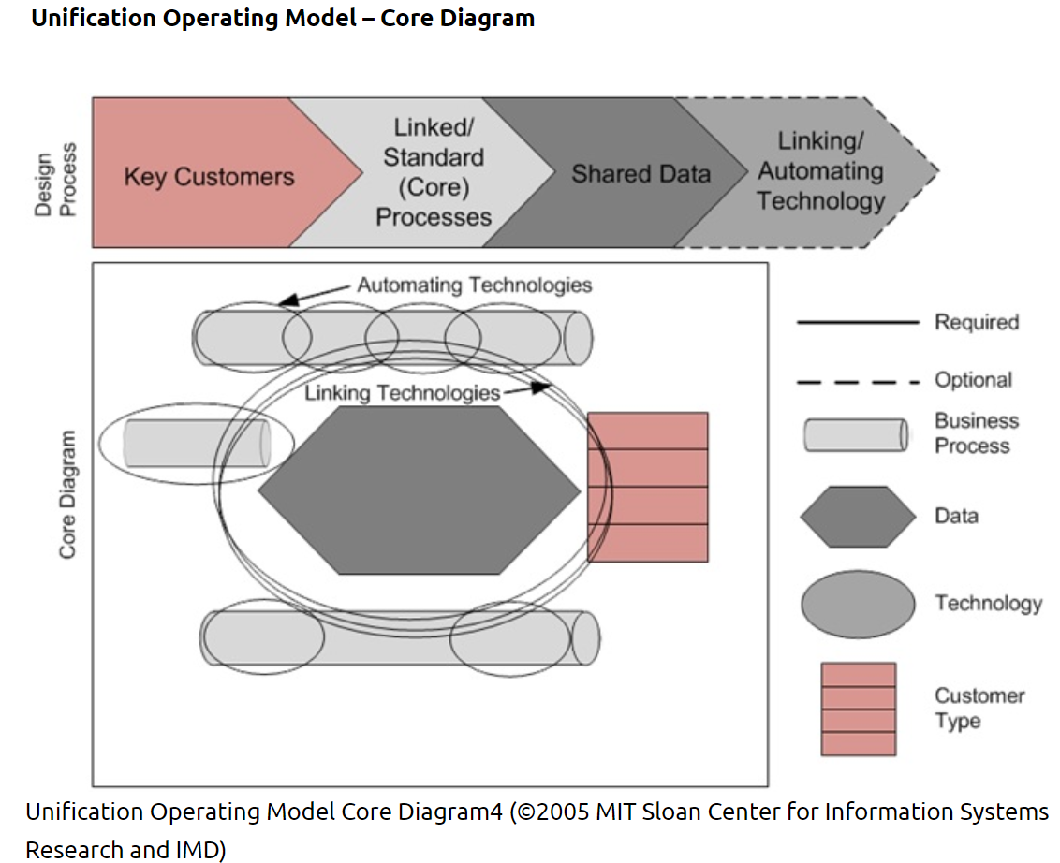

Slide 4
Core Diagram
Appointment operational pipeline
Allocate
resources
Prep for
appointment
Initiate appointment
Record Information
Determine and communicate Treatment
Record visit information
Determine
Follow-up needs
Assess Need
Initiate Billing
E
V
E
N
T
S
Hand-held
Electronic Medical Devices
Pagers
Desktops
Voice
Kiosks
Patient
Assets
Medical Condition
Business Reflexes
Employee Relationship Management
Staff
Financial
Corporate
Appointment Systems
P
R
O
F
I
L
E
Laptops
Cell Phones
Scanners
Appointments
Follow-up Care
Clinical Services
Care Management
Information Gathering
Communication
Billing
Patient experience

