Slide 1

Automating Visualizations with Azure Data Factory, SQL Server, and Power BI: Data to Insights
Deexith Reddy
Senior Data Engineer at Fidelity Investments

Slide 2
Project Goal
Analyst spends 200 hours a year extracting, cleaning and analyzing the data
Save time for Analyst by providing online dashboard that updates itself every month

Slide 3


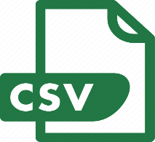

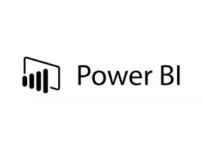


Process Flow
Process owner adds tables from in CSV format to SharePoint folder
The data is pulled into cloud database when updated
Data cleaning and transformation rules set as per requirements

Slide 4
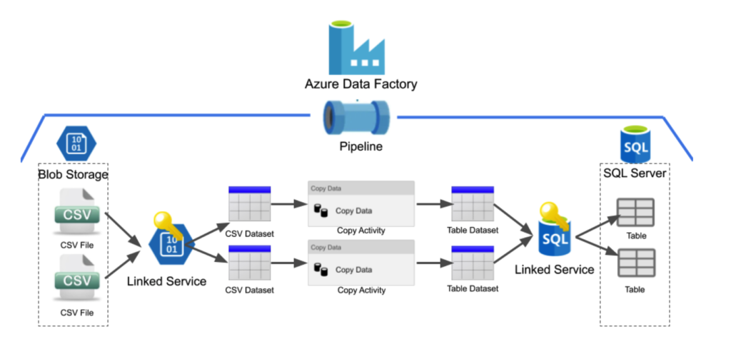
Architecture Overview

Slide 5
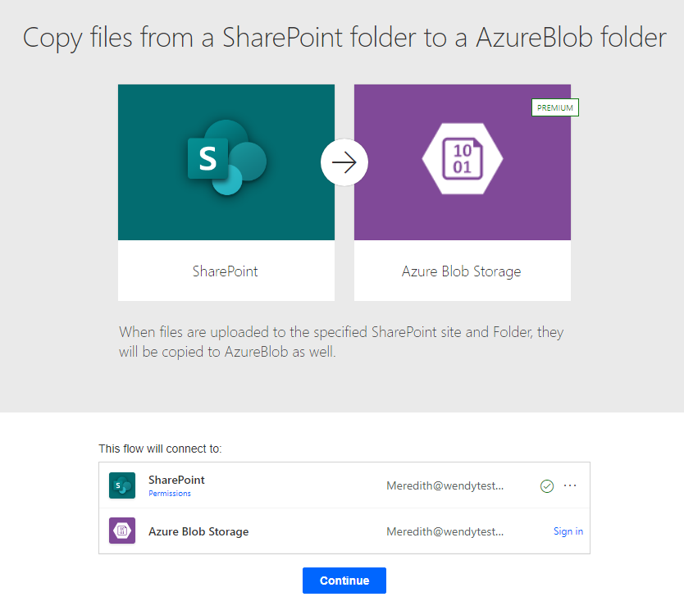
Setting up SharePoint Folder and Blob Storage Integration
To connect the SharePoint folder to Blob Storage, you can use a tool like Azure Logic Apps or Microsoft Flow to automate the process of copying files from SharePoint to Blob Storage

Slide 6
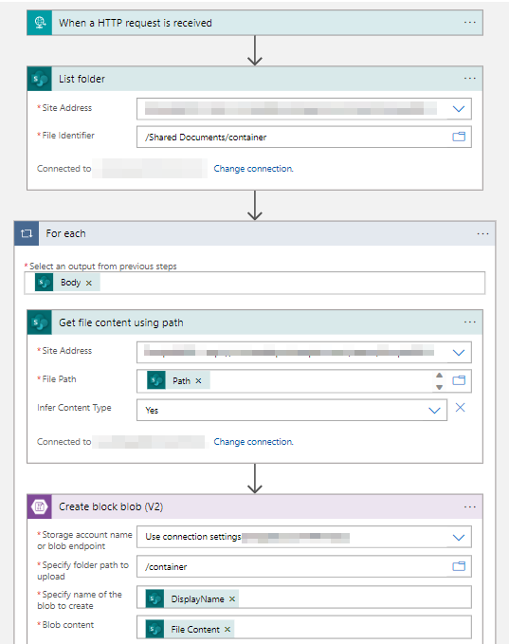
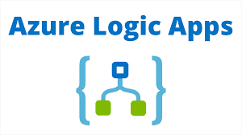
Creating Logic App
Create a new Logic App
Configure the trigger
Set up actions to copy files from SharePoint to Blob Storage

Slide 7
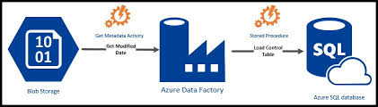
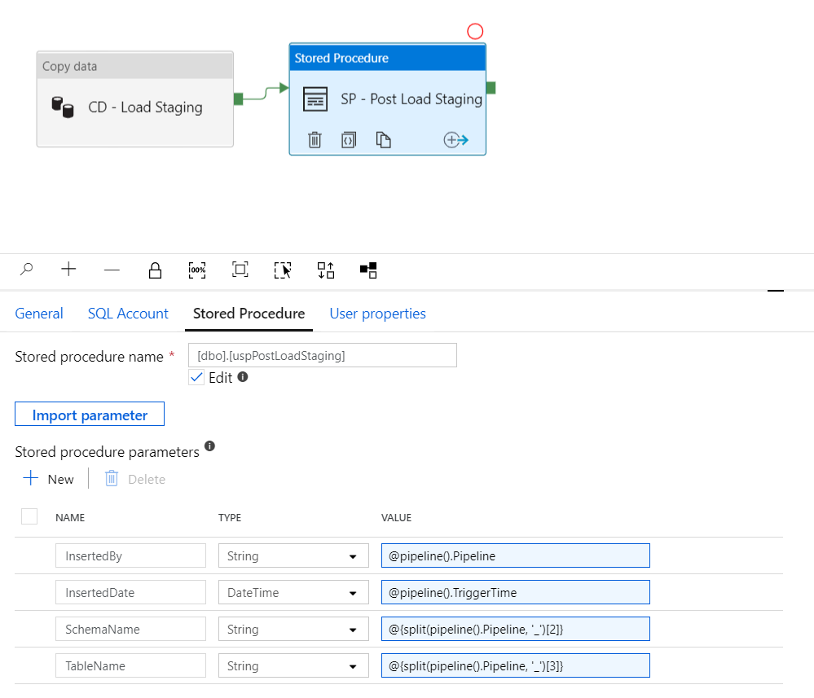
Configuring Azure Data Factory to Connect with Blob and SQL Server
Create a new pipeline
Add activities for data movement and transformation
Configure input and output datasets
Validate and publish the pipeline
IMPORTANT: -"Copy Data" activity will handle the data movement from Blob Storage to SQL Server
-"Stored Procedure" activity will execute the SQL Server stored procedures for data cleaning and transformation. Connect the activities in a sequence, with the "Copy Data" activity followed by the "Stored Procedure" activity.

Slide 8
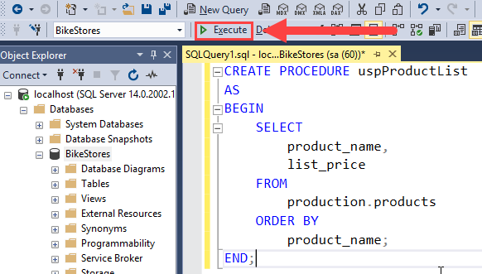
Three Layers in SQL Server: Staging, Transformation, and Final Layer
Staging Layer: Raw data storage
Transformation Layer: Data cleaning and processing
Final Layer: Cleaned and transformed data ready for analysis

Slide 9
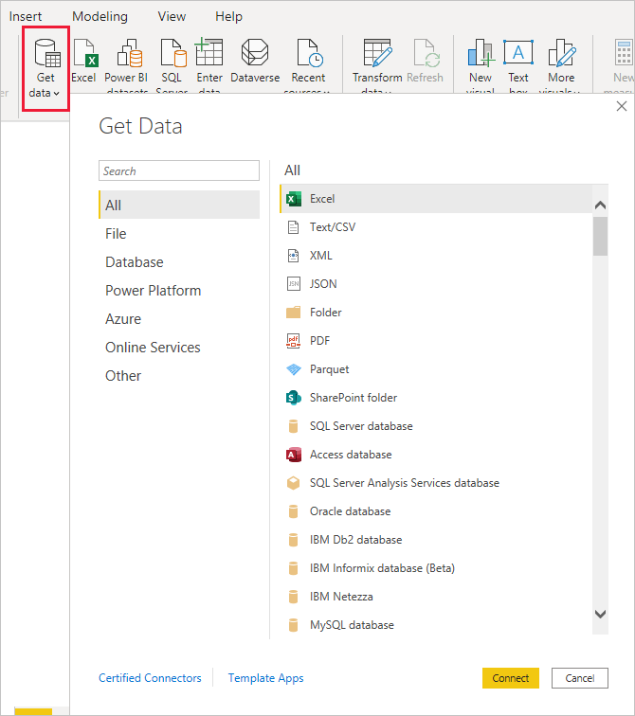
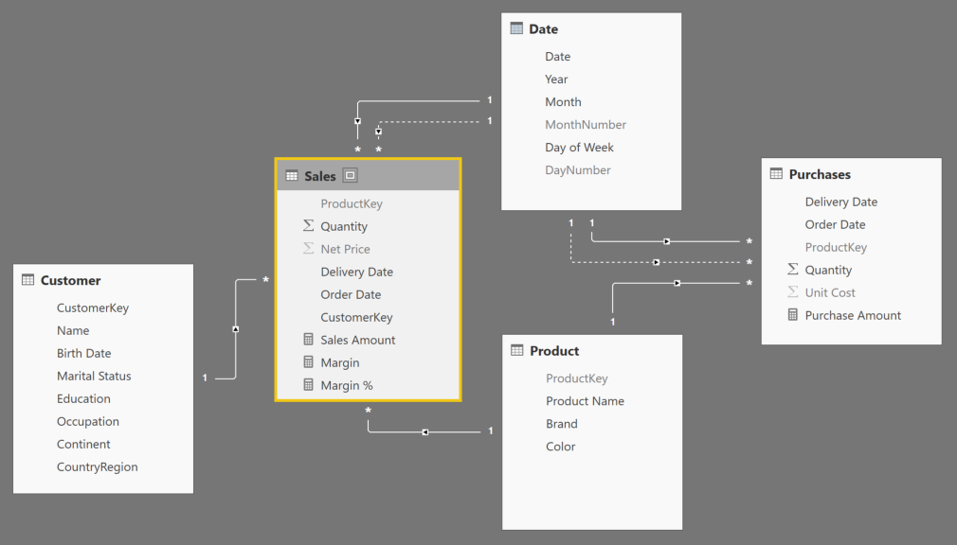
Connecting SQL Server to Power BI and use semantic modelling

Slide 10
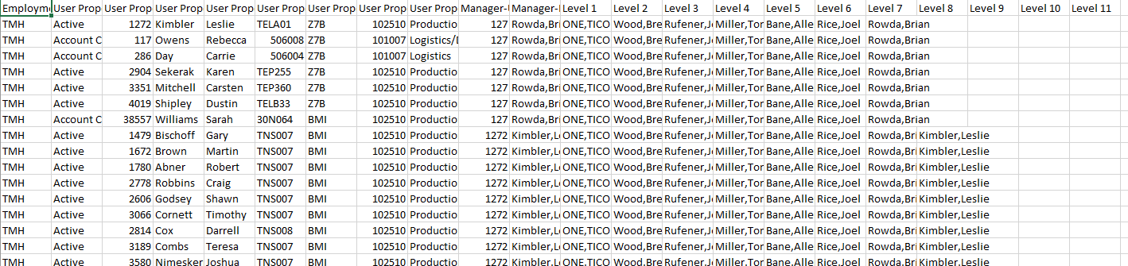
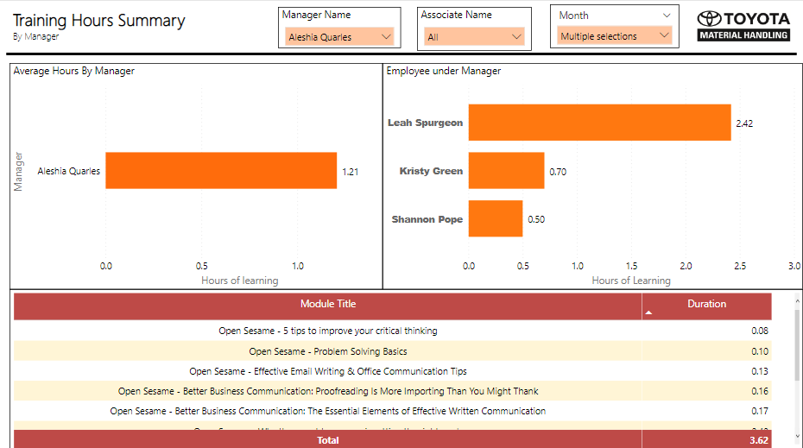
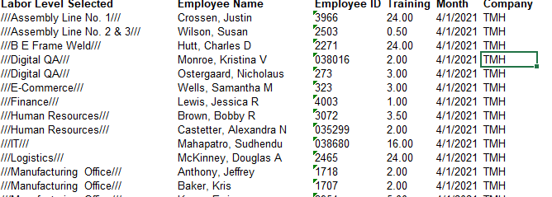
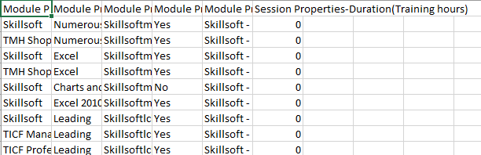
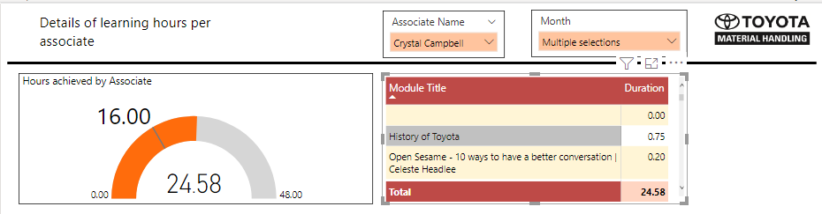
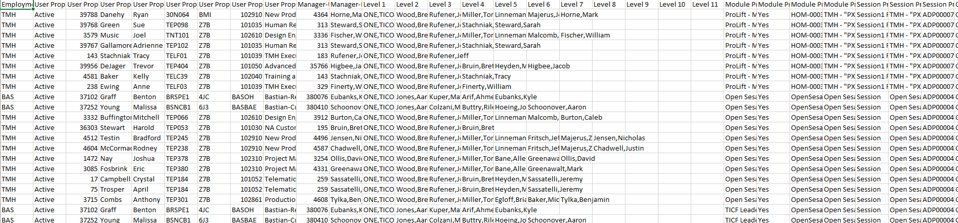

Slide 11
Q&A

