Slide 1

Best Buy TV Analysis
By: Khurram Awan, Abisola Olakanmi, Ishita Nagar, Amina, Kerry-Ann Morrison-Jame

Slide 2
Why we choose best buy:
Best Buy is one of the biggest retailers that sells a wide variety of electronics.
The website had enough data to draw an accurate analysis of sale per brand
eCommerceDB.com ranking best buy as one of the biggest retailer of electronics, making it a reliable source
Watching TV is also the second most popular method that an adult in Canada spends their time on (statista.com).
Making TV sales one of the most popular sales and thus marking the TV sales as an important parameter to analyse.

Slide 3

Data Limitations:
In collecting our data, we came across two Data Limitations.
Number of reviews is not restricted to just the two month period, but is a representation of total reviews over the life of the product. New TVs could be rated as not being popular..
Sale volume (units available, total sales) not supplied by BestBuy website.

Slide 4
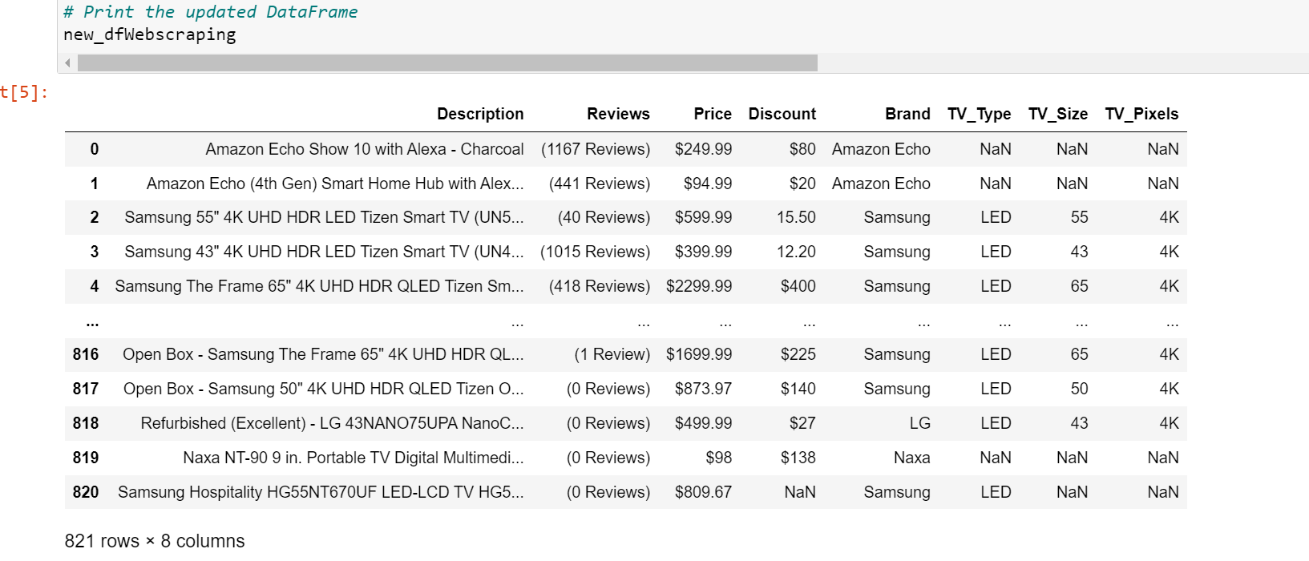
Methods: data collection
Web scraping and data cleanup using Pandas in Jupyter notebook.
Gathered Additional Data
Reran web scraping Python script created in Project 3, to get additional data
Refined Data Preprocessing by:
Changed NAs to zeros;
Removed none TV items;
Changed reviews column from text to numeric;
Added two additional columns to improve analysis

Slide 5
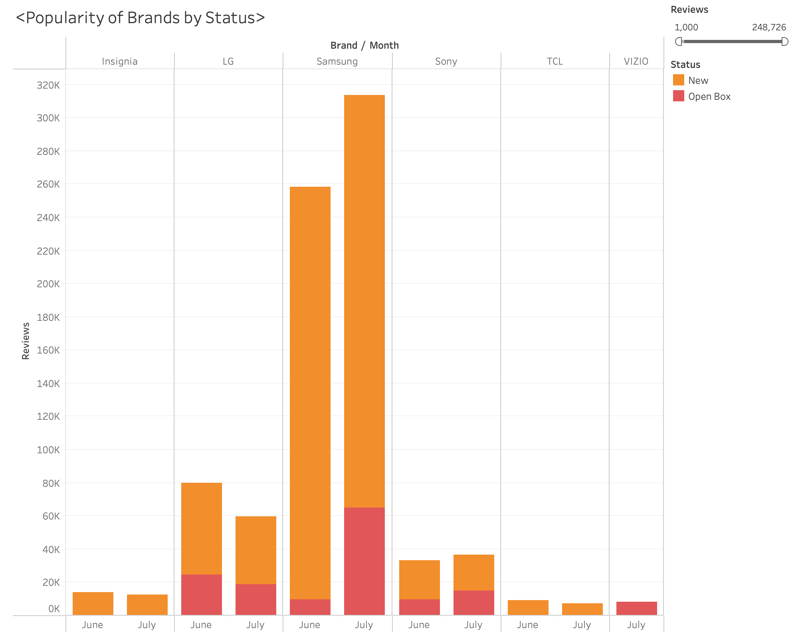
Methods: Visualization
Visualized data in Tableau to Create a story about the current TV sales data for June and July.
Tableau stories
https://public.tableau.com/views/BestBuyAnalysisProject/Sheet1?:language=en-US&:display_count=n&:origin=viz_share_link
https://public.tableau.com/views/BestBuyTVProject/Story1?:language=en-US&:display_count=n&:origin=viz_share_link
Notes:
Json screen

Slide 6
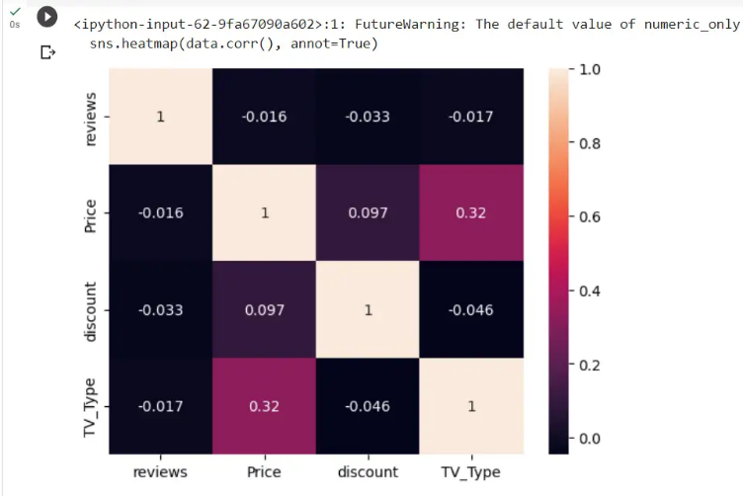
Methods: Machine Learning
Through clustering in unsupervised learning, we are are aiming to predict the effect of different parameters on the future price and in relation the sale of the TV.
For example: here is a heat map portraying the correlation between the parameters and price.
Showcases that TV type has the maximum effect on price.

Slide 7
Demo and Analysis:
We took deeper dive into the web scraping data, and found that the items are sold under new, refurbished and open box.
From the following data it is obvious that Samsung as a brand is the most popular despite the status of its items, based on the number of models sold and reviews received.
In terms of average price Samsung rests above the average price yet it is still more in demand and lands below the costliest models.
Based on our machining learning model we were able to predict the price and found that TV model type tends to have the biggest impact on price with , an R-squared score of 0.8013 indicates that approximately 80.13% of the variance in the target variable (TV prices) is explained by the model using the input features (TV_Type, TV_Pixels, Brand) and 0.8817 for model using Scaled feature

Slide 8
Thank you!

