Slide 1
BestBuy Project 4
Machine Learning & Tableau Analysis

Slide 2
Data Collection
Get Additional Data
Rerun web scraping Python script created in Project 3, to get additional data,
Refined Data Preprocessing
Changed NAs to zeros;
Removed none TV items;
Changed reviews column from text to numeric;
Added two additional columns to improve analysis

Slide 3
Tableau Analysis

Slide 4
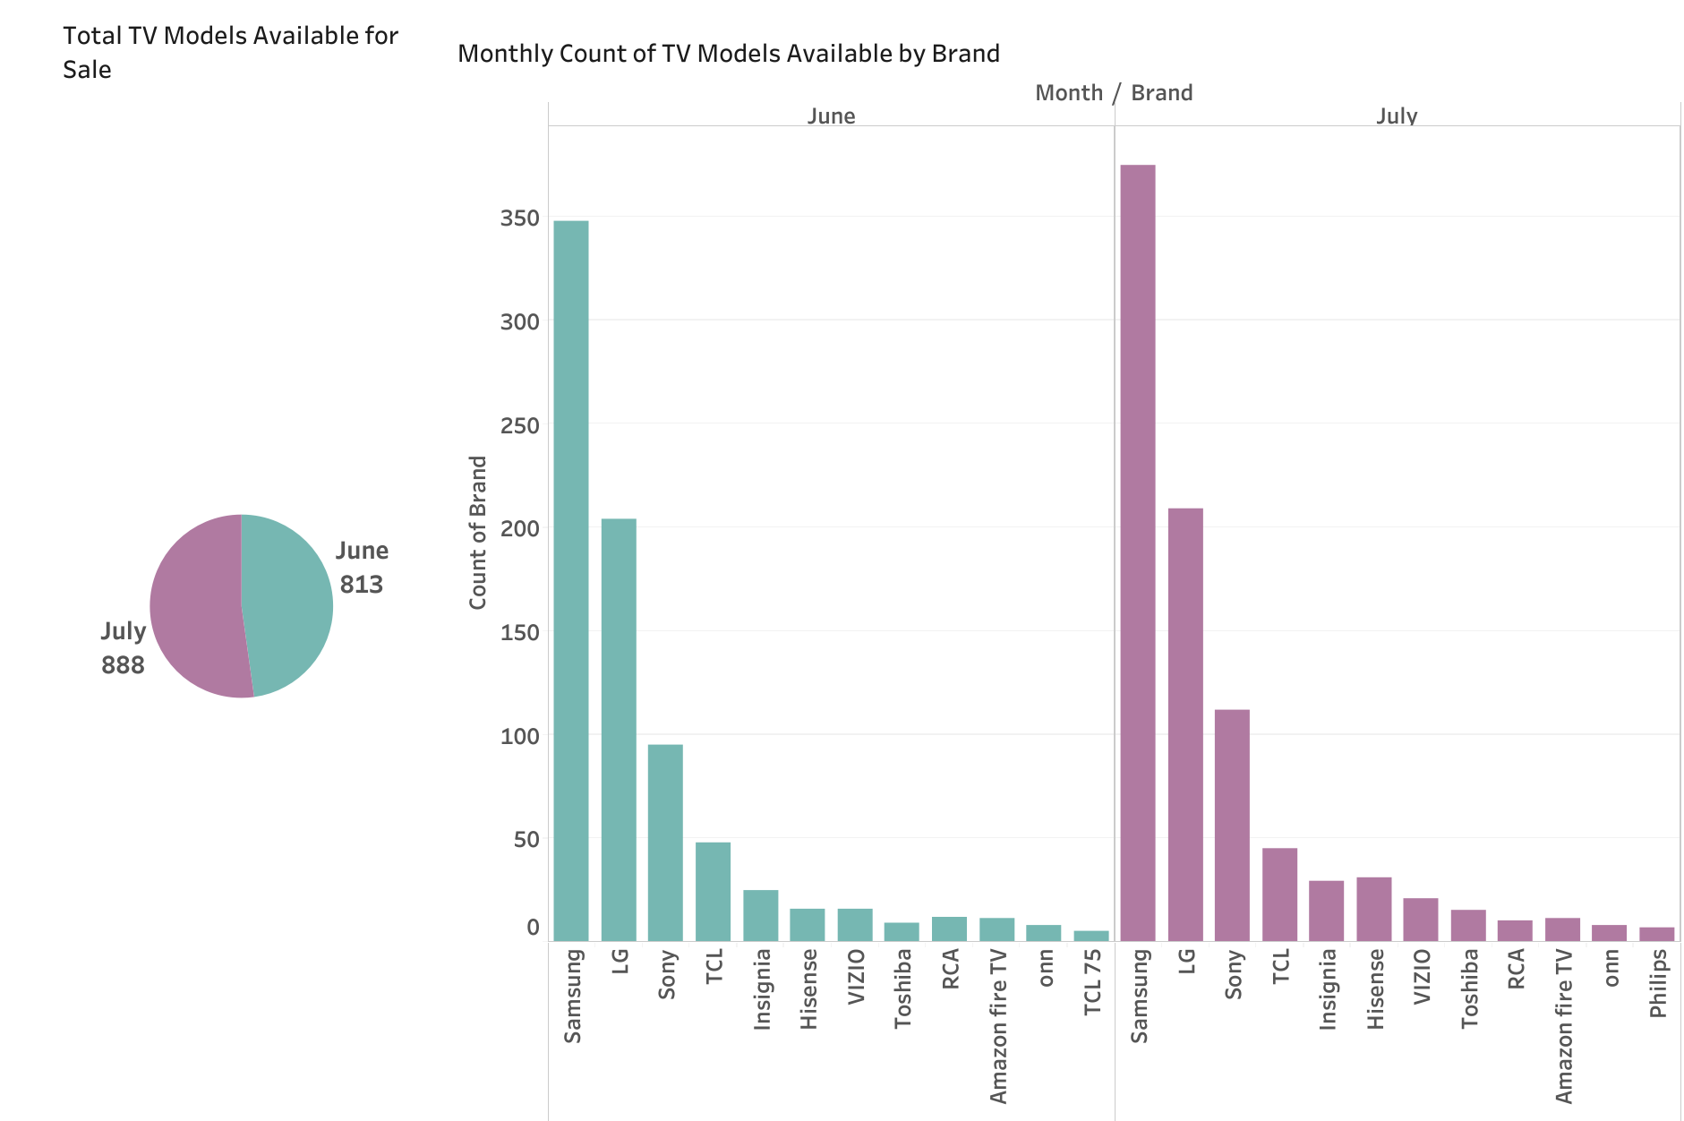
Tableau Hghlights – Number of Models Available

Slide 5
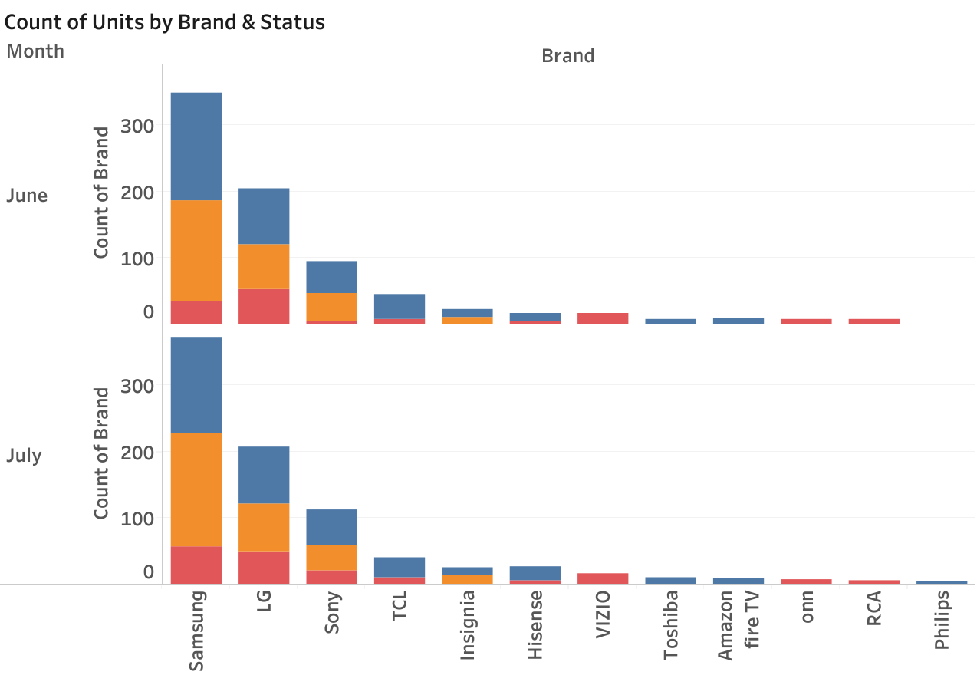
Tableau Highlights – Breakdown of Count by Brand and Status

Slide 6
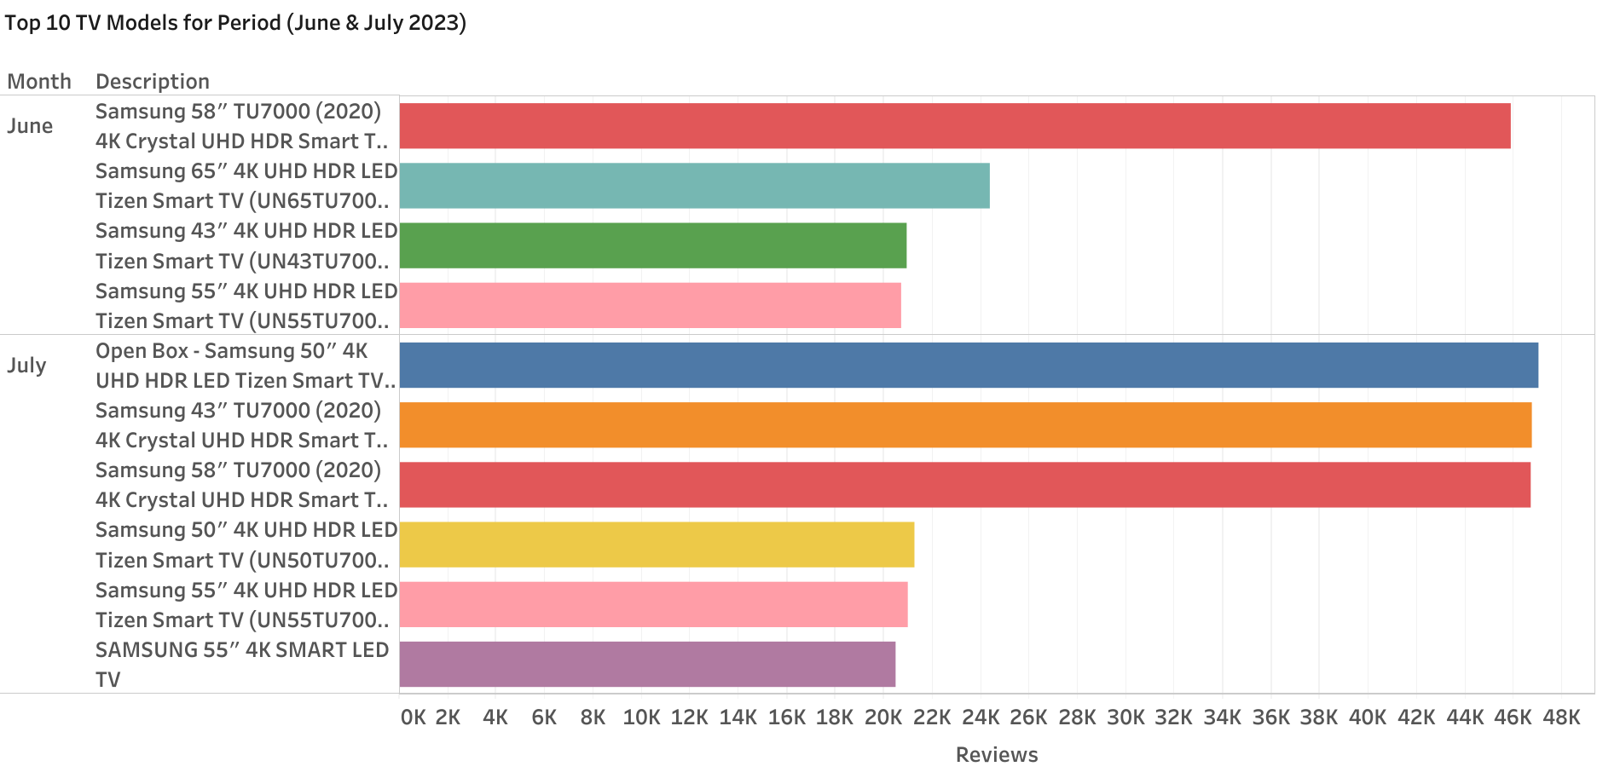
Tableau Highlights – Popular TV Models for June & July

