Slide 1

Best Buy TV Analysis
By: Khurram Awan, Abisola Olakanmi, Ishita Nagar, Amina, Kerry-Ann Morrison-Jame

Slide 2
Why we choose best buy:
Best Buy is one of the biggest retailers that sells a wide variety of electronics.
The website had enough data to draw an accurate analysis of sale per brand
eCommerceDB.com ranking best buy as one of the biggest retailer of electronics, making it a reliable source
Watching TV is also the second most popular method that an adult in Canada spends their time on (statista.com).
Making TV sales one of the most popular sales and thus marking the TV sales as an important parameter to analyse.

Slide 3

Data Limitations:
In collecting our data, we came across two Data Limitations.
Number of reviews is not restricted to just the two month period, but is a representation of total reviews over the life of the product. New TVs could be rated as not being popular..
Sale volume (units available, total sales) not supplied by BestBuy website.

Slide 4
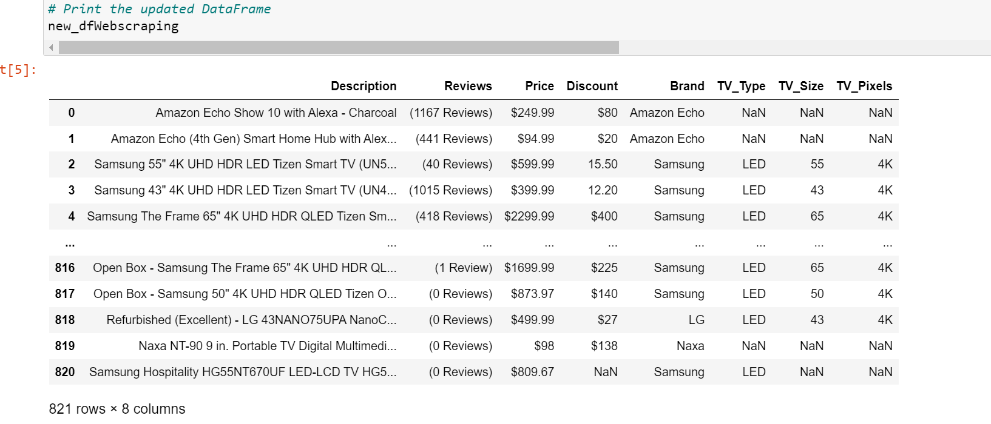
Methods: data collection
Web scraping and data cleanup using Pandas in Jupyter notebook.
Gathered Additional Data
Reran web scraping Python script created in Project 3, to get additional data
Refined Data Preprocessing by:
Changed NAs to zeros;
Removed none TV items;
Changed reviews column from text to numeric;
Added two additional columns to improve analysis

Slide 5
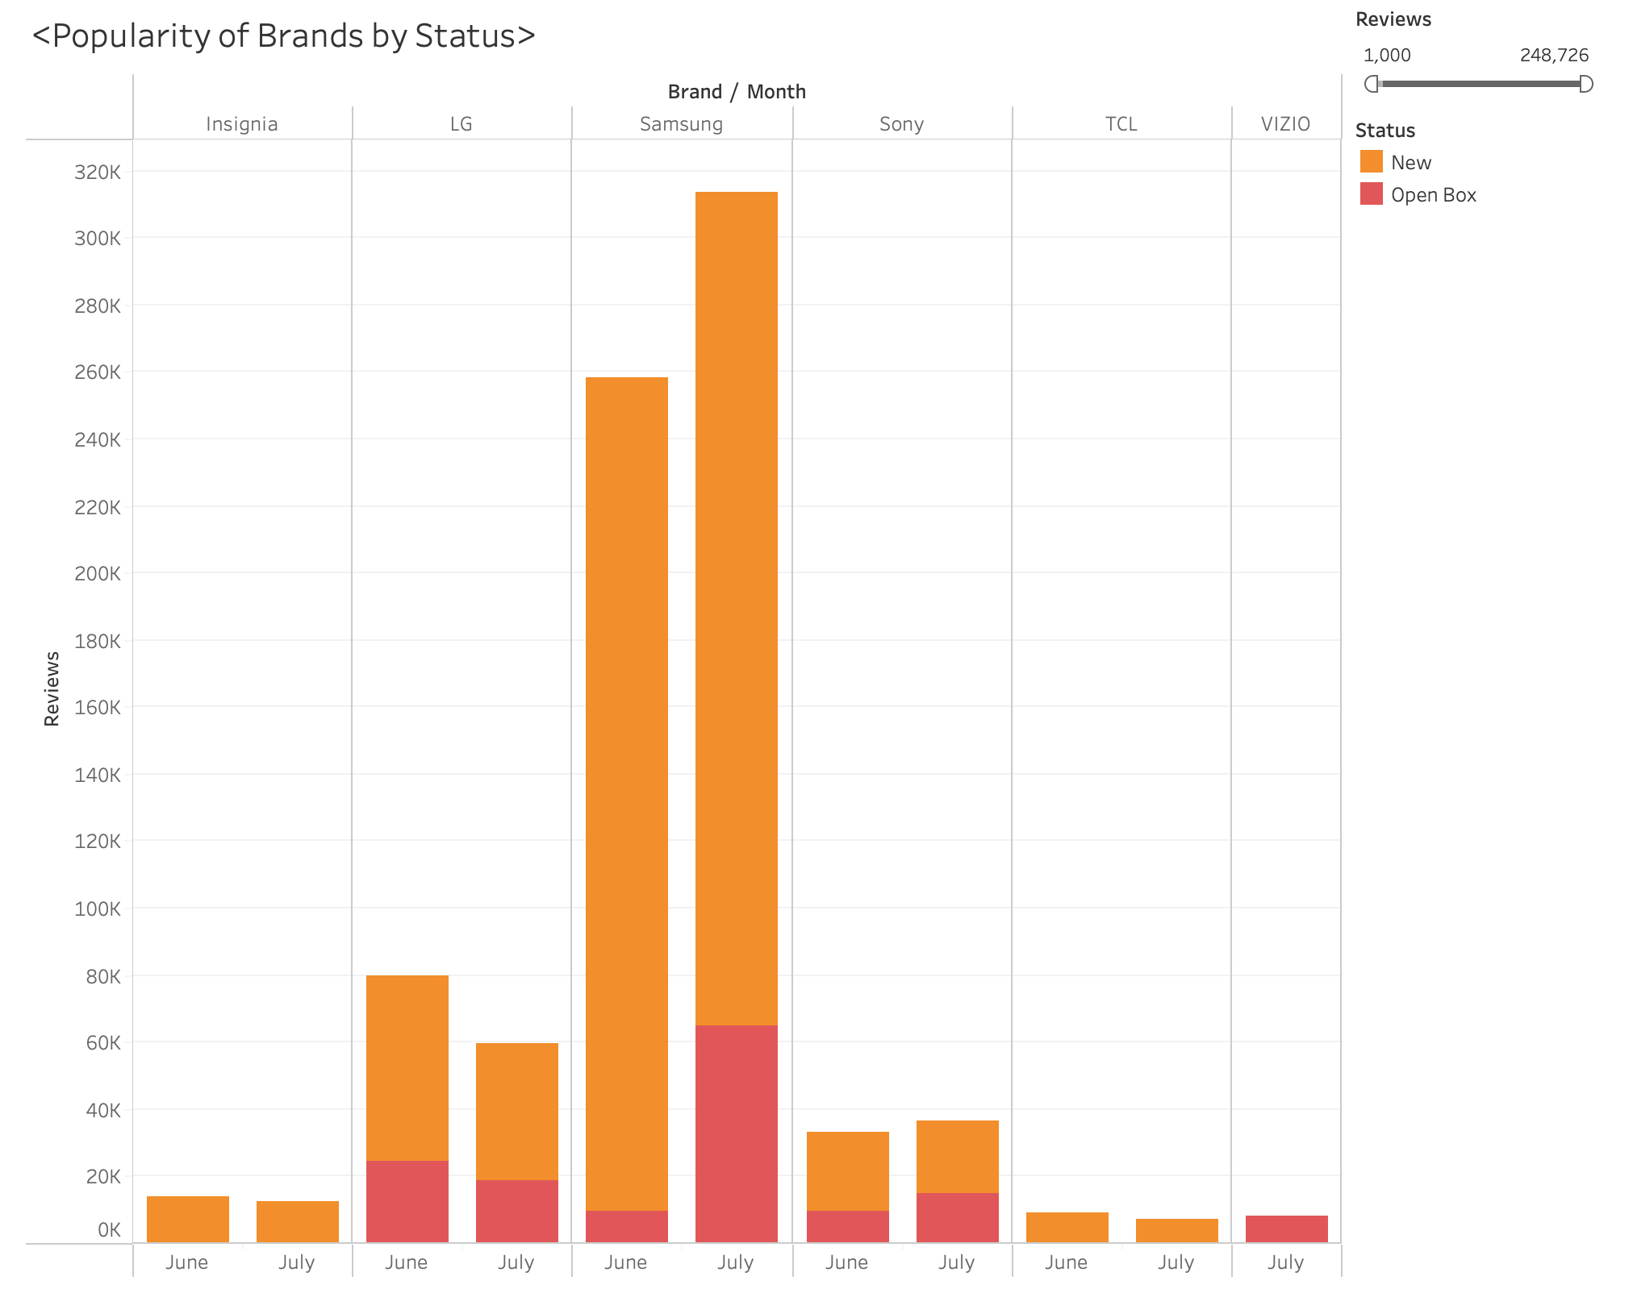
Methods: Visualization
Visualized data in Tableau to Create a story about the current TV sales data for June and July.
Tableau stories
https://public.tableau.com/views/BestBuyAnalysisProject/Sheet1?:language=en-US&:display_count=n&:origin=viz_share_link
https://public.tableau.com/views/BestBuyTVProject/Story1?:language=en-US&:display_count=n&:origin=viz_share_link
Notes:
Json screen

Slide 6
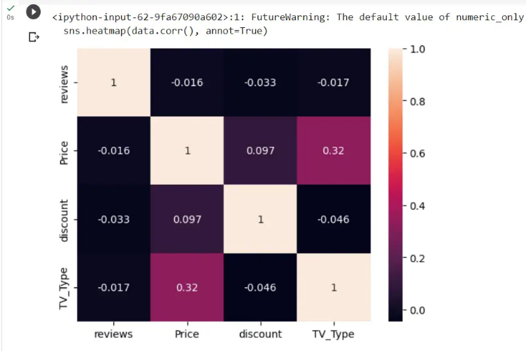
Methods: Machine Learning
Through clustering in unsupervised learning, we are are aiming to predict the effect of different parameters on the future price and in relation the sale of the TV.
Here is a heat map portraying the correlation between the parameters and price.
It's a heatmap. Say that, Price and Tv_type has better correlation compared to others.
So based on this, based on the Tv_type price varies. Discount and price are not linked together.

Slide 7
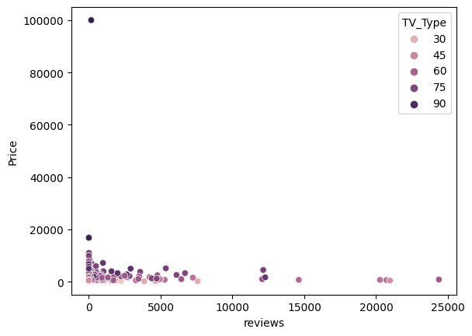
The tv type shows the various size of TV’s that are available. It's clear that, the price is in the lower side for most of the TV Size and as the size increases the cost increases.

Slide 8
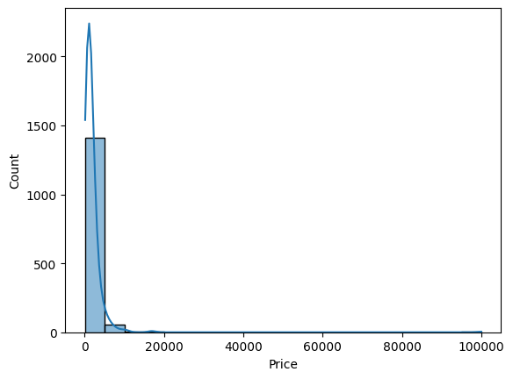
It's a plot showing how the price works. Notable thing is, all price mostly lies less than 10000

Slide 9
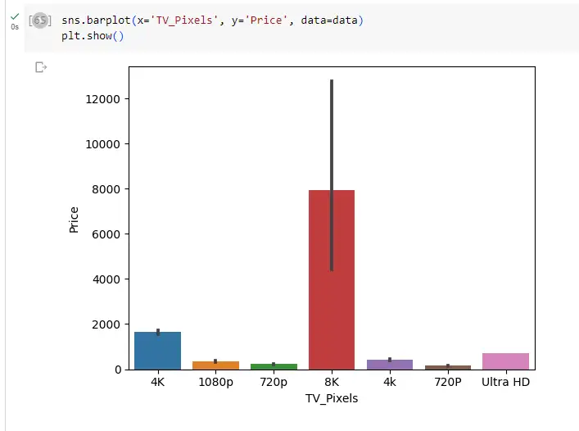
8K resolution TVs are available the most and their price lies between 4000 to 12000

Slide 10
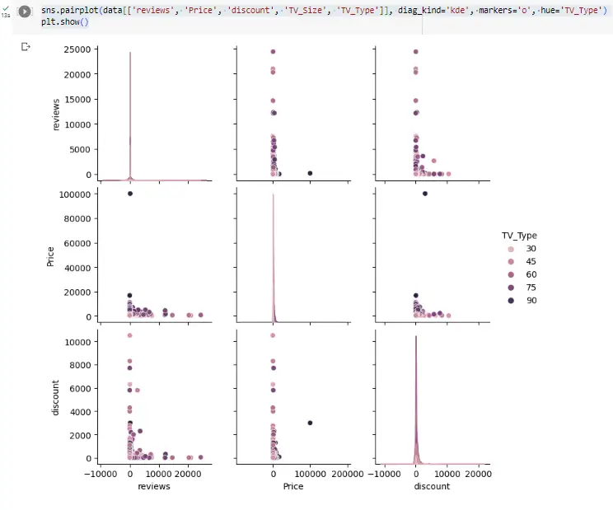
This is a scatter plot matrix, in which we compare price, discount and reviews with respect to the size of the tv. Most of the products, have discount scattered all over. Discount is not important feature and it is visible through this graph based on how it is positioned.

Slide 11
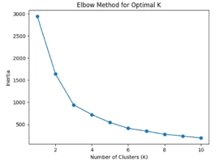
We chose the 6 which was optimal by using the elbow method.
Cluster basically enhances the model. we chose 6 as in this graph, 6 is the optimal number we can choose. The visual suggests the slope providing a better value to split.

Slide 12
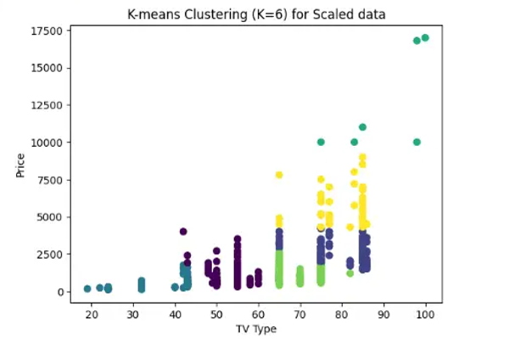
This plot is just depicting, how the tv type and price is behaving when we group them with clusters, and it isn't overlapping so its optimal.

Slide 13
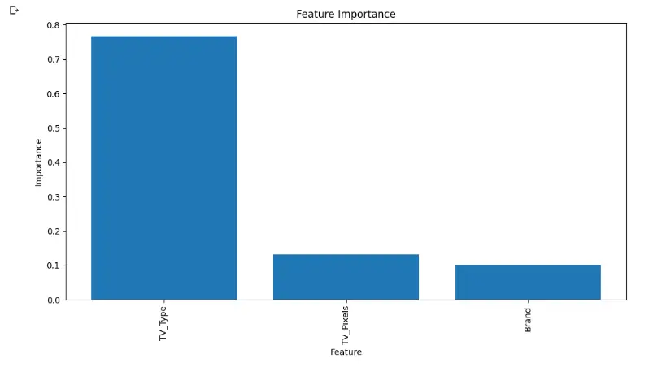
Use of Decision Tree
Based on our machining learning model we were able to predict the price and found that TV model type tends to have the biggest impact on price with an R-squared score of 0.8013 indicates that approximately 80.13% of the variance in the target variable (TV prices) is explained by the model using the input features (TV Type, TV Pixels, Brand) and 0.8817 for model using Scaled feature.

Slide 14
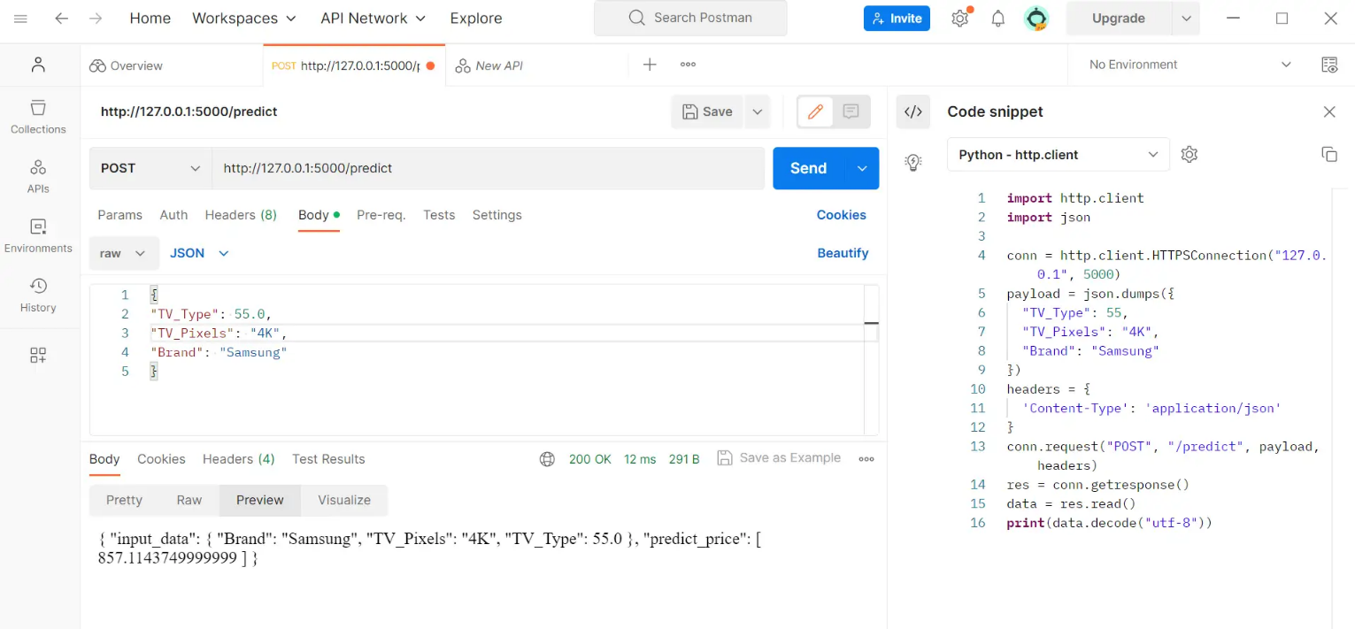
Lastly, we used the Flask API to show how can we predict price by using model.

Slide 15
Demo and Analysis:
We took deeper dive into the web scraping data, and found that the items are sold under new, refurbished and open box.
From the following data it is obvious that Samsung as a brand is the most popular despite the status of its items, based on the number of models sold and reviews received.
In terms of average price Samsung rests above the average price yet it is still more in demand and lands below the costliest models.
Based on our machining learning model we were able to predict the price and found that TV model type tends to have the biggest impact on price with , an R-squared score of 0.8013 indicates that approximately 80.13% of the variance in the target variable (TV prices) is explained by the model using the input features (TV_Type, TV_Pixels, Brand) and 0.8817 for model using Scaled feature

Slide 16
Thank you!

