Slide 1

Best Buy TV Analysis
By: Khurram Awan, Abisola Olakanmi, Ishita Nagar, Amina, Kerry-Ann Morrison-Jame

Slide 2
Why we choose best buy:
Best Buy is one of the biggest retailers that sells a wide variety of electronics.
The website had enough data to draw an accurate analysis of sale per brand
eCommerceDB.com ranking best buy as one of the biggest retailer of electronics, making it a reliable source
Watching TV is also the second most popular method that an adult in Canada spends their time on (statista.com).
Making TV sales one of the most popular sales and thus marking the TV sales as an important parameter to analyse.

Slide 3

Challenges:
The html code for the website was difficult to interpret
Due to time constraints, we found it difficult to gather extensive data highlighting locations and any other parameters.
We also faced challenges connecting the SQL data base to the flask. As well as using the flask to then create the plotly.
Navigating GITHUB

Slide 4
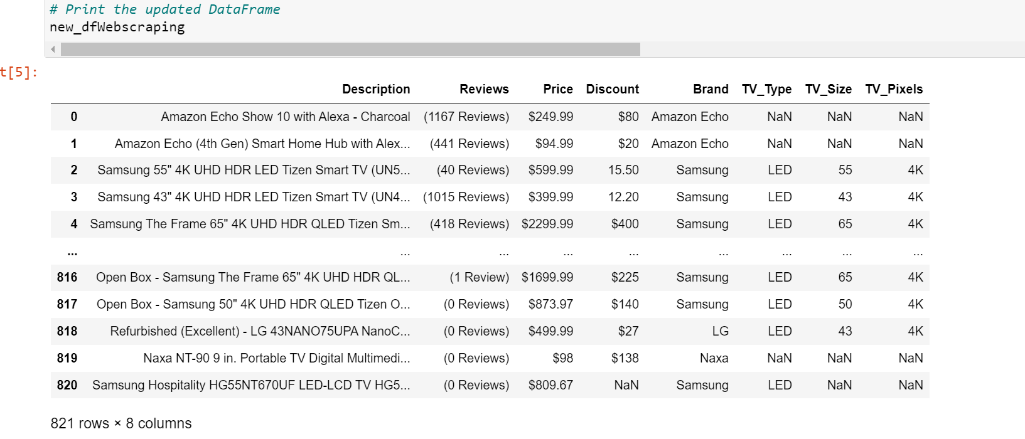
Methods: data collection
Web scraping and data cleanup using Pandas in Jupyter notebook.
Using automation code to scrape the entire website, we got the descriptions of the various TV types sold by best buy
Created a data set based on the information scraped from the web

Slide 5
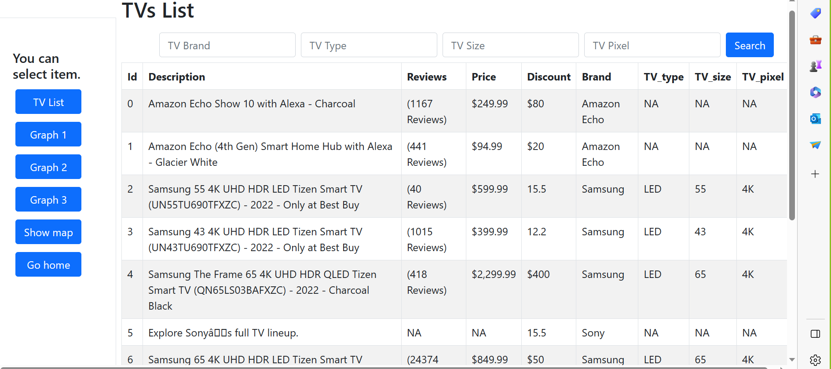
Methods: flasks
Established a PostgresSQL database connection
Imported required libraries.
Created flask instance
Created the main routing and views
Ran the code seamlessly.
Notes:
Json screen

Slide 6
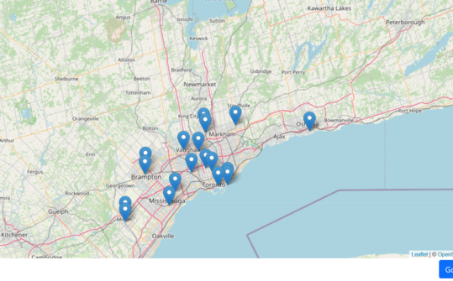
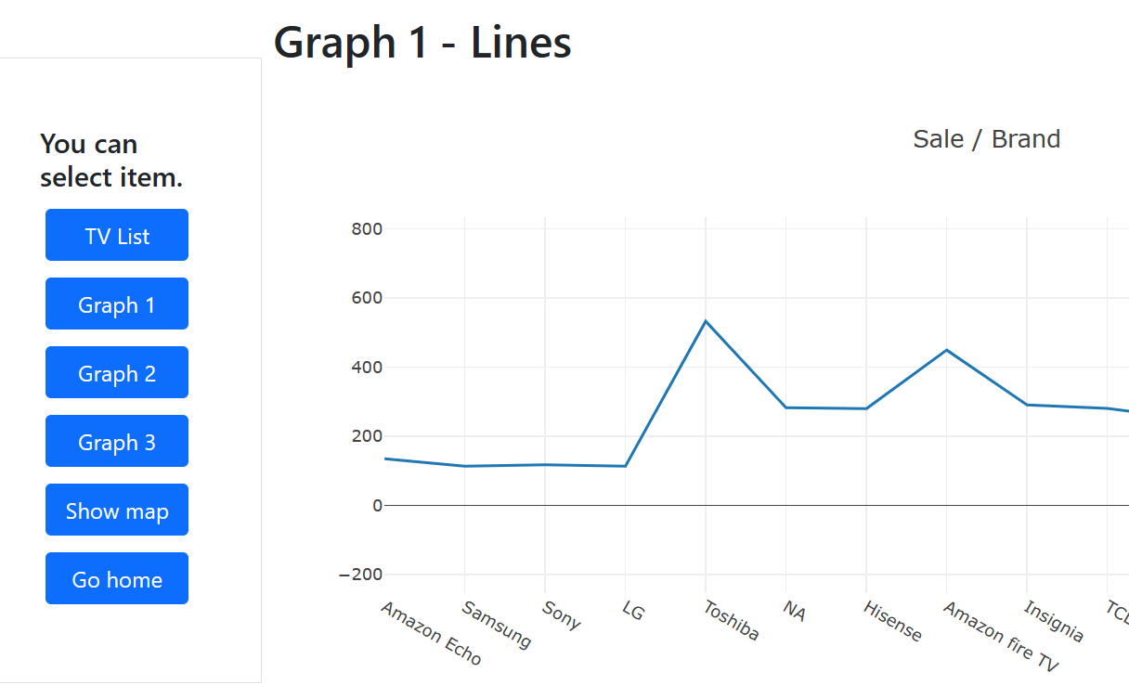
Methods: visualization
Used Plotly, to visualize data into graphs
Used line graph, marker to depict the sales by brand.
Used plotly table to visual the entire data set, that can be filtered based on the desired information
Created a leaflet map based on best buy location

Slide 7
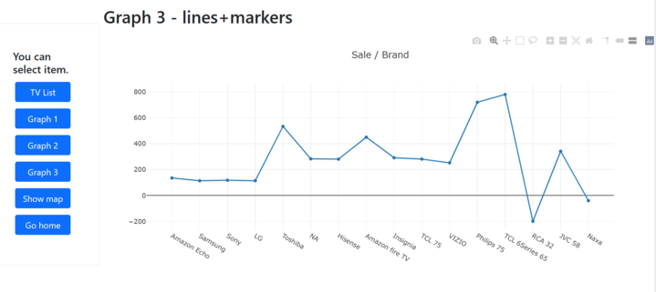
Demo and Analysis:
Based on the data extracted it can be analyzed that TCL series6 has the highest sale price, while RCA 32 has the lowest sale price.
We are also able to see a fairly even distribution of best buy stores around the Toronto and GTA region.

Slide 8
Thank you!

