Slide 1


CrysXPP: An Explainable Property Predictor for Crystalline Materials
Kishalay Das, Bidisha Samanta, Pawan Goyal, Seung-Cheol Lee, Satadeep Bhattacharjee, Niloy Ganguly
NPJ Computational Material Science

Slide 2
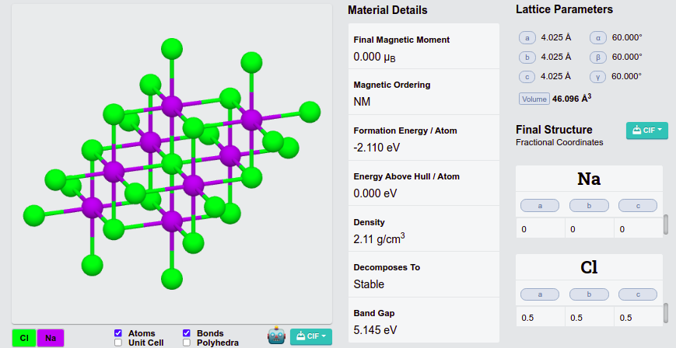
Crystalline Materials
State Properties
Lattice
Structure
Atomic
Coordinates

Slide 3
Deep models for crystal property prediction
Fast and accurate prediction of different properties (e.g : State Properties, Elastic Properties etc.) for crystalline materials is a challenging task and has lots of interest to the materials science community since it is imperative for finding new functional materials.
Density functional theory (DFT) [Orio et al., 2009] is an effective tool to estimate several chemical Properties, but requires substantial computation costs.
In recent times several machine learning techniques [Tian Xie et.al 2018, Chen,C et. al., 2019] have been proposed to enable fast and accurate prediction of different properties for crystalline materials, thus facilitating rapid screening over large material search spaces.
Existing techniques either use handcrafted feature based descriptors or deep graph neural network (GNN) to generate a representation from the 3d conformation of crystal structures.
Notes:
STATE PROPERTY: FORMATION ENERY, FERMI ENERGY, BAND GAP, MAGNETIC MOMEMT; ELASTIC PROPERY: POISSON RATIO, BULK MODULII, SHEAR MODULI.

Slide 4
Limitation of existing works
Generating handcrafted features requires specific domain knowledge and human intervention
Deep models require a huge amount of tagged training data
DFT error bias in current models.
Lack of interpretability and algorithmic transparency
Opportunity
A large corpus of unlabelled crystal data is available, which can be used to learn the structural and chemical information of the atoms and crystal graph in unsupervised way.
Notes:
Generating handcrafted features requires specific domain knowledge and human intervention, which makes the methods inherently restricted
Deep models typically have a large number of workable parameters, they require a huge amount of tagged training data to estimate the parameters and certain properties like Band-gap, Magnetic Moment and other elastic properties does not have enough tagged data.
As experimental data for the various properties are small and less diverse, these models are trained using data gathered from the DFT calculations. Hence model prediction has the DFT error bias and current methods hardly can mitigate this bias.
Existing neural network based methods hardly provide any explanation for their results. The lack of interpretability and algorithmic transparency allow little use of them in the field of material science.

Slide 5
Our Proposed Method
We propose an explainable deep property predictor for crystalline materials which comprised of two modules :
CrysAE (Crystal Auto Encoder) and CrysXPP (Crystal eXplainable Property Predictor)
CrysAE, an auto-encoder based architecture which is trained with a large amount of unlabeled crystal data which leads to the deep encoding module capturing all the important structural and chemical information of the constituent atoms (nodes) of the crystal graph.
This learned encoding is leveraged to build up the property predictor, CrysXPP, to which the knowledge acquired by the encoder is transferred and which is further trained with a small amount of property-tagged data, thus largely mitigating the need for having a huge amount of dataset tagged with a specific property.

Slide 6
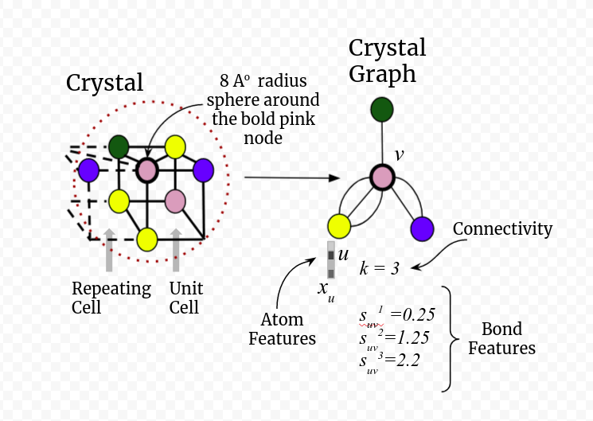
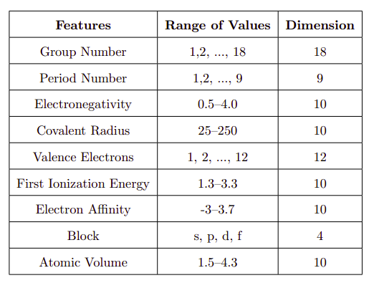
Graph Representation of Crystal
Atom Features

Slide 7
CrysAE ( Crystal Auto Encoder )
Encoder Module : Crystal graph encoder based on graph convolution network, encodes the chemical and structural information of a crystal graph into embedding.
Decoder Module : We design an effective decoder which plays an inevitable role in learning the local and global structure which are extremely useful. Decoder reconstructs the following :
Node features
Edge features
Graph Connectivity
We learn the trainable parameters of both encoder and decoder end to end by minimizing these reconstruction loss of different global and local structural and chemical features.
Notes:
Decoder reconstructs two important features that induce the local chemical environment : node features and local connectivity
Further we reconstruct the global structure i.e The connectivity and periodicity of the crystal structures.

Slide 8
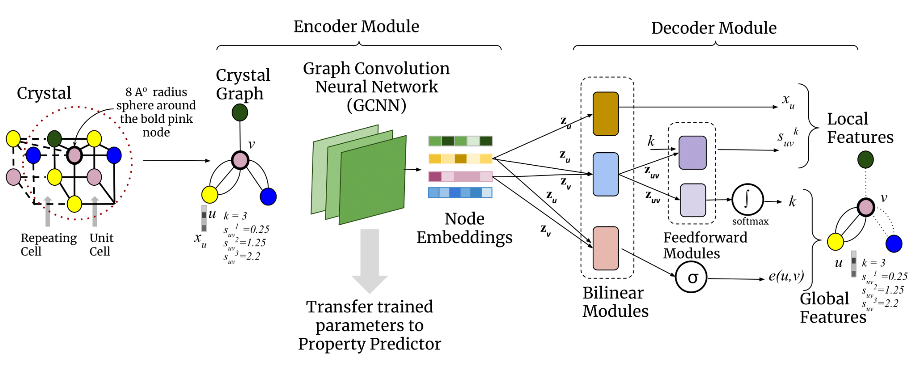
CrysAE ( Crystal Auto Encoder )
Materials Project database
(38000 crystalline materials)

Slide 9
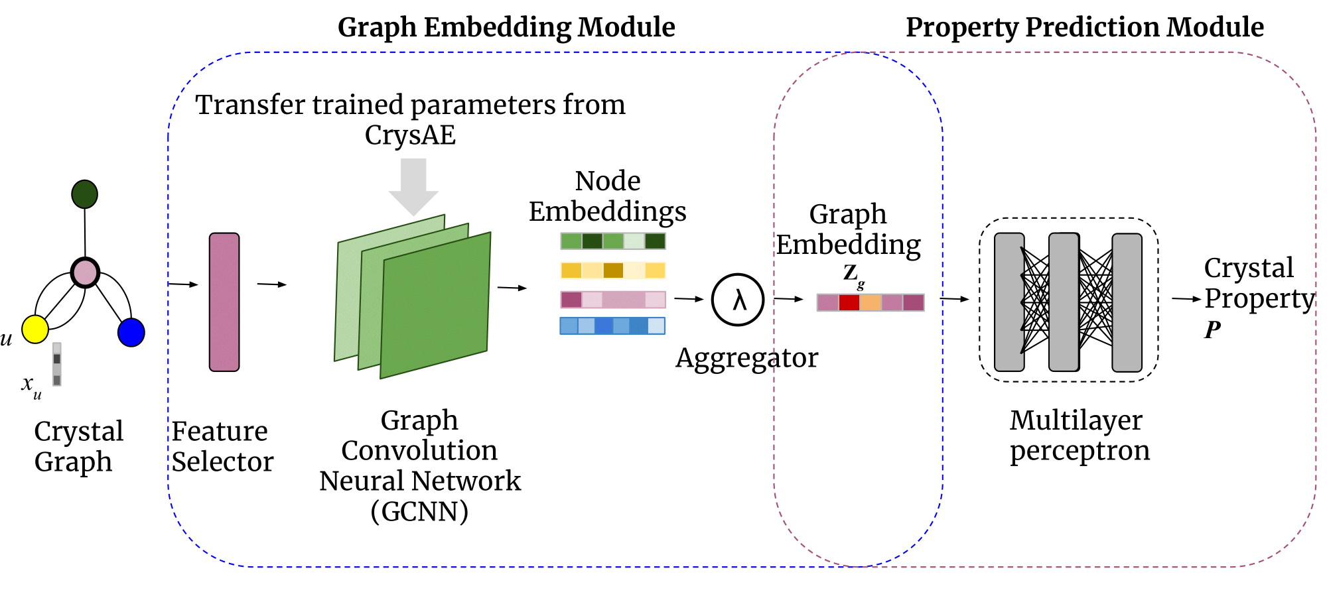
CrysXPP ( Crystal eXplainable Property Predictor )
We build a model explainability module by introducing a feature selector before the convolution of the node properties.
The feature selector is a trainable weight vector that selects a weighted subset of important node level features for a given property of interest P.
We use a LASSO regression to impose sparsity on the feature selector layer.
Notes:
FORMATION ENERGY – VALENCE ELECTRON, ELECTRON AFFINITY, ATOMIC VOLUME MAY NOT BE IMPORTANT

Slide 10
CrysXPP ( Crystal eXplainable Property Predictor )
Property predictor is designed specific to a property that can take the advantage of the structural information learned by the encoder of the CrysAE.
Use a symmetric aggregation function to generate graph embedding from the node embedding (which is invariant of the node orderings).
Graph Embedding is fed to a multilayer perceptron which predicts the value of the properties.
Notes:
FORMATION ENERGY – VALENCE ELECTRON, ELECTRON AFFINITY, ATOMIC VOLUME MAY NOT BE IMPORTANT

Slide 11
Evaluation
How effective is the property predictor?
How is the the performance of the property predictor especially when it functions with a small amount of DFT tagged data?
How robust is the structural encoding?
Whether the structural encoding helps us to mitigate the noise introduced by DFT calculated properties?
How effective is the explanation?
Cross-validate the obtained explanation with domain experts.

Slide 12
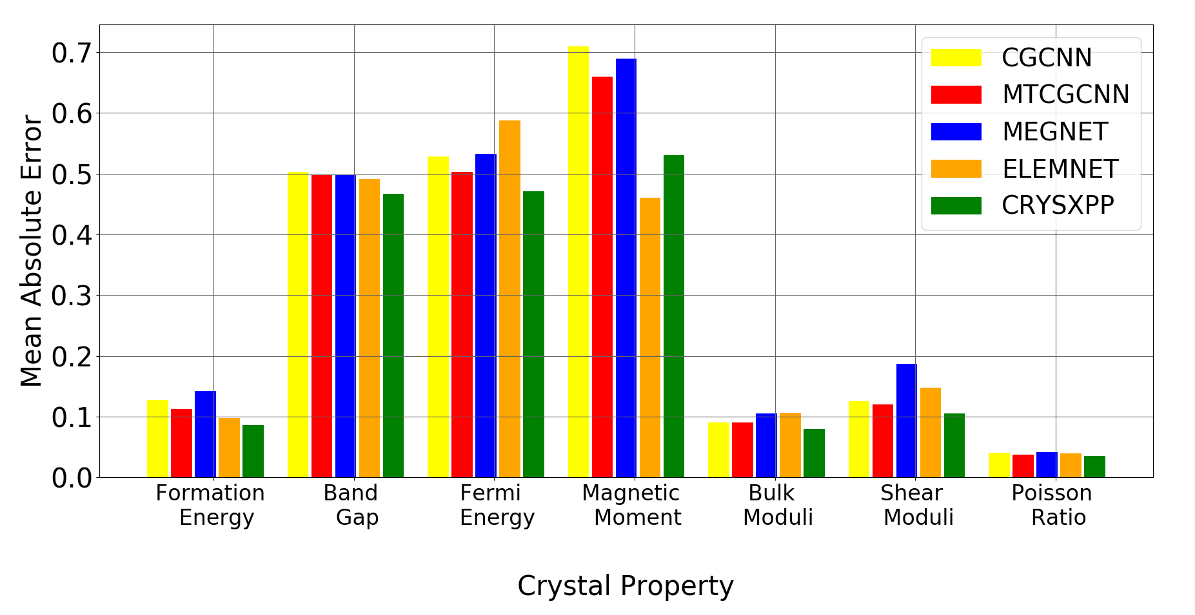
Effectiveness of Property Predictor
Materials Project database
(38000 crystalline materials)
Fig : Summary of the prediction performance (MAE) of different properties trained on 20% data and evaluated on 80% data.
Notes:
IN MANY CASES IT IS AROUND FIVE HUNDRED DATA POINTS, BULK MODULI, SHEAR MODULI, POISSON RATIO

Slide 13
Removal of DFT error bias
Setup :
We consider a property predictor which has been trained with crystals whose particular property (say Band Gap) values have been theoretically derived using DFT.
We then fine tune the parameters with limited amount of experimental data.
Band Gap : we collect 20 experimental instances from the domain experts, out of which we randomly pick 10 instances to fine-tune the parameters and report the prediction value for the rest

Slide 14
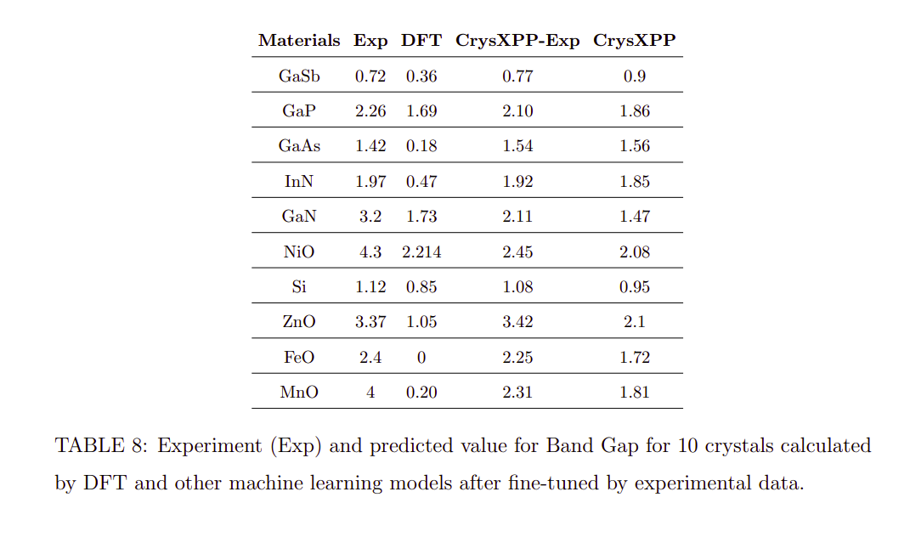

Slide 15
Explanation through feature selection
To demonstrate the effectiveness of the feature selector, we present a case study

Slide 16
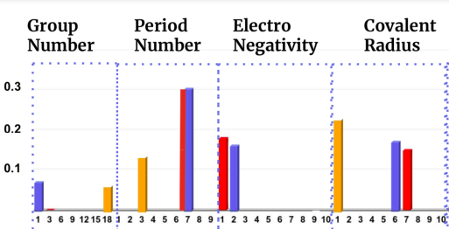

Explanation for Formation Energy
BaEr₂F₈ has Formation Energy -4.41, indicating stability of the materials
Period and Group Numbers provide the information to distinguish each atom.
Non-zero difference in Electronegativity of atoms indicates stability in structure.
Covalent Radius determines the extent of overlap of electron densities of constituents. Higher the radius means weaker the bond. Interesting to note here the trend of weights is the reverse than that of radius itself.

Slide 17
Summary
In this work, we propose an explainable property predictor for crystalline materials, CrysXPP to predict different crystal state and elastic properties with accurate precision using small amount of property-tagged data.
We address the issue of limited crystal data of a particular property, using transfer learning from an encoding module CrysAE; which we train in a property agnostic way with a large amount of untagged crystal data to capture all the important structural and chemical information useful to a specific property predictor.
We further find the encoder knowledge is extremely useful in de-biasing DFT error using a meagre instances of experimental results.
With appropriate case studies, we show that the explanations provided by the feature selection module are in sync with the domain knowledge.

Slide 18

Email: niloy@cse.iitkgp.ac.in
Complex Network Research Group (CEnRG) : @cnerg

