Slide 1
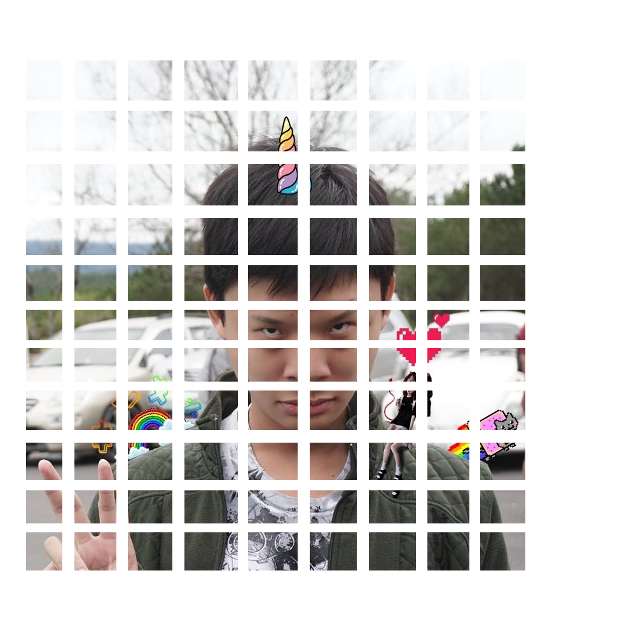
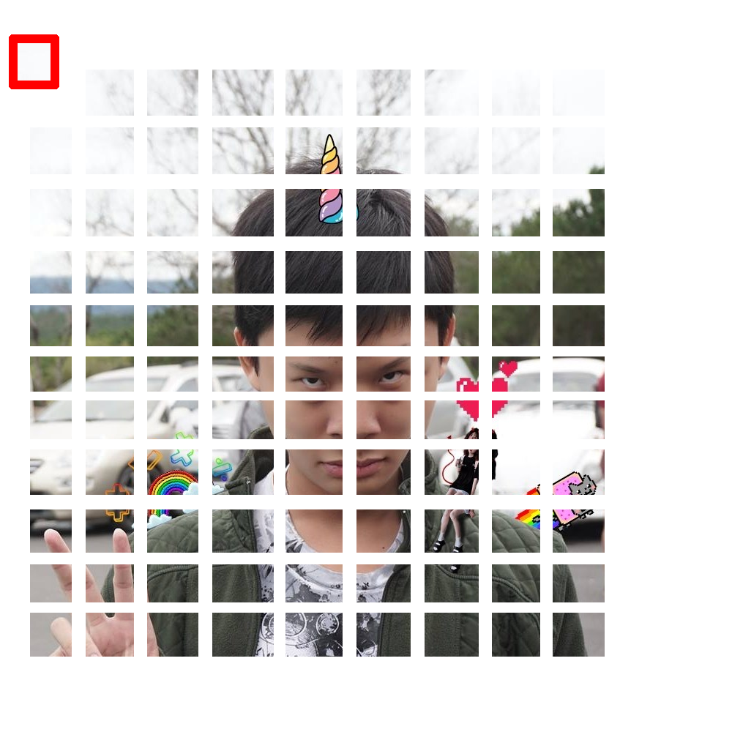



Slide 2
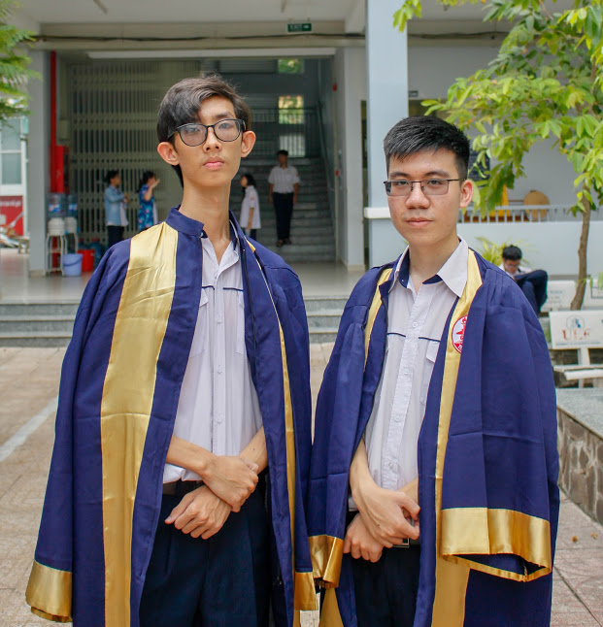

Slide 3
1
2
3
4
5
6
7
8
9
10
11
12
13
14
15
16
17
18
19
20
21
22
23
24
25
26
27
28
29
30
31
32
33
34
35
36
37
38
39
40
41
42
43
44
45
46
47
48
49
50
51
52
53
54
55
56
57
58
59
60
61
62
63
64
65
66
67
68
69
70
71
72
73
74
75
76
77
78
79
80

Slide 4

1
2
3
4
5
6
7
8
$$\vec{piece_{1}}=$$
9
10
11
12
13
14
15
16
$(x_{1};x_{2};x_{3};x_{4};x_{5};x_{6};x_{7};x_{8};x_{9};x_{10};x_{11};x_{12};x_{13};x_{14};x_{15};x_{16};x_{17};x_{18};x_{19};x_{20};x_{21};x_{22};x_{23};x_{24};x_{25}$;…)
17
18
19
20
21
22
23
24
25
26
27
28
29
30
31
32
33
34
35
36
37
38
39
40
41
42
43
44
45
46
47
48
49
50
51
52
53
54
55
56
57
58
59
60
61
62
63
64
65
66
67
68
69
70
71
72
73
74
75
76
77
78
79
80

Slide 5
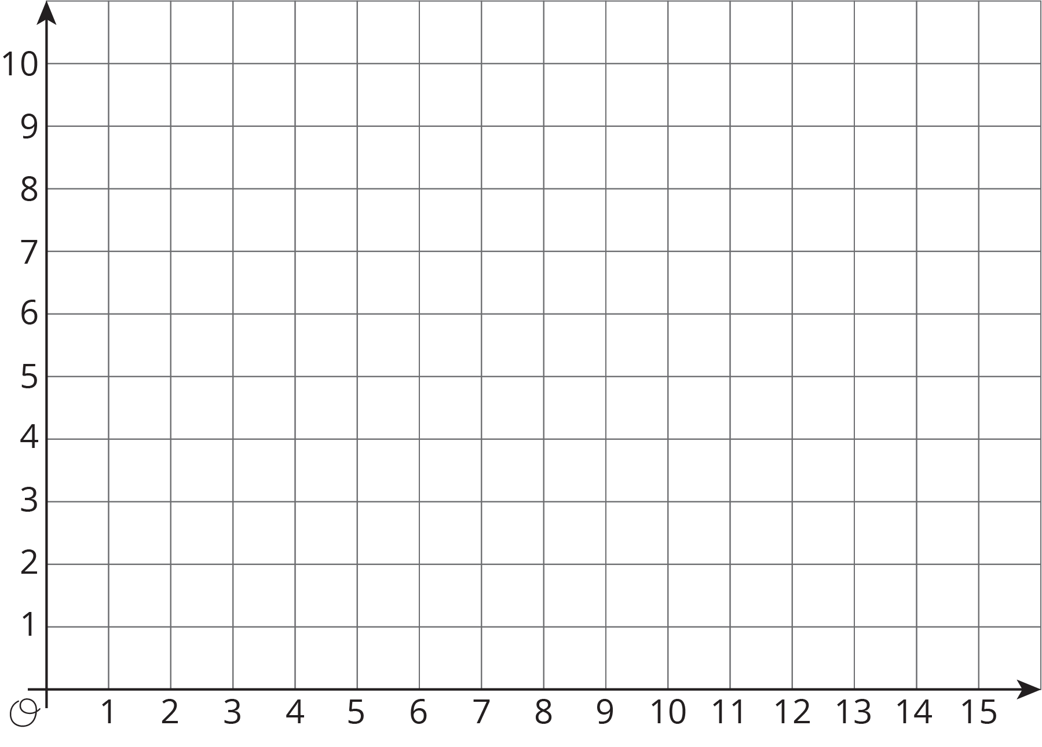

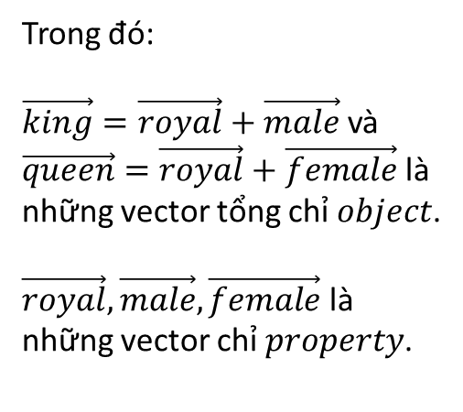


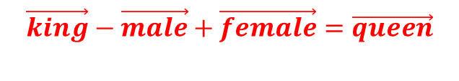






$$\vec{male}=\left(0;5\right)$$
$$\vec{king}=\left(5;10\right)$$
Trong đó:
$\vec{king}=\vec{royal}+\vec{male}$ và
$\vec{queen}=\vec{royal}+\vec{female}$ là những vector tổng chỉ $object$.
$\vec{royal},\vec{male},\vec{female}$ là những vector chỉ $property$.
$$?$$
$$\vec{king}−\vec{male}+\vec{female}=\vec{queen}$$
$$\vec{male}=\left(0;5\right)$$
$$−\vec{male}=\left(−5;−5\right)$$
$$\vec{female}=\left(5;0\right)$$
$$\vec{royal}=\left(5;5\right)$$
$$\vec{queen}=\left(10;5\right)$$
$$\vec{female}=\left(5;0\right)$$

