Slide 1
M3_Demo_Cluster_Profiles_Normalized
File created on: 11/16/25 7:26:11 PM EST

Slide 2
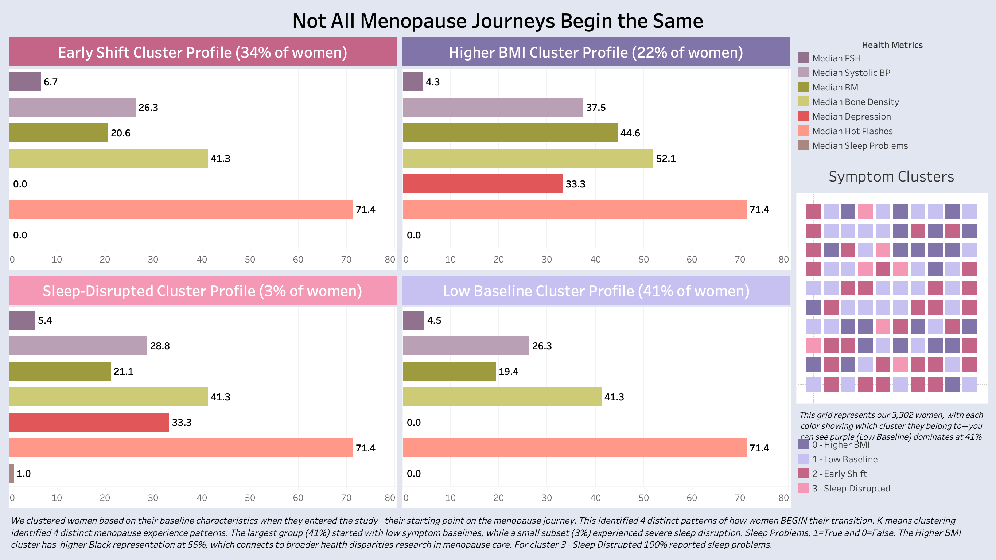

Slide 3
