Slide 1

Satellite Broadband
Connecting the World
Bringing the internet to remote and rural regions
Overcoming terrestrial infrastructure
Can serve as a lifeline for communities in times of crisis
By: Kyle Dooley, Carlos Reyes,
Jahsend Jones

Slide 2


What is Satellite Broadband Technology?
Satellite broadband is a technology that provides high-speed internet access to user using satellites that have been sent in orbit around the earth
Satellite internet can be offered to virtually anywhere in the world
Notes:
Source for picture: https://www.rcrwireless.com/20211210/opinion/readerforum/is-fiber-internet-or-satellite-internet-the-future-reader-forum

Slide 3
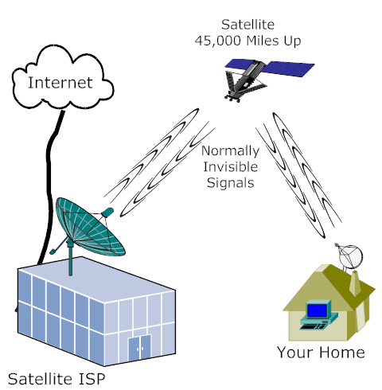
How Does Satellite Internet Work?
Transmitting the signal to a usable connection
Keeping and upstream connection to the satellite in orbit
Once it receives a request from a user it sends the information to a ground station
The ground station is the powerhouse behind the usability of satellite internet
Data is transmitted back to the satellite
The data that was requested by the user is sent back to their reciever

Slide 4
Advantages of Satellite Broadband
Global coverage: Access to internet connectivity in remote and rural areas.
Broadband Speeds: High-speed internet access regardless of physical infrastructure limitations.
Quick deployment: Rapid implementation without extensive infrastructure requirements.
Scalability: Ability to handle increased demand and expand coverage as needed.
Notes:
Information Sources: 11 Advantages and Disadvantages of Satellite Internet (honestproscons.com)
Pros and Cons of Satellite Internet Service | SatelliteInternet.com

Slide 5
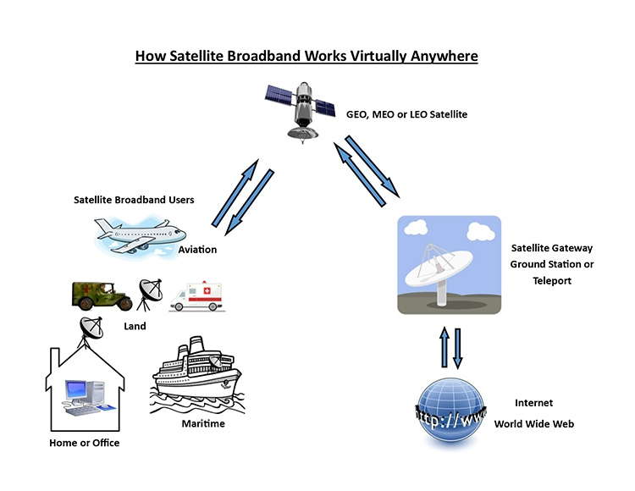
Application of Satellite Broadband
Telecommunications: Enabling voice and data communication in remote regions.
Education: Facilitating e-learning and remote education programs.
Healthcare: Supporting telemedicine and remote healthcare services.
Disaster Response: Providing connectivity during natural disasters and emergencies.
Notes:
Source for picture and info: Broadband Connectivity – Satellite Industry Association (sia.org)
Additional info sources: Satellite communication - Telecommunications, Broadcasting, and Data Communications | Britannica
Broadband Access as a Public Health Issue: - PMC (nih.gov)
Two Ways Broadband Internet Is Improving Health Care and Education - Cisco Blogs

Slide 6
Challenges and limitations
Latency: delay in signal transmission and slower speeds than cable due to long distance.
Cost: Initial setup costs and service fees might be higher than other broadband options.
Weather conditions: Adverse weather can affect signal quality.
Notes:
Information Source: Pros and Cons of Satellite Internet | Local Cable Deals

Slide 7
On Going Advancements
.
.
.
Satellite providers integrate with existing networks to enable hybrid connectivity, combining satellite and terrestrial connections for reliable high-speed internet access in all areas
Electronically steered phased array antennas improve satellite tracking and communication. Dynamic beam adjustment enhances connectivity and optimizes satellite capacity utilization.
New satellite broadband tech optimizes frequency band utilization, increasing data transmission capacity and enhancing overall throughput and user experience

Slide 8
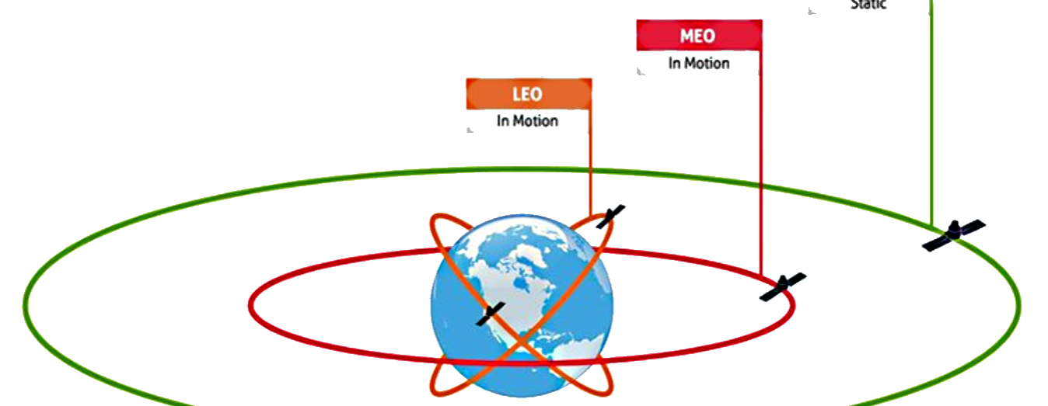
FUTURE TRENDS
Lower Earth Orbit Satellite Constellations: LEO satellite constellations consist of numerous smaller satellites orbiting closer to the Earth. Making about 16 orbits day about 1 every 120 minutes
LEO satellites offer reduced latency and increased capacity, enabling faster internet speeds and improved performance for users.
Companies like SpaceX, OneWeb, and Amazon's Project Kuiper are deploying such constellations to provide global broadband coverage.
Notes:
Low Earth Orbit (LEO) Satellites: LEO satellites orbit the Earth at altitudes ranging from about 160 to 2,000 kilometers (100 to 1,200 miles). They are commonly used for Earth observation, remote sensing, and communication purposes. Examples include the satellites of the International Space Station (ISS) and many satellite constellations like SpaceX's Starlink.
Medium Earth Orbit (MEO) Satellites: MEO satellites operate at higher altitudes than LEO satellites, typically between 2,000 and 35,786 kilometers (1,200 to 22,236 miles). They are often used for global navigation and positioning systems, such as the Global Positioning System (GPS) and the European Galileo system.
Geostationary Earth Orbit (GEO) Satellites: GEO satellites orbit the Earth at an altitude of approximately 35,786 kilometers (22,236 miles) directly above the equator. They have an orbital period matching the Earth's rotation, which allows them to remain fixed relative to a specific location on the ground. GEO satellites are commonly used for telecommunications, television broadcasting, and weather monitoring

