Slide 1
Final Cooling Technique with Thick Wedges
Daniel Fu, University of Chicago
Diktys Stratakis and David Neuffer, Fermilab
11/30/2023

Slide 2
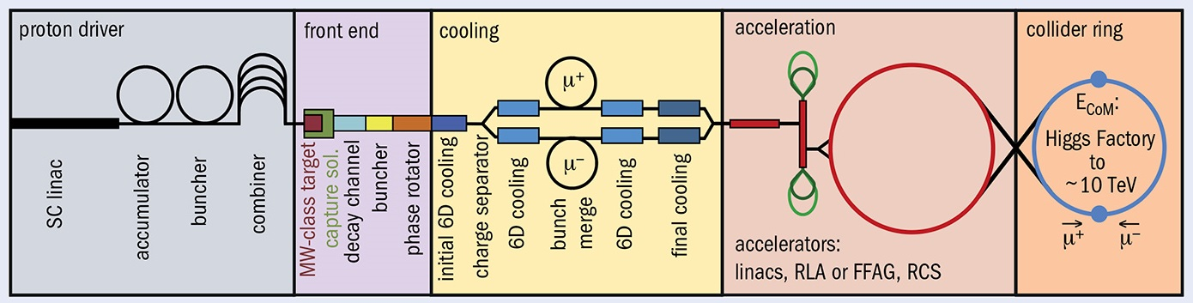
Introduction
Final cooling is a major problem for development of a muon collider
Conceptual method for final cooling proposed by Neuffer in 1612.08960
We demonstrated feasibility and optimized design using simulation

Slide 3
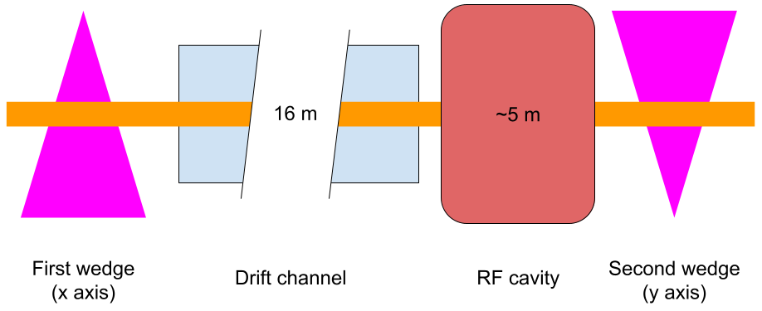
Proposed Final Cooling Concept
Beam passed through a thick wedge, which cools beam in one transverse axis through emittance exchange
Drift channel to build up correlation between time and momentum
RF cavity reduces momentum spread through phase rotation
Beam passed through second wedge to cool in second transverse axis

Slide 4
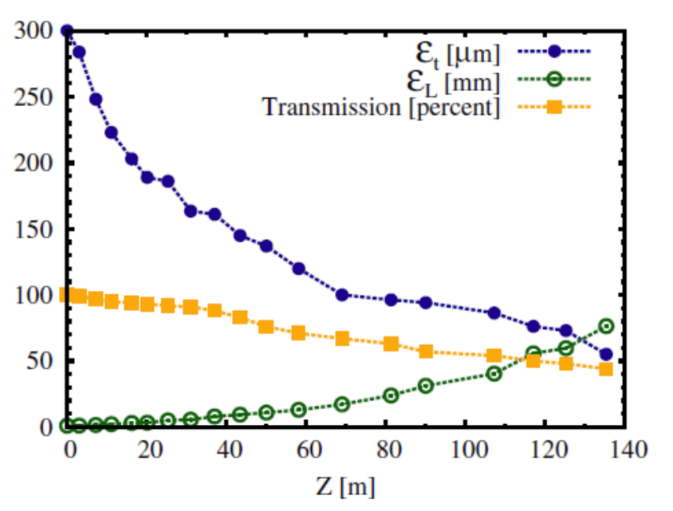
Simulation Methods
Input distributions based on intermediate stages of high-field solenoid cooling channel
Considered two initial transverse emittances
G4Beamline used to simulate wedge and phase rotation process
Source: 1612.08960

Slide 5
Parameters Considered
Wedge geometry
Half-angle
Length
Initial beam parameters
Momentum
Momentum spread
Emittances
Twiss parameters (beta, alpha)
RF cavity parameters
Drift channel length
Frequency
Gradient
Phase

Slide 6
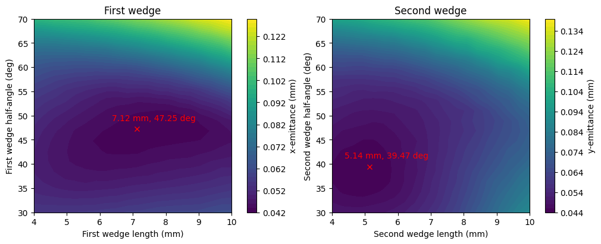
Optimal geometries for wedges
Determined optimal length and half-angle of first and second wedges to minimize output transverse emittance
Notes:
These graphs were generated for the 145 um case

Slide 7
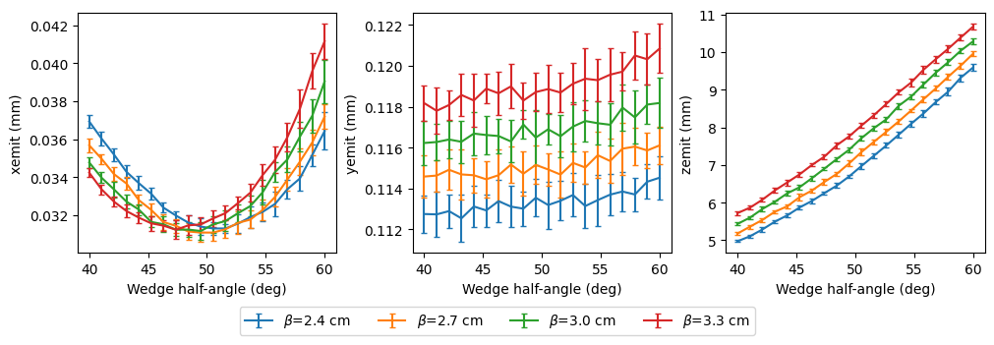
Effects of β
Decreasing β (stronger focusing) reduces emittance growth in longitudinal and non-cooling transverse axes
Does not significantly affect emittance in cooling axis

Slide 8
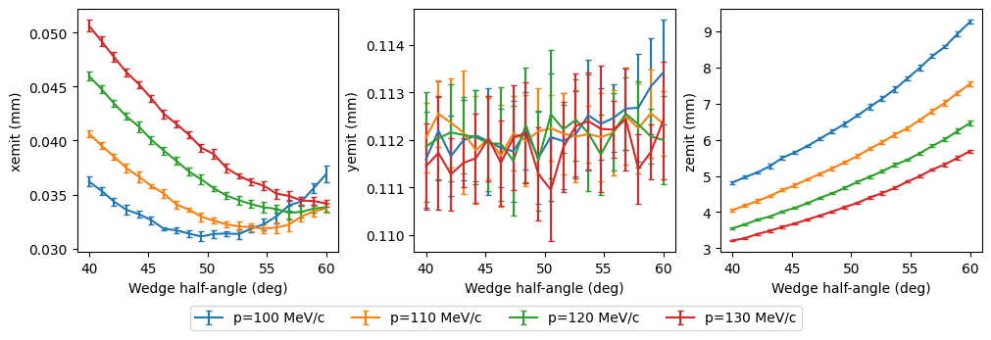
Effect of Momentum
Reducing momentum improves cooling
Does not affect emittance in non-cooling axis

Slide 9
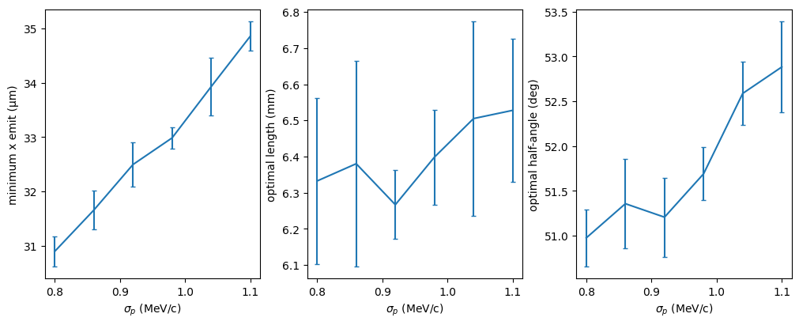
Effect of Momentum Spread
Decreasing momentum spread increases cooling
Optimal wedge angle correlated with initial momentum spread
Optimal wedge length unaffected

Slide 10
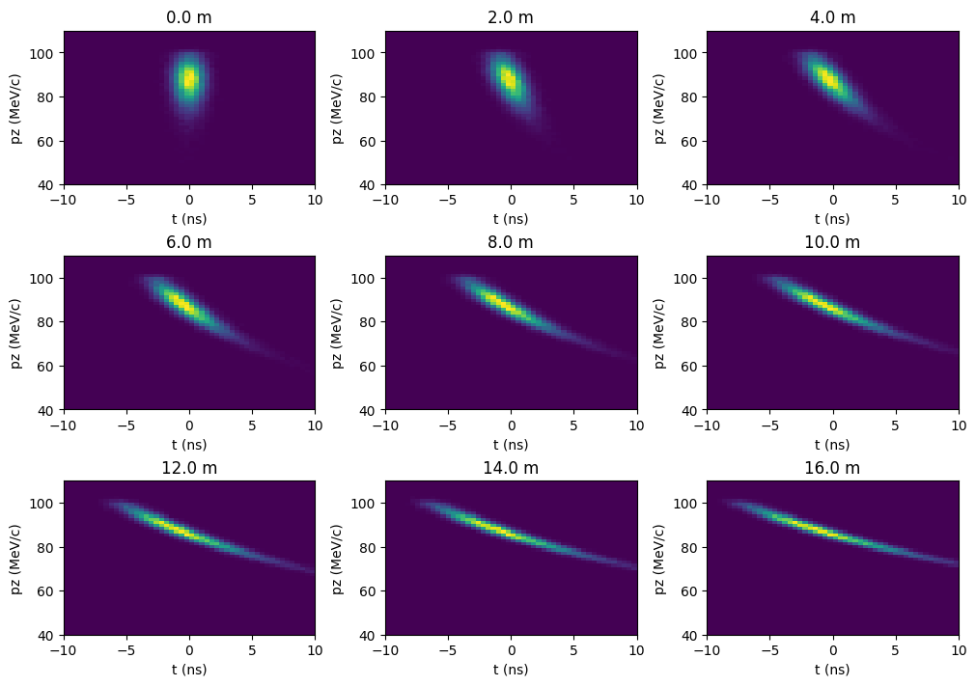
Effect of Drift Length
Higher drift length makes phase rotation more effective
16m chosen as longest practical length

Slide 11
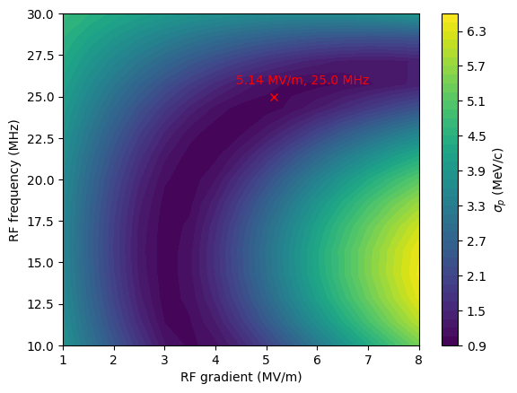
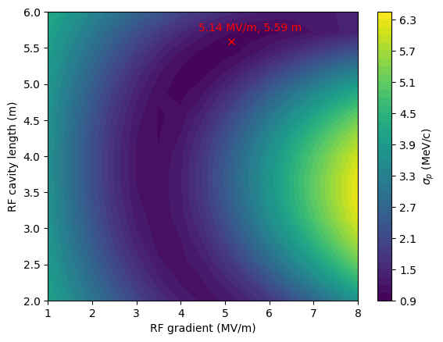
Effect of RF cavity parameters
Optimal frequency is lower, 25 MHz chosen as lowest practical frequency
Optimal gradient and cavity length determined

Slide 12
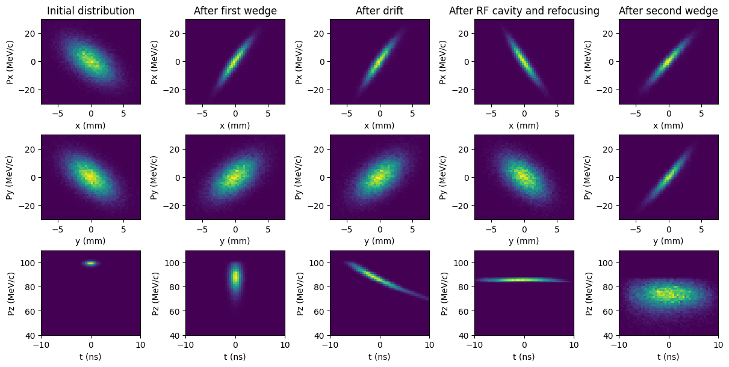
Phase-space diagram of cooling process

Slide 13
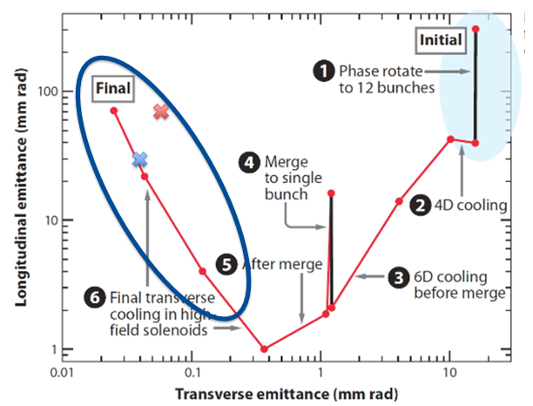
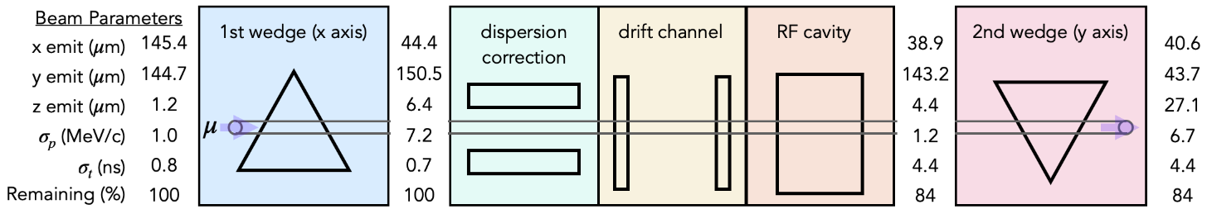
Results
Achieved lower transverse emittance than previous best results
Demonstrated cooling from first and second wedges

Slide 14
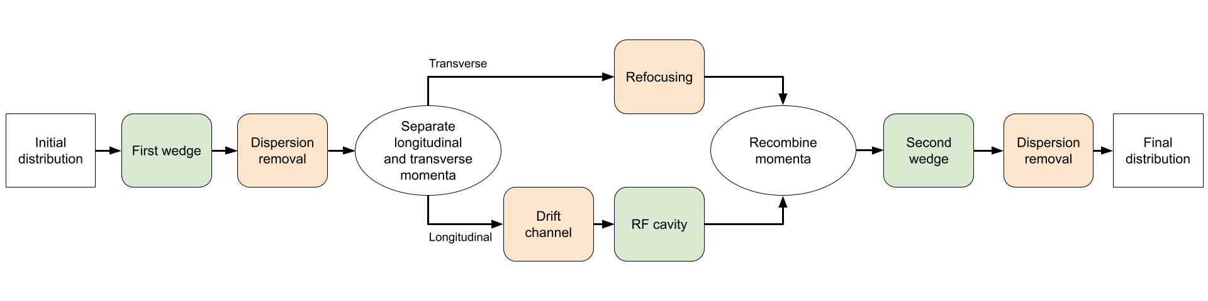
Assumptions and Caveats
Dispersion removal, drift channel, and focusing lattice not designed, idealized versions assumed (previous results are best-case)
Only longitudinal behavior was considered in the RF cavity
Possibility of refocusing before second wedge (potential for further performance improvement)

Slide 15
Next Steps
Reduce assumptions described on previous slide, specifically by designing and simulating the magnetic components
Further optimize design to achieve equal cooling from second wedge
Characterize effect of changing multiple variables (potentially with high-performance computing)

Slide 16
(additional slides follow)

Slide 17
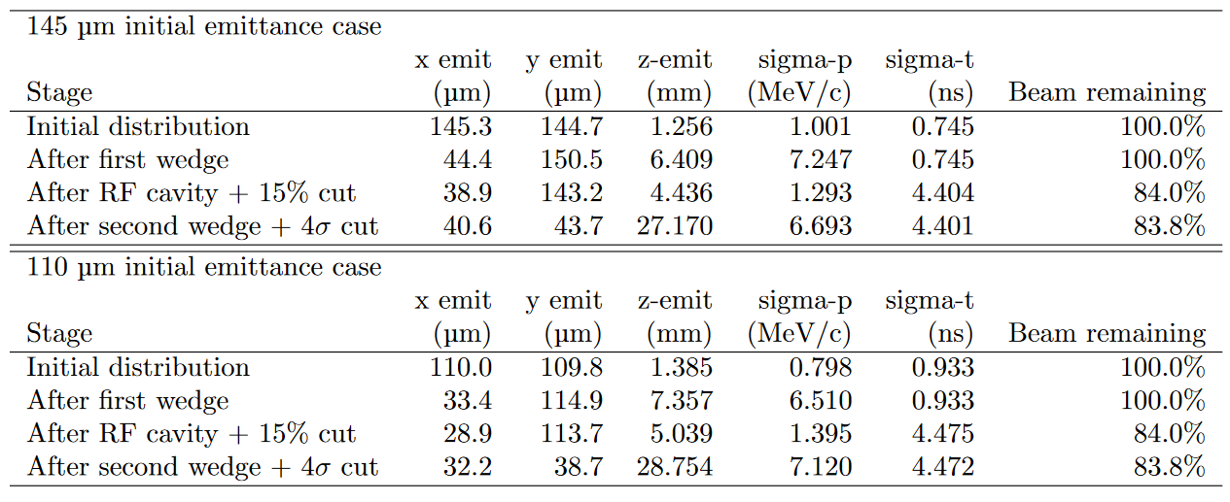
Optimized Channel Statistics

Slide 18
Summary of Variables Considered
Variable | Status
Wedge geometry (half-angle and length) | Optimal values determined
Initial beta | As low as possible; 3.0 used
Initial alpha | Optimal value estimated at 0.7
Initial momentum | As low as possible; 100 MeV/c used
Initial momentum spread | As low as possible; 0.8-1.0 MeV/c used
Drift length | As long as practical; 16m used
RF frequency | 25 MHz used, optimal value is lower
RF gradient and length | Optimal values determined

Slide 19
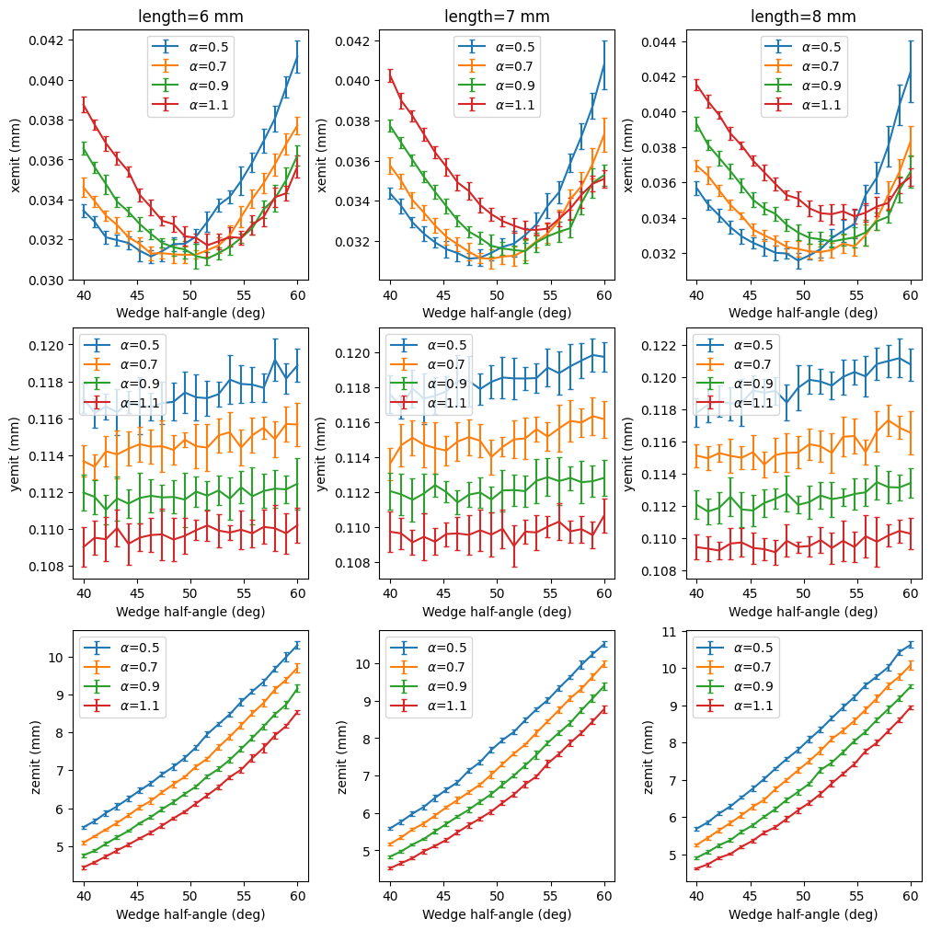
Effects of α
Increasing α decreases growth of emittance in longitudinal and second transverse axes (similar to decreasing beta)
Past around 0.5, increasing α decreases wedge performance (minimum transverse emittance increases)

