Slide 1
Accuracy effects of particle count and max step sizes
Daniel Fu, 2/18/2024

Slide 2
Setup
Parameters considered
Particle count, N
Max step in vacuum (not in wedge)
Max step in wedge
Technical note: G4Beamline has a global parameter “maxStep” and the wedge has its own “maxStep” value that overrides the global value
Graphs were generated by running each simulation 30 times with a 4-sigma cut and graphing the mean and standard deviation. The optimized 145μm parameters (145_new.pkl) were used for these tests.
As each parameter was varied, the others were left at default values of N=20000, max step in vacuum=0.5mm, max step in wedge=0.1
Code is in accuracy.py

Slide 3
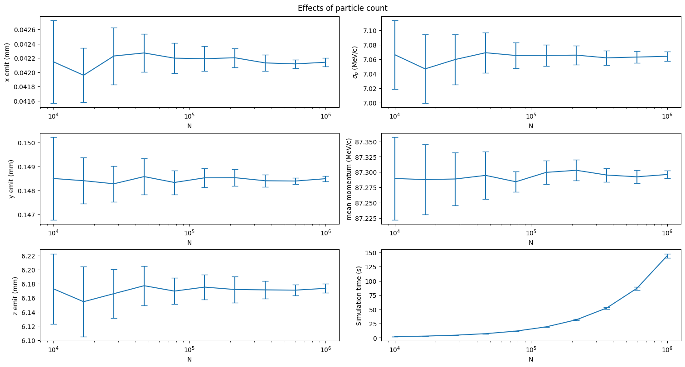
Number of particles

Slide 4
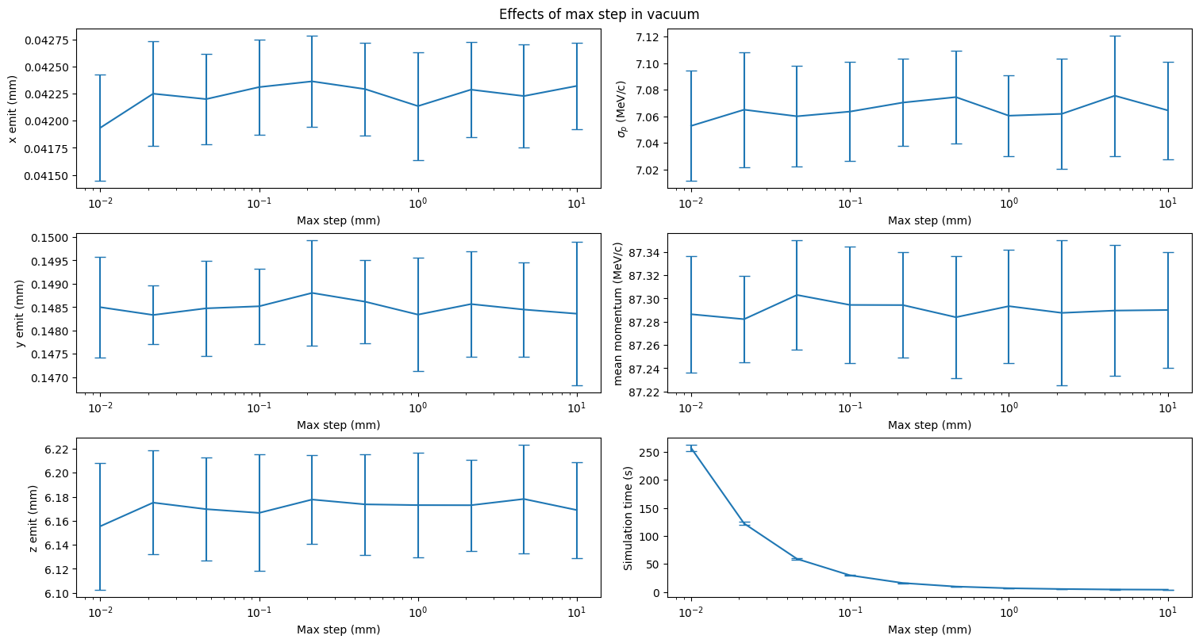
Max step in vacuum

Slide 5
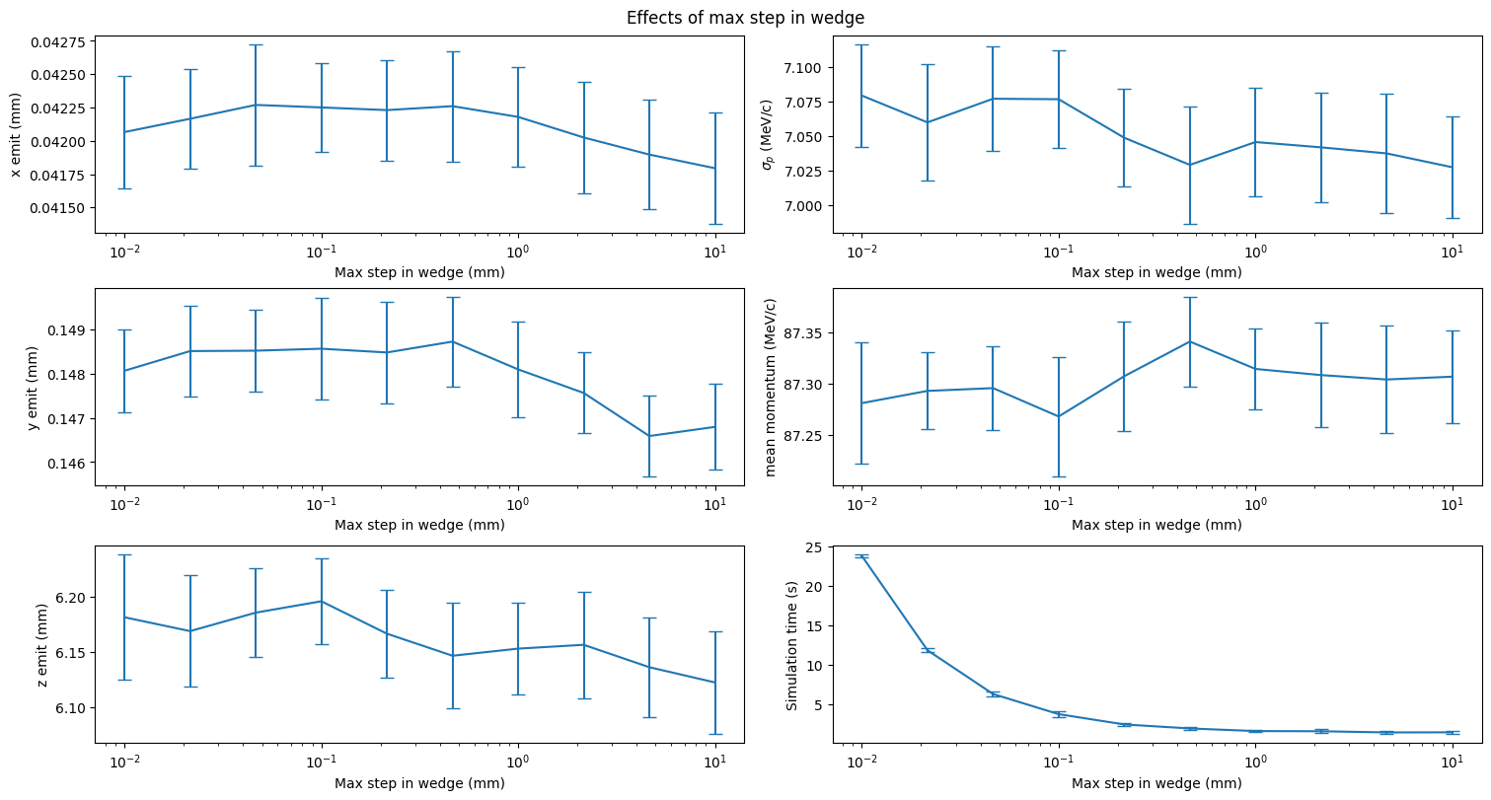
Max step in wedge

Slide 6
Conclusions
Simulation is stable in number of particles
Higher particle counts reduce error
Simulation time is linear in particle count (as expected)
Simulation is stable with max step in vacuum up to 10mm
Several graphs show sharp downward trends when max step in wedge increases beyond a certain point
Occurs around 0.5 mm in xemit and yemit and around 0.1 mm in zemit
Momentum mean and std show general trends that may be more concerning (but are within error ranges)
Previous simulations have been run at max step in vacuum = 0.5mm and max step in wedge = 0.1mm
To improve speed, the max step in vacuum can probably be increased to 1-2mm without accuracy loss
Max step in wedge should probably be left at 0.1mm

Slide 7
Particle count effects on optimization setup
For each value of N, I generated a distribution with that many particles and optimized for x-emit on that distribution. I then repeated this 30 times for each value.
Notably, there's another way you could do this where you generate a new distribution at each optimization step. I'm unsure how that would affect the results

Slide 8
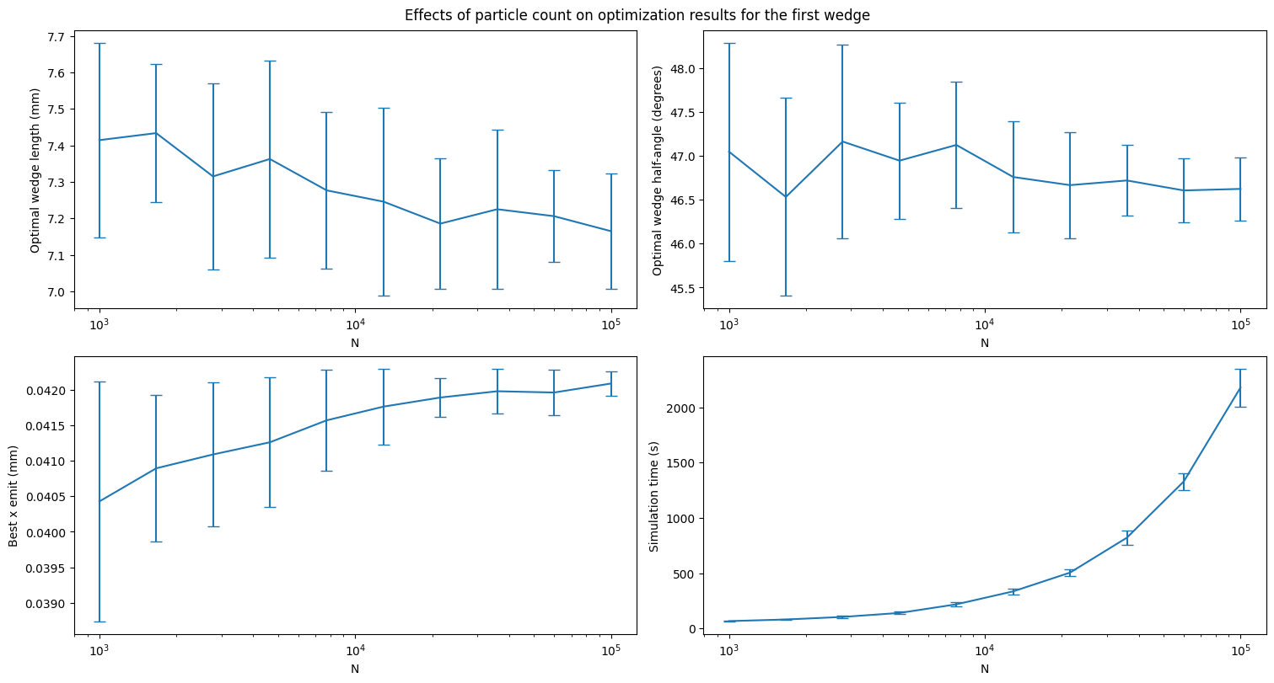
Particle count effects on optimization

Slide 9
Observations
Optimal length descends steadily with no substantial change in standard deviation, which is... concerning
Optimal half-angle remains stable with decreasing error (as we desire)
Best x-emit achieved: it seems the upper end of the initial range is the value it settles on as N increases
Simulation time is proportional to particle count as expected (I confirmed that the number of iterations to convergence is fairly constant)

