Slide 1

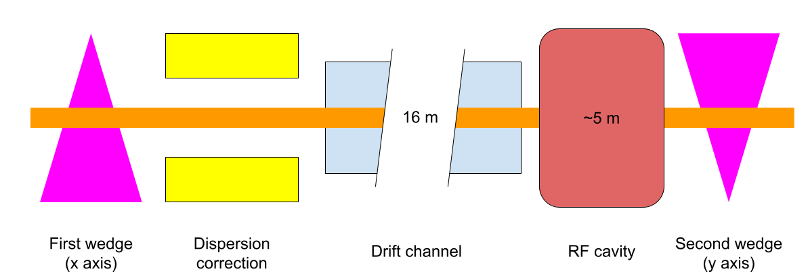
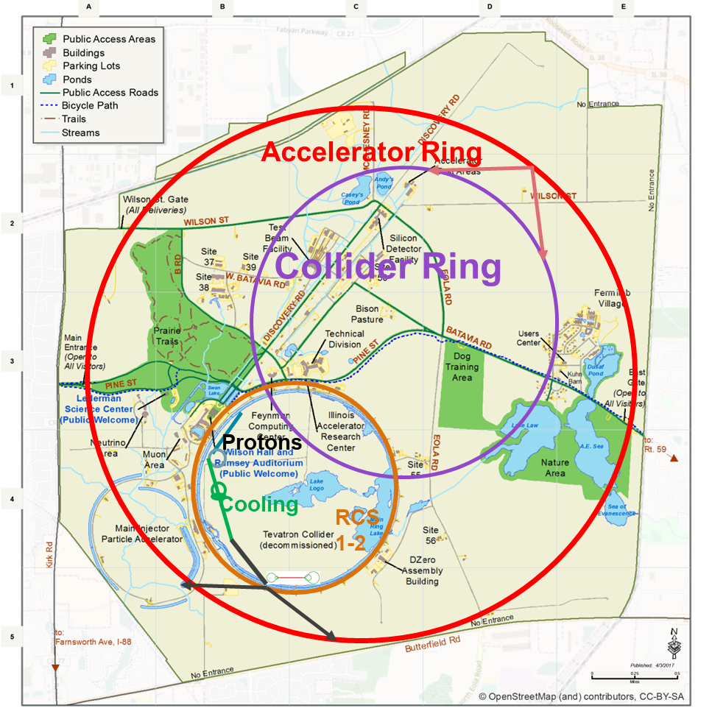
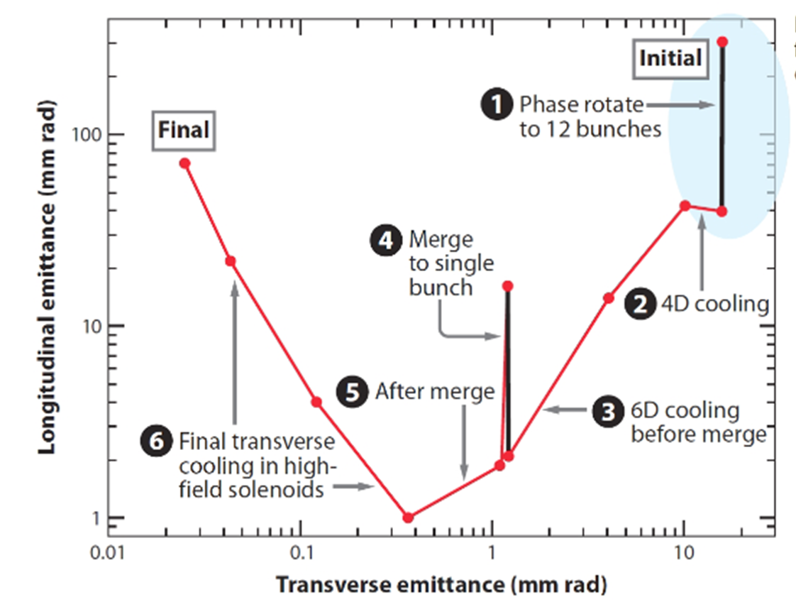
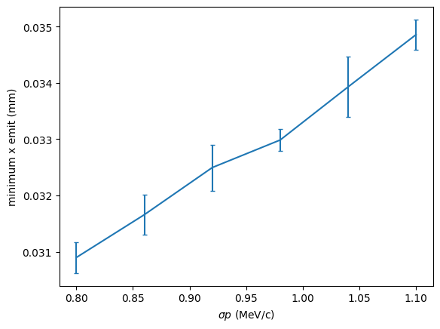
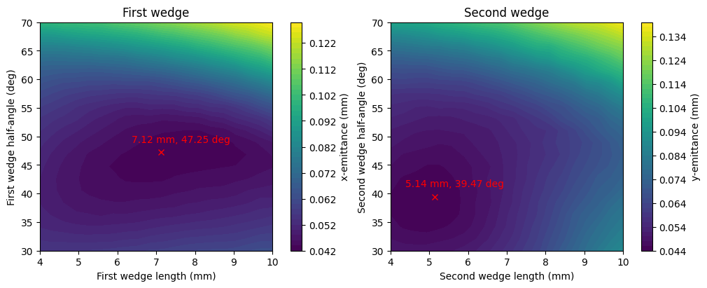
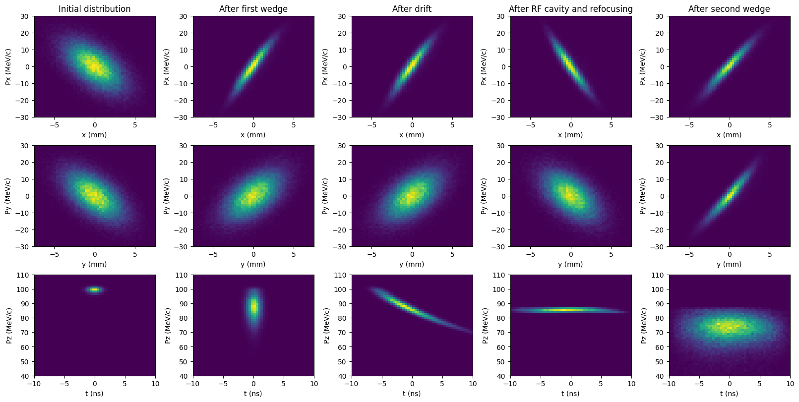
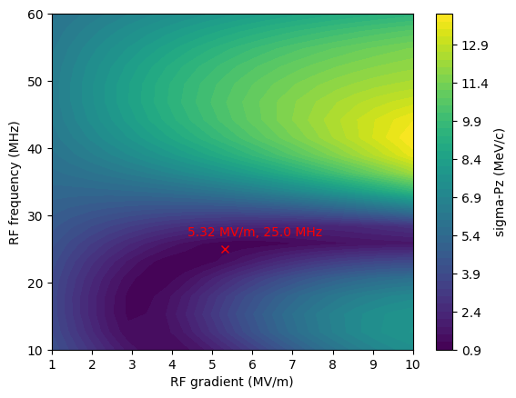
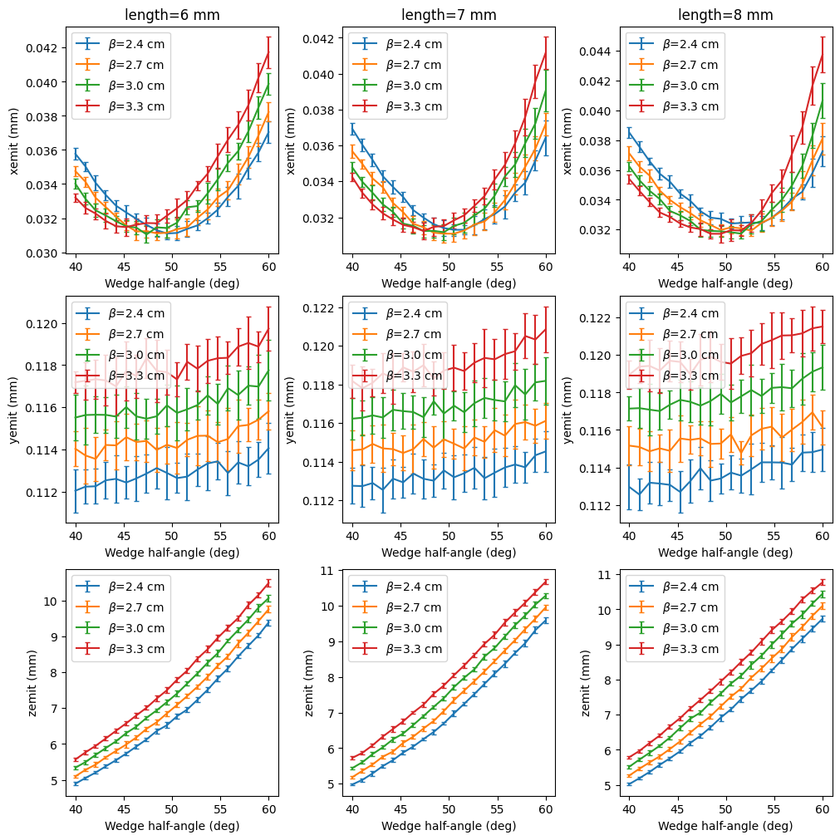
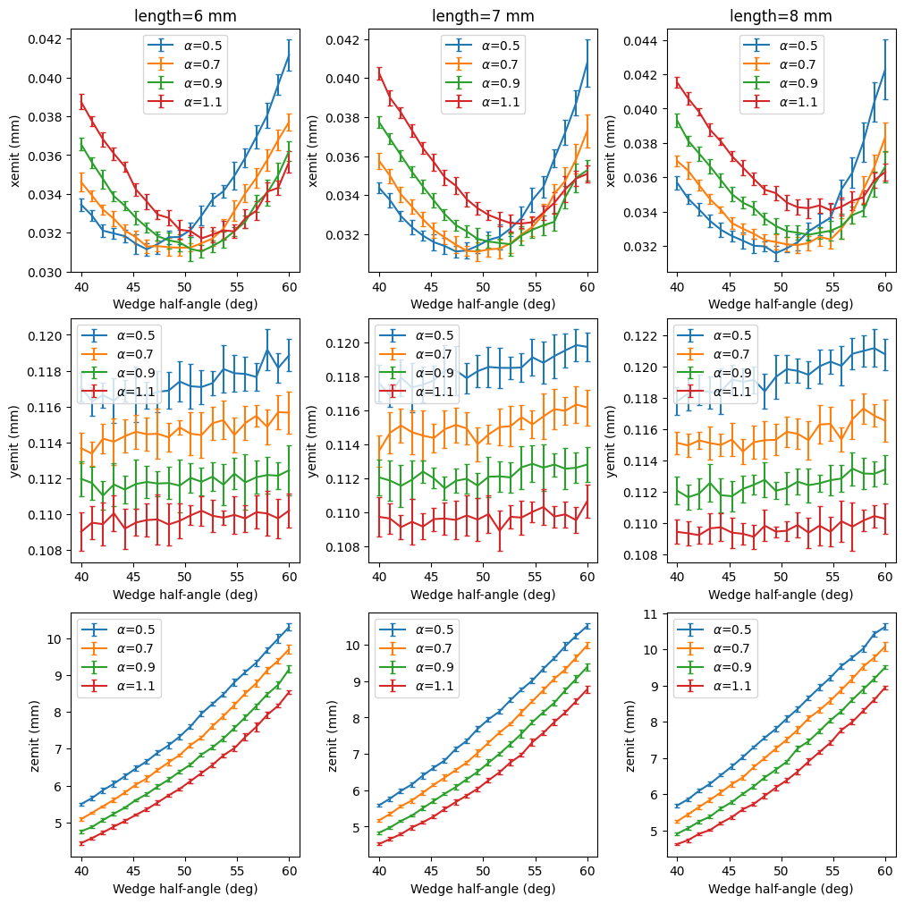
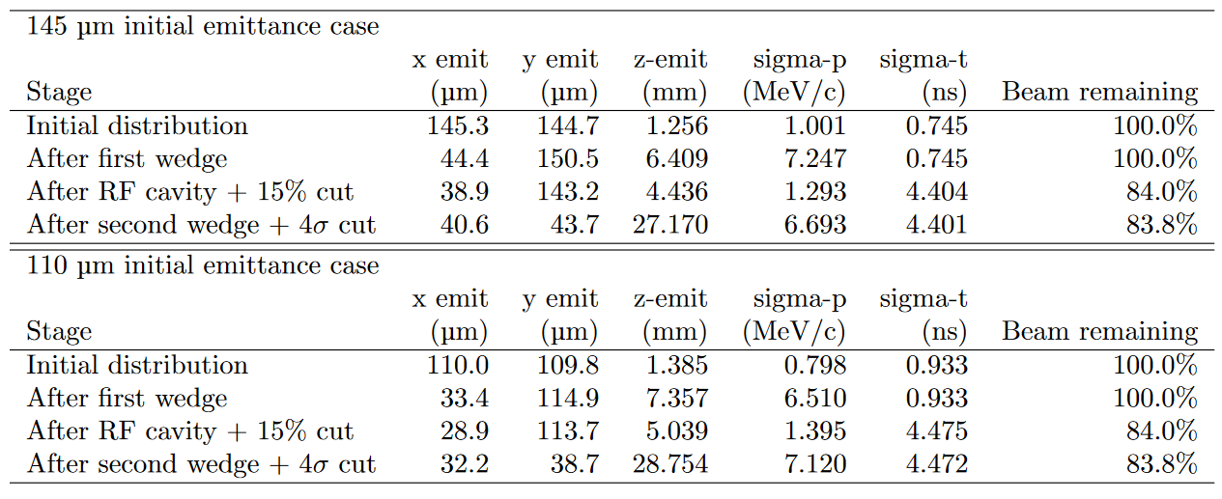
FERMILAB-POSTER-23-218-AD-STUDENT
Final Cooling with Thick Wedges for a Muon Collider
Daniel Fu, University of Chicago – SULI program
Diktys Stratakis, Fermi National Accelerator Laboratory
David Neuffer, Fermi National Accelerator Laboratory
Introduction
A muon collider is a particle accelerator that collides muons rather than protons or electrons. The muons for such an accelerator would be generated by the decay of pions produced in the collision of a proton beam with a target. These muons are produced with high transverse and longitudinal emittance, which must be reduced before they enter the accelerator. The final step of this process is 4D cooling, reducing the transverse emittance of the beam while allowing the longitudinal emittance to grow. We modeled one such method of achieving 4D cooling, consisting of two thick wedges separated by a drift channel and RF cavity for phase rotation.
Above: Diagram of 4D cooling pathway. Diamond was used as the wedge material for this study.
Methods
We used G4Beamline to model the two wedges and RF cavity. We used Python to generate particle distributions with specified beam parameters and to compute these parameters from G4Beamline output. Designing the dispersion correction system, drift channel, and focusing lattice was beyond the scope of this project, so idealized versions of these components were modeled using mathematical manipulations. We used the Nelder–Mead method to optimize the length and half-angle of the wedges for minimum transverse emittance, and the gradient, phase, and length of the RF cavity for minimum momentum spread.
Above: Schematic of a muon collider on the Fermilab site
Below: Minimum x-emittance v.s. initial sigma-p for 110 μm initial emittance, showing lower output emittance at lower momentum spreads
Above: Graph of steps in the muon cooling process. The final 4D cooling analyzed here is circled in blue. The endpoints of our cooling channel (blue) and the previous best published (Sayed et al., PRAB, 2015) cooling channel (red) are marked.
Results
Wedge performance is primarily limited by the transverse emittance and momentum standard deviation (sigma-p) of the input beam. We produced two optimized cooling channels, one starting from 145 μm transverse emittance and 1.0 MeV/c sigma-p and one starting from 110 μm and 0.8 MeV/c. These starting points correspond to two possible endpoints of a previous cooling stage. We studied the system’s performance for different input beam parameters, momentum spreads, and wedge geometries.
Above: Emittance landscapes in wedge length (measured at beam centerline) and half-angle for the first and second wedges in the 145 μm case, displaying different optimal points between the two wedges
Right: sigma-p after RF cavity v.s. RF frequency and length, with values used in optimal channel marked
Below: Emittance after first wedge v.s. half-angle for various lengths and initial beta values, showing that decreasing beta decreases emittance growth in y-axis
Below: Emittance after first wedge v.s. half-angle for various lengths and initial alpha values, showing optimal value of alpha around 0.7, and that increasing alpha also decreases emittance growth in y-axis
Above: Evolution of phase-space distributions as a beam passes through the optimal cooling channel for the 110 μm, 0.8 MeV/c start point
Below: Beam properties at various stages of the optimal cooling channel for both start points considered
Conclusion
We have developed a conceptual design of a final cooling scheme for a muon collider and achieved emittances that are below existing published designs.
This manuscript has been authored by Fermi Research Alliance, LLC under Contract No. DE-AC02-07CH11359 with the U.S. Department of Energy, Office of Science, Office of High Energy Physics.
This work was supported in part by the U.S. Department of Energy, Office of Science, Office of Workforce Development for Teachers and Scientists (WDTS) under the Science Undergraduate Laboratory Internships Program (SULI).

