Slide 1
Hydrologic Routing
Reading: Applied Hydrology Sections 8.1, 8.2, 8.4

Slide 2
Flow Routing
Q
Procedure to determine the flow hydrograph at a point on a watershed from a known hydrograph upstream
As the hydrograph travels, it
attenuates
gets delayed
t
Q
t
Q
t
Q
t

Slide 3
Why route flows?
Q
t
Account for changes in flow hydrograph as a flood wave passes downstream
This helps in
Accounting for storages
Studying the attenuation of flood peaks

Slide 4
Types of flow routing
Lumped/hydrologic
Flow is calculated as a function of time alone at a particular location
Governed by continuity equation and flow/storage relationship
Distributed/hydraulic
Flow is calculated as a function of space and time throughout the system
Governed by continuity and momentum equations

Slide 5


Hydrologic Routing
Discharge
Discharge
Inflow
Transfer
Function
Outflow
Upstream hydrograph
Downstream hydrograph
Input, output, and storage are related by continuity equation:
Q and S are unknown
Storage can be expressed as a function of I(t) or Q(t) or both
For a linear reservoir, S=kQ

Slide 6
Lumped flow routing
Three types
Level pool method (Modified Puls)
Storage is nonlinear function of Q
Muskingum method
Storage is linear function of I and Q
Series of reservoir models
Storage is linear function of Q and its time derivatives

Slide 7
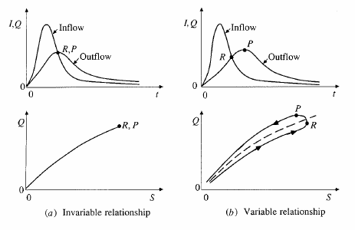
S and Q relationships

Slide 8
Level pool routing
Procedure for calculating outflow hydrograph Q(t) from a reservoir with horizontal water surface, given its inflow hydrograph I(t) and storage-outflow relationship

Slide 9
Level pool methodology
Discharge
Inflow
Outflow
Time
Storage
Unknown
Known
Need a function relating
Time
Storage-outflow function

Slide 10
Level pool methodology
Given
Inflow hydrograph
Q and H relationship
Steps
Develop Q versus Q+ 2S/Δt relationship using Q/H relationship
Compute Q+ 2S/Δt using
Use the relationship developed in step 1 to get Q

Slide 11
Ex. 8.2.1
Given I(t)
Given Q/H
Area of the reservoir = 1 acre, and outlet diameter = 5ft

Slide 12
Ex. 8.2.1 Step 1
Develop Q versus Q+ 2S/Δt relationship using Q/H relationship

Slide 13
Step 2
Compute Q+ 2S/Δt using
At time interval =1 (j=1), I₁ = 0, and therefore Q₁ = 0 as the reservoir is empty
Write the continuity equation for the first time step, which can be used to compute Q₂

Slide 14
Step 3
Use the relationship between 2S/Δt + Q versus Q to compute Q
Use the Table/graph created in Step 1 to compute Q
What is the value of Q if 2S/Δt + Q = 60 ?
So Q₂ is 2.4 cfs
Repeat steps 2 and 3 for j=2, 3, 4… to compute Q₃, Q₄, Q₅…..

Slide 15
Ex. 8.2.1 results

Slide 16
Ex. 8.2.1 results
Outflow hydrograph
Inflow
Peak outflow intersects with the receding limb of the inflow hydrograph
Outflow

Slide 17
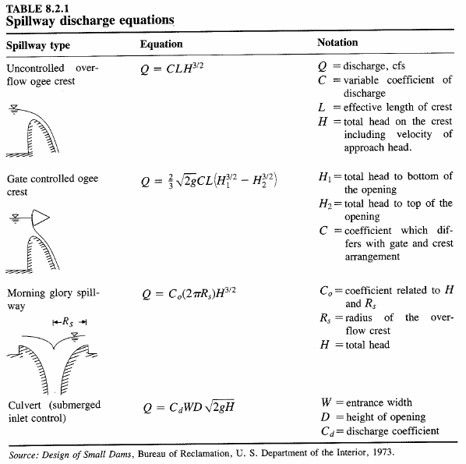
Q/H relationships
http://www.wsi.nrcs.usda.gov/products/W2Q/H&H/Tools_Models/Sites.html
Program for Routing Flow through an NRCS Reservoir

Slide 18
Hydrologic river routing (Muskingum Method)
Wedge storage in reach
Advancing
Flood
Wave
I > Q
K = travel time of peak through the reach
X = weight on inflow versus outflow (0 ≤ X ≤ 0.5)
X = 0 ➔ Reservoir, storage depends on outflow, no wedge
X = 0.0 - 0.3 ➔ Natural stream
Receding
Flood
Wave
Q > I

Slide 19
Muskingum Method (Cont.)
Recall:
Combine:
If I(t), K and X are known, Q(t) can be calculated using above equations

Slide 20
Muskingum - Example
Given:
Inflow hydrograph
K = 2.3 hr, X = 0.15, Δt = 1 hour, Initial Q = 85 cfs
Find:
Outflow hydrograph using Muskingum routing method

Slide 21
Muskingum – Example (Cont.)
C₁ = 0.0631, C₂ = 0.3442, C₃ = 0.5927

