Slide 1
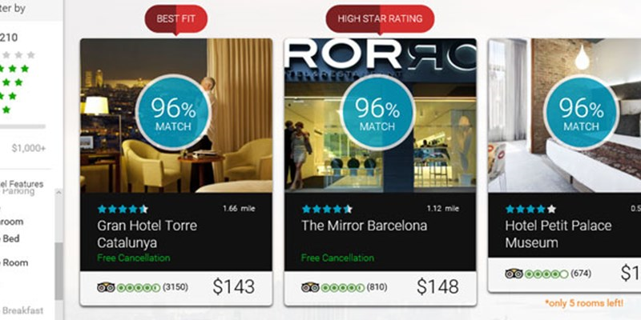

Accommodation Recommendation Engine using Collaborative Filtering
Guided by
Dr. DILIP SINGH SISODIA
Prepared by
Kuldeep pisda 16115036
Prince Jain 16115061

Slide 2
PROBLEM STATEMENT
The task is to identify accurately item/hotel that a customer will select.
The data provided for this challenge consists of a training and test set, and metadata for accommodations (items).
The recommendations should be provided for a test set in which the required output is a list of maximum 25 items for each click-out ordered by preferences for the specific user.
The higher the actually clicked item appears on the list the higher the score.

Slide 3
IMPORTANCE & OBJECTIVE
The Objective is to create a recommendation engine where
Efficiently predicts the most suitable accommodation for customer
Scores high in performance metric
The importance of this Project is
It improves the user experience in hospitality platforms like trivago
It will help increase revenue for companies.

Slide 4
CONTRIBUTION & MOTIVATION
Implement Research Paper as mentioned in further slides
Improve on already built Recurrent Neural Network based solutions
Perform a detailed analysis of Various Models for Recommendation systems

Slide 5
BACKGROUND WORK - REFERENCES
S.no | Paper | Year | Authors
1 | An Attentive RNN Model for Session-based and Context-aware Recommendations | 2019 | Ricardo Gama
2 | Deep Matrix Factorization With Implicit Feedback Embedding for Recommendation System | 2019 | Baolin Yi
3 | Hotel Recommendation System Using SAW (Simple Additive Weighting) and TOPSIS Method | 2019 | Aditya Heramawan
4 | A trust‑based collaborative filtering algorithm for E‑commerce recommendation system | 2018 | Liaoliang Jiang

Slide 6
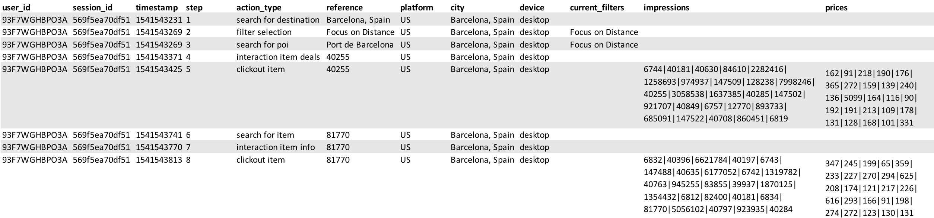
DATASET

Slide 7

IMPLEMENTATION
Data – Training and testing csv files
Preprocessing - Noise Reduction and Augmentation
Model - Collaborative Filtering architectures and other models discussed
Training – Dividing labeled set in two halves(80/20)
Hyper Parameter Optimization-dimensions of embeddings and RNN, learning rate and regularization values) were optimized via cross validation
Post Processing and Evaluation – Using MRR to check the efficiency of the solution

Slide 8
EVALUATION PARAMETER
Mean Reciprocal Rank(MRR)
MRR = (∑ 1/rank_i)/N
Query | Proposed Results | Correct response | Rank | Reciprocal rank
cat | catten, cati, cats | cats | 3 | 1/3
tori | torii, tori, toruses | tori | 2 | 1/2
virus | viruses, virii, viri | viruses | 1 | 1

Slide 9
Example:
query 1:
impressions = [100, 101, 102, 103, 104, 105]
clicked_item_id = 102
submission = [101, 103, 104, 102, 105, 100]
reciprocal rank = 0.25
query 2:
impression = [101, 103, 104, 100, 105]
clicked_item_id = 105
submission = [103, 105, 101, 100, 104]
reciprocal rank = 0.5
mrr = (0.25 + 0.5) / 2 = 0.375

Slide 10
COMPARATIVE STUDY TO BE PEROFORMED
Collaborative filtering – Nearest Neighbourhood Method
Matrix factorization – Singular Value Decomposition(SVD)
Multi-Layer Perceptron Based Recommendation
Recurrent Neural Networks Based Recommendation
Restricted Boltzmann Machines Based Recommendation *
* - If time permits

Slide 11
TOOLS USED
Hardware Requirements
GTX 1650 Gpu with 12 GB Ram
OS Requirements
Windows/Ubuntu
Libraries and Language
Python
Tensorflow
Keras

Slide 12
CURRENT STATUS
Literature Survey is going on various architectures
Basic Implementation is done - a dry run
TIME REQUIRED – 2 MONTHS

