Slide 1
JOBS FOR YOU
A Job Recommendation system

Slide 2
Datasets
Sources : Kaggle
Columns : ID, Title, Job Query, Description
IT : 13000 tuples
Non-IT : 9900 tuples
Job URLs : 102676 tuples
IT-Jobs Datasets
Non IT-Jobs Datasets
Job URLs

Slide 3
Progress

Slide 4
Removing numbers and non-alphabetic characters from the dataset.
The process of splitting a string or text into a list of tokens.
Converting the words to meaningful base form(Lemma)
Removing special characters
Text Lowering
Tokenization
Stop words
removal
Lemmatization
Stemming
Special characters removal
Converting the whole text to the lower case alphabets.
Removing unnecessary or repeated words from the dataset
Reducing a word to it’s stem that affixes to it’s suffix or prefix

Slide 5
Generates top 3 recommendations based on similarity scores.
Vectorize user resume and job descriptions using TF-IDF.
Vectorise
Summarization
Special characters removal
Result
Calculate cosine similarity between user’s resume and job description.

Slide 6
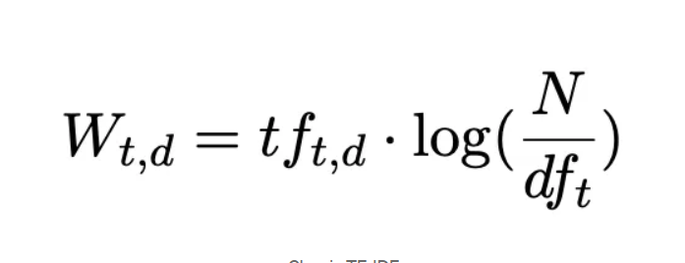

TF-IDF Vectorization
Term frequency–inverse document frequency, is a measure of importance of a word to a document in a collection or corpus, adjusted for the fact that some words appear more frequently in general.
TF-IDF highlights terms that are frequent in a specific document (e.g., a job description) but less common across the entire dataset, helping identify critical skills and qualifications.

Slide 7
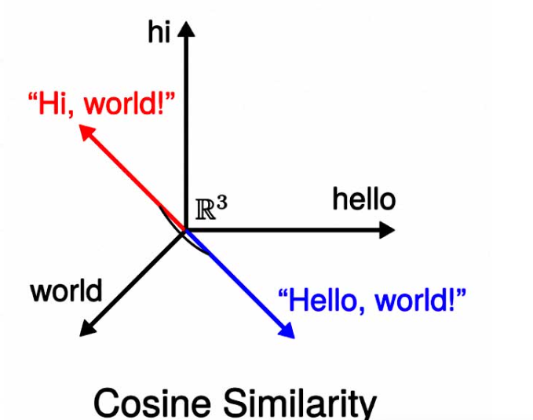
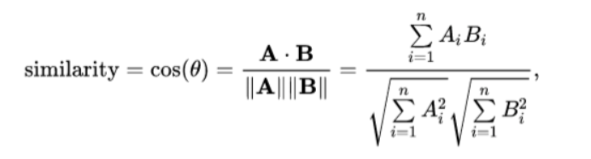
Cosine similarity
Cosine similarity is a metric used to measure how similar the documents are irrespective of their size. Mathematically, it calculates the cosine of the angle between two vectors projected in a multi-dimensional space.
Cosine similarity is crucial in job recommendation systems as its application enhances the relevance of recommendations by accurately measuring the alignment of candidate profiles with job descriptions, contributing to more effective and personalized job matching.

Slide 8
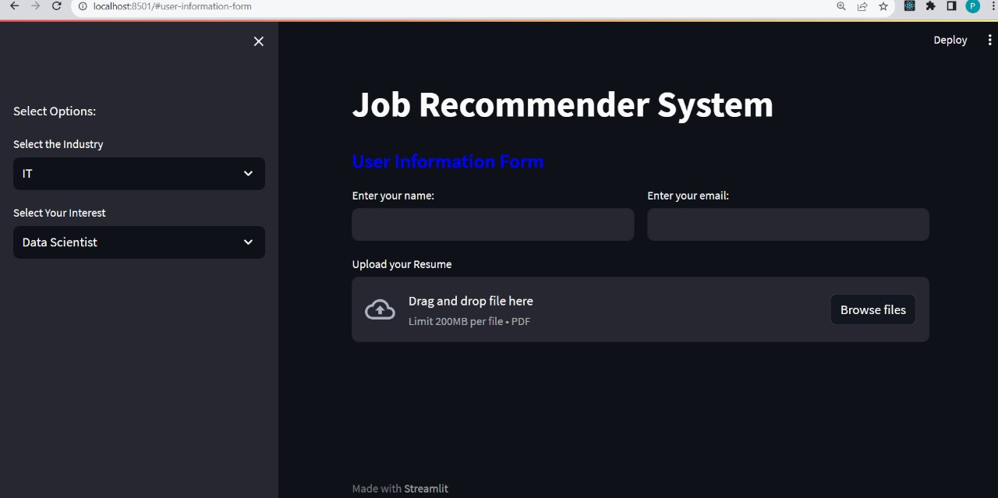
Results

Slide 9
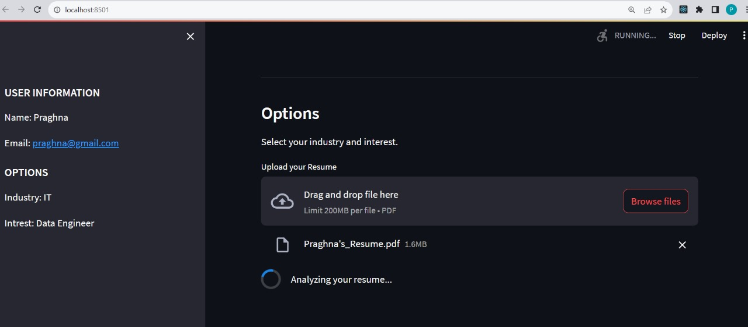
Results

Slide 10
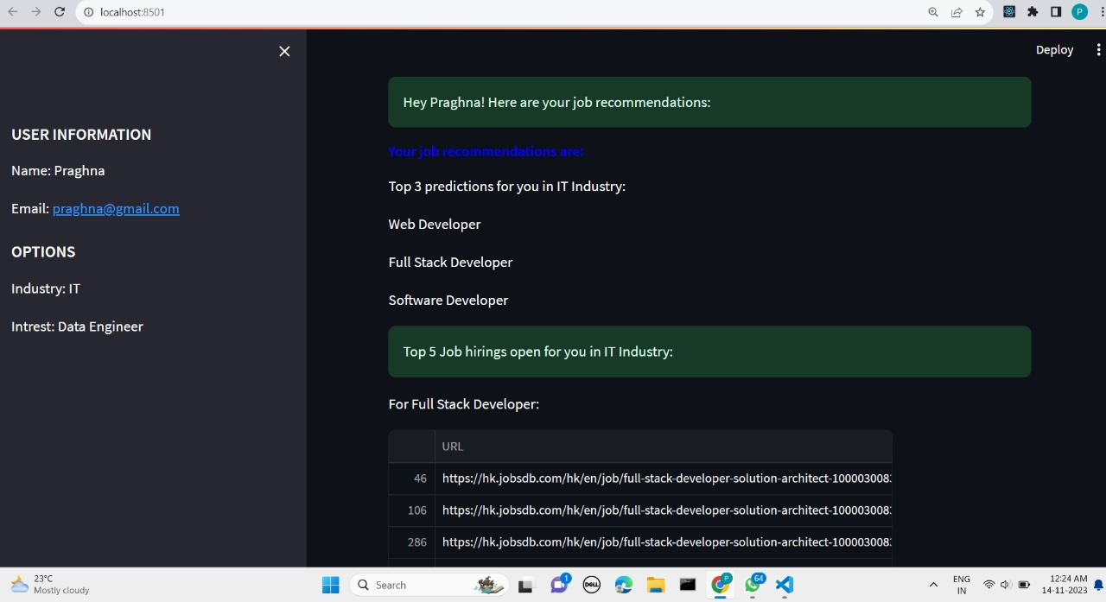
Results

Slide 11
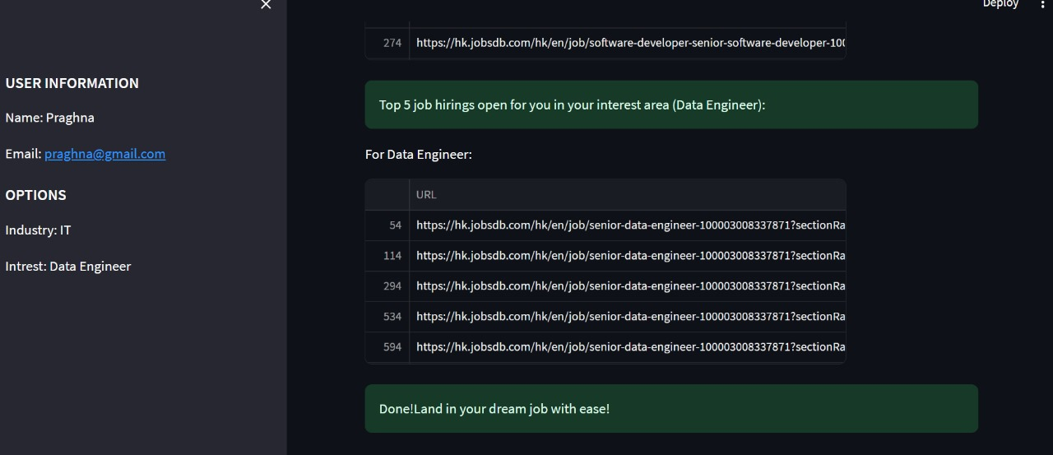
Results

Slide 12

Thank you

