Slide 1

iBus – The future for London Buses
Martin Davey
Head of Technical Services Group, TfL
Notes:
My role in Tfl, I am responsible for the design and operation of the entire fleet wide AVL, radio, RTPI, service control, performance analysis tools, systems and applications

Slide 2
London’s transport challenge
In common with any world class city, London faces many transport and traffic challenges. London’s bus network, one of the largest and most comprehensive urban transport systems in the world, is facing up to these challenges
The number of people using buses in London is at its highest level since 1968, every weekday, 6.3 million journeys are made on London’s buses
The challenges involved in keeping so many buses moving and coordinated as well as ensuring passengers have access to the right information at the right time demand innovative solutions.

Slide 3
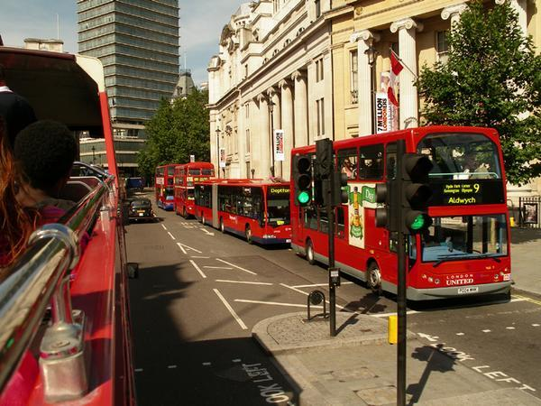

8000 buses running on 700 routes with 17,500 bus stops
Radio communications no longer sufficient
New AVL platform required
Notes:
The number of people using buses in London is at its highest level since 1968, with an average of 5.3% more bus journeys made each year since 2000
The network consists of 17,500 bus stops and 700 routes serviced by 8,000 buses
Each year, they cover around 450 million kilometres in total mileage
The challenges involved in keeping so many buses moving and coordinated demand innovative solutions.
London’s bus network is currently coordinated by radio communications systems- but with passenger numbers increasing dramatically, there is a need to find a more reliable and efficient system
iBus is a technology platform based on AVL which will deliver information for service control and passenger use.
TfL is working to introduce a £117m state-of-the-art Automatic Vehicle Location (AVL) technology system and telecommunications across London, called iBus
iBus - the largest projects of its kind in the world - will revolutionise how services are delivered and monitored

Slide 4
AVL: Key challenges
Robustness against poor GPS reception and outages and multipath effect
Previous research told us it could be done (and has now been proved) however…
Technique should not be dependent on parameters that can change and are difficult to maintain (e.g. 17,500 bus stops in London)

Slide 5
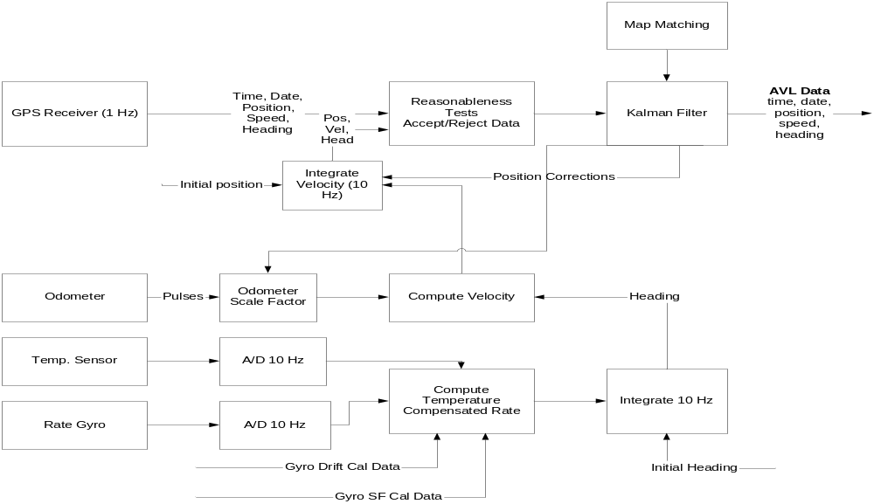
Overcoming GPS limitations: location system architecture

Slide 6
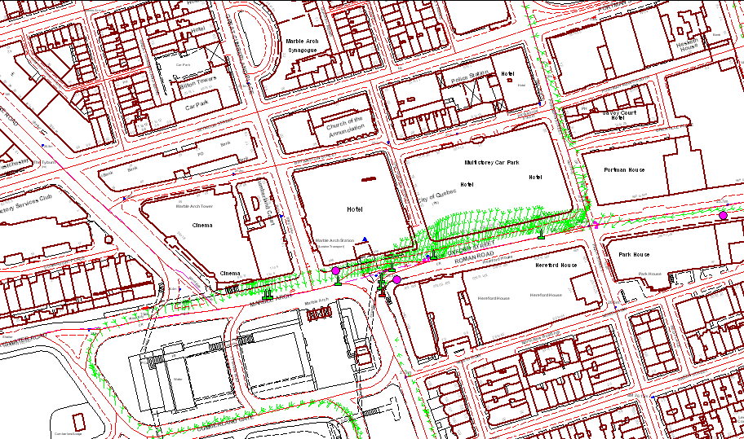
The road ahead: it has been done
Trial route being tested
Purple circles: AVL beacons (“truth points”)
Green pins: reported vehicle location when beacon seen
Green vectors: correction from raw GPS to location solution

Slide 7
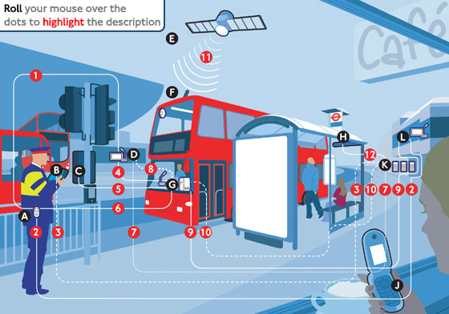
iBus
Notes:
Buses will be equipped with the new systems over the next four years with the first full garage installation expected to be completed in 2007
What is it?:
On bus systems will trigger traffic lights at specific junctions providing priority to buses, improving reliability
Passengers can receive up-to-the-minute timetable information before even leaving the house- an SMS is sent to the passenger’s mobile phone with information on the next bus at the passenger’s nearest bus-stop
There will be valuable information on buses with the new ‘on board next stop’ visual displays and audio announcements. Access to valuable information, such as next stops, will be of particular benefit to passengers with disabilities, infrequent travellers or passengers facing language barriers
Services will be more reliable, with service control centres able to track the precise location of buses. This means that 3 of the same buses will no longer all arrive at once (headway information, the time gap between consecutive buses, will be available to a service controller at all times on a screen so that they can make decisions such as slowing down or speeding up to help maintain a regulated service and stop undesirable ‘bunching’ of buses), and passengers will have improved countdown information at bus-stops.
better capability for response to emergencies by authorities as the location of all buses can be monitored at all times future applications support using new technology to communicate real-time passenger information.
Controllers will be able to text information, requests and actions to the driver, and drivers, in turn, will be able to respond or send a pre-set text message back to the controller. This will ensure good two-way communication between the controller and driver over and above the existing radio voice communication.
When the bus arrives back at its garage at the end of the day, the on-board computer uploads all the data associated with trips and schedules planned and completed during the day. The system also uploads CCTV data associated with traffic offences and on-bus passenger incidents

Slide 8
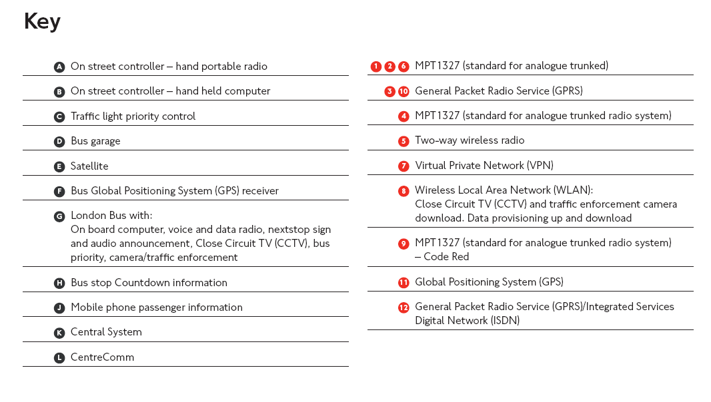

Slide 9
iBus – the platform supports…
iBus is a complex technology that is designed to support bus operators and bus passengers needs
Service control benefit –
Improved mileage
Improved Q.S.I. performance
Real time performance
reports
Improved voice call coverage
Code Red and Blue
Passenger benefit –
On Bus Next Stop Signs and
audio announcements
Real time passenger information
(RTPI) for high frequency bus
routes via mobile phones
On street RTPI
Improved coverage of routes
Better predictions

Slide 10
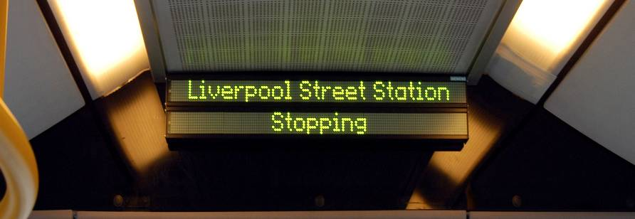
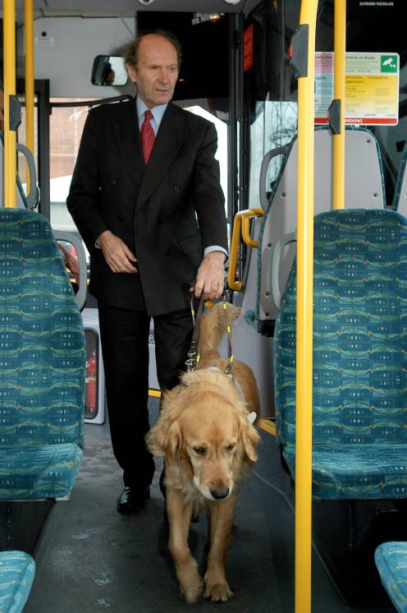
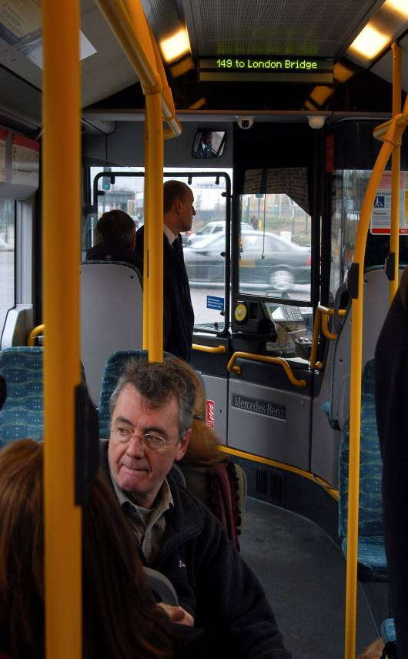
iBus pilot
A trial of the on bus next stop signs and audio announcements was carried out in early 2006
5 buses on route 149 demonstrated the capabilities of the new AVL system with limited functionality
Passenger research was carried out with a wide range of user groups – regular, new and infrequent users, passengers with disabilities, school children and users who do not have English as their first language
Notes:
The pilot was carried out on 5 buses on route 149 in Jan/Feb 2006.
During this time research was carried out encompassing all user groups including; regular and irregular users, users with disabilities, schoolchildren, people who do not have English as their first language.
The research assessed passenger reaction to the system, specifically focusing on:
if passengers can understand and identify key information messages of the system
the prototype design during the trial, specifically exploring passenger response to the information provided (both audio and visual aspects), focusing on volume, format, visibility and usefulness
if the system meets the needs of specific passenger groups, particularly those with disabilities
Surveys were carried out on buses and drivers were interviewed as well. There was some concern that drivers might find the audio announcements irritating but the feedback they gave was actually very positive as the extra information allows them to get on with the job of driving the bus, rather than remembering to give information such as announcing certain stops that passengers might request.
The next task is to make changes to the signage and announcements as suggested during the user research, and to trial software with bus operators. Garages will start to be fitted with equipment in November and the new technology will begin appearing on buses from Spring 2007.

Slide 11
iBus passenger research
  Headline results:
  The results were very positive, 91 per cent of respondents said the new system would be beneficial
  Perceived importance to personal journeys
    New 149 users 93%
    Irregular 149 users 68%
    Regular 149 users 69%
  Both the visual messages and audio announcements were well received. When asked which method passengers preferred
    46% liked both
    19% preferred text
    28% preferred audio
Notes:
The research resulted in very positive feedback from all groups and overall results suggests signage system is seen as a great start – 91 per cent saying system beneficial.
There was a better than expected response from regular passengers. This is thought to be connected to the audio announcements, which reduce need to concentrate. Sign information also provides reassurance.
Both the visual messages and audio announcements were well received. When asked which method passengers preferred
46% liked both (visual and audio back each other up, reduces the need to focus too hard on one source)
19% preferred text (available very soon after the bus leaves the previous stop and until the next stop is reached)
28% preferred audio (don’t need to continually check the sign, can’t miss the voice)
Comments highlighted that new/irregular users and tourists would find it easier to use buses and that for users with disabilities the signs and announcements provide reassurance.

Slide 12
iBus passenger research
  User comments:
  “Emma (Hignett, voice of bus announcements), speaks with very clear diction and the right level of authority which will give passengers confidence."
  Visually impaired passenger
  “I'm actually really looking forward to having this system on the buses....it would make my life a lot easier. I would feel more relaxed.”
  Hearing impaired passenger
  We have an ongoing programme of research looking at many aspects of passenger benefits, both on-bus and on-street
Notes:
These comments highlight that new/irregular users and tourists would find it easier to use buses, and that for users with disabilities the signs and announcements provide reassurance.
It is intended that more research will be carried out next year.

Slide 13
iBus – next steps…
  Real time CCTV – safer travel, intelligent policing, fares evasion
  Vehicle telematics
  Hearing ‘T’ Loop integration
  Floating sensors - performance monitoring and air quality measurement
  iBus as a platform and architecture - scalable and can integrate ticketing with fares/position, as well as route performance indicators for evidence-based decision making
  Evaluation – measuring benefits and on-going performance in order to make long-term improvements

