Slide 1
Probe based Arterial Travel Time Estimation and Prediction – A Case Study of Using Chicago Transit Authority Bus Fleet as Probes
Jie (Jane) Lin, Ph.D.
Associate Professor
Department of Civil and Materials Engineering
Institute for Environmental Science and Policy
University of Illinois at Chicago
September 29, 2009
CTS-IGERT Seminar

Slide 2
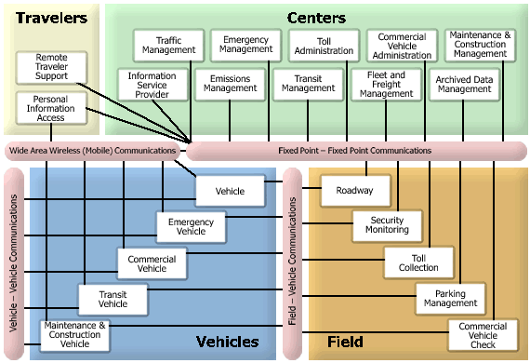
National ITS Architecture
Source: RITA, U.S. DOT

Slide 3
ITS Applications
Type of applications
  Advanced Traffic Management System (ATMS)
  Advanced Traveler’s Information System (ATIS)
Area of applications
  Freeway
  Highway
  Arterial/Urban streets

Slide 4
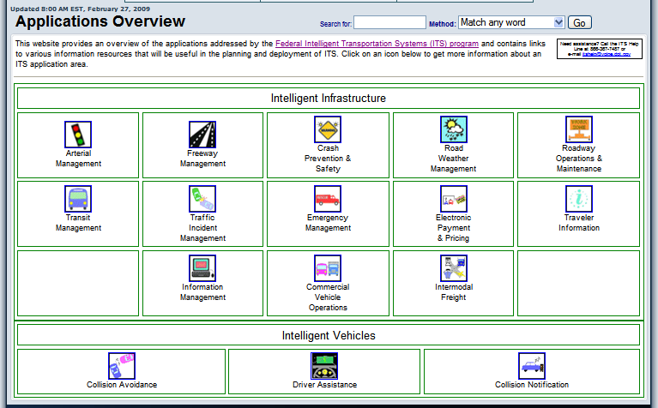
Classification of Applications
Source: RITA, U.S. DOT

Slide 5
The Focus of Today’s Talk
Is travel time estimation and prediction.
Travel time data collection/sources
  Traffic sensors, e.g., inductive loop detector
  Floating car method/probe vehicle
  Cell phone signals

Slide 6
Travel Time Estimation and Prediction
Estimation
Prediction
Instantaneous prediction
Short-term prediction
Long-term prediction
Space
Travel time
Travel time
Travel time
Travel time
Known traffic conditions
Unknown traffic conditions
Past
Now
1 hour
Future time

Slide 7
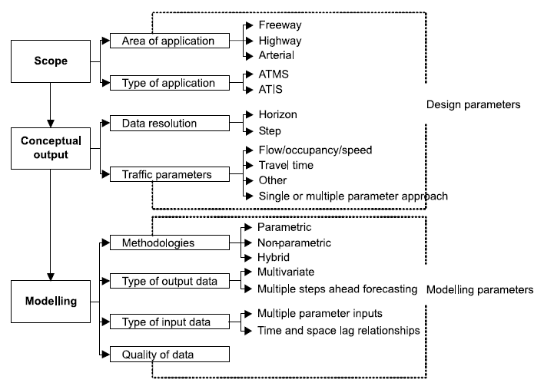
Travel Time Prediction
Source: Vlahogianni et al. 2004

Slide 8
Traffic Forecasting Models (source: You and Kim, 2003)
Type | Model | Advantages | Disadvantages
Statistical models | Historical Profile Approaches | -Relatively easy to implement -Fast execution speed | -Difficult to respond to traffic incidents
 | Time series models ARMA/ARIMA State Space/Kalman filter | -Many applications -Well-defined model formulation | -Difficult to handle missing data
 | Nonparametric regression -Dynamic clustering/pattern recognition | -Pattern recognition -No assumption of underlying relationship | - Complexity of search for “neighbors”
 | Hybrid models -Clustering+linear regression -ARIMA+SOM -Fuzzy logic+GA | -Smaller and more efficient network | -Not yet many implementations
Computer simulation | Traffic simulation | -Possible to simulate various situations | - Requires traffic flow prediction in priori
Mathematical optimization | Dynamic Traffic Assignment | -Various types of models available and well known | -Not suitable for micro-simulation
Artificial Intelligence | Neural Networks | -Suitable for complex, non-linear relationships | -Forecasting in black box -Training procedure

Slide 9
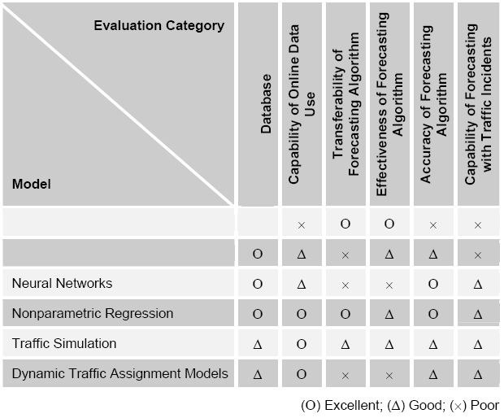
Performance of Forecasting Models
Historical Profile Approach
Time Series Analysis
Source: You and Kim, 2003

Slide 10
Urban Arterial Travel Time Prediction
Largely in void because of the challenging nature
  Complex urban traffic environment
  Lack of continuous traffic data/measurements
  Most existing applications are focused in the area of ATMS rather than ATIS
    Qualitative versus quantitative measures
    Other traffic parameters

Slide 11
Bus Probe Based Arterial Travel Time Estimation and Prediction
Research Questions
  Can real-time AVL bus data be used to identify any form of interaction (or relation) between buses and cars in a traffic stream on a signalized urban street? If yes, what is the best way to quantify that?
  Is it possible to use real-time incoming bus data to derive concurrent car travel time in recurring or non-recurring traffic conditions?
  Is it possible to use bus probes to forecast future car travel time?

Slide 12
Findings in Bus Probe Literature
Limited research effort – 6 bus probe studies
Buses can be probe vehicles.
  On freeway and suburban highway: Real-time AVL buses are used as complementary speed sensors reporting real-time speeds in King County, WA.
  On urban street: Statistically significant relationships between archived AVL buses and general vehicles were identified.
Bus stop dwell time is the most significant noise and should be excluded in directly relating bus travel time to general vehicle travel time.
Linear regression is a common method in quantifying bus-car relationship.

Slide 13





Travel Time Prediction Framework
Historical bus travel
Real-time
bus travel
Predicted
bus travel
Historical relationships
Historical car travel
Real-time
car travel
Predicted
car travel
Past
Now
Future
Historic estimation
Instantaneous prediction
Future prediction: short-term (15 min) and long term (>1 hr)

Slide 14
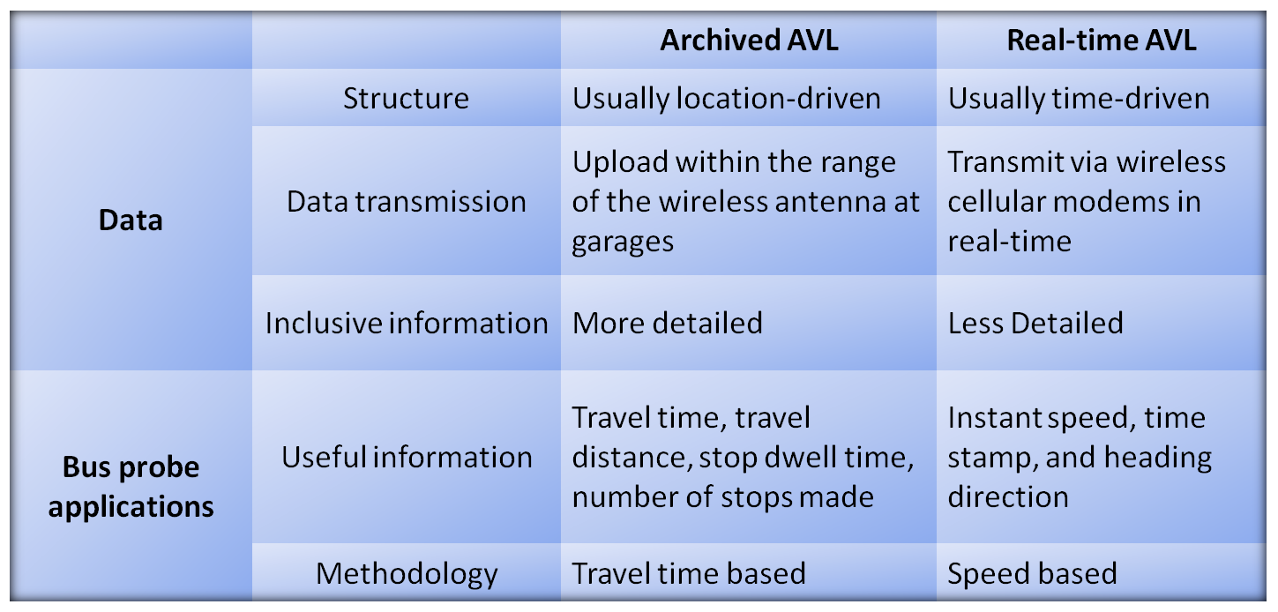
Type of Input Data:
Archived AVL vs. Real-time AVL
Real-time AVL data was used in the study

Slide 15
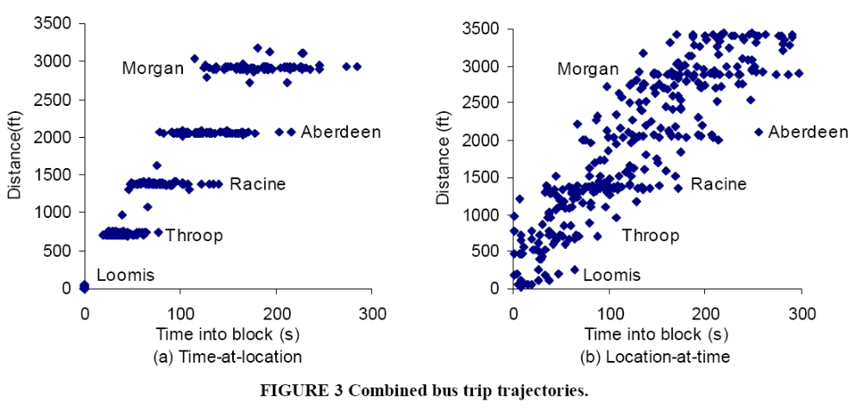
Archived versus Real-time AVL
(a) Archive AVL
(b) Real-time AVL

Slide 16
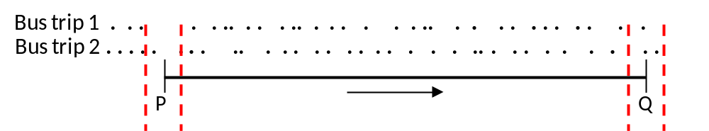
Travel Time versus Speed as Predictor
In Real-time Bus AVL:
Poll during a bus trip
Intrinsic measurement errors
In addition, no stop dwell time is available in real-time AVL

Slide 17
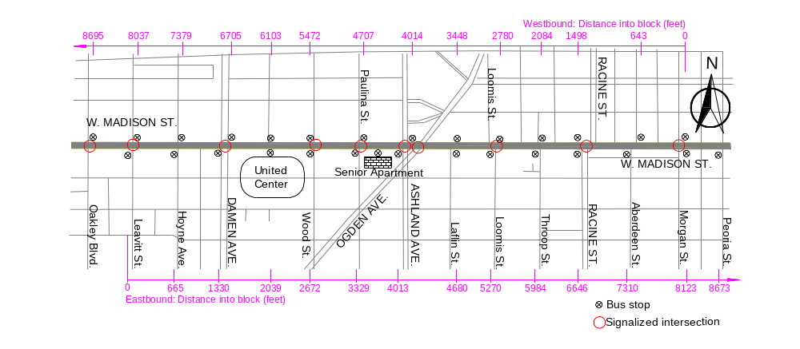
Field Study Segment

Slide 18
Data Collection
Bus: real-time AVL data from Route #20 (Madison) covering about 4 months from June 1st – September 19th, 2007.
Car: GPS-equipped test vehicle data covering 9 weekdays (September 4th – 14th, 2007), 2 hours a day (10:30am – 11:30am, 5:30pm-6:30pm). The GPS records car speed, location and time every 0.1 seconds.
Street configuration.
Bus stop configuration.
Intersection control strategy .

Slide 19

Part I: Building Historical Bus–Car Relationship – base model
Historical bus travel
Real-time
bus travel
Predicted
bus travel
Historical relationship
Historical car travel
Real-time
car travel
Predicted
car travel
Past
Now
Future

Slide 20
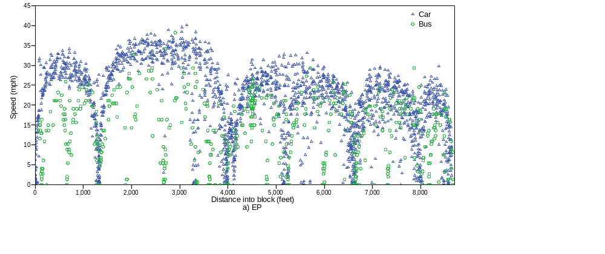
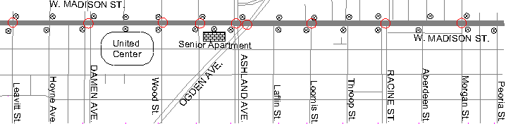
Spatial Profiles of Bus and Car Speeds
EB

Slide 21
Three Types of Location (Links)
Number | Name | Location | Relationship between bus speed and car speed | Representativeness of car speed by bus speed
1 | Midblock | The portion of street that is outside the influence of a bus stop and/or intersection | 1) Vehicles travel at relatively high speeds under normal and undisturbing conditions; 2) Cars generally travel faster than buses. | Good, expected similar travel patterns between buses and cars.
2 | Bus-stop-only | At posted bus stops where general vehicle traffic is not controlled. | Buses stop upon passengers’ requirements; while general vehicles may travel at normal speeds if not obstructed by buses. | Poor, expected dissimilar patterns between buses and cars.
3 | Controlled- intersection | At controlled intersections, with or without a bus stop. | Both buses and cars may experience full stops or low-speed travel. | Most probably not good, hard to tell.

Slide 22
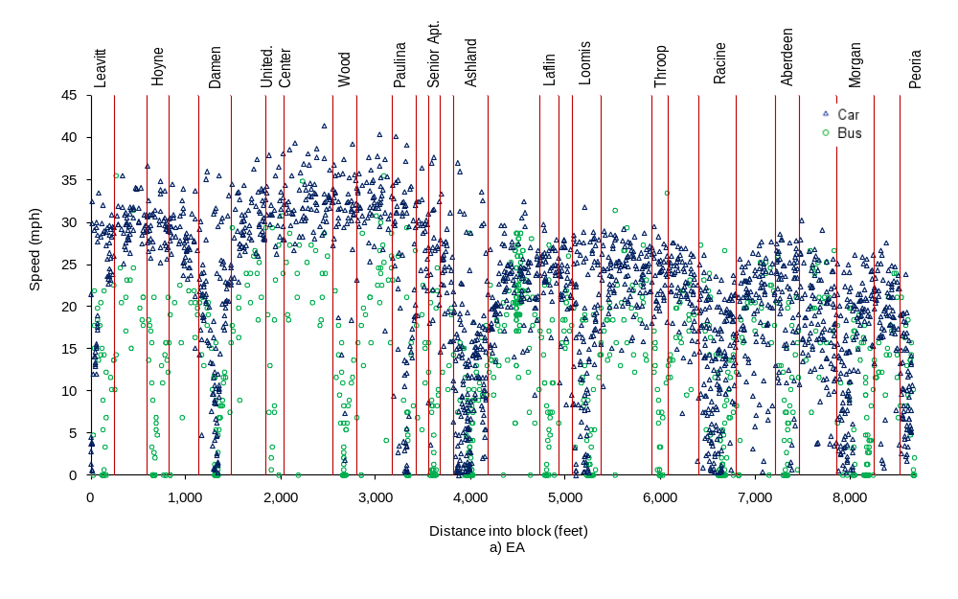
Heuristic Engineering Segmentation
Total: EB 29 links + WB 29 links

Slide 23
Three Forecasting Models Applied
Were tried and compared:
  Multiple linear regression
    2-hour aggregate model
    1-hour aggregate models
    15-minute models
  Seemingly unrelated regression
    2-hour aggregate model
    1-hour aggregate models
    15-minute models
  State-space model

Slide 24
(i) Multiple Linear Regression (MLR)
y = Xβ + ε
Variable | Name | Definition or value
y | Delta | Car speed – Bus speed
X | Midblock | 1, if a link is midblock link; 0, otherwise.
 | Signal | 1, if a link is signalized intersection link; 0, otherwise.
 | StopSign | 1, if a link is Stop sign-controlled intersection link; 0, otherwise.
 | BusStopOnly | 1, if a link is bus-stop-only link; 0, otherwise.
 | busBay | 1, if a link is bus bay stop link; 0, otherwise.
 | ParkingArea | 1, if a link is within the United Center parking area; 0 otherwise.
 | Nlane | 1 or 2, Number of lanes.

Slide 25
(ii) Seemingly Unrelated Regression (SUR)
y_{c} = X_{c}β_{c} + ε_{c}
y_{b} = X_{b}β_{b} + ε_{b}
y_{c} is car speed, is y_{b} bus speed, X_{c} and X_{b} are explanatory variables.
X_{c} and X_{b} may not sufficiently explain the variations and some common factors that affect both car speed and bus speed may be omitted. Thus the errors can be correlated.
The SUR model and the associated generalized least square (GLS) estimation will take the correlations among the errors into consideration and may produce better results.

Slide 26
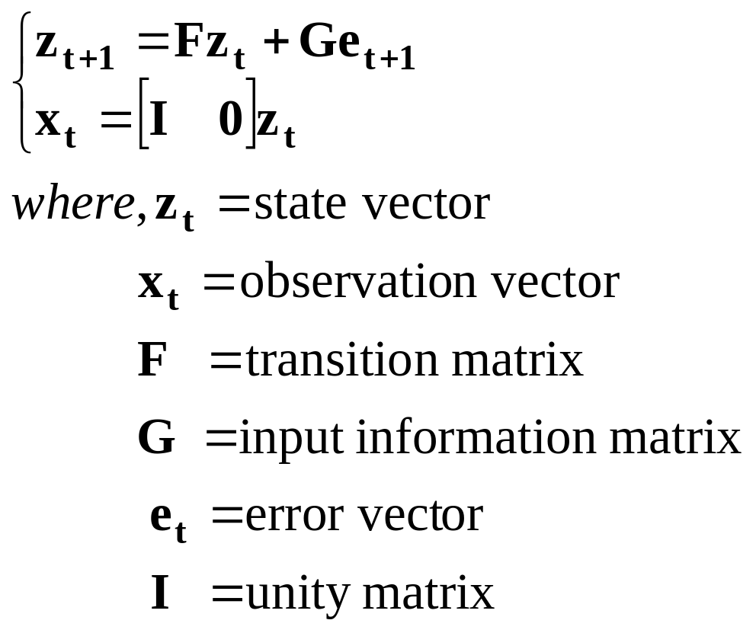
(iii) State Space Model
  In essence, SSM uses the observed trajectory of one object to predict the unknown states of the same or a different object

Slide 27
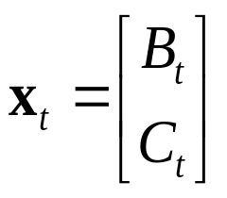

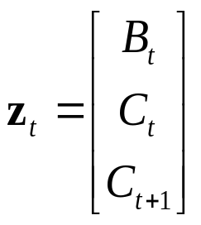
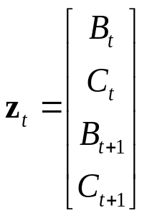
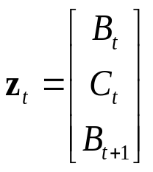
Estimation
VAR
Smallest AIC?
Canonical correlation analysis
I (Determine state vector z)
Significant correlation?
zt could be:
, , ,
etc.
State vector z
II
State equation estimation (F, G, Σ)
III
Estimates of Z

Slide 28
Data used in SSM
Spatial unit: equal-distance link (10ft, 150ft or 300ft) in each direction respectively.
Temporal unit: average link speed, of 2 hour, 1 hour, and 15 minutes of the nine weekdays.
Stationarity is checked first; if nonstationary, differencing of the original data series is used.

Slide 29
Base Model Results: (i) Estimation from MLR
Model | Time Period | N | Root MSE | Adj. R-Sq. | Parameter Estimates
 |  |  |  |  | Intercept |  | BusStopOnly |  | Signal
2-Hour Model | 2 hours | 58 | 3.2190 | 0.6348 | 5.28 |  | 10.91 |  | 4.95
1-Hour Model | Pooled | 116 | 4.6685 | 0.4268 | 5.83 |  | 10.39 |  | 4.85
 | 10:30am-11:30am | 58 | 5.0027 | 0.3350 | 6.37 |  | 9.187 |  | 4.77
 | 5:30pm-6:30pm | 58 | 4.3720 | 0.5089 | 5.28 |  | 11.58 |  | 4.92
15-Minute Model | Pooled | 464 | 5.9489 | 0.3412 | 5.58 |  | 10.95 |  | 5.30
 | 10:30am-10:45am | 58 | 7.2325 | 0.1578 | 7.25 |  | 8.18 |  | 5.21
 | 10:45am-11:00am | 58 | 5.3749 | 0.3504 | 5.92 |  | 10.43 |  | 4.44
 | … | … | … | … | … |  | … |  | …
 | 6:00pm-6:15pm | 58 | 5.2335 | 0.4438 | 5.07 |  | 12.21 |  | 5.28
 | 6:15pm-6:30pm | 58 | 6.6157 | 0.2568 | 4.41 |  | 9.25 |  | 7.02

Slide 30
Estimated Car Travel Time from MLR
Model | Time Period | Car travel time (seconds)
 |  | Eastbound |  |  | Westbound
 |  | Est’d | Obs’d | Error (%) | Est’d | Obs’d | Error (%)
2-Hour Model | 2 Hours | 285 | 289 | 1.38 | 285 | 293 | 2.73
1- Hour Model | Pooled | 277 | 289 | 4.15 | 282 | 293 | 3.75
 | 10:30am-11:30am | 276 | 290 | 4.83 | 283 | 288 | 1.74
 | 5:30pm-6:30pm | 279 | 289 | 3.46 | 281 | 298 | 5.70
15-Minute Model | Pooled | 282 | 289 | 2.42 | 287 | 293 | 2.05
 | 10:30am-10:45am | 257 | 293 | 12.29 | 294 | 278 | 5.76
 | 10:45am-11:00am | 291 | 302 | 3.64 | 273 | 289 | 5.54
 | 11:00am-11:15am | 287 | 283 | 1.41 | 269 | 284 | 5.28
 | 11:30am-11:45am | 280 | 282 | 0.71 | 332 | 300 | 10.67
 | 5:30pm-5:45pm | 298 | 293 | 1.71 | 268 | 289 | 7.27
 | 5:45pm-6:00pm | 284 | 297 | 4.38 | 289 | 315 | 8.25
 | 6:00pm-6:15pm | 289 | 282 | 2.48 | 278 | 282 | 1.42
 | 6:15pm-6:30pm | 272 | 284 | 4.23 | 282 | 302 | 6.62

Slide 31
(ii) Estimation of SUR Models
Model | Time Period | Method | Cross Corr | Parameter Estimates
 |  |  |  | Intercept | Midblock | BusStop Only | Parking Aera | Nlane
2-Hour Model | 2 Hours | OLS | 0.4625 | 14.88 | 7.53 | 9.12 | 4.14 | -
 |  | SUR |  | 14.83 | 7.58 | 9.22 | 4.15 | -
1-Hour Model | Pooled | OLS | 0.2497 | 15.31 | 7.47 | 8.93 | 4.41 | -
 |  | SUR |  | 15.30 | 7.47 | 8.95 | 4.41 | -
 | 10:30am-11:30am | OLS | 0.2981 | 17.08 | 6.54 | 7.68 | - | -
 |  | SUR |  | 17.08 | 6.53 | 7.66 | - | -
 | 5:30pm-6:30pm | OLS | 0.2127 | 8.54 | 8.70 | 10.47 | 4.76 | 3.81
 |  | SUR |  | 9.06 | 8.68 | 10.46 | 5.00 | 3.43

Slide 32
Estimated Car Travel Time from SUR
Model | Time Period | Car travel time (seconds)
 |  | Eastbound |  |  | Westbound
 |  | Estimated | Observed | Error (%) | Estimated | Observed | Error (%)
2-Hour Model | 2 Hours | 286 | 289 | 1.04 | 288 | 293 | 1.71
1- Hour Model | Pooled | 279 | 289 | 3.46 | 282 | 293 | 3.75
 | 10:30am-11:30am | 277 | 290 | 4.48 | 277 | 288 | 3.82
 | 5:30pm-6:30pm | 289 | 289 | 0.00 | 285 | 298 | 4.36
15-Minute Model | Pooled | 277 | 289 | 4.15 | 280 | 293 | 4.44
 | 10:30am-10:45am | 262 | 293 | 10.58 | 263 | 278 | 5.40
 | 10:45am-11:00am | 276 | 302 | 8.61 | 276 | 289 | 4.50
 | 11:00am-11:15am | 273 | 283 | 3.53 | 273 | 284 | 3.87
 | 11:30am-11:45am | 289 | 282 | 2.48 | 289 | 300 | 3.67
 | 5:30pm-5:45pm | 280 | 293 | 4.44 | 283 | 289 | 2.08
 | 5:45pm-6:00pm | 291 | 297 | 2.02 | 285 | 315 | 9.52
 | 6:00pm-6:15pm | 288 | 282 | 2.13 | 283 | 282 | 0.35
 | 6:15pm-6:30pm | 293 | 284 | 3.17 | 285 | 302 | 5.63

Slide 33
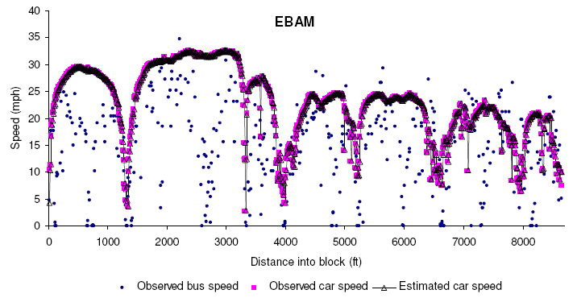
(iii) Speed Estimation Results from SSM

Slide 34
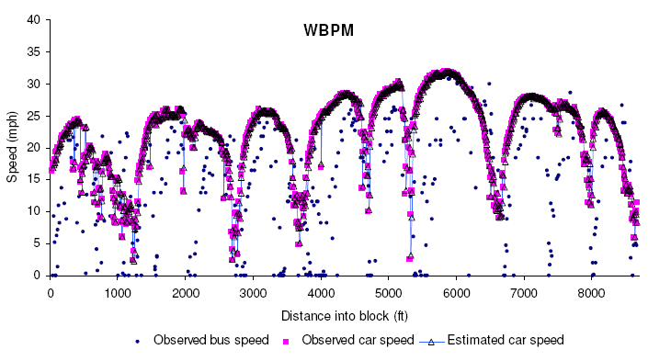

Slide 35
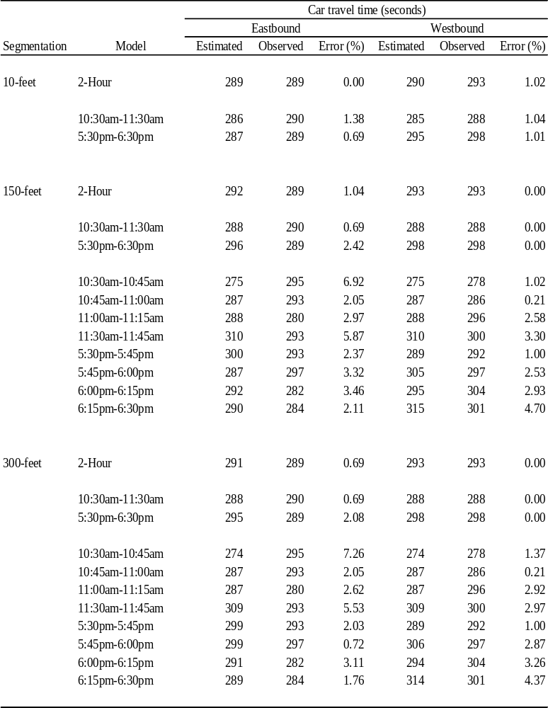
Estimated Car Travel Time from SSM

Slide 36
Findings
Statistically significant relationships between bus and car speeds exist.
The variations of the difference between bus and car speeds can be largely explained by two location dummy variables: “bus-stop-only” and “signal-controlled intersection”.
The SUR model did not gain much efficiency over OLS models. Nonetheless, SUR is a good method to check the correlations among errors.
The most accurate travel time estimation is obtained by using state space models.

Slide 37




Part II: Real-Time Travel Time Prediction
Historical bus travel
Real-time
bus travel
Predicted
bus travel
Historical relationships
Historical car travel
Real-time
car travel
Predicted
car travel
Past
Now
Future

Slide 38
Approach
Linear model
State space model
Linear
bus-car relationship
Updated
bus speed
Concurrent
car speed
Updated
bus speed
State space model
Concurrent
car speed
Historical car speed

Slide 39
Bus Speed Updating
Historical database
Confidence interval (C.I.)
Is b in the C.I.?
Yes
New bus speed (b)
Historical mean
No
Bayesian updating

Slide 40
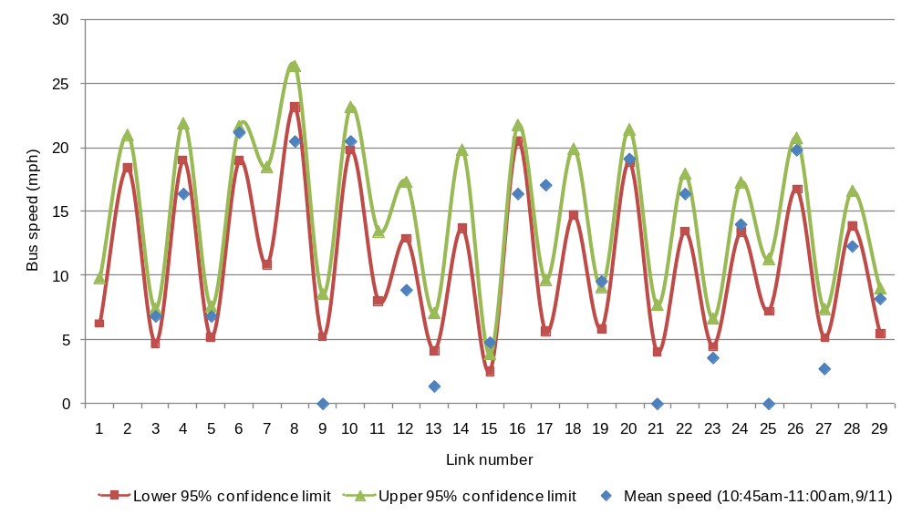
Example

Slide 41
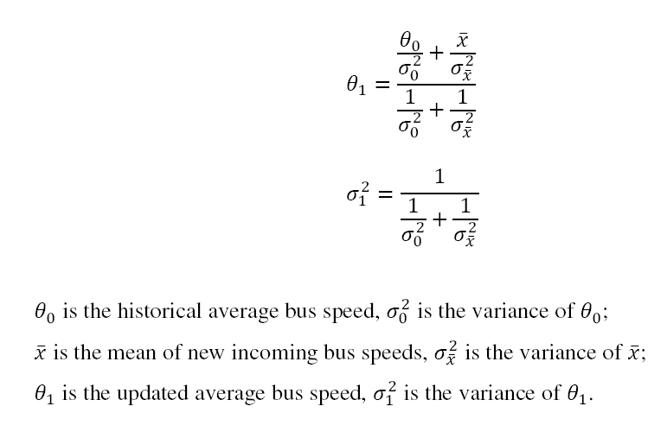

Bayesian Updating

Slide 42
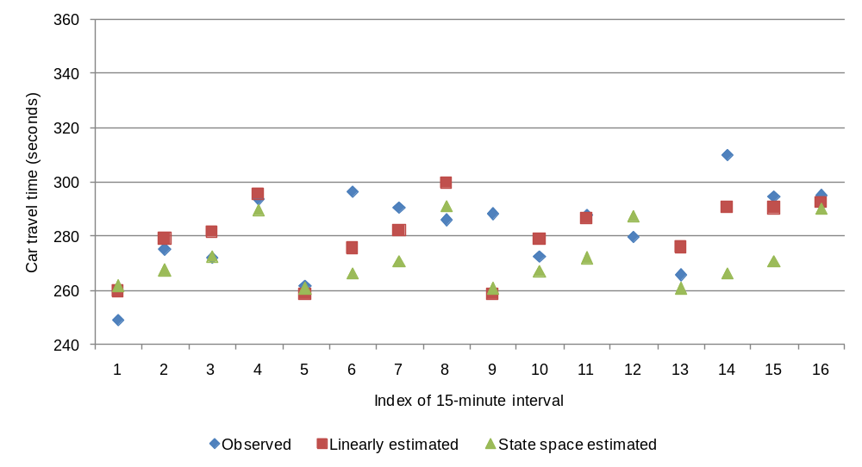
Estimated Car Travel Time - WBAM

Slide 43
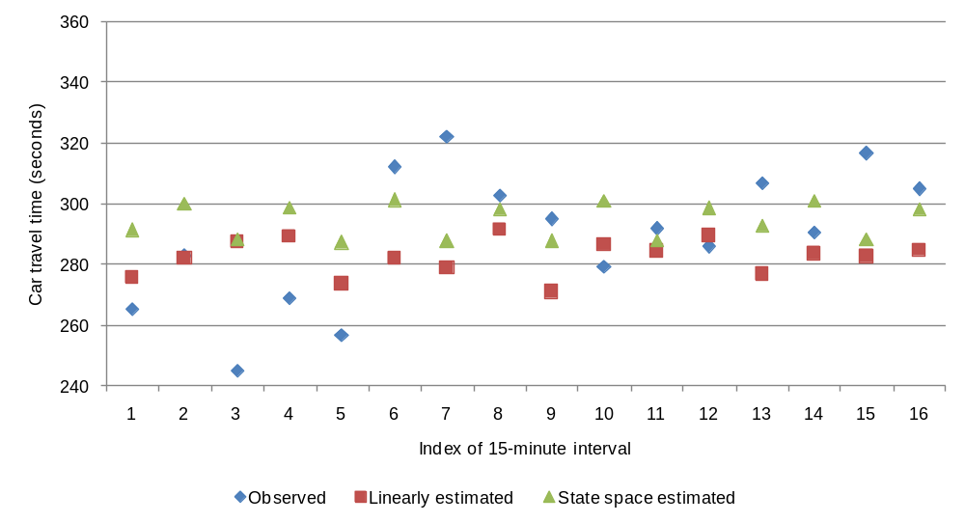
WBPM

Slide 44
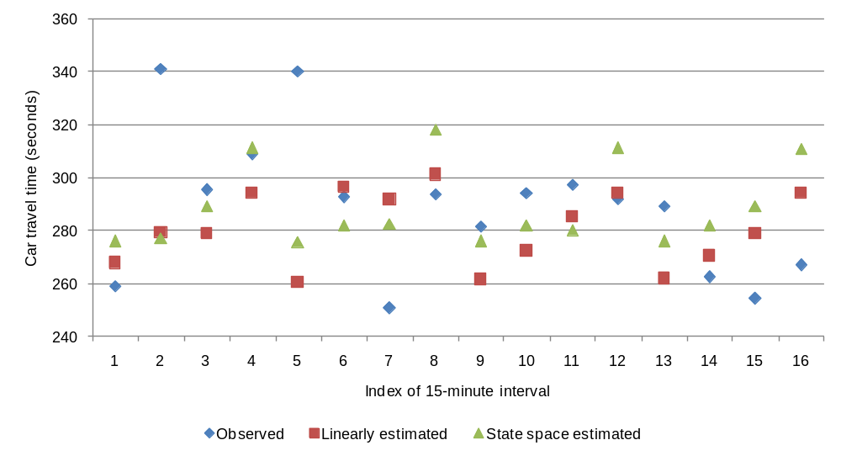
EBAM

Slide 45
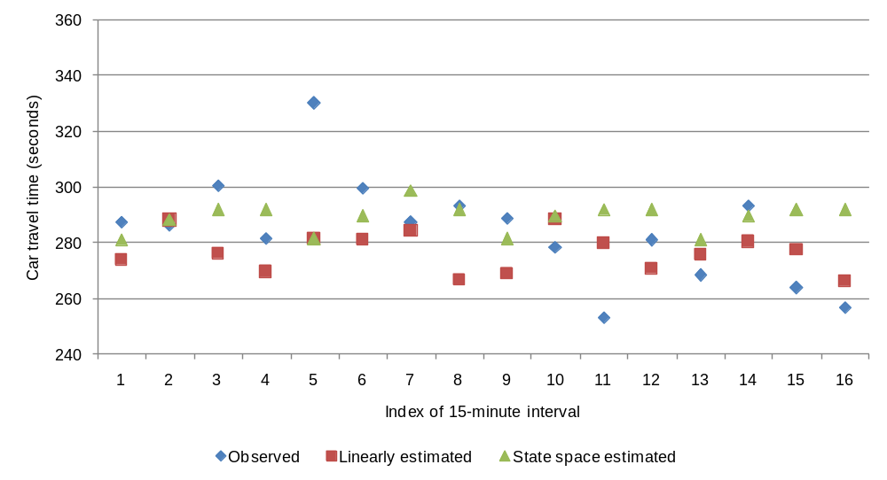
EBPM

Slide 46

Part III: Short-Term Travel Time Prediction
Historical bus travel
Real-time
bus travel
Predicted
bus travel
Historical relationships
Historical car travel
Real-time
car travel
Predicted
car travel
Past
Now
Future

Slide 47
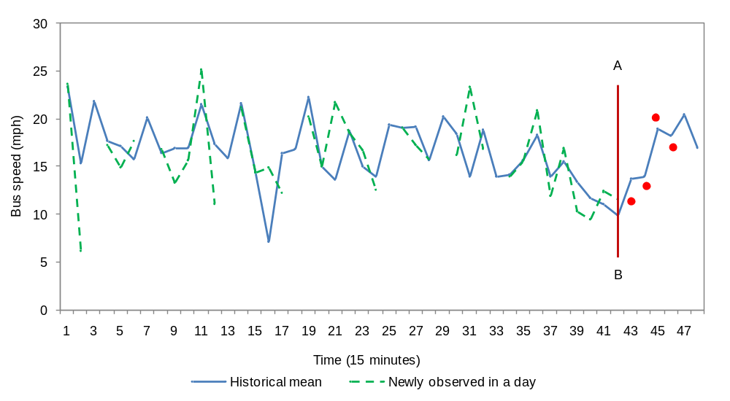
Approach
Step 1. Bus speed prediction (State Space Model)
Updating --> forecasting --> updating
Step 2. Car speed prediction (linear regression) using predicted bus speeds

Slide 48
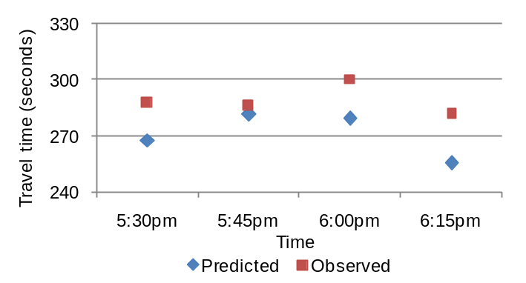
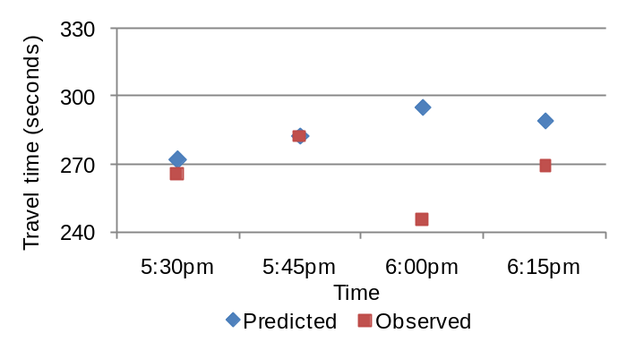
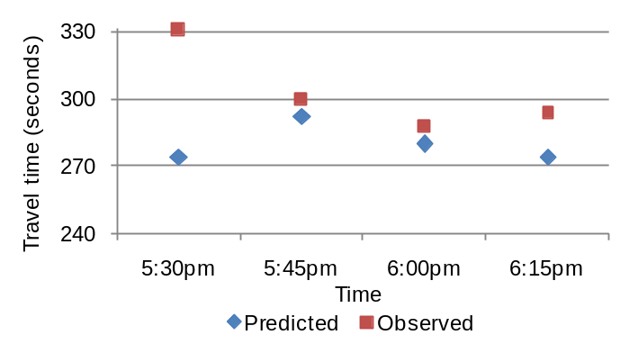
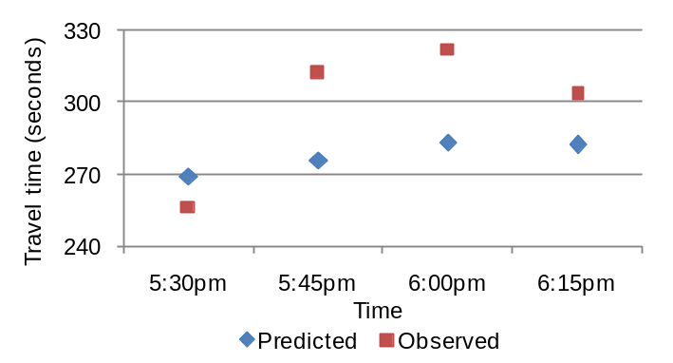
Car Travel Time Prediction
Eastbound, September 11th Westbound, September 11th
Eastbound, September 12th Westbound, September 12th

Slide 49
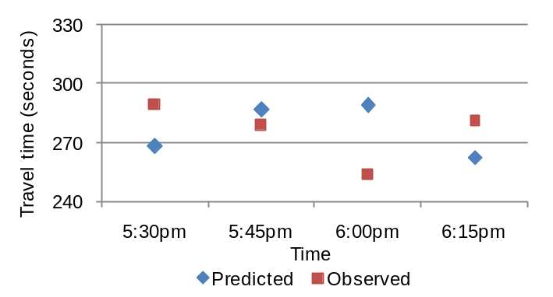
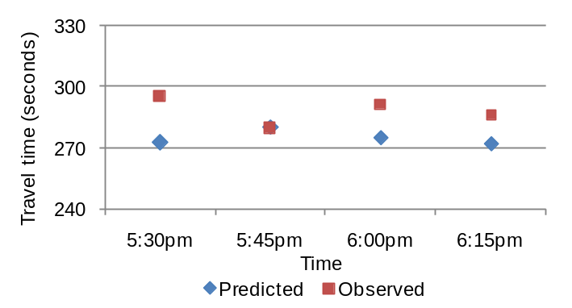
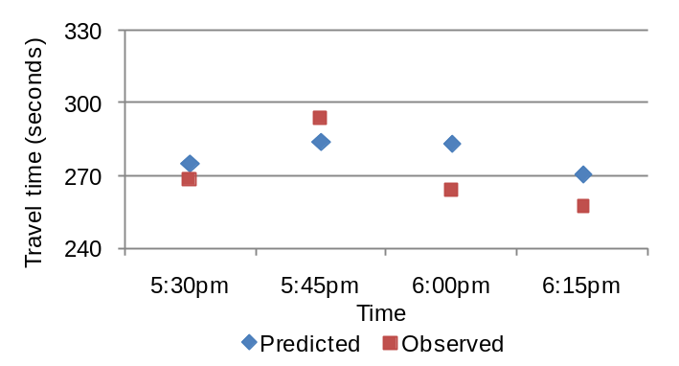
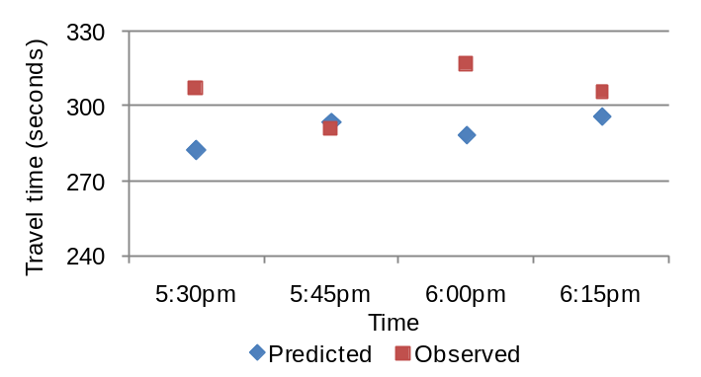
Eastbound, September 13th Westbound, September 13th
Eastbound, September 14th Westbound, September 14th

Slide 50
Bus Probe Micro-Simulation Study
Three scenarios:
  Drastic increase in traffic demand
  Road block due to traffic incident.
  Drastic increase in bus ridership along the route

Slide 51
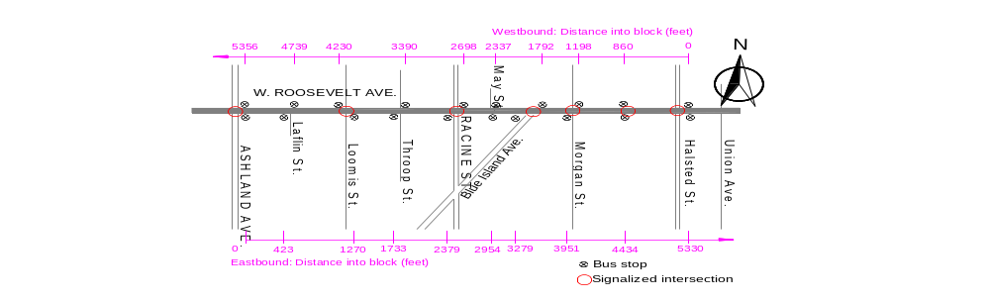
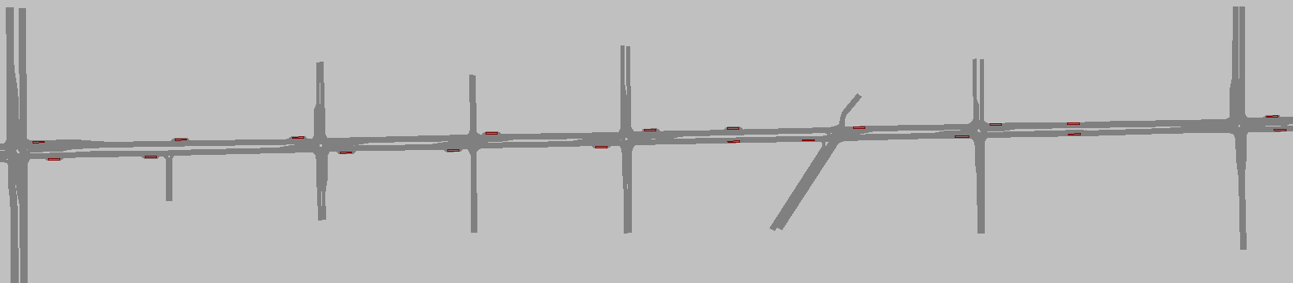
Testbed: Roosevelt Road
Network representation in VISSIM

Slide 52
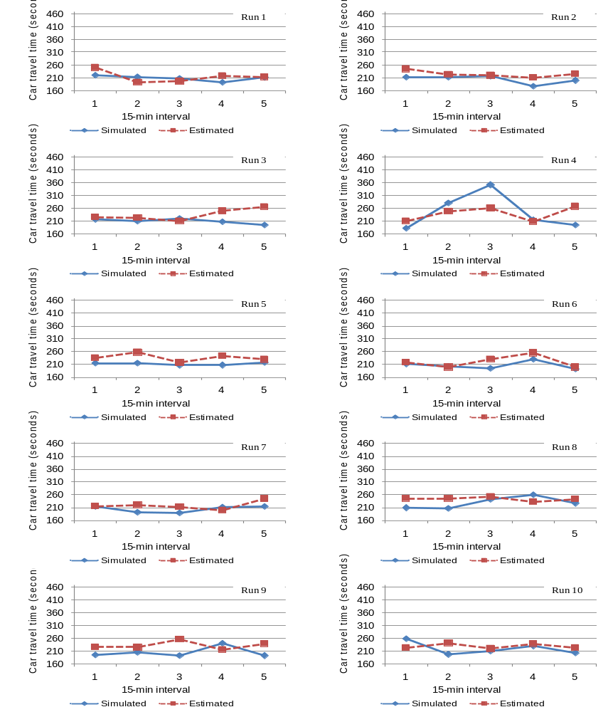
Scenario 3 – Large increase in bus ridership:
Estimated car travel time

Slide 53
Summary of Major Findings
First of its kind, this is a proof-of-concept study of urban street travel time prediction using real-time bus probes.
This study finds statistically significant relationships between bus travel and car travel.
This study finds bus speed is a better predictor for arterial travel time prediction compared to bus travel time.
Bus-car speed relationship is location-specific, i.e., at midblocks, bus-stop-only location and controlled-intersection location.

Slide 54
Major Findings (cont’d)
Difference between bus and car speeds at midblock is minimal when traffic is either highly congested or very light, and largest when traffic condition is somewhere in between.
Drastic increase of bus ridership has minor impact on the performance of bus probes, suggesting a superiority of a speed-based approach to a travel-time based one.

Slide 55
Future Research
Need better base models under various traffic conditions.
Sample size issue should be further investigated
Issues with spatial and temporal coverage
The transferability and scalability of the proposed bus probe development framework and algorithms should be further investigated.

Slide 56
Acknowledgements
Chicago Transit Authority (CTA) and Clever Devices, Ltd. for generously providing AVL data.
American Society of Civil Engineers (ASCE), for partial financial support via the 2007 Freeman Fellowship.

Slide 57
Thank You.

Slide 58
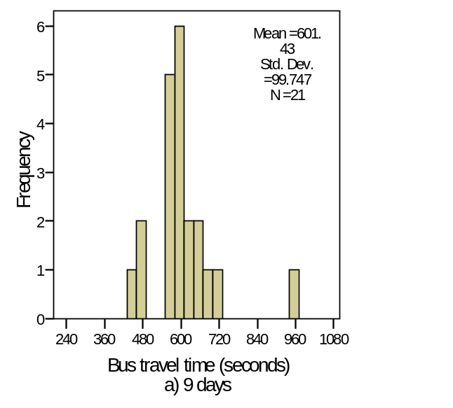
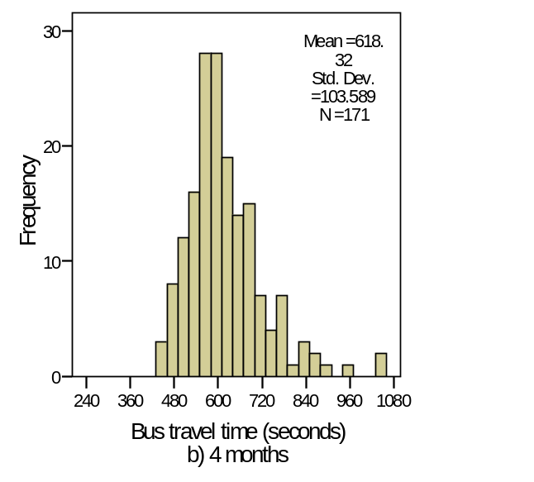
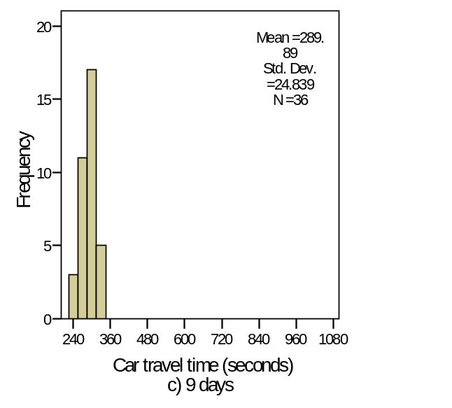
Travel Time
Eastbound Madison Street, 10:30am – 11:30am
Bus stop dwell time is not available from the real-time AVL system
Poll during a bus trip
Intrinsic measurement errors

Slide 59
Past Bus Probe Studies
Study | Objective | Bus Data | Car Data | Model | Facility Type | Conclusion
Bae (1995) | Travel time and speed probe | Field collected, location-driven | Test vehicle | Simple linear regression, ANN | Urban streets | Buses can be probes
King County, WA (Dailey et al. 1999-2005) | Speed probe | Real-time AVL, time-driven | Loop detector | Kalman filter, Speed mapping | Freeways and principle arterials | Buses are used as speed probes in reality
Orange County, CA (Hall et al. 1999-2000) | Congestion detection | Self-designed AVL system | GPS floating car | Simple linear regression | Urban streets | Buses are imperfect probes
Delaware DOT (Chakroborty and Kikuchi, 2004) | Travel time probe | Field collected, location-driven | Test vehicle | Simple linear regression | Urban arterials | Bus probe is promising
TriMet (Bertini and Tantiyanugulchai, 2004) | Travel time and speed probe | Archived AVL, location-driven | GPS floating car | Simple linear reverse regression | Urban arterials | Buses can be probes
Central Ohio (Coifman and Kim, 2006) | Travel time and speed probe | Real-time AVL, time-driven | Loop detector | Filtering | Freeways | Bus speeds are consistent with car speeds
Notes:
Six studies

Slide 60
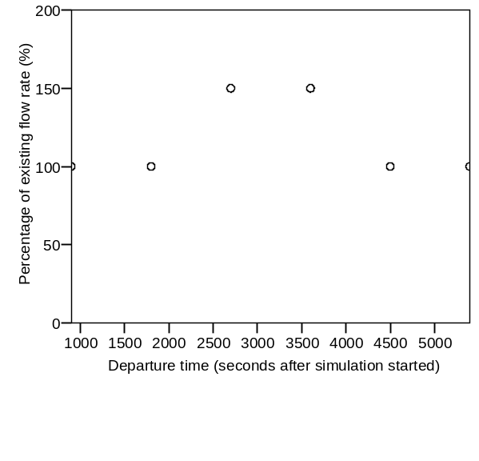
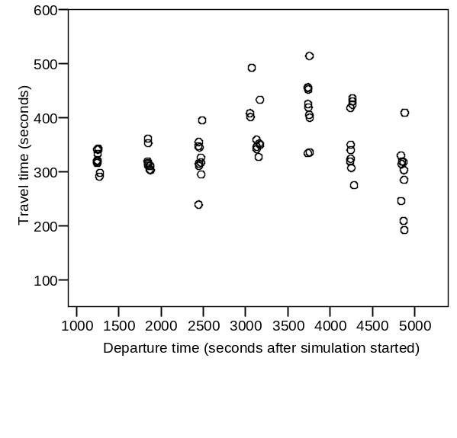
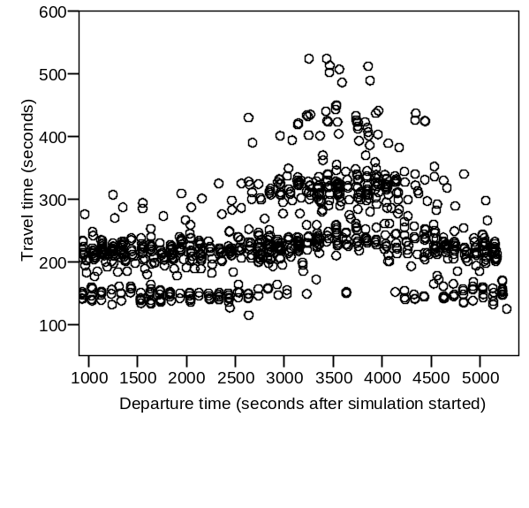
Traffic demand surge
Flow rate
Bus travel time
Car travel time

Slide 61
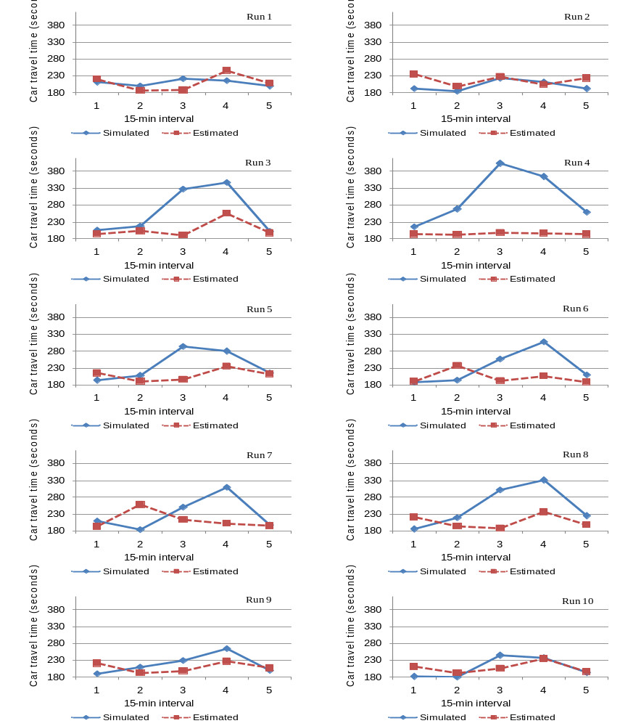
Estimated car travel time
(traffic demand surge)

Slide 62
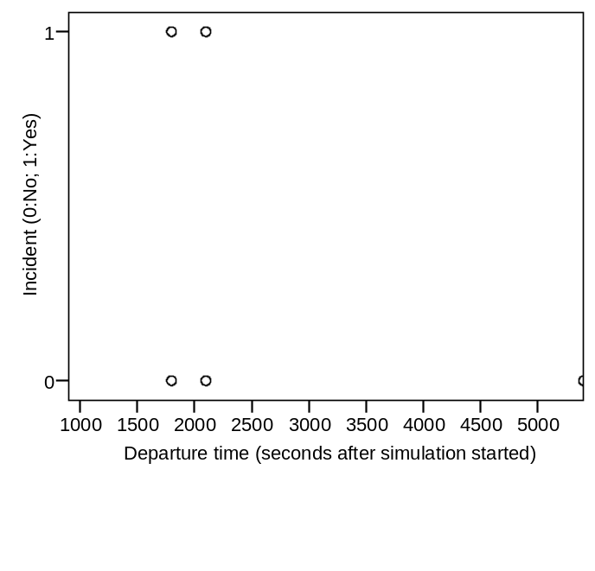
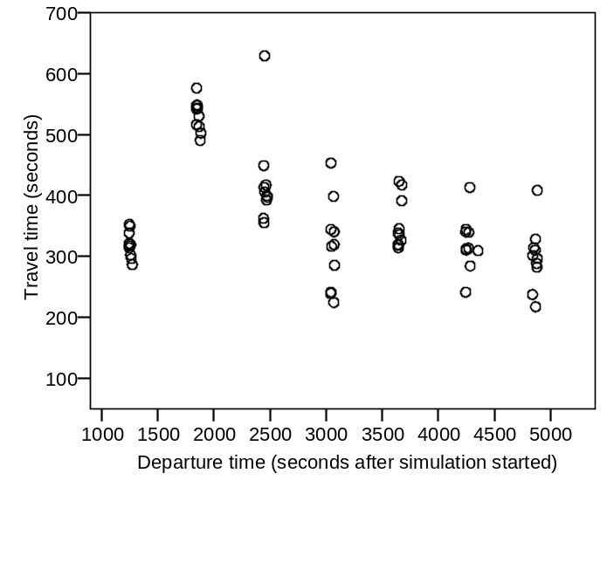
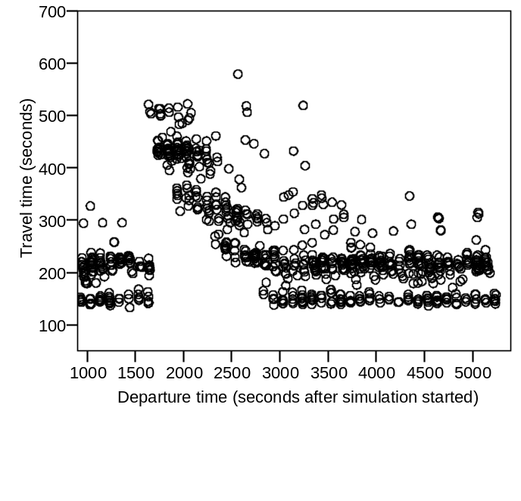
Scenario 2 – Road Block
Incident
Bus travel time
Car travel time

Slide 63
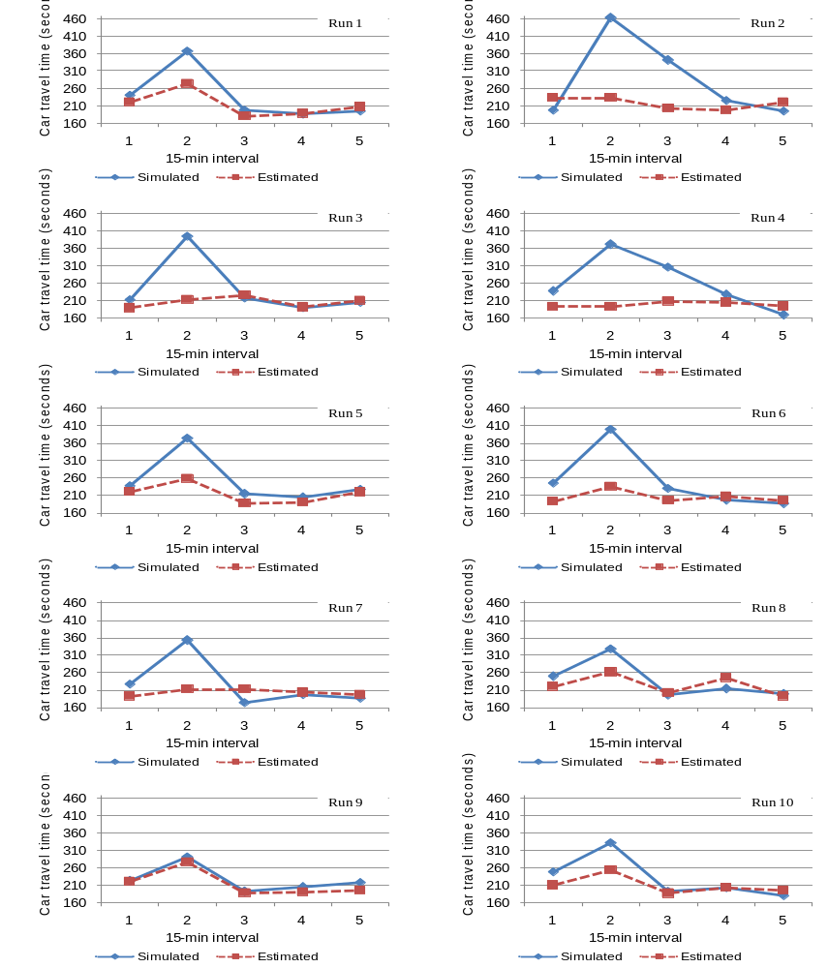
Estimated car travel time

Slide 64
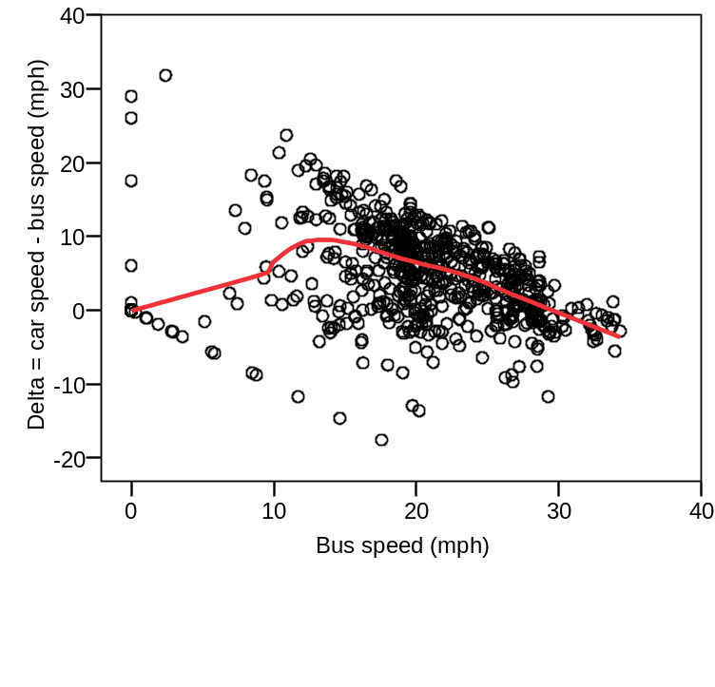
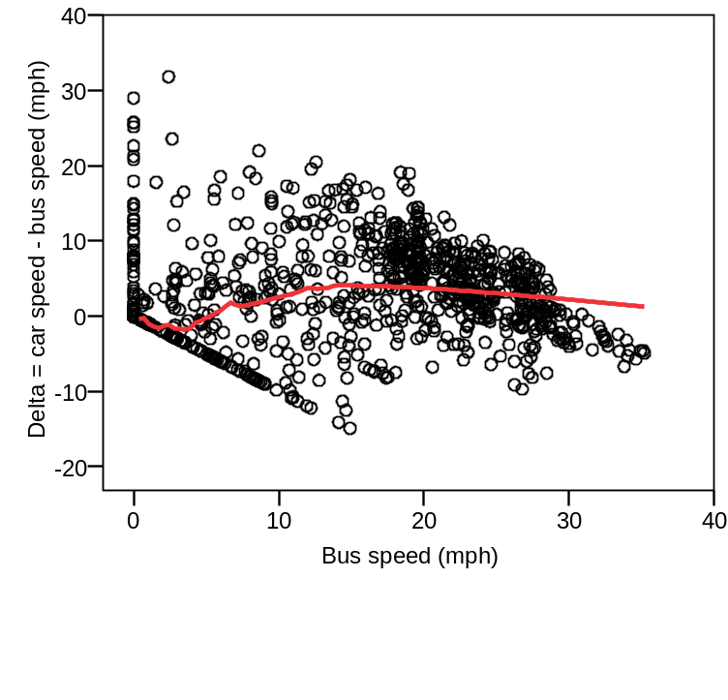
Reasons
Updating algorithm puts too much weight on the historical average
Bus-car relationship
  Linear base bus-car model used
  Nonlinear bus-car relationship in reality
Baseline
Unexpected incident

