Slide 1
Time-series analysis

Slide 2

Basic time series
Data on the outcome of a variable or variables in different time periods are known as time-series data.
Time-series data are prevalent in finance and can be particularly challenging because they are likely to violate the underlying assumptions of linear regression.
Residual errors are correlated instead of being uncorrelated, leading to inconsistent coefficient estimates.
The mean and/or variance of the explanatory variables may change over time, leading to invalid regression results.
Example of a basic time series known as an autoregressive process:
$$x_{t}=b_{0}+b_{1}x_{t−1}+ε_{t}$$
Notes:
This slide introduces time series as a concept, and the basic autoregressive process makes it easy to see where the correlation of the error terms can be a problem. If we are using time-series observations on a given variable, x, then observations in two or more periods are likely to be related to observations from the prior period purely by construction (they may not be so but are likely to be so) as seen in the autoregressive process in the slide.

Slide 3




Trend analysis
The most basic form of time-series analysis examines trends that are sustained movements in the variable of interest in a specific direction.
Trend analysis often takes one of two forms:
Linear trend analysis, in which the dependent variable changes at a constant rate over time.
Ex: if b₀=3 and b₁=2.3, then the predicted value of y after three periods is
2. Log-linear trend analysis, in which the dependent variable changes at an exponential rate over time or constant growth at a particular rate
Ex: if b₀=2.8 and b₁=1.4, then the predicted value of y after three periods is
$$y_{t}=b_{0}+b_{1}t+ε_{t}$$
$$\ln{(y_{t})}=b_{0}+b_{1}t+ε_{t}$$
Notes:
LOS: Compute the predicted trend value for a time series modeled as either a linear trend or log-linear trend, given the estimated trend coefficients.
Pages 377–381
Recall that the inverse process of ln() is raising e to the () power. Because it is the slope of the trend line, b₁ is referred to as the trend coefficient. Log-linear growth should be familiar already, it is the foundation for continuous compounding from earlier chapters.

Slide 4
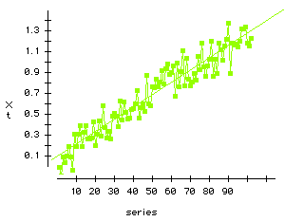
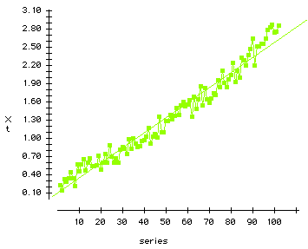
Linear or log-linear?
How do we decide between linear and log-linear trend models?
Is the estimated relationship persistently above or below the trend line?
Are the error terms correlated?
We can diagnose these by examining plots of the trend line, the observed data, and the residuals over time.
Notes:
LOS: Discuss the factors affecting the choice between a linear trend and a log-linear trend model for a time series incorporating a trend.
Pages 381–384
The first plot has a linear trend, and the second, an exponential trend. Point out the curvature in the second plot and the fact that the error terms frequently lie above or below the line for consistent periods of time—both signs that your trend (here shown, again, as a linear trend) isn’t the right model.

Slide 5
Trend models and serial correlation
Are the results of our trend model estimation valid?
Trend models, by their very construction, are likely to exhibit serial correlation.
In the presence of serial correlation, our linear regression estimates are inconsistent and potentially invalid.
Use the Durbin–Watson test to establish whether there is serial correlation in the estimated model.
If so, it may be necessary to transform our data or use other estimation techniques.
Notes:
LOS: Discuss the factors affecting the choice between a linear trend and a log-linear trend model for a time series incorporating a trend.
Page 385

Slide 6
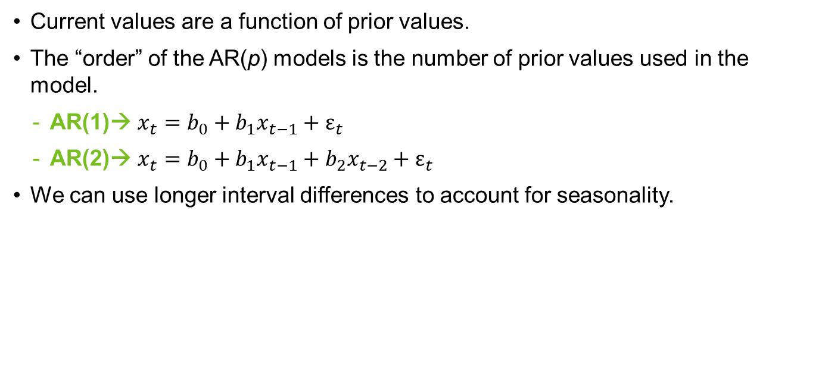

Autoregressive time-series models
Abbreviated as AR(p) models, the p indicates how many lagged values of the dependent variable are used and is known as the “order” of the model.
Current values are a function of prior values.
The “order” of the AR(p) models is the number of prior values used in the model.
AR(1)→ $x_{t}=b_{0}+b_{1}x_{t−1}+ε_{t}$
AR(2)→ $x_{t}=b_{0}+b_{1}x_{t−1}+b_{2}x_{t−2}+ε_{t}$
We can use longer interval differences to account for seasonality.
$$x_{t}=b_{0}+b_{1}x_{t−1}+b_{2}x_{t−4}+ε_{t}$$
Notes:
LOS: Discuss the structure of an autoregressive model of order p.
Page 386
Notice the notation of x and y, which we have used for independent and dependent, are now gone because the distinction is a moot point. In a time-series model, we are only focused on the underlying statistical process.

Slide 7
Covariance-stationary series
A time series is said to be covariance stationary if its mean and variance do not change over time.
Time series that are not covariance stationary have linear regression estimates that are invalid and have no economic meaning.
For a time series to be stationary,
The expected value of the series must be finite and constant across time.
The variance of the series must be finite and constant across time.
The covariance of the time series with itself must be finite and constant for all intervals over all periods across time.
Visually, we can inspect the time-series model for a mean and variance that appear stationary as an initial screen for likely stationarity.
Notes:
LOS: Explain the requirements for a time series to be covariance stationary, differentiate between stationary and nonstationary time series by visual inspection of time-series plots, and explain the impact of nonstationarity in the context of autoregressive time-series models.
Pages 386–387
“Weakly stationary” is a synonym for covariance stationary. Most financial time series are unlikely to be stationary, and visual stationarity of the mean and variance do NOT guarantee covariance stationarity.

Slide 8
Residual autocorrelation
We can use the autocorrelation of the residuals from our estimated time-series model to assess model fit.
The autocorrelation between one time-series observation and another one at distance k in time is known as the kth order autocorrelation.
A correctly specified autoregressive model will have residual autocorrelations that do not differ significantly from zero.
Testing procedure:
Estimate the AR model and calculate the error terms (residuals).
Estimate the autocorrelations for the error terms (residuals).
Test to see whether the autocorrelations are statistically different from zero.
This is a t-test, which, if the null hypothesis of no correlation is rejected, mandates modification of the model or data.
A failure to reject the null indicates that the model is statistically valid.
Notes:
LOS: Explain how autocorrelations of the residuals from an autoregressive model can be used to test whether the model fits the time series.
Pages 387–389
The Durbin–Watson test is invalid for AR(p) series; hence, we need another test to assess the presence of serial correlation and model fit.

Slide 9




Mean reversion
A series is mean reverting if its values tend to fall when they are above the mean and rise when they are below the mean.
For an AR(1) →
the values will
Stay constant when→
Rise when→
Fall when→
$$x_{t}=b_{0}+b_{1}x_{t−1}+ε_{t}$$
Notes:
LOS: Explain mean reversion and determine whether particular time series are mean reverting.
Page 391
Mean reversion is extremely common, particularly for a long-run macro-economic series. However, it is often misapplied. It is worth noting that all covariance-stationary time series will have finite mean-reverting levels.

Slide 10




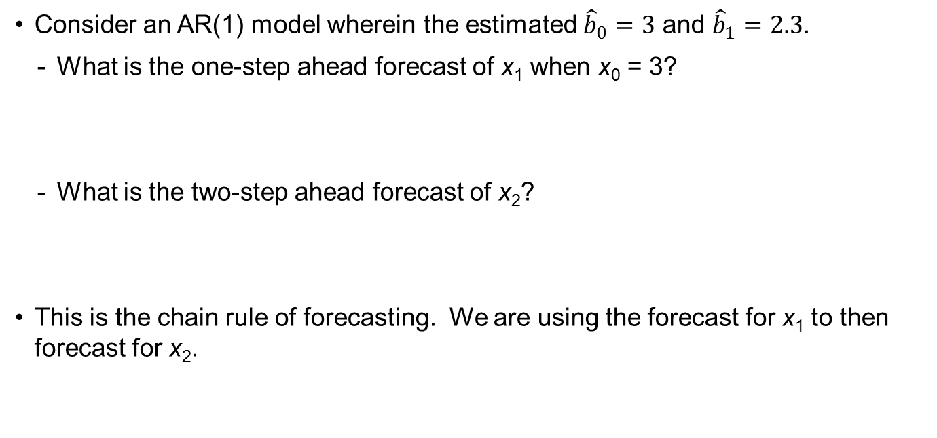
Multiperiod forecasts
We can use the chain rule of forecasting to gain multiperiod forecasts with an AR(p) model.
Consider an AR(1) model wherein the estimated ${\hat{b}}_{0}=3$ and ${\hat{b}}_{1}=2.3$.
What is the one-step ahead forecast of x₁ when x₀ = 3?
What is the two-step ahead forecast of x₂?
This is the chain rule of forecasting. We are using the forecast for x₁ to then forecast for x₂.
Notes:
LOS: Compute the one- and two-period-ahead forecasts of a time series using an autoregressive model.
Pages 391–394
We can do this indefinitely into the future, but recall that each forecast includes the parameter estimation error. So the forecast for x₂ includes the error in the forecast of x₁, which itself includes the parameter estimation error plus any other model or data error, and then x₂ also “re-includes” the parameter estimation error again because we are using the same parameters we used to get x₁ to get x₂. It should be easy to see that as we move progressively further into the future, the error of the forecast gets larger as a multiplicative function of the parameter estimation errors. A confidence interval on the forecast must then get progressively larger, quickly making forecasts further out less reliable even if the underlying parameters don’t change over time.

Slide 11
In- and out-of-sample forecasting
In-sample forecast errors are simply the residuals from a fitted time series, whereas out-of-sample forecast errors are the difference between predicted values from outside the sample period and the actual values once realized.
An in-sample forecast uses the fitted model to obtain predicted values within the time period used to estimate model parameters.
An out-of-sample forecast uses the estimated model parameters to forecast values outside of the time period covered by the sample.
In both cases, the forecast error is the difference between the forecast and the realized value of the variable.
Ideally, we will select models based on out-of-sample forecasting error.
Model accuracy is generally assessed by using the root mean squared error criterion.
Calculate all the errors, square them, calculate the average, and then take the square root of that average.
The model with the lowest mean-squared error is judged the most accurate.
Notes:
LOS: Explain the difference between in-sample forecasts and out-of-sample forecasts, and contrast the forecasting accuracy of different time-series models based on the root mean squared error criterion.
Pages 394–395
Refer to the prior forecasting example. Both of the forecasts in the prior example would be out-of-sample forecasts, and the forecast errors (uncalculated) would be the difference between the forecasts and the actual values.

Slide 12
Coefficient instability
Time-series coefficient estimates can be unstable across time. Accordingly, sample period selection becomes critical to estimating valuable models.
This instability can also affect model estimation because changes in the underlying time-series process can mean that different time-series models work better over different time periods.
Ex. A basic AR(1) model may work well in one period, but an AR(2) may fit better in another period. If we combine the two periods, we are likely to select either the AR(1) or AR(2) model for the combined time span, thereby poorly fitting at least one time span of data.
There are no clear-cut rules for selecting an appropriate time frame for a particular analysis.
Rely on basic sampling theory → Don’t use two clearly different populations.
Rely on basic time-series properties → Don’t mix stationary and nonstationary series or series with different mean or variance terms.
The longer the sample period → The more likely the samples come from different populations.
Notes:
LOS: Discuss the instability of coefficients of time-series models.
Page 397
Selection of appropriate sample periods for time-series estimation is notoriously difficult, but users should follow, at a minimum, basic statistical common sense. For example, don’t mix regimes (different populations).

Slide 13

Random walks
$$x_{t}=x_{t−1}+ε_{t}$$
An AR(1) series where b₀=0 and b₁=1 is known as a random walk because the best prediction for tomorrow is the value today plus a random error term.
Very prevalent in finance
Undefined mean-reversion level because b₀/(1 – b₁) = 0/0 → undefined
Not covariance stationary
There is another common variation, known as a random walk with a drift, where b₀ is a constant number that is not zero.
Notes:
LOS: Define a random walk.
Page 400
Burton Malkiel’s, A Random Walk Down Wall Street, is a reference to this type of series. Demonstrate the first bullet point by pointing out that E(error) = zero; hence, x_{t} = 0 +(1)x_{t-1} + 0 = x_{t-1} .

Slide 14
Unit roots
For an AR(1) time series to be covariance stationary, the absolute value of the b₁ coefficient must be less than 1.
When the absolute value of b₁ is 1, the time series is said to have a unit root.
Because a random walk is defined as having b₁ = 1, all random walks have a unit root.
We cannot estimate a linear regression and then test for b₁ = 1 because the estimation itself is invalid.
Instead, we conduct a Dickey–Fuller test, which is available in most common statistics packages, to determine if we have a unit root.
Notes:
LOS: Explain the relationship between a random walk and unit roots, and discuss the unit root test for nonstationarity.
Page 404
If the presenter has sufficient time, covering the derivation of the Dickey–Fuller test is a nice transition to first differencing on the next slide

Slide 15
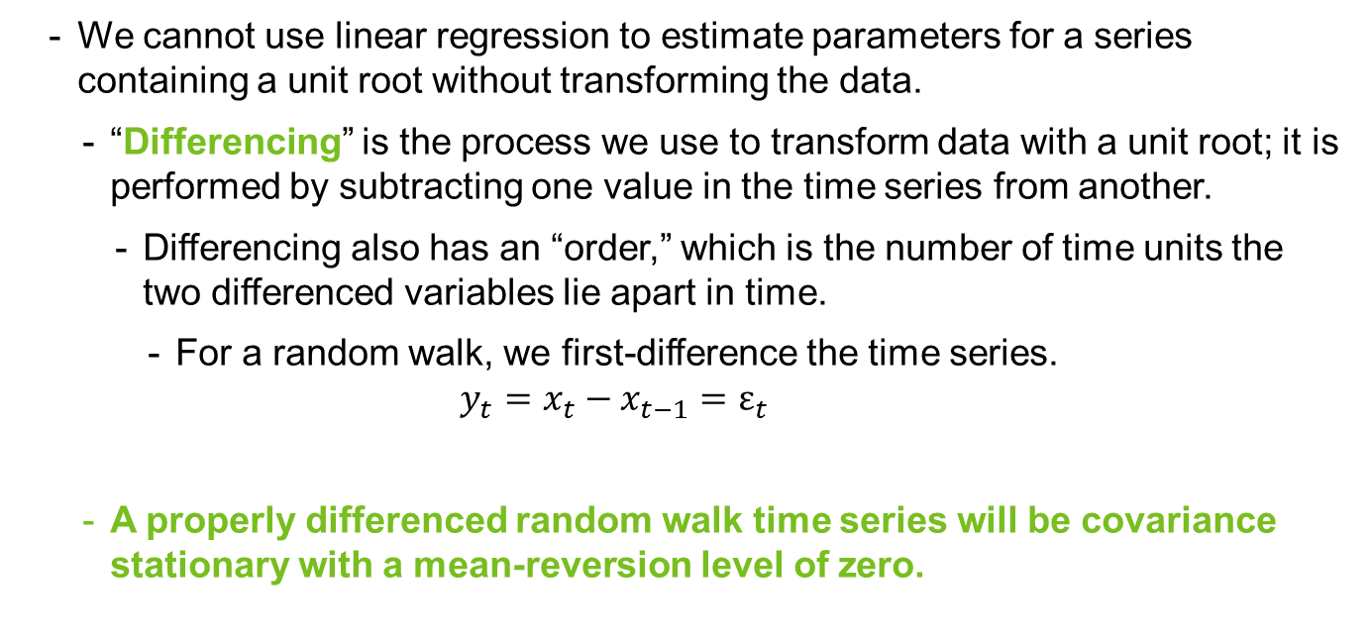
Unit roots and estimation
We cannot use linear regression to estimate parameters for a series containing a unit root without transforming the data.
“Differencing” is the process we use to transform data with a unit root; it is performed by subtracting one value in the time series from another.
Differencing also has an “order,” which is the number of time units the two differenced variables lie apart in time.
For a random walk, we first-difference the time series.
$$y_{t}=x_{t}−x_{t−1}=ε_{t}$$
A properly differenced random walk time series will be covariance stationary with a mean-reversion level of zero.
Notes:
LOS: Discuss how a time series with a unit root can be transformed so that it can be analyzed with an autoregressive model.
Pages 400–403
The differencing process can be used with all time series that exhibit nonstationarity, including those in which the nonstationarity occurs at greater than order 1, although most financial time series will become nonstationary with first-order differencing. A first-differenced variable is often denoted d(1).

Slide 16



Smoothing models
These models remove short-term fluctuations by smoothing out a time series.
An n-period moving average is calculated as
Consider the returns on a given bond index as x₀ = 0.12 , x₋₁ = 0.14, x₋₂ = 0.13, x₋₃ = 0.2.
What is the three-period moving-average return for one period ago (t = –1)?
What is the three-period moving-average return for this period (t = 0)?
Notes:
LOS: Compute an n-period moving average of a time series.
Pages 407–409
One weakness of these models is that they will always “turn late” when the actual data turns. Accordingly, there is a class of n-period average models that may perform better.
It is worth noting that this is an equally weighted n-period moving average. We can also use unequally weighted n-period moving averages, in which the weight of each past observation is different and all weights sum to 1. By doing so, we can, for example, place more weight on more recent observations (i.e., w_{t} = 0.5,
w_{t-1} = 0.3, w_{t-2} = 0.2).
We often use root mean squared error to assess the quality of an n-period moving-average model.

Slide 17
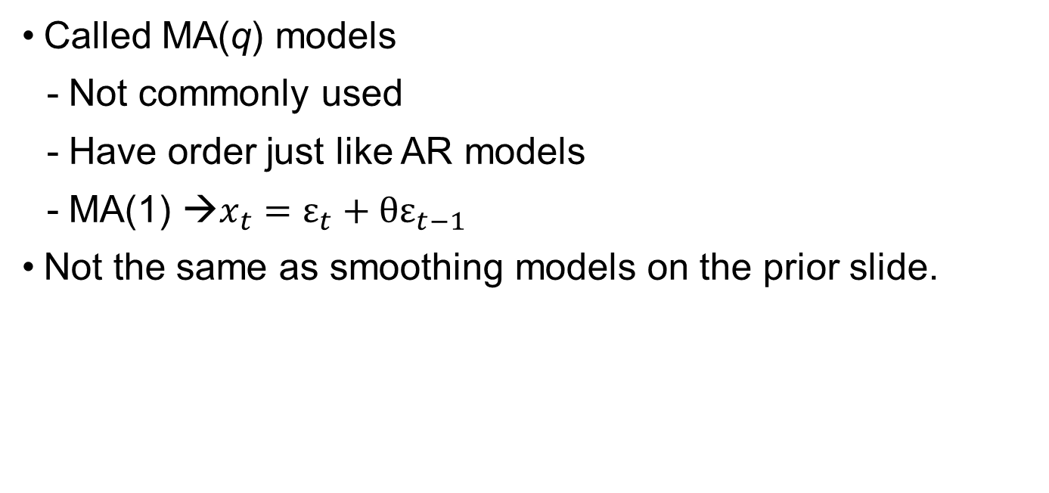
Moving-average time-series models
Called MA(q) models
Not commonly used
Have order just like AR models
MA(1) →$x_{t}=ε_{t}+θε_{t−1}$
Not the same as smoothing models on the prior slide.
Notes:
LOS: Discuss the structure of a moving-average model of order q.
Pages 407–409
Moving-average models are much less common in financial applications than AR models except when we use more advanced models that include both MA and AR terms.

Slide 18

Determining the order of a MA(q)
For a MA(q) model, the first q autocorrelations will be significantly different from 0, and all autocorrelations beyond that will be equal to 0.
For a MA(1) such as, $x_{t}=ε_{t}+θε_{t−1}$, we would expect all autocorrelations beyond the first to be statistically zero.
What is the likely MA order of this process?
Lag | Autocorrelation | t-Statistic
1 | 1.4609 | –6.8912
2 | 1.4384 | 5.4589
3 | 1.4589 | 6.1204
4 | 0.9875 | –0.2345
5 | 0.0356 | 0.0132
Notes:
LOS: Determine the moving-average order of a time series from the autocorrelations of that series.
Pages 409–411
This is likely a MA(3) because the size of the autocorrelations and the statistical significance of the autocorrelations drop off rapidly after the third lag.

Slide 19
AR(p) vs. MA(q)
To determine whether a time series is an AR(p) or a MA(q), examine the autocorrelations.
The autocorrelations for an AR model will generally begin as large values and gradually decline.
The autocorrelations for a MA model will drop dramatically after q lags are reached, identifying both the MA process and its order.
Notes:
LOS: Distinguish an autoregressive time series from a moving-average time series.
Page 410
Distinguishing between these time series is more of an art than a science, and has led to a great number of tests designed to assess the quality of the “fit” for time-series models. Such tests are beyond the scope of this book, but those interested are recommended to further research time-series models before moving much beyond a basic AR or MA process.

Slide 20

seasonality
Time series that show regular patterns of movement within a year across years.
Seasonal lags are most often included as a lagged value one year before the prior value.
We detect such patterns through the autocorrelations in the data.
For quarterly data, the fourth autocorrelation will not be statistically zero if there is quarterly seasonality.
For monthly, the 12th, and so on.
To correct for seasonality, we can include an additional lagged term to capture the seasonality.
For quarterly data, we would include a prior year quarterly seasonal lag as
$$x_{t}=b_{0}+b_{1}x_{t−1}+b_{2}x_{t−4}+ε_{t}$$
Notes:
LOS: Discuss how to test and correct for seasonality in a time-series model.
Pages 412–414
Balance sheet and income statement data, in particular, will often have seasonality related to the underlying nature of the business (the fourth-quarter retail bump in sales, third-quarter wholesale bump in sales, etc.).

Slide 21


Forecasting with seasonal lags
Recall our AR(1) model, wherein the estimated ${\hat{b}}_{0}=3$ and ${\hat{b}}_{1}=2.3$. We have determined that the model, which uses monthly data, has a one-year seasonal component with ${\hat{b}}_{12}=0.4$.
What is the one-step ahead forecast of x₁ when x₀ = 3 and x₋₁₂ = 1.1?
Notes:
LOS: Compute a forecast using an autoregressive model with a seasonal lag.
Pages 412–414

Slide 22
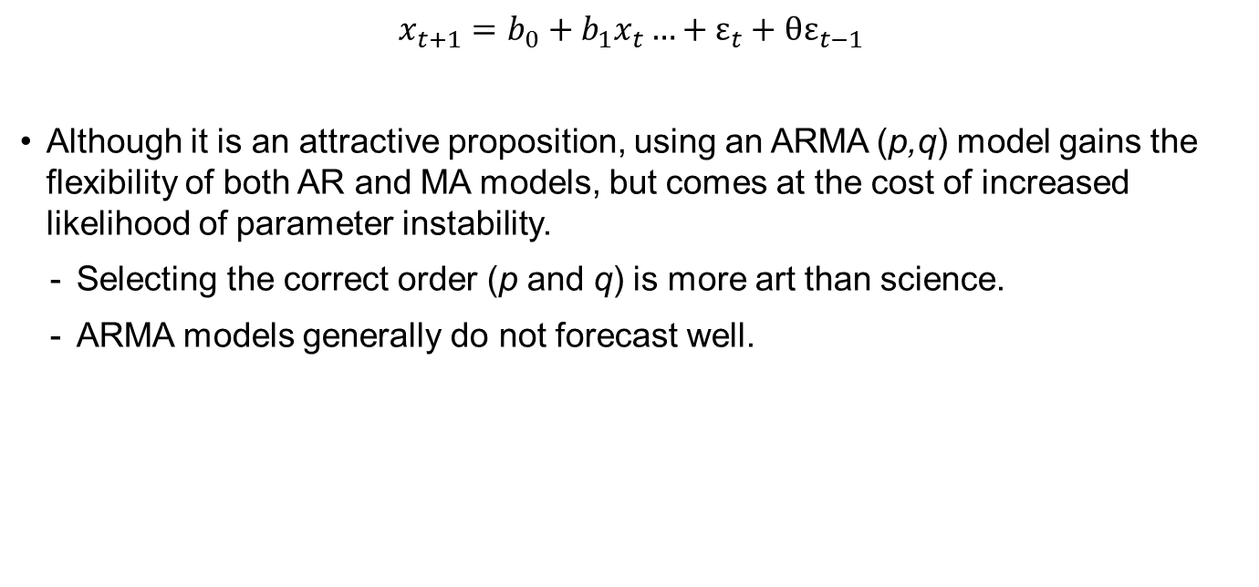
Autoregressive Moving-Average models
It is possible for a time series to have both AR and MA processes in it, leading to a class of models known as ARMA (p,q) models (and beyond).
$$x_{t+1}=b_{0}+b_{1}x_{t}…+ε_{t}+θε_{t−1}$$
Although it is an attractive proposition, using an ARMA (p,q) model gains the flexibility of both AR and MA models, but comes at the cost of increased likelihood of parameter instability.
Selecting the correct order (p and q) is more art than science.
ARMA models generally do not forecast well.
Notes:
LOS: Discuss the limitations of autoregressive moving-average models.
Pages 416– 417

Slide 23
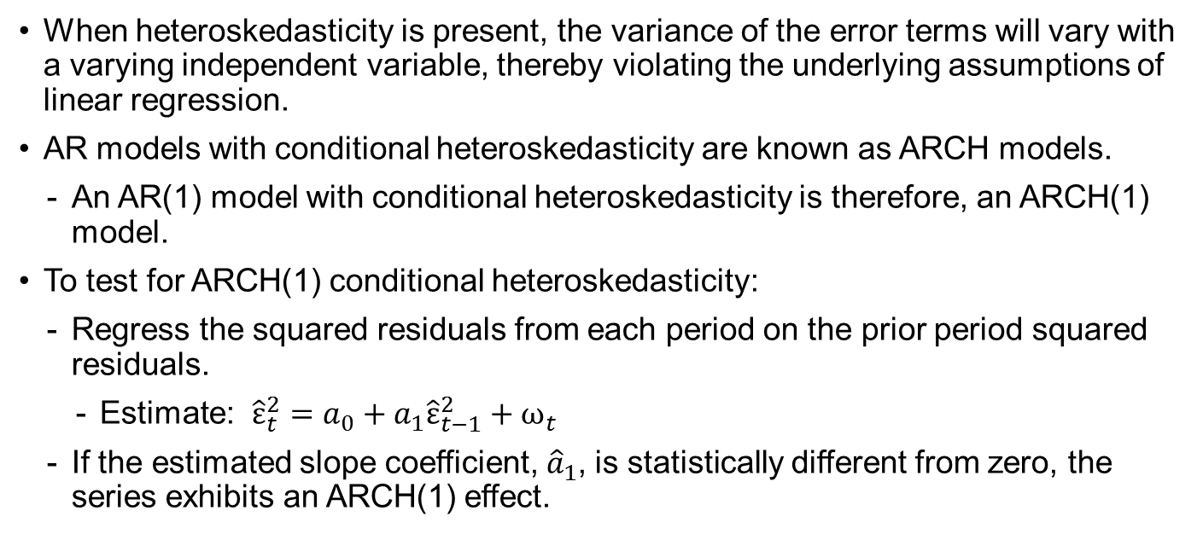
Autoregressive conditional heteroskedasticity
Heteroskedasticity is the dependence of the error term variance on the independent variable.
When heteroskedasticity is present, the variance of the error terms will vary with a varying independent variable, thereby violating the underlying assumptions of linear regression.
AR models with conditional heteroskedasticity are known as ARCH models.
An AR(1) model with conditional heteroskedasticity is therefore, an ARCH(1) model.
To test for ARCH(1) conditional heteroskedasticity:
Regress the squared residuals from each period on the prior period squared residuals.
Estimate: ${\hat{ε}}_{t}^{2}=a_{0}+a_{1}{\hat{ε}}_{t−1}^{2}+ω_{t}$
If the estimated slope coefficient, ${\hat{a}}_{1}$, is statistically different from zero, the series exhibits an ARCH(1) effect.
Notes:
LOS: Discuss how to test for autoregressive conditional heteroskedasticity.
Pages 417–418

Slide 24

Predicting variance
If a series is an ARCH(1) process, then we can use the parameter estimates from our test for conditional heteroskedasticity to predict next period variance as
$${\hat{σ}}_{t}^{2}={\hat{a}}_{0}+{\hat{a}}_{1}{\hat{ε}}_{t−1}^{2}$$
Notes:
LOS: Discuss how to predict the variance of a time series using an autoregressive conditional heteroskedasticity model.
Pages 417–420

Slide 25
Cointegration
Two time series are cointegrated when they have a financial or economic relationship that prevents them from diverging without bound in the long run.
We will often formulate models that include more than one time series.
If any time series in a regression contains a unit root, the ordinary least squares estimates may be invalid.
If both time series have a unit root and they are cointegrated, the error term will be stationary and we can proceed with caution to estimate the relationship via ordinary least squares and conduct valid hypothesis tests.
The caution arises because the regression coefficients represent the long-term relationship between the variables and may not be useful for short-term forecasts.
We can test for cointegration using either an Engle–Granger or Dickey–Fuller test.
Notes:
LOS: Discuss the effects of cointegration on regression results.
Pages 420–424
Cointegration is a “good thing” from the standpoint of our ability to obtain valid estimates, but it is a “bad thing” from the standpoint of our ability to interpret those estimates as being economically meaningful and/or to exploit them.

Slide 26
Selecting an appropriate time-series model
Focus On: Regression Output
You are modeling the rate of growth in the money supply of a developing country using 100 years of annual data. You have estimated an AR(1) model and used the residuals to form the table to the right.
Is the AR(1) model sufficient?
If not, how would you modify it?
Lag | Autocorrelation | t-Statistic
1 | 0.0699 | 1.3019
2 | 0.1007 | 0.1985
3 | 0.0964 | 1.6370
4 | 0.0556 | 8.0553
5 | 0.0377 | 0.1105
6 | –0.0933 | –0.9724
Notes:
LOS: Select and justify the choice of a particular time-series model from a group of models, given regression output and other information for those models.
Pages throughout the chapter
This topic is huge in time series. As the careful reader will note, we generally do not select an appropriate time-series model from the regression output per se, but from the autocorrelations and their statistics.
This model looks like it needs a four-year “seasonal” term. It might be worth asking what could explain a four-year seasonal component to the money supply. One possible answer is a political business cycle in which politicians run up the money supply to get themselves reelected. The likelihood of this explanation could be examined by seeing if the country has a four-year term cycle.

Slide 27
Summary
Most financial data are sampled over time and, accordingly, can be modeled using a special class of estimations known as time-series models.
Time-series models in which the value in a given period depends on values in prior periods, are known as autoregressive, or AR models.
Time-series models in which the value in a given period depends on the error values from prior periods, are known as moving average, or MA models.
Models whose error variance changes as a function of the independent variable are known as conditional heteroskedastic models.
For an AR dependency, these are known as ARCH models.

