Slide 1
CBM Collaboration Meeting
Dresden 25-29 September 2007
WAVELET APPROACH
FOR PEAK FINDING IN HEAVY ION PHYSICS
Gennady Ososkov*, Alexey Stadnik**
^{*)}LIT JINR, Dubna Branch of the Moscow Technical University
^{**)} VBLHE JINR

Slide 2
Outline
About invariant mass method
What are wavelets?
Using discrete wavelet transform for detection peaks from mass spectrum
Continuous wavelet transform based algorithm for calculation peak parameters. Gaussian wavelets “Mexican hat” G₂ and G₄.
An example of determination of K_{S}⁰ meson invariant mass with STAR data
Could it be applicable for the CBM?

Slide 3
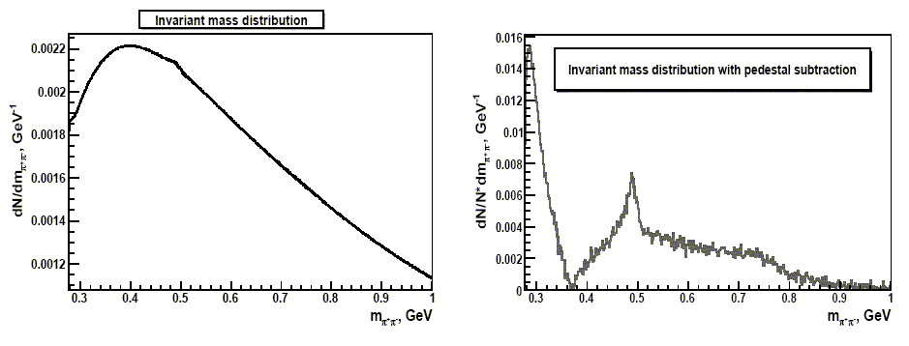
The invariant mass method
Two steps:
approximate the spectrum pedestal
subtract it from the spectrum
Step 1: either approximate by a polynomial or (more effective)
simulate the pedestal by Monte Carlo as a combination of background particles contributing to the same event
K_{S}⁰
Inv. mass = 0.49765
Shortcomings: it supposes, one has adequate knowledge about background processes.
However, it is not always the case. An arbitrariness appears which leads to a stray
background and/or worsen the accuracy.
Is it possible to avoid background estimation?

Slide 4




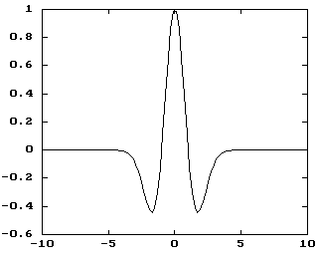
Brief introduction to wavelets
One-dimensional wavelet transform (WT) of the signal f(x) has 2D form
where the function Ψ is the wavelet, b is a displacement (shift), and a is a scale.
Condition C_{ψ} < ∞ guarantees the existence of Ψ and the wavelet inverse transform. Due to freedom in Ψ choice, many different wavelets were invented.
The family of continuous wavelets is presented here by Gaussian wavelets, which are generated by derivatives of Gaussian function
Two of them, we use, are
and
Most known
wavelet G₂ is named
“the Mexican hat”

Slide 5
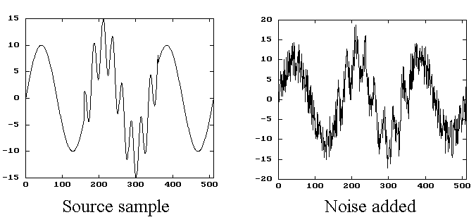
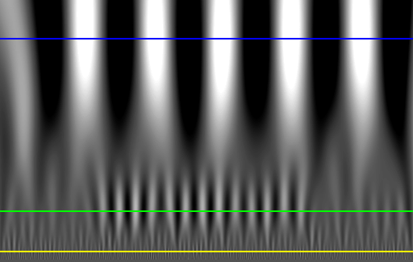
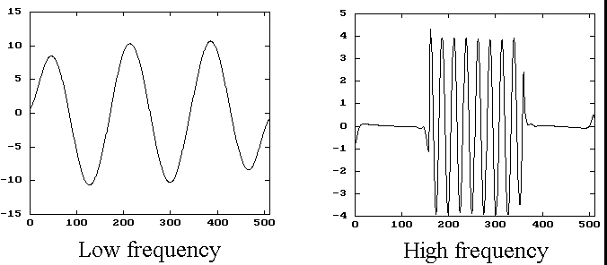
Wavelets can be applied for extracting very special features of mixed and contaminated signal
An example of the signal with a localized high frequency part and considerable contamination
then wavelet filtering is applied
G₂ wavelet spectrum of this signal
Filtering works in the wavelet domain by
thresholding of scales, to be eliminated
or extracted, and then by making
the inverse transform
Filtering results. Noise is removed and high frequency part perfectly localized

Slide 6
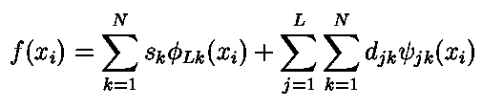

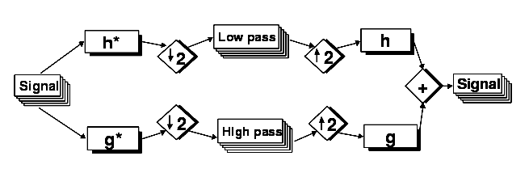

Continuous wavelets: pro and contra
PRO: - Using wavelets we overcome background estimation
- Wavelets are resistant to noise (robust)
CONTRA: - redundancy → slow speed of calculations
- nonorthogonality (signal distotrs after inverse transform)
Besides, real signals to be analised by computer are discrete,
So orthogonal discrete wavelets should be preferable.
The discrete wavelet transform (DWT) was built by Mallat as multi-resolution analysis. It consists in representing a given data as a signal decomposition into basis functions φ and ψ. Both these functions must be compact in time/space and frequency domains.
Scheme of one step of the wavelet decomposition and reconstruction

Slide 7
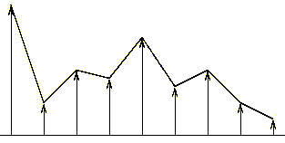
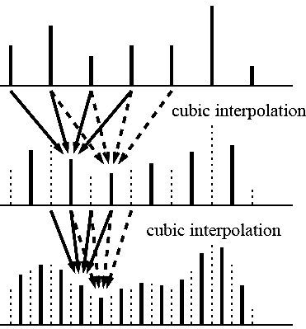
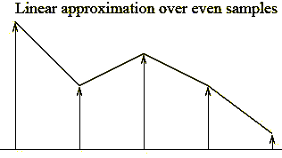
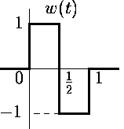
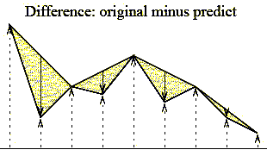
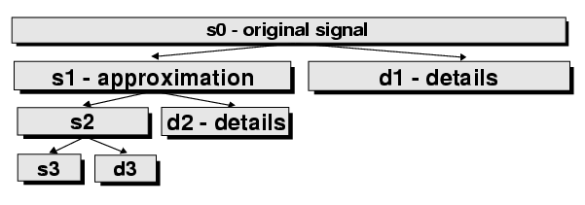
Lifting scheme as an example of discrete wavelets
Original signal
Algorithm:
Decimate into odd - even
Predict and obtain details
Store s_{k} and d_{k} “in place”
continue recursively
requirement: sample size
must be a power of 2 (2^{n})
approximation
Haar wavelet
Prediction can be
non-linear
details
Scheme of decomposition algorithm

Slide 8
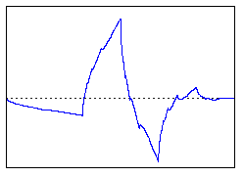
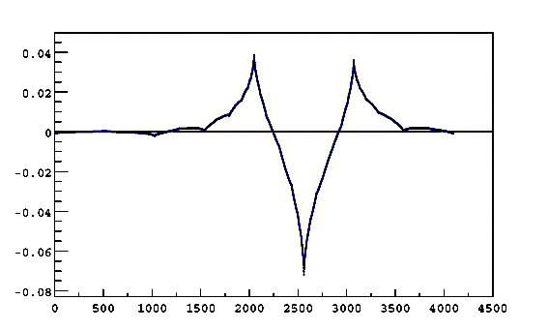
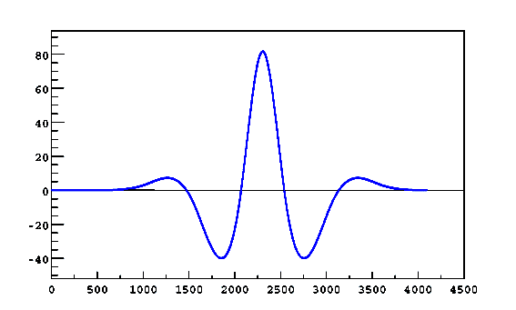


Various types of discrete wavelets
Daubechie’s wavelet
with 2 vanishing momenta
Bi-orthogonal
CDF44 wavelet
Coiflet – most symmetric
Denoising by DWT shrinking
wavelet shrinkage means, certain wavelet
coefficients are reduced to zero:
Our innovation is
the adaptive shrinkage,
i.e. λ_{k}= 3σ_{k} where k is decomposition level (k=scale₁,...,scale_{n}), σ_{k} is RMS of Wψ for this level (recall: sample size is 2^{n})
An example of Daub2 spectrum

Slide 9
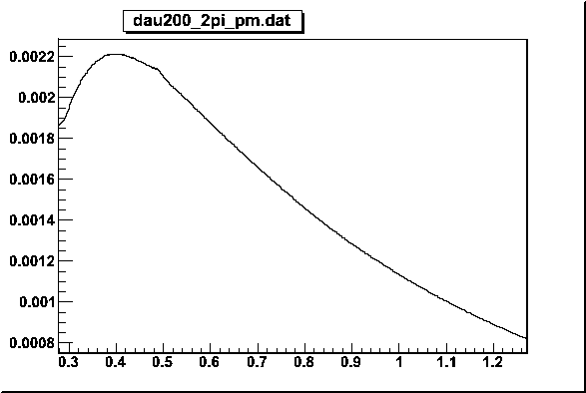
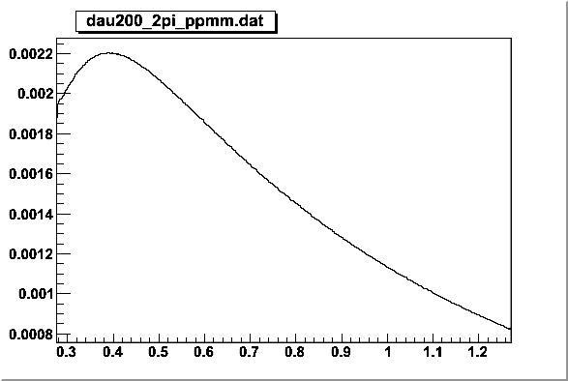
An example of peak detecting by wavelets
We use STAR data d-Au collisions @ 200 GeV (about 1000K events)
Primary tracks (data from TPC)
Pion identification performed by dE/dx: sigma < 2.8
Invariant mass spectrum
of π+π-
Looking for:
K_{S}⁰ invariant mass = 0.49765 GeV
Invariant mass spectrum of combined background
π+π+ & π-π-
K_{S}⁰
No K_{S}⁰
GeV
GeV

Slide 10
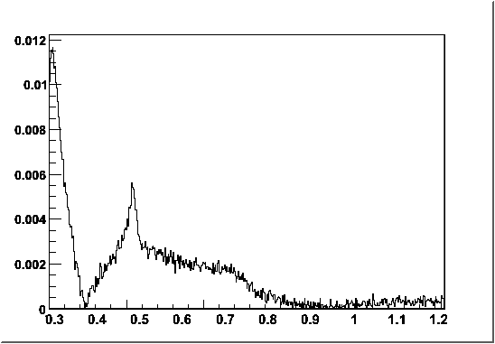
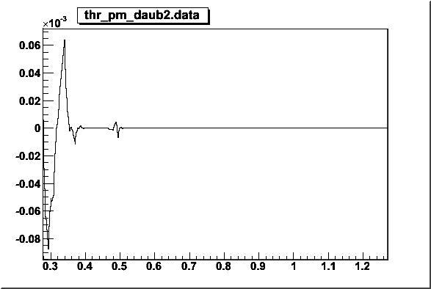
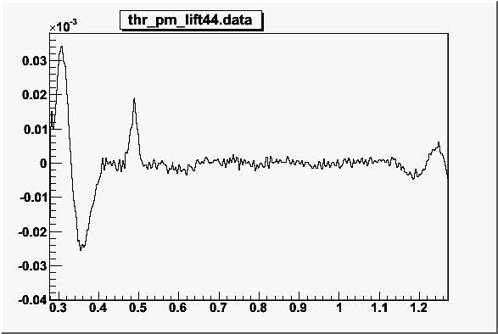
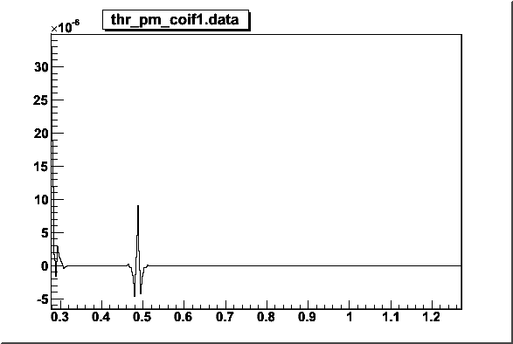
Combined background subtraction
Analysis using wavelet daub2
Peak around 0.37 GeV
due to the edge effect
K_{S}⁰
K_{S}⁰
The indication that we have
K-short here (for orthogonal
wavelets)
GeV
GeV
Analysis using wavelet cdf44
Analysis using wavelet coif1
K_{S}⁰
The indication that we have
K-short here (for orthogonal
wavelets)
K_{S}⁰
Clear peak extraction
(for bi-orthogonal wavelets)
GeV
GeV

Slide 11


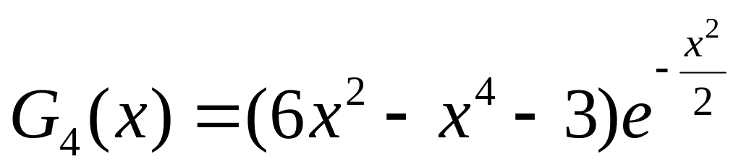
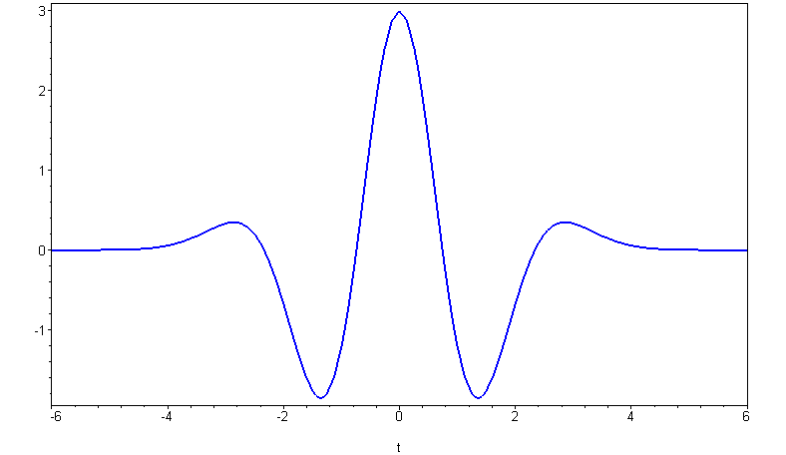
Could be gaussian wavelets applicable for estimating peak parameters?
Yes, if a signal is bell-shaped one and
can be approximated by a gaussian
Then it can be derived analytically that its wavelet transformation looks
as the corresponding wavelet:
For instance, for G₄ we have:
Why G4? - It should eliminate a pedestal if it is a polynomial of 2nd order.
Thus we can work directly in the wavelet domain instead of time/space domain and use this analytical formula for W_{G4}(a,b;x₀,σ)g surface in order to fit it to the surface, obtained for a real invariant mass spectrum.
The most remarkable point is: since the fitting parameters are x₀ and σ,
we do not need the inverse transform!

Slide 12


Analytical calculations to fulfil G₄ wavelet transform
It is easy to find and then to
solve the
equation in order to find the scale
in maximum. The solution on the scale a is a_{max} = 3σ.
Now we can transform the invariant mass spectrum to G₄ domain (a,b), find there b_{max} a_{max} of the obtained surface and then fit it by the analytical formula for W_{G4}(a,b;x₀,σ)g starting fit from x₀= b_{max} and σ = a_{max}/3.
To test this approach we prepared the simulated spectrum of invariant mass, consisting of small gaussian peak at the point 0.47GeV and a pedestal produced by a power four polynomial.

Slide 13
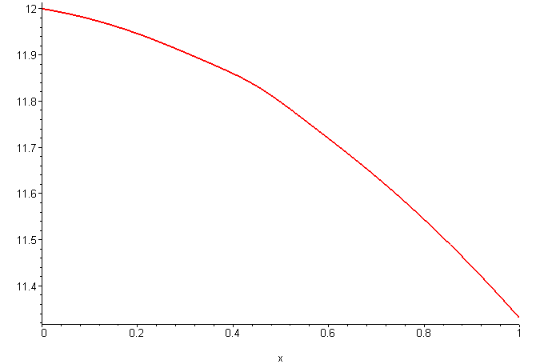
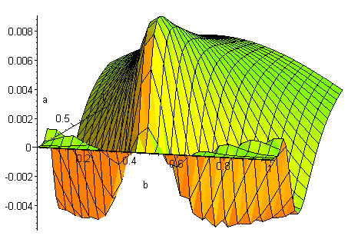
What G4 wavelet gives in ideal case of a polynomial pedestal
Even if it is hard to recognize peak existence by eyes, the G₄ surface clearly shows the sharp maximum at the peaks position.
Important: to avoid edge effects wavelet transformation in this particular example was calculated assuming the signal can be prolonged outside of the boundaries of distribution interval

Slide 14
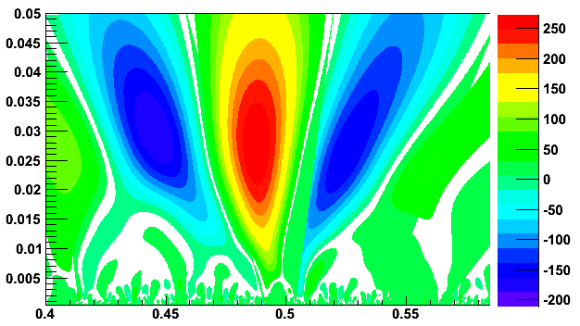
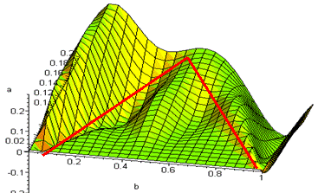
Boundaries and pedestal problem.
In case of real data we have only information at the some finite interval.
Thus, if pedestal is not zero we have an admissible triangle area of wavelet domain between scales:
scale_{min} = 7 * (b₁ – b₀) / 6 / N_{b}
(due to constraint of the historam bin size)
scale_{max} = (b₁ – b₀) / 6
(due to the boundaries of the
finite spectrum interval)
Thus we have the constraint
on the peak search:
it should be inside this triangle.

Slide 15
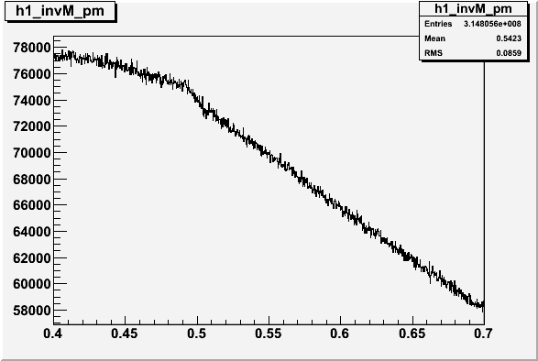
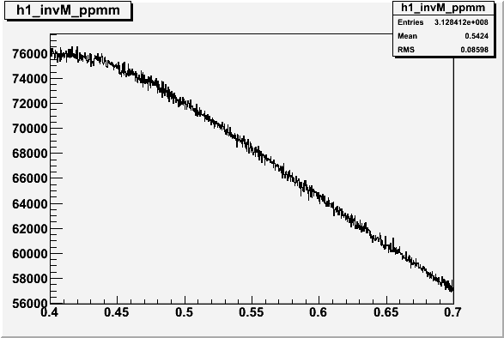
One more example of determination of K_{S}⁰ meson invariant mass
Were used STAR data d-Au collisions @ 200 GeV
Statistics: 240K events.
Primary tracks (data from TPC)
Pion identification performed by dE/dx: sigma < 2.8
Invariant mass spectrum
of π+π-
GeV
Invariant mass spectrum of
combined background of
π+π+ & π-π-
GeV

Slide 16
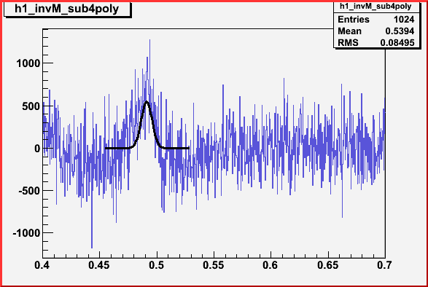
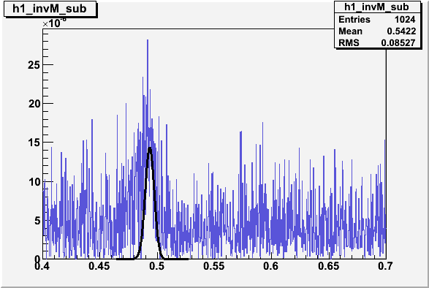
Pedestal estimation + Least square fit.
Two different ways of pedestal estimation: combined background subtraction and subtraction of fitted polynomial power 4.
Least square fitting procedure
gives us following results:
in case of polynomial estimation
0.491095 GeV,
in case of combined estimation
0.493544 GeV.
Particle Data Group K₀^{S} invariant mass 0.497648 GeV.
While G4 gives following results: 0.498821GeV .
GeV
GeV

Slide 17
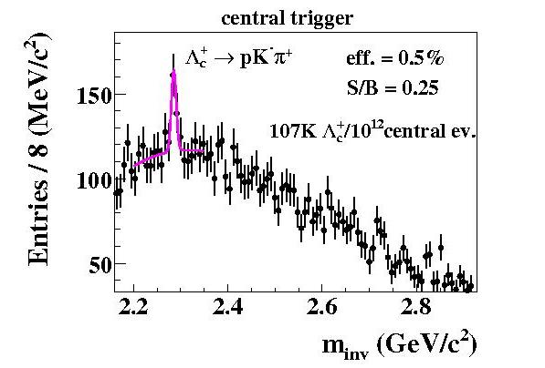
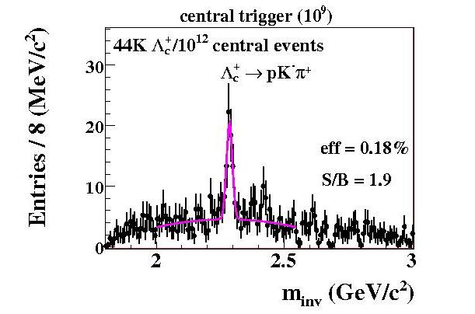
CBM examples
1. Open charm simulations, Dresden 2007, Vassiliev
The common problem of pedestal subtracting approach:
a compromise between S/B and efficiency (0.25% is desirable).
It can be solved by wavelets!
Besides, wavelets provide much better tool for peak fitting than LSQ

Slide 18
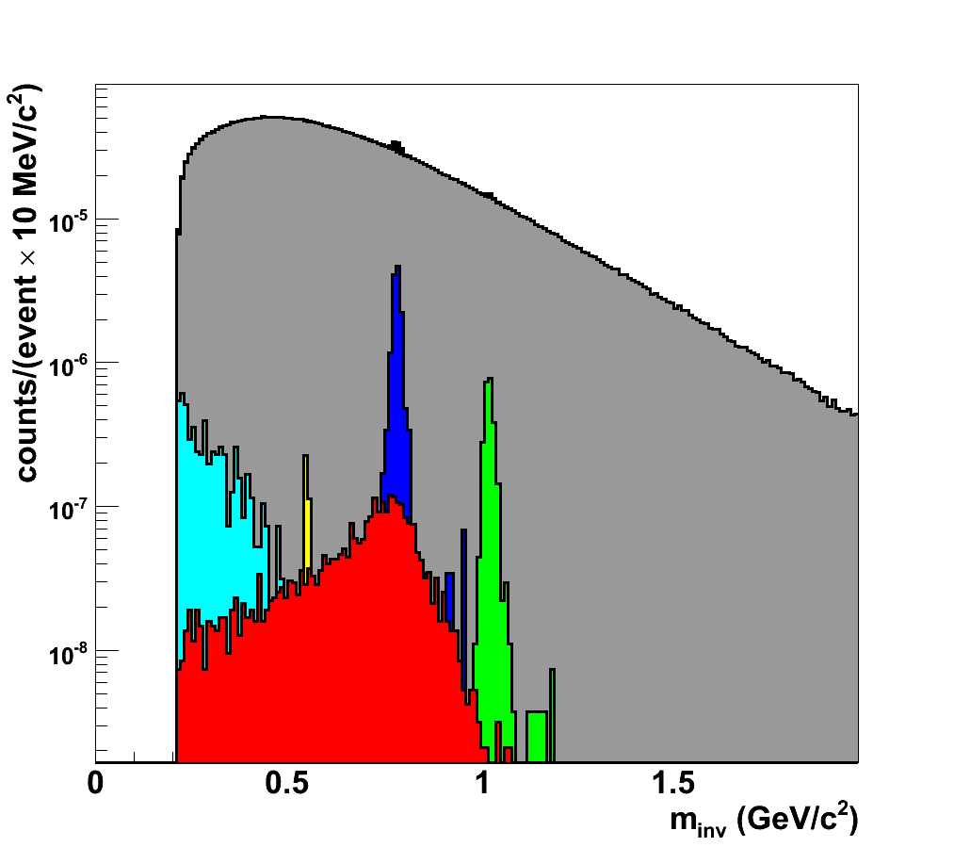
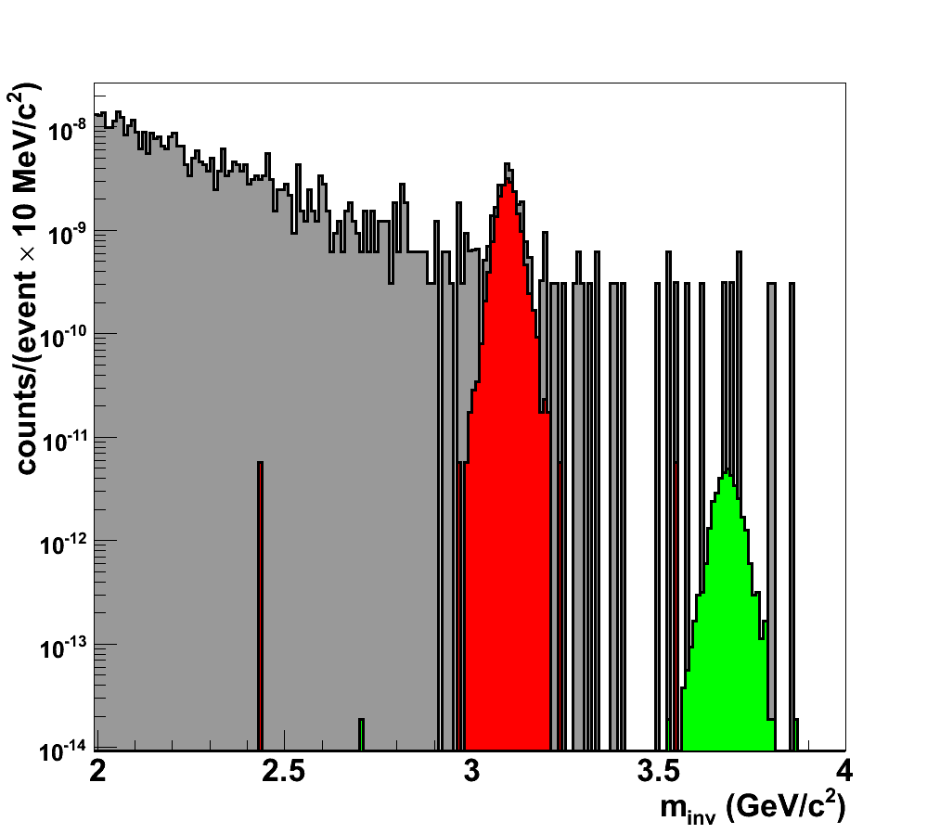
2. Muon identification with realistic detector layout
Dresden 2007, A.Kiseleva:
 background
signals
 ρ
 ω
 φ
 η
 η_{Dalitz}
Central Au+Au collision at 25 AGeV
S/B Efficiency Mass
ratio (%) resolution
(MeV)
ω 0.08 3.7 10
φ 0.03 6 12
ρ 0.001 2.7
J/ψ 7 16 24
Ψ' 0.09 19 28
 background
signals
 J/ψ
 Ψ'
*LMVM: ≥ 4STS + 15(12)MuCh
charm: ≥ 4STS + 18MuCh

Slide 19
Summary and outlook
Discrete wavelets are good for detecting the peak existence.
Wavelets robust to noise or small statistics.
Wavelet G4– based algorithm gives better result comparing to standard LS fit after combined background estimation.
Wavelet approach looks applicable for handling CBM invariant mass spectra, but an intensive study is needed

Slide 20
References
G.A.Ososkov, A.V. Stadnik and M.V.Tokarev, WAVELET APPROACH FOR PEAK FINDING IN HEAVY ION PHYSICS, JINR Comm. E-10-2007-138, Dubna, 2007 – detail of this talk
G.Ososkov, A.Shitov, Gaussian Wavelet Features and Their Applications for Analysis of Discretized Signals, Comp. Phys. Comm, v.126/1-2, (2000) 149-157. – Gaussian wavelet features, resolving two overlapping peaks
W.Sweldens, I.Daubechies, Factoring Wavelet Transforms into Lifting Steps. Fourier Analysis Applications, vol.4 (1998)
http://www.toolsmiths.com/docs/CT199809.pdf - wavelet shrinking

