Slide 1


Comic Book Reference System
By: Kelly Dong

Slide 2
Problem Overview
The comic book industry has been alive and well since the 1940s. With this comes an enormous amount of volumes and issues. That's not even taking account the various reboots, contradicting storylines and similar title names. Altogether, the Marvel and DC fandoms are bethometh messes.
It is a challenge for veteran fans to navigate. Many new fans are put off by this hurdle. The question — What shall I read next? — has never been harder to answer!

Slide 3
The Solution
Using data science and machine learning, the goal is to create a model that will take in user preferences and output comic recommendations.
The user’s preferences could be based on a favorite character/team, plotline (action/slice of life), favorite writer or artist, etcetc. Recommendations are also based on similarities to between comics that you have read before. These models will be created using various classification machine learning methods and natural language processing.
The final product should be a simple website created with either HTML/CSS or Ruby to present our findings in an easily digestible method.

Slide 4

Impact of Solution
The main service that our solution provides is convenience. The typical reader has to plow through tons of different sites to hunt for descriptions and summaries to decide what to read. This process is even harder for new fans who are not familiar with the comic series.
Our model does the legwork, saving the user both time and effort. This allows them to effortlessly enjoy reading.

Slide 5
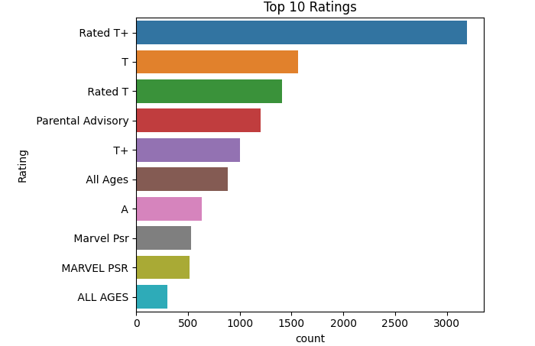
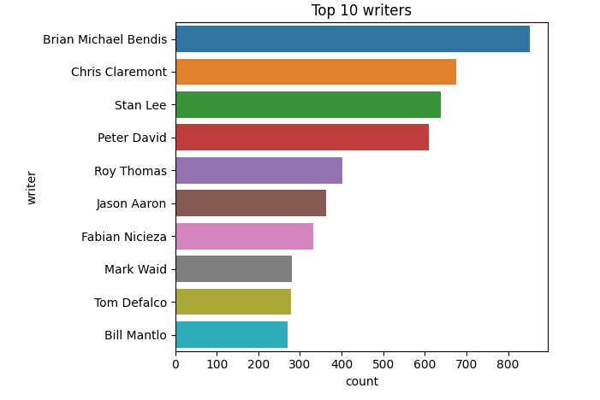
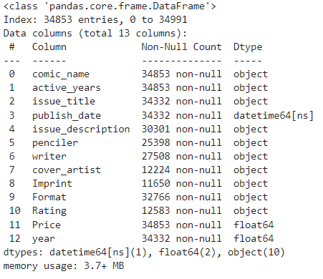
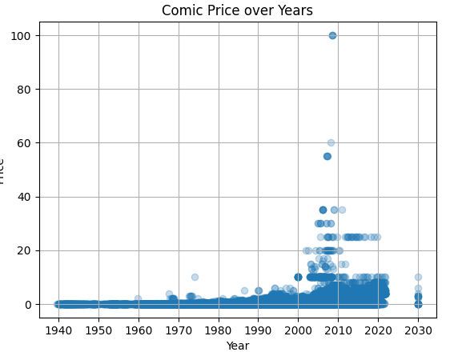
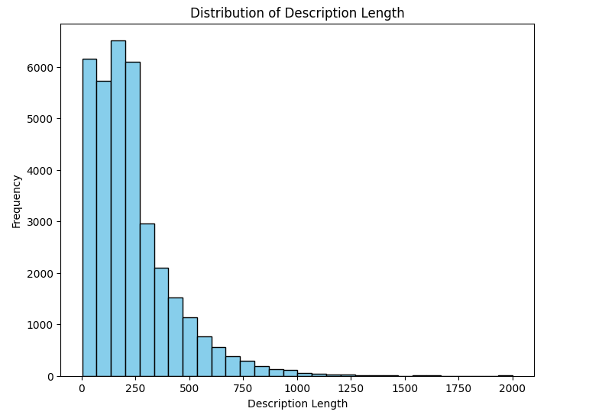
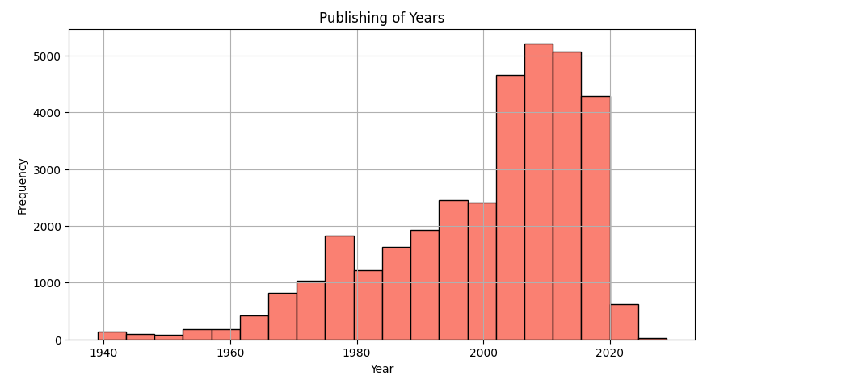
Kaggle Marvel Dataset

Slide 6

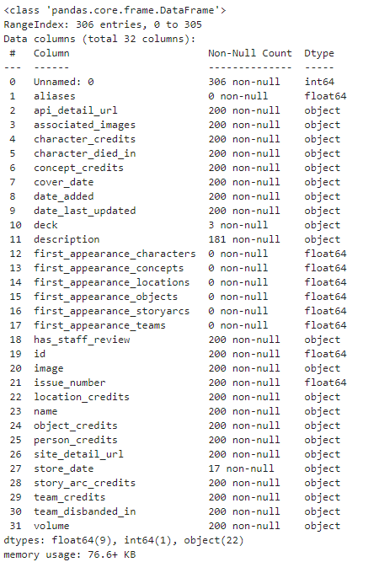
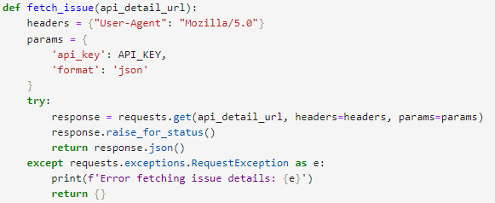
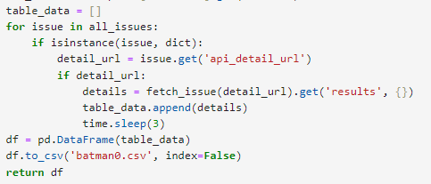
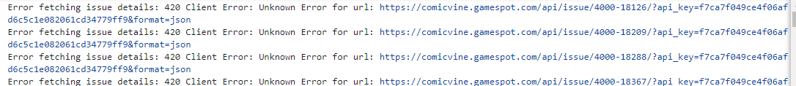
ComicVine API

Slide 7
Next Steps
A deeper dive (EDA) into the marvel dataset. Especially into word frequency. I also want to do some EDA for associating certain keywords with common plot toupes.
Create a simple natural language processing model for the marvel dataset.
Gathering more data using the comicvine API.
Gather data in chunks to get around request limit
Join datasets and then clean data.
There is a lot of redundancy in this dataset to clean
ComicVine Dataset EDA
Focus on natural language processing EDAs such has word frequency
Focus on artists, writers, locations for EDA

