Slide 1


Comic Book Recommendation System
By: Kelly Dong

Slide 2
Project Overview
The comic book industry is a behemoth mess with an enormous amount of volumes and issues. It is a constant challenge to search through the large backlog for a story that will interest you.
Using natural language processing and feature engineering, we will create a model that takes in an issue name that you have read before and output recommendations that are similar to your input.
The resulting product will save the user time and energy as they browse for their next comic book.

Slide 3
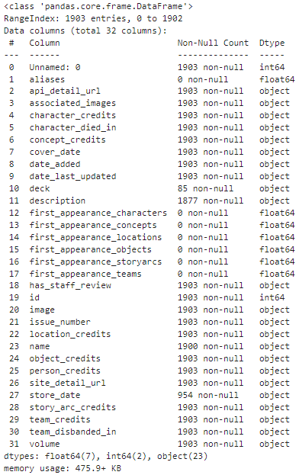
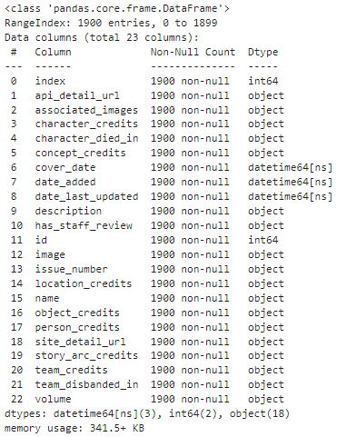
Dataset Overview & Preprocessing

Slide 4

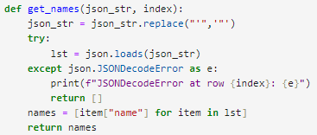
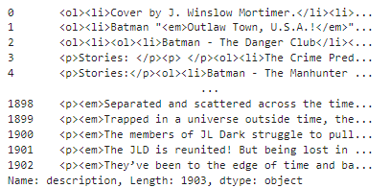
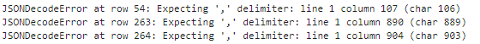
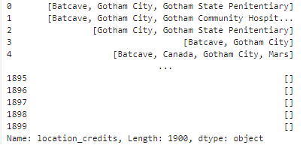
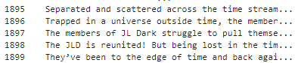
Dataset Overview & Preprocessing

Slide 5
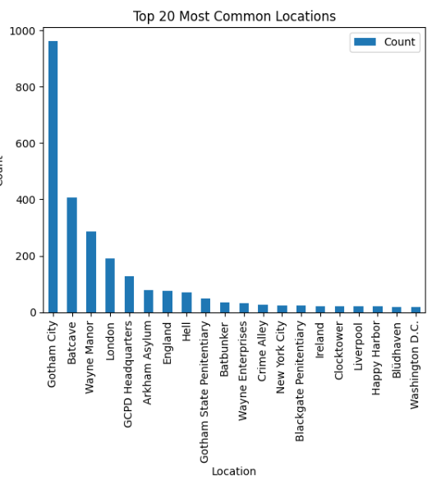
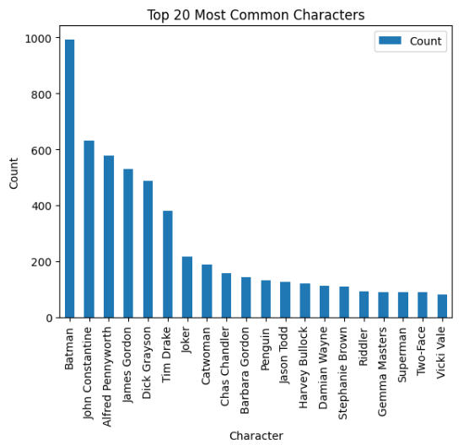
EDA

Slide 6
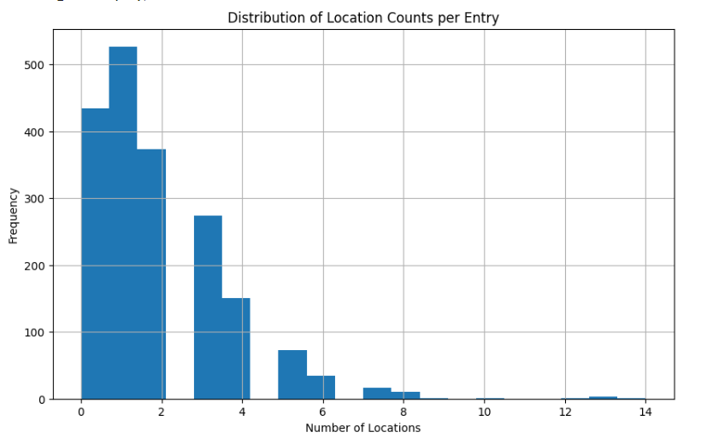
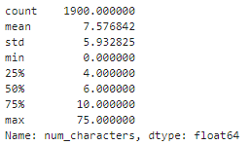
EDA

Slide 7
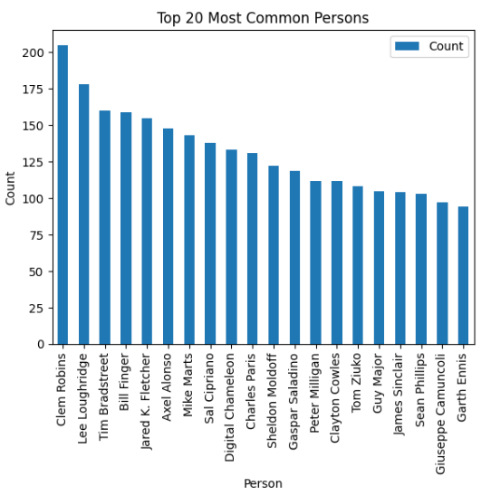
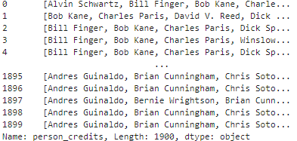
EDA
"[{'api_detail_url': 'https://comicvine.gamespot.com/api/person/4040-46732/', 'id': 46732, 'name': 'Alvin Schwartz', 'site_detail_url': 'https://comicvine.gamespot.com/alvin-schwartz/4040-46732/', 'role': 'writer'}, {'api_detail_url': 'https://comicvine.gamespot.com/api/person/4040-43591/', 'id': 43591, 'name': 'Bill Finger', 'site_detail_url': 'https://comicvine.gamespot.com/bill-finger/4040-43591/', 'role': 'writer'}, {'api_detail_url': 'https://comicvine.gamespot.com/api/person/4040-19137/', 'id': 19137, 'name': 'Bob Kane', 'site_detail_url': 'https://comicvine.gamespot.com/bob-kane/4040-19137/', 'role': 'penciler'}, {'api_detail_url': 'https://comicvine.gamespot.com/api/person/4040-38494/', 'id': 38494, 'name': 'Charles Paris', 'site_detail_url': 'https://comicvine.gamespot.com/charles-paris/4040-38494/', 'role': 'inker'}, {'api_detail_url': 'https://comicvine.gamespot.com/api/person/4040-47799/', 'id': 47799, 'name': 'Dick Sprang', 'site_detail_url': 'https://comicvine.gamespot.com/dick-sprang/4040-47799/', 'role': 'penciler, inker'}, {'api_detail_url': 'https://comicvine.gamespot.com/api/person/4040-60917/', 'id': 60917, 'name': 'Lew Sayre Schwartz', 'site_detail_url': 'https://comicvine.gamespot.com/lew-sayre-schwartz/4040-60917/', 'role': 'penciler'}, {'api_detail_url': 'https://comicvine.gamespot.com/api/person/4040-62244/', 'id': 62244, 'name': 'Pat Gordon', 'site_detail_url': 'https://comicvine.gamespot.com/pat-gordon/4040-62244/', 'role': 'colorist'}, {'api_detail_url': 'https://comicvine.gamespot.com/api/person/4040-32572/', 'id': 32572, 'name': 'Winslow Mortimer', 'site_detail_url': 'https://comicvine.gamespot.com/winslow-mortimer/4040-32572/', 'role': 'penciler, inker, cover'}]"

Slide 8
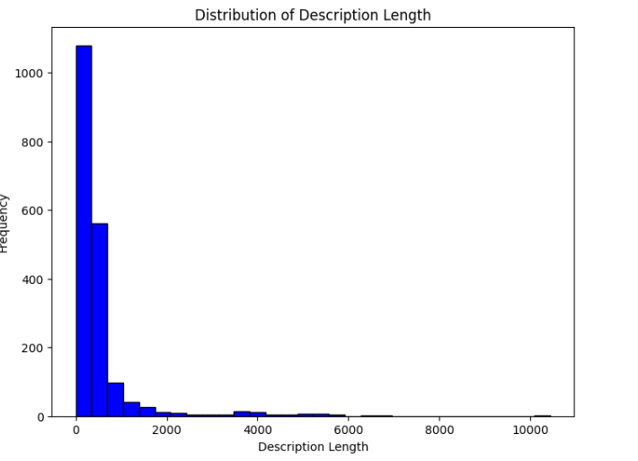
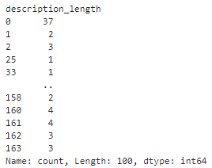
EDA

Slide 9
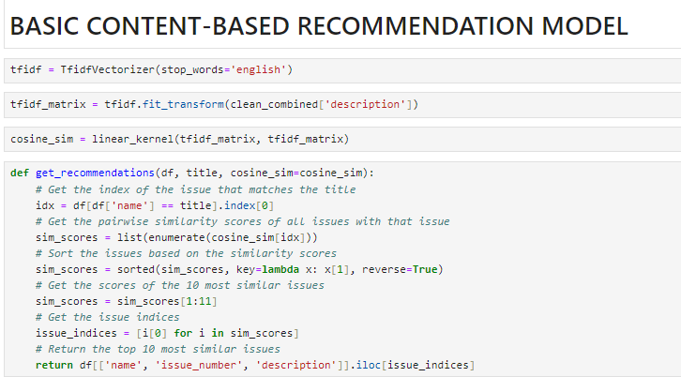
Baseline Model & Evaluation

Slide 10
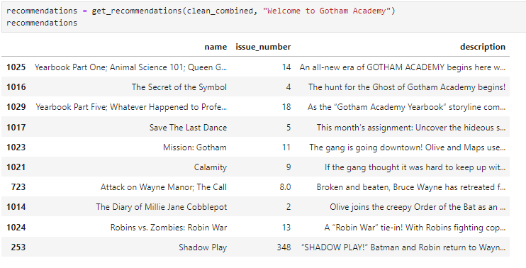
Baseline Model & Evaluation

Slide 11
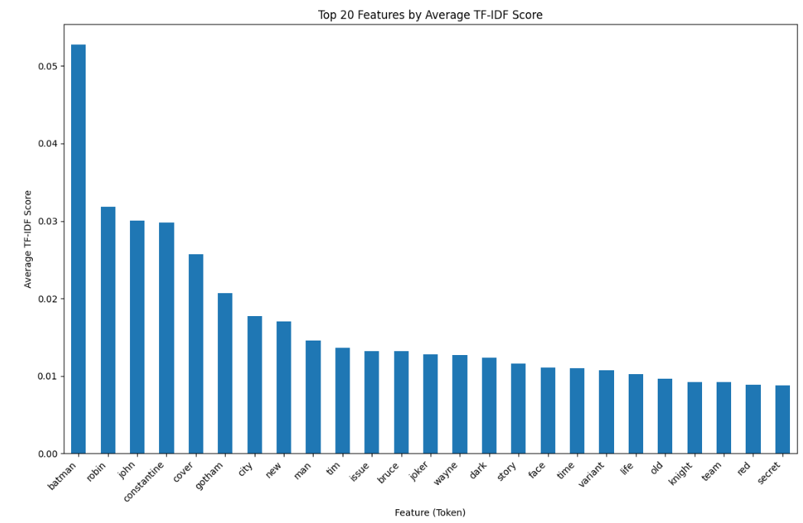
Baseline Model & Evaluation

Slide 12
Next Steps…
Continue to collect data for our model.
Continue to clean our collected data and find a way to resolve errors in the json strings.
Build off of our baseline model. Add our other features into the NLP model and create custom tokens for these features.
Try other Vectorization methods.
Create a simple R SHINY application for ease of use of model.

