Slide 1

Project Trials
Garrett Kizior, Keith Droll, Ryan Desalvio, Nicolas Bratton

Slide 2
Problem Motivation
We wanted to make a game that incorporated many game elements :
Advancing Storyline
Original Soundtrack
Fast-Paced Action
High Replayability
It is hard to find a game that includes all of these elements
So we made our game to satisfy this demand

Slide 3
Project Goals
To:
Learn Unity game engine
Collaborate in a team for a large project
Develop a game from scratch that meets our motivation criteria
Learn and utilize source control software ( Github )

Slide 4
Design Outline
Model-View-Controller design
Model:
Storing game data (enemy health, location)
Storing game attributes, experience gained
View:
Displays GUI that shows:
Map, Enemies, User Player, Health bar, etc.
Controller:
Receives mouse clicks, keyboard input, and game-pad input

Slide 5
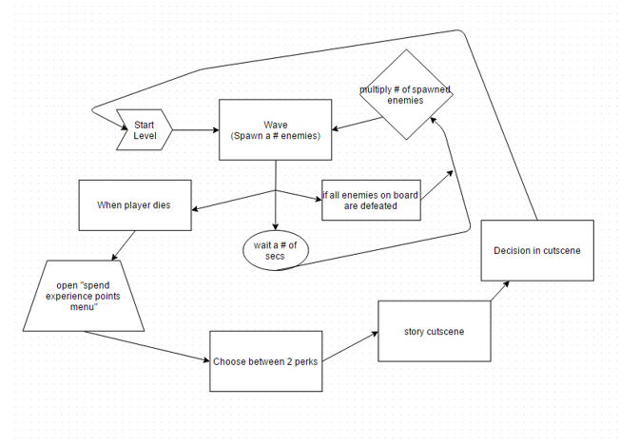
Design Outline cont..

Slide 6
Iteration 3 tasks
Implement a storyline (Cut scenes and decisions after each level)
Multiple playable levels included (w/ different environments and enemies
Include soundtrack and sound effects
Implement more enemies, consumable pickup items, and weapons
Balance the game (Enemy damage, health, spawn rate, item influence)

Slide 7
Iteration 3 – video

