Slide 1
adding internationalization and localization
“The zoo is holding a special event on 4/1/15 to look at animal behaviors” - When is this event?
If we are making a website or program that will run in multiple countries, we want to use the correct language and formatting.
Notes:
In the United States, it is on April 1. However a British reader would interpret this as January 4. A British reader might also wonder why we didn’t write “behaviours.”

Slide 2
Internationalization is the process of designing your program so it can be adapted
placing strings in a property file
using classes like DateFormat
Notes:
Internationalization:
You do not actually need to support more than one language or country to internationalize the program. Internationalization just means that you can.

Slide 3
Localization means actually supporting multiple locales.
Oracle defines locale as “a specific geographical, political, or cultural region.”
translating strings to different languages
outputting dates and numbers in the correct format for that locale
Notes:
- You can think of a locale as being like a language and country pairing.
- You can go through the localization process many times in the same application as you add more languages and countries.

Slide 4
Internationalization and Localization are such long words, therefore often abbreviated as i18n and l10n
Notes:
The number refers to the number of characters between the first and last characters, in other words, the number of characters that are replaced with a number.
In this section, we will look at how to define a locale, work with resources bundles, and format dates and numbers.

Slide 5
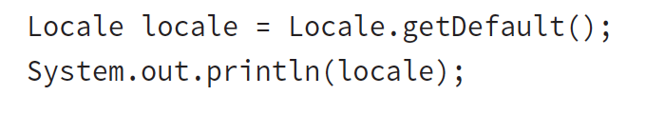
Picking a locale
The Locale class is in the java.util package
Notes:
When we run it, it prints en_US. It might be different for you. This default output tells us that our computers are using English and are sitting in the United States.

Slide 6
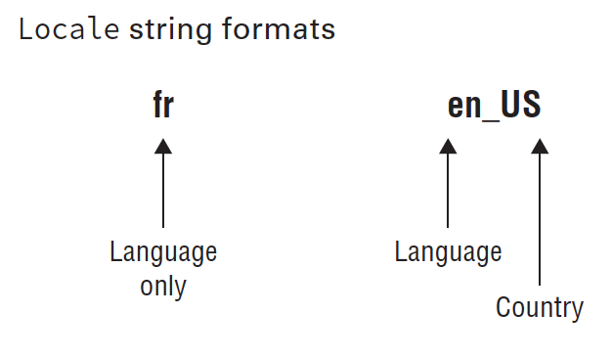
First comes the lowercase language code. Then comes and underscore followed by uppercase country code
underscore and country code are optional
It is valid for a Locale to be only a language

Slide 7
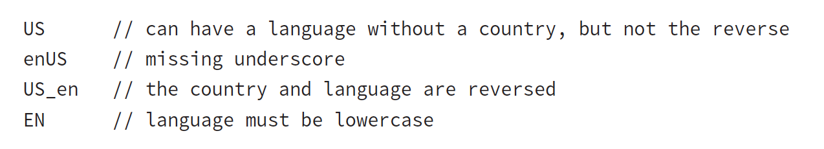
Notes:
- You do not need to memorize language or country codes. The exam will let
you know about any that are being used.
- You do need to recognize valid and invalid formats. Pay attention to uppercase/lowercase and the underscore.

Slide 8
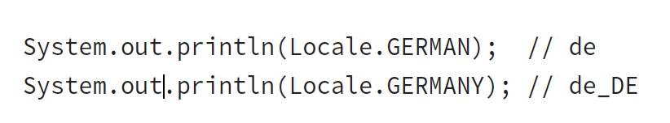
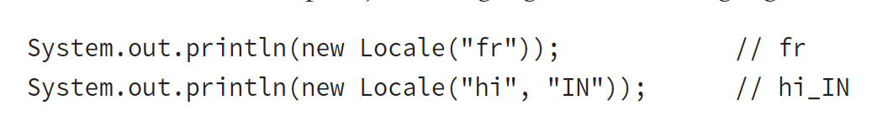
Creating a Locale other than default (3 main ways)
1. thru constants
2. using constructors
Notes:
- 1. Notice that the first one is the German language and the second is Germany the country— similar, but not the same.
2. The first is the language French and the second is Hindi in India. Again, you don’t need to memorize the codes. There is another constructor that lets you be even more specific about the locale. That variant is not on the exam.
Java will let you create a Locale with an invalid language or country. However, it will not match the Locale that you want to use and your program will not behave as expected.

Slide 9
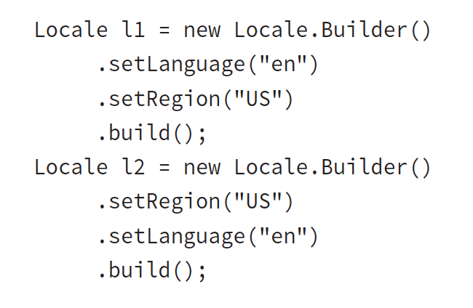
1. thru builder design pattern
Notes:
The builder design pattern lets you set all of the properties that you care about and then build it at the end.
As you saw in Chapter 2 , the advantage of the builder pattern is that you can easily use different combinations of setter methods. Locale.Builder supports a number of other setter methods that you don’t need to know for the exam.

Slide 10
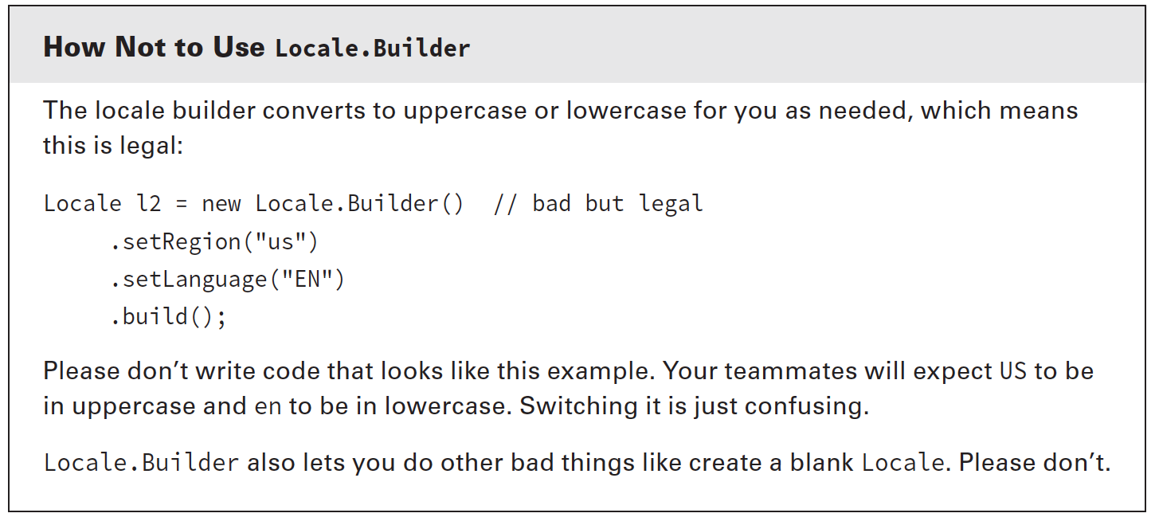

Slide 11
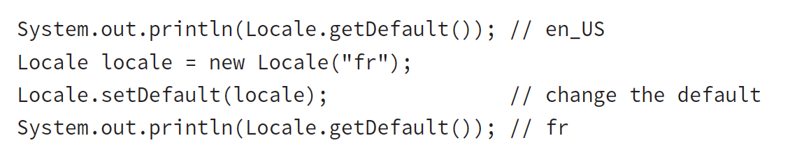
Setting a locale other than the default
changes apply only to that one Java program
does not change any computer settings
don’t even change future programs
Notes:
- The exam uses setDefault a lot because it can’t make assumptions about
where you are located. In practice, setDefault is used extremely rarely.

Slide 12
using a resource bundle
A resource bundle contains the local specific objects to be used by a program.
It is like a map with keys and values.
Can be in a property file or a Java class
Notes:
Up until now, we’ve kept all of the strings from our program in the classes that use them.
Localization requires externalizing them to elsewhere. This is typically a property file, but it could be a resource bundle class.

Slide 13
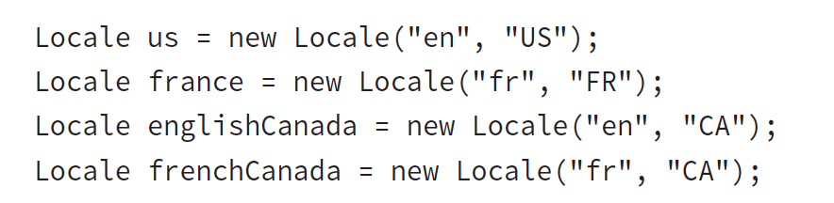
Zoo expansion - 3 more zoos
Zoo de La Palmyre in France
the Greater Vancouver Zoo in English-speaking Canada
Zoo de Granby in French-speaking Canada
Notes:
- We immediately realized that we are going to need to internationalize our program.
- Resource bundles will be quite helpful. They will let us easily translate our application to multiple locales or even support multiple locales at once. It will also be easy to add more locales later if we get zoos in even more countries interested.

Slide 14
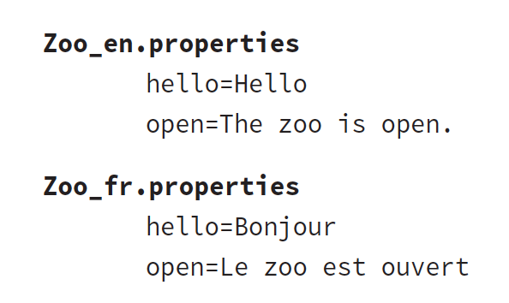
Creating a property file resource bundle
No need to create four different resource bundles
If no country-specific, Java will use language-specific resource bundle

Slide 15
See demo: _031_ZooOpenResourceBundle.java
Notes:
- Notice how much is happening behind the scenes here. Java uses the name of the bundle (Zoo) and looks for the relevant property file. You will see this again later in the chapter and learn how Java figures out which one to use.

Slide 16
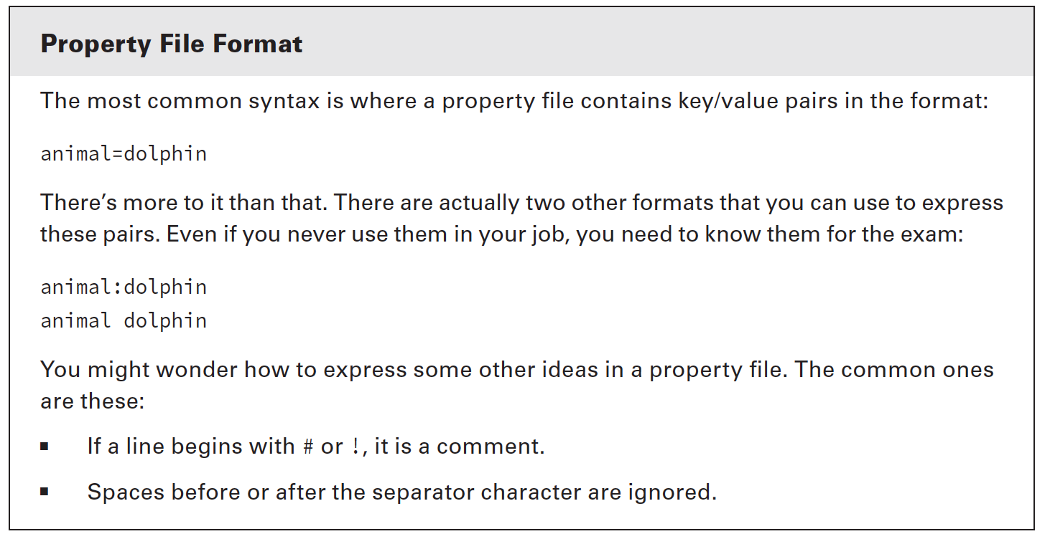

Slide 17
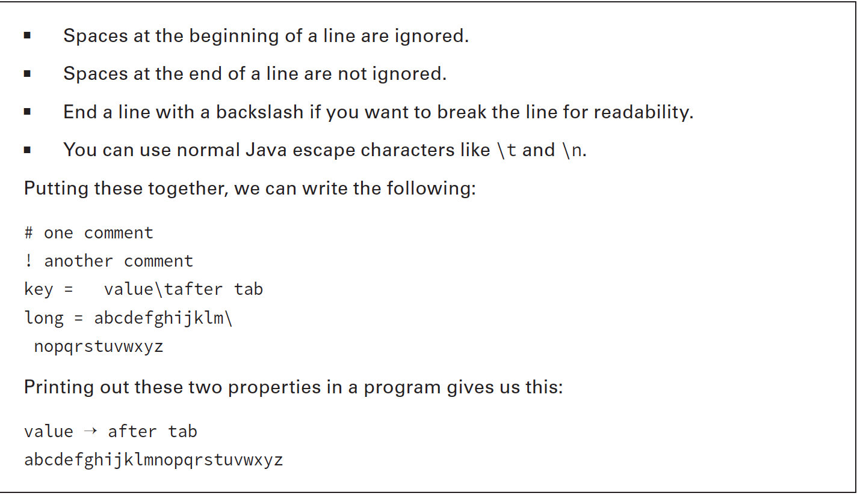

Slide 18
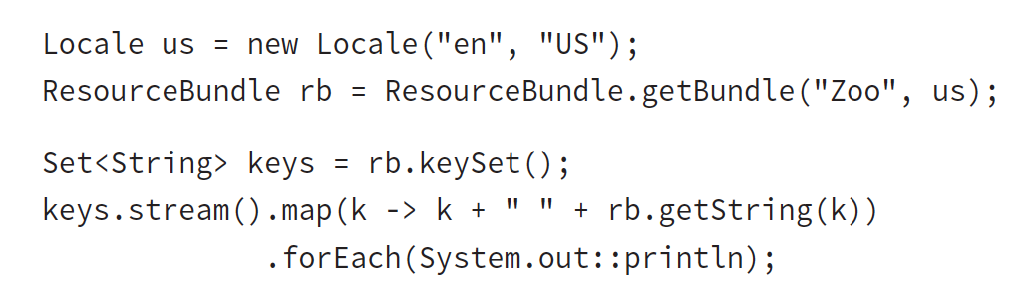
Looping through resource bundle to list all pairs:
Notes:
- And yes, we could have used a traditional for loop. You need to know both loops and functional programming for the exam, so we use both approaches throughout the book.

Slide 19
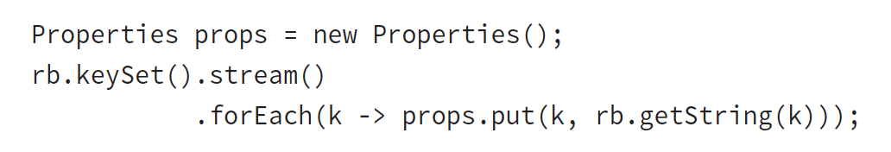
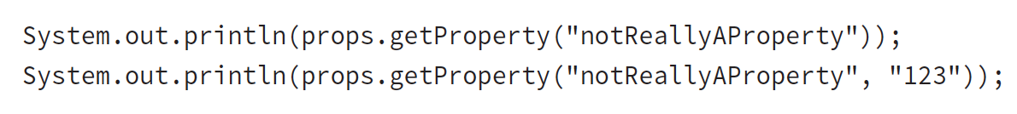
In addition to ResourceBundle, Java supports a class named Properties.
Properties has some additional features, including being able to pass a default.
Converting from ResourceBundle to Properties is easy:
Notes:
Properties is like a Map that you learned about in Chapter 3, “Generics and Collections.” It was written before Map existed, so it doesn’t use all of the same method names.
Note that the method called is getProperty(). There is also a get() method as we’d expect with any collection. Only getProperty() allows for a default value.

Slide 20
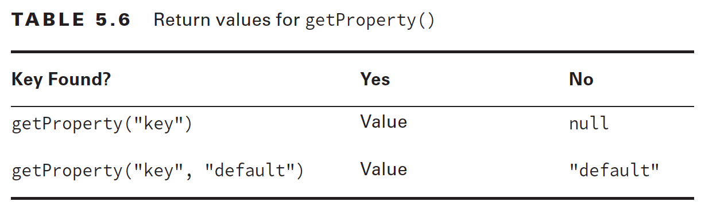

Slide 21
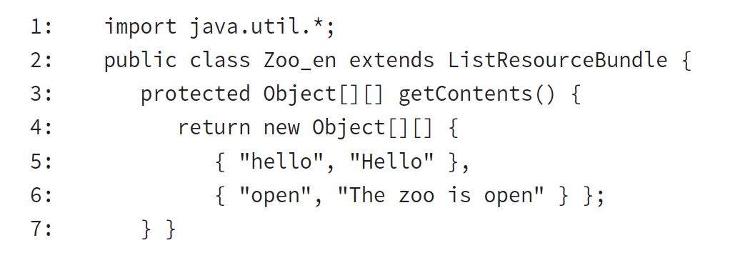
Creating a Java Class Resource Bundle
Most of the time Property file resource bundle is enough
Limitation of Property file: only String values are allowed
Java resource bundles allow any Java type as the value. Keys are strings regardless

Slide 22
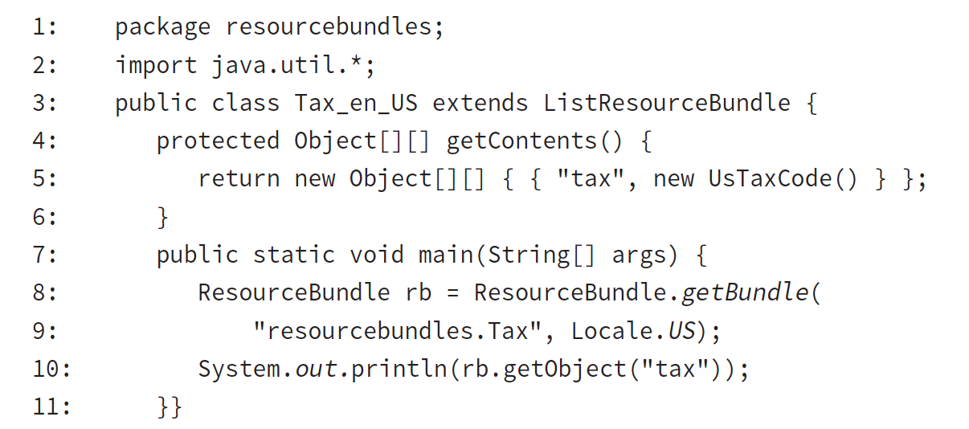
2 main advantages of Java resource bundle
You can use a value type that is not String
You can create the values of the properties at runtime
In our zoos, we realize we need to collect tax differently on each country

Slide 23
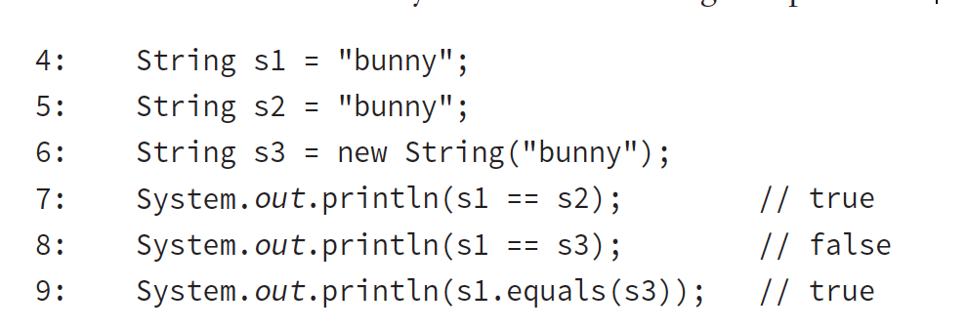
ex 5.12 What’s the output?
Notes:
Line 7 prints true because the s1 and s2 references point to the same literal in the string pool.
Line 8 prints false because line 6 intentionally creates a new object in memory by calling the constructor. Line 9 returns true because the values are the same, even though the location in memory is not.

Slide 24
Java allows using the + operator to combine Strings, which is called concatenation

Slide 25
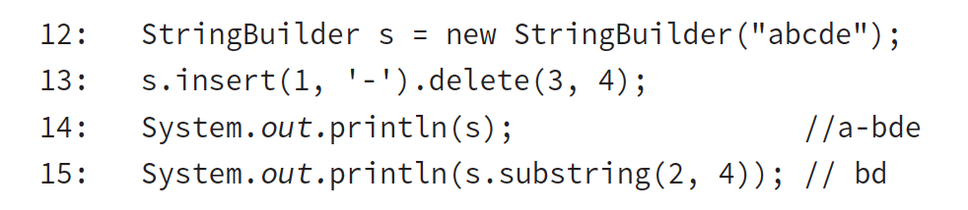
ex 5.16 StringBuilder chaining
Notes:
Line 13 uses chaining. We insert at the index that is right before the second character, b, making the string a-bcde. Then we delete from the third index until right before the fourth index, which happens to be only one character, c.
On line 15, we get the characters starting with index 2 and ending right before index 4. This is the two characters, bd.

Slide 26
-END-

