Slide 1

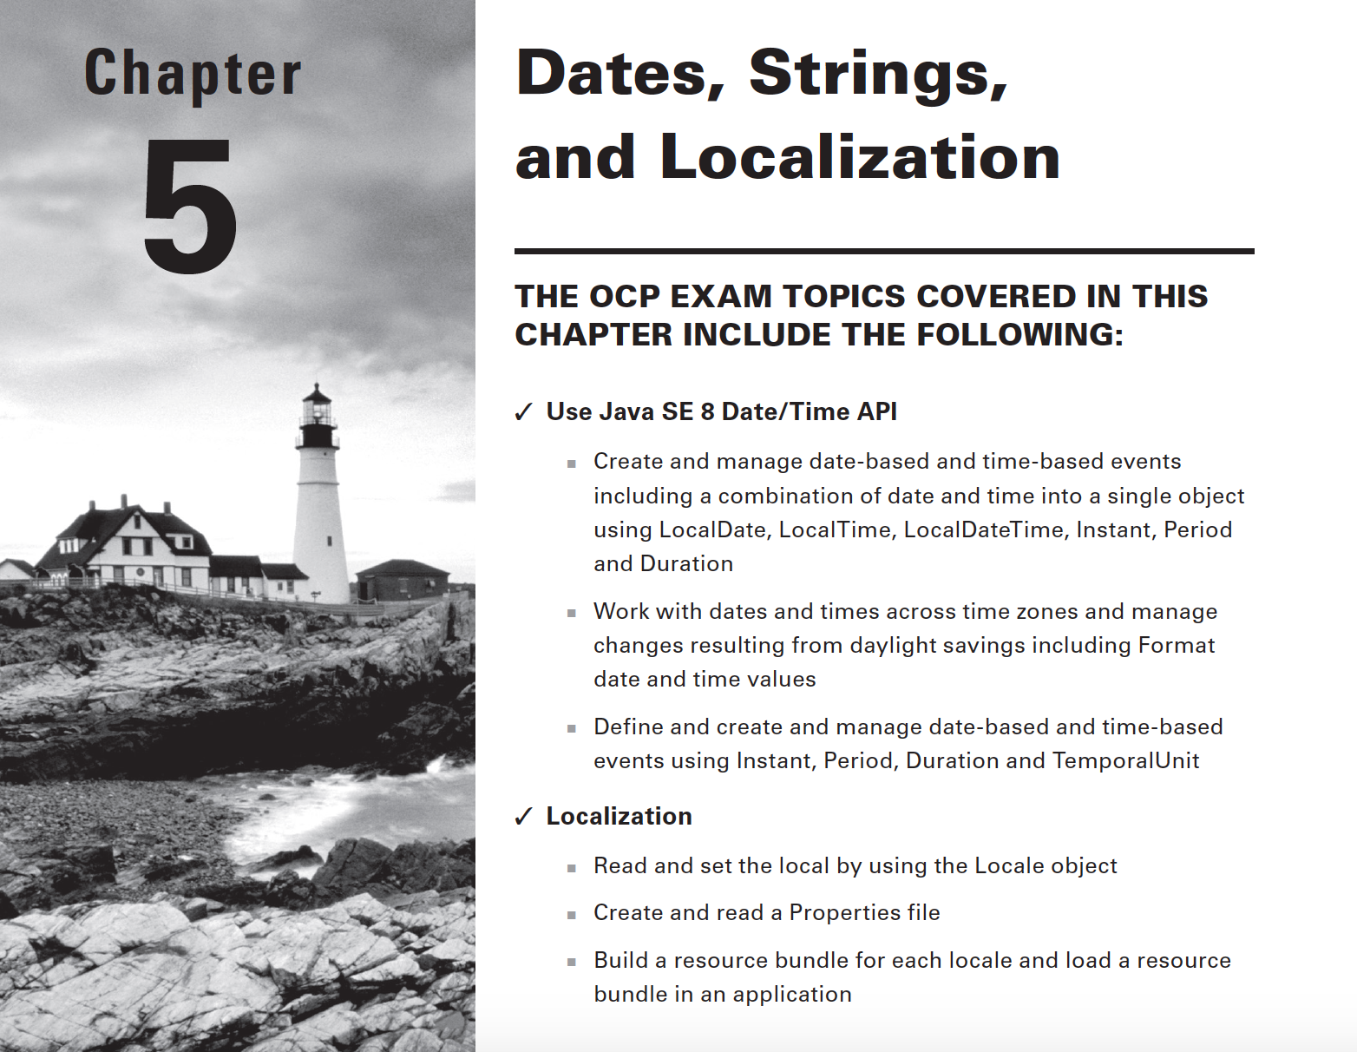

Slide 2
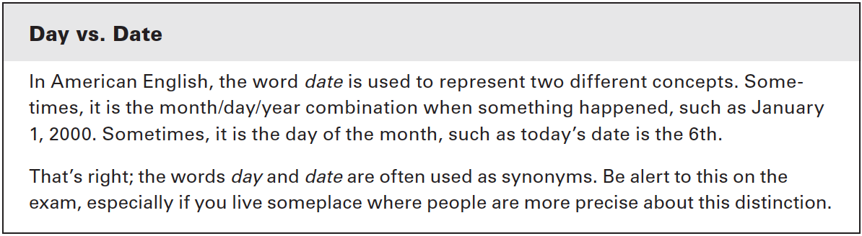
Working with dates and times
Completely revamped in Java 8

Slide 3
Creating dates and times
LocalDate - contains just a date - no time and no time zone (bday)
LocalTime - contains just a time - no date and no time zone (midnight)
LocalDateTime - contains both a date and time but no time zone (midnight on January 2)
ZonedDateTime - contains a date, time, and timezone (conference call at 9AM EST)
* Oracle recommends avoiding time zones unless you really need them. Try to act as if everyone is in the same time zone when you can.
Notes:
- we usually talk about dates and time zones as if the other person is
located near us.
- different if remote

Slide 4
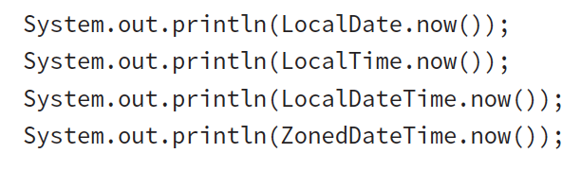
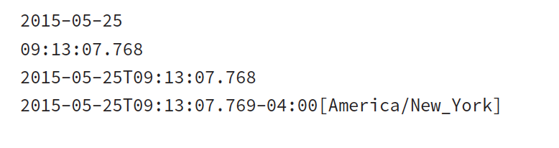
If we are in United States on May 25, 2015 9:13 a.m. the output would be :
Notes:
The first line contains only a date and no time.
The second contains only a time and no date. The time displays hours, minutes, seconds, and fractional seconds.
The third contains both a date and a time. Java uses T to separate the date
and time when converting LocalDateTime to a String
Finally, the fourth adds the time zone offset and time zone. New York is four time zones away from Greenwich Mean Time (GMT).
Greenwich Mean Time is a time zone in Europe that is used as time zone zero when discussing offsets.
Coordinated Universal Time (UTC) ; UTC uses the same time zone zero as GMT.

Slide 5

Converting to GMT:
* The time zone offset can be listed in different ways: +02:00, GMT+2, and UTC+2 all mean the same thing. You might see any of them on the exam.

Slide 6

ex 5.1
How many hours apart are California in the Pacific U.S. time zone and India?

Slide 7
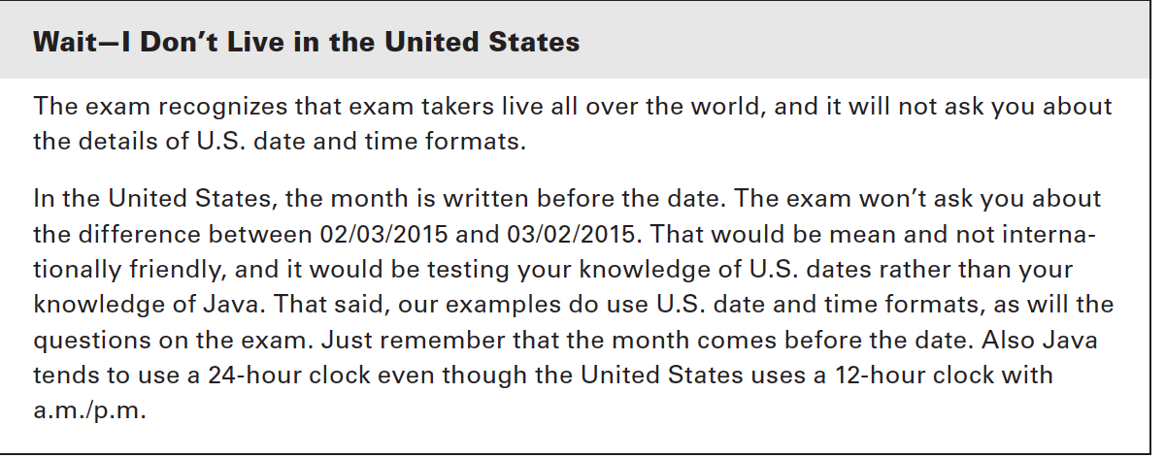

Slide 8

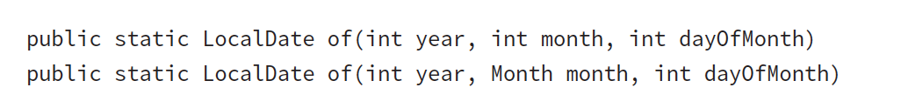
Creating a date with no time
Method Signatures are as follows:
Notes:
- Both pass in the year, month, and date. Although it is good to use the Month constants (to make the code easier to read), you can pass the int number of the month directly. Just use the number of the month the same way you would if you were writing the date in real life.

Slide 9
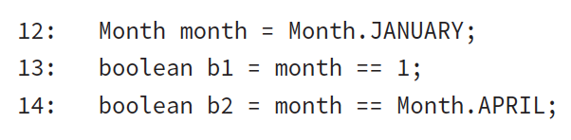
ex 5.2
What’s the value of b1 and b2?
Notes:
13. does not compile
14. false

Slide 10
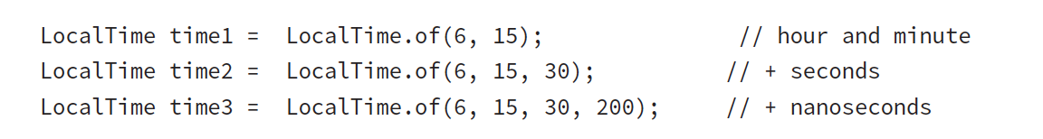
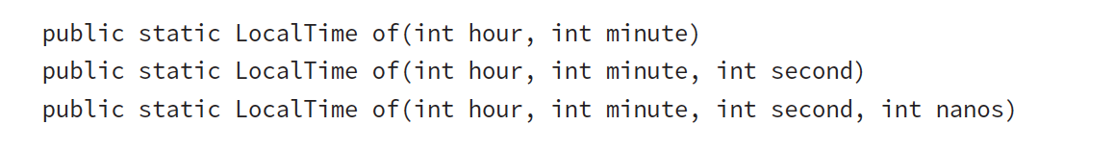
Creating a time
Method Signatures are as follows:

Slide 11
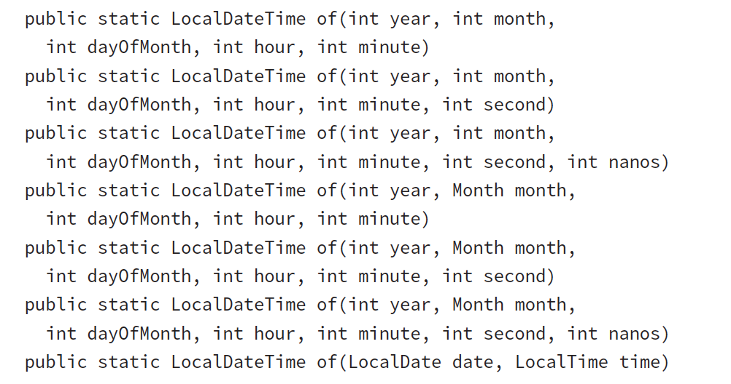
Combining dates and time into one object
Other method signatures:
Notes:
- The first line of code shows how you can specify all of the information about the LocalDateTime right in the same line. There are many method signatures allowing you to specify different things. Having that many numbers in a row gets to be hard to read, though. The second line of code shows how you can create LocalDate and LocalTime objects separately first and then combine them to create a LocalDateTime object.

Slide 12
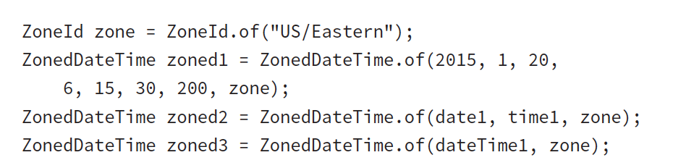
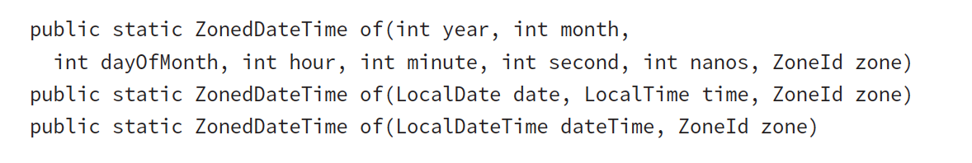
In order to create a ZonedDateTime, we first need to get the desired time zone.
Although there are other ways of creating a ZonedDateTime, you only need to know three for the exam:
Notes:
- We start by getting the time zone object. Then we use one of three approaches to create the ZonedDateTime. The first passes all of the fields individually. We don’t recommend this approach—there are too many numbers, and it is hard to read. A better approach is to pass a LocalDate object and a LocalTime object, or a LocalDateTime object.

Slide 13
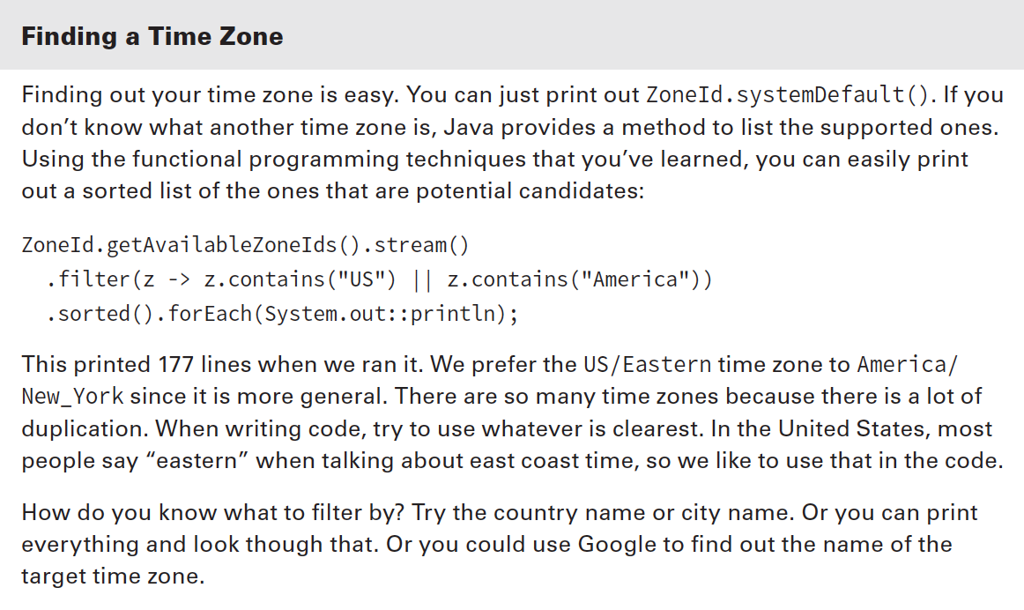

Slide 14
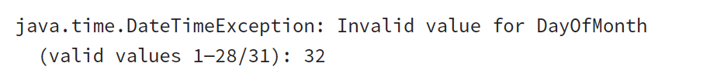
Date and time classes have private constructors
What happens when you pass invalid numbers to of()
no need to know the exact exception but it’s a clear one:

Slide 15
