Slide 1
Working with durations
Intended for smaller units of time
You can specify the number of days, hours, minutes, seconds, or nanoseconds
Yes you can pass 365 days to make a year but Period is more suitable for that
Used with objects that have time
Output beginning with PT, you can think of this as period of time
Stored in hours, minutes, and seconds

Slide 2
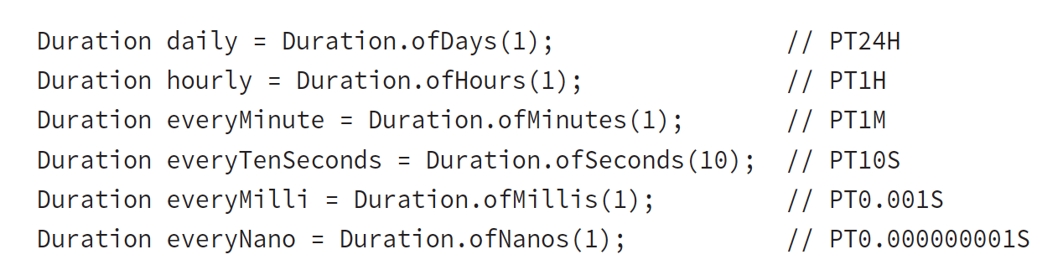
Creating Duration
Duration doesn’t have a constructor that takes multiple units like Period does
Notes:
We could say Duration.ofSeconds(3600) to mean one hour.
If you want something to happen every hour and a half, you would specify 90 minutes.

Slide 3
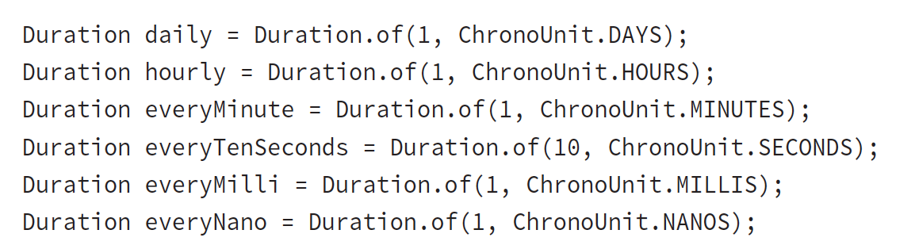
Duration includes another more generic factory method. It takes a number and a TemporalUnit. At the moment one implementation: ChronoUnit
ChronoUnit also includes convenient units such as ChronoUnit.HALF_DAYS to represent 12 hours

Slide 4
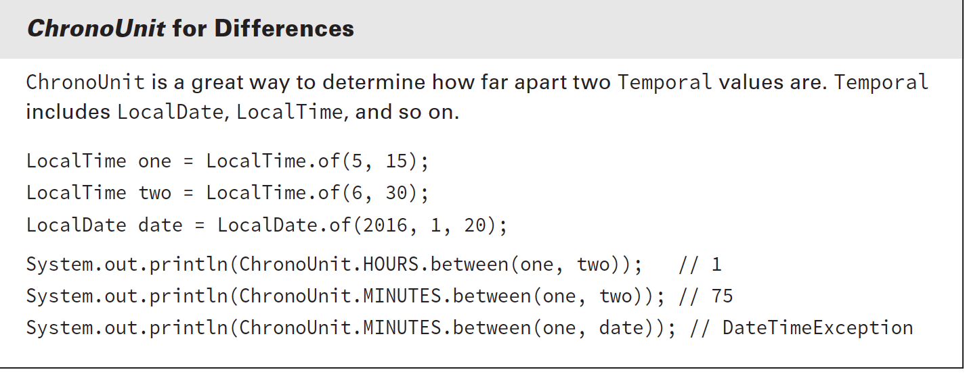
Notes:
The first print statement shows that between truncates rather than rounds.
The second shows how easy it is to count in different units. Just change the ChronoUnit type.
The last reminds us that Java will throw an exception if we mix up what can be done on date vs. time objects.

Slide 5
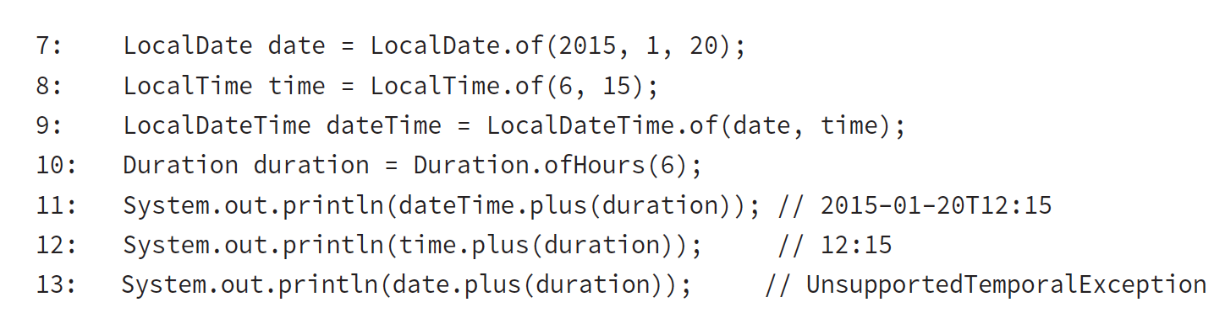
Using a Duration works the same way as using a Period
Notes:
Line 11 shows that we can add hours to a LocalDateTime, since it contains a time.
Line 12 also works, since all we have is a time.
Line 13 fails because we cannot add hours to an object that does not contain a time.

Slide 6
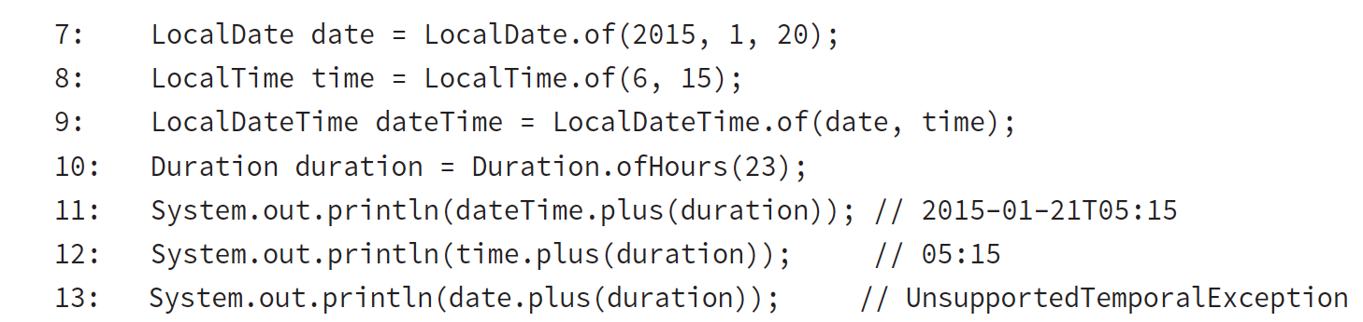
ex 5.6
What’s the output:
Notes:
This time we see that Java moves forward past the end of the day. Line 11 goes to the next day since we pass midnight.
Line 12 doesn’t have a day, so the time just wraps around—just like on a real clock.

Slide 7
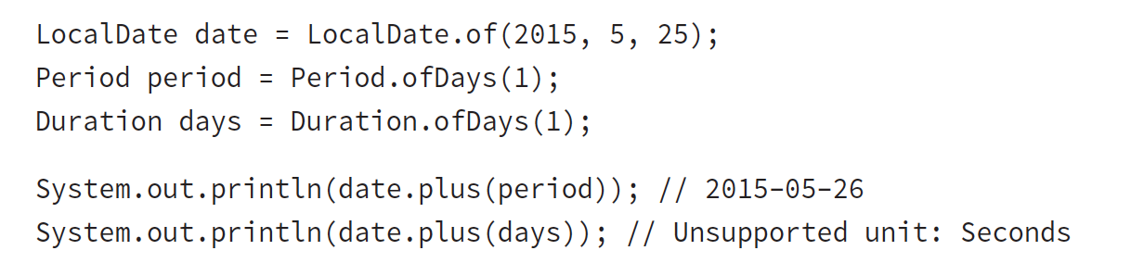
ex 5.7
What’s the output:
Notes:
Since we are working with a LocalDate, we are required to use Period. Duration has time units in it, even if we don’t see them and they are meant only for objects with time.

Slide 8
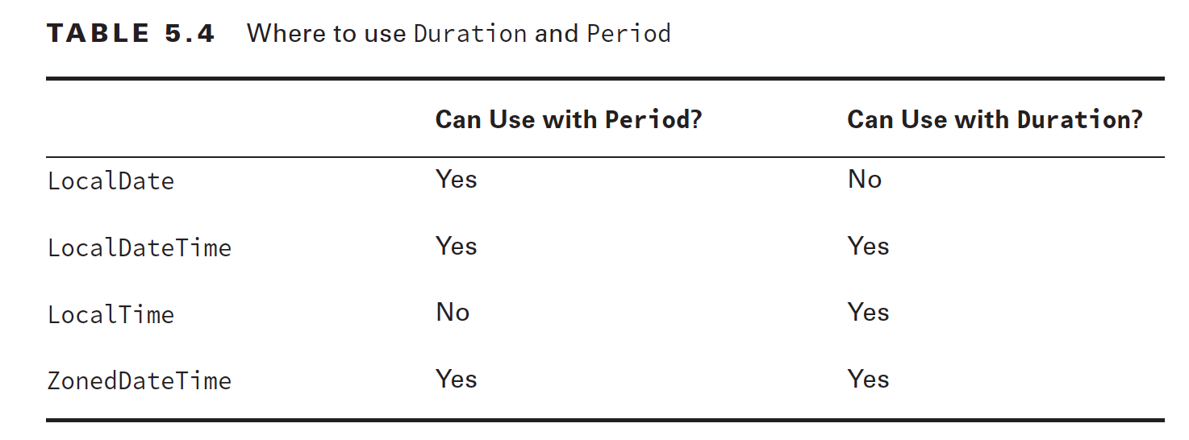
ex 5.8

Slide 10
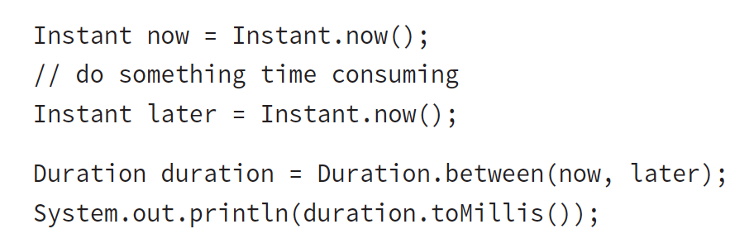
Working with Instants
The Instant class represents a specific moment in time in the GMT time zone.
Suppose you want to run a timer:

Slide 11
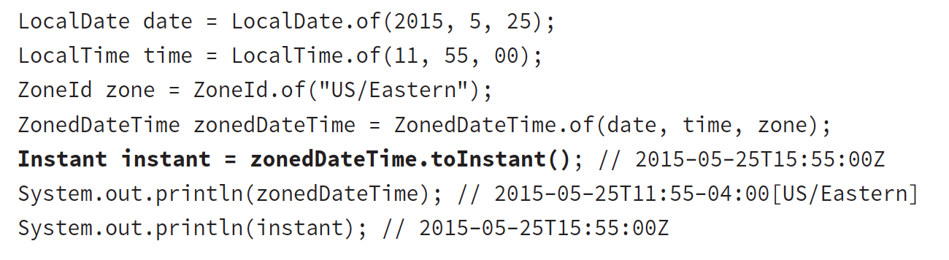
If you have a ZonedDateTime, you can turn it into an Instant
Notes:
The last two lines represent the same moment in time. The ZonedDateTime includes a timezone. The Instant gets rid of the time zone and turns it into an Instant of time in GMT.
You cannot convert a LocalDateTime to an Instant. Remember that an Instant is a point in time. A LocalDateTime does not contain a time zone, and it is therefore not universally recognized around the world as the same moment in time.

Slide 12
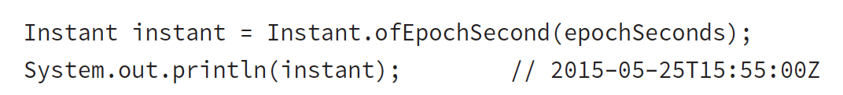
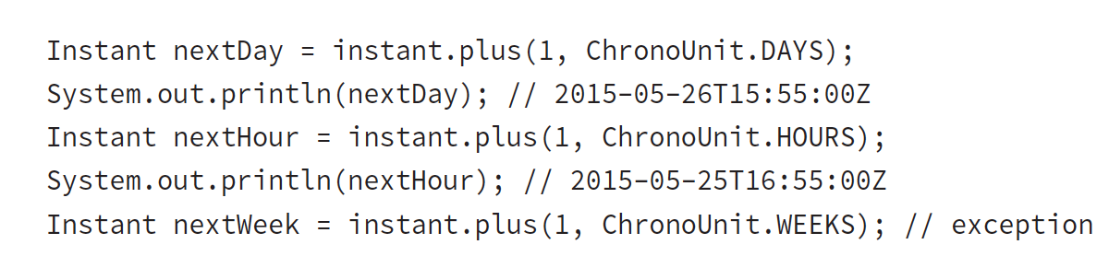
If you have the number of seconds since 1970, you can also create an Instant that way
Using that Instant, you can do the math
Notes:
It’s weird that an Instant displays a year and month while preventing you from doing math with those fields. Unfortunately, you need to memorize this fact.

Slide 13
Accounting for daylight savings time
Some countries observe daylight savings time
This is where clocks are adjusted by an hour twice a year to make better use of the sunlight
Not all countries participate, and those that do, use different weekends for the change
In the US they move the clocks an hour ahead in March and move them an hour back in November. The exam will let you know if a date/time mentioned falls on a weekend. If it is not mentioned, safe to assume it is a normal weekend. Officially change the clocks at 2AM, which falls early Sunday morning

Slide 14
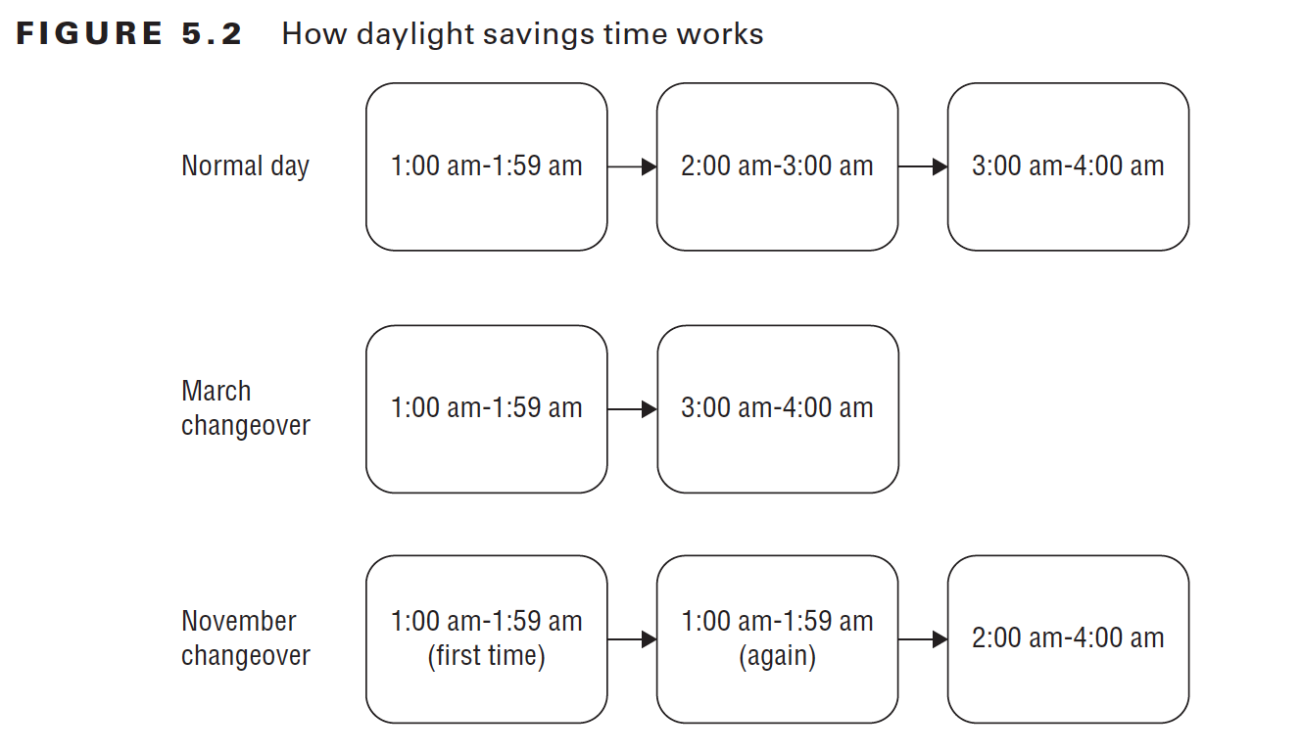
Notes:
Figure 5.2 shows what happens with the clocks. On a normal day, time proceeds linearly from 1:00 a.m. to 2:00 a.m. to 3:00 a.m. to 4:00 a.m. and so on.
When we change our clocks in March, time springs forward from 1:59 a.m. to 3:00 a.m. Technically it is 1:59 a.m. and 59 seconds plus milliseconds; in other words, the moment immediately before 2:00 a.m. Luckily, the exam doesn’t get that granular, and we can think of it as simply 1:59 a.m.
When we change our clocks in November, time falls back and we experience the hour from 2:00 a.m. to 2:59 a.m. Children learn this as spring forward in the spring and fall back in the fall.

Slide 15
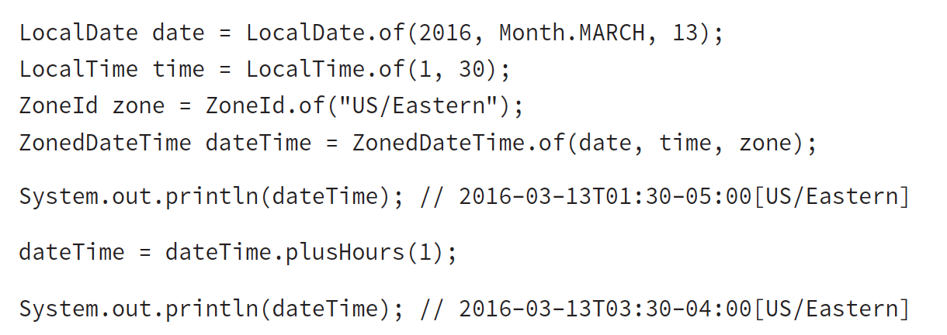
For example, on March 13, 2016, we(US) move our clocks forward an hour and jump from 2:00 am to 3:00 am. This means that there is no 2:30am that day.
ex 5.9 What’s the output?
Notes:
2 things changed: The time jumps from 1:30 to 3:30. The UTC offset also changes.
You can see that we went from 6:30 GMT (1:30 minus -5:00) to 7:30 GMT (3:30 minus -4:00). This shows that the time really did change by one hour from GMT’s point of view.

Slide 16
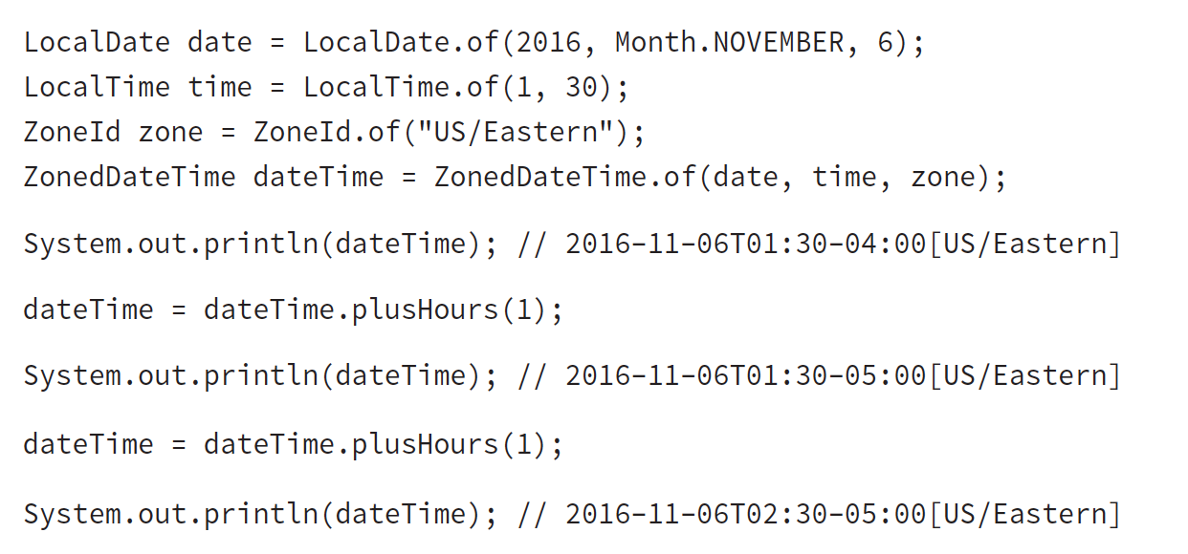
Similarly in November, an hour after the initial 1:30 is also1:30 because at 2:00 a.m. we repeat the hour
ex 5.10 Calculate the GMT time:
Notes:
Did you get it? We went from 5:30 GMT to 6:30 GMT to 7:30 GMT.

Slide 17
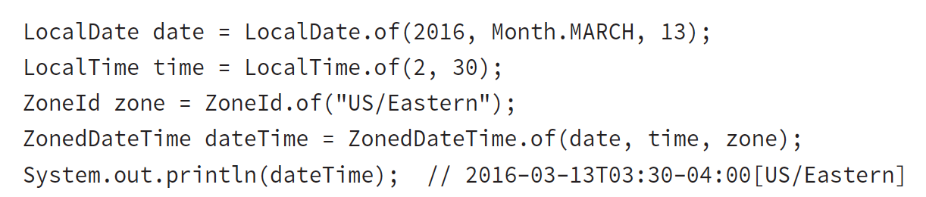
ex 5.11 What’s the output?
Notes:
Java is smart enough to know that there is no 2:30 a.m. that night and switches over to the appropriate GMT offset.

Slide 18
Yes, it is annoying that Oracle expects you to know this even if you aren’t in the United States—or for that matter in a part of the United States that doesn’t follow daylight savings time.
The exam creators are in the United States, and they decided that everyone needs to know how United States time zones work.

Slide 19
-END-

