Slide 1
Reviewing the String Class
We don’t want you to get a question on another topic wrong because you forget how concatenation works!
String is a sequence of characters
String class is final and String object is immutable
Immutability allows Java to optimize by storing string literals in the string pool

Slide 2
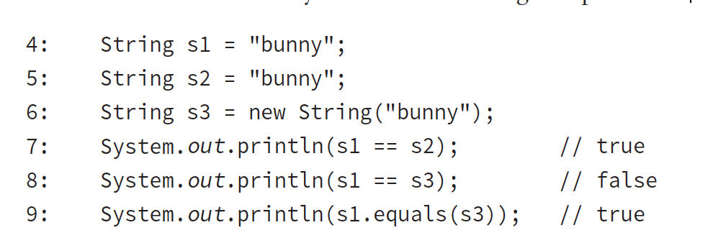
ex 5.12 What’s the output?
Notes:
Line 7 prints true because the s1 and s2 references point to the same literal in the string pool.
Line 8 prints false because line 6 intentionally creates a new object in memory by calling the constructor. Line 9 returns true because the values are the same, even though the location in memory is not.

Slide 3
Java allows using the + operator to combine Strings, which is called concatenation

Slide 4
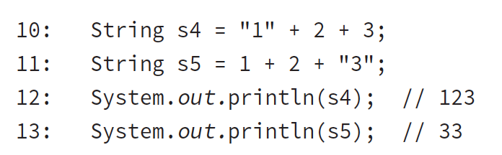
ex 5.13 What’s the output?
Notes:
Line 12 prints out 123 because it sees a String first and then keeps concatenating, making new strings.
Line 13 sees two numbers to add first, and it does that using integer arithmetic. It isn’t until the end of the line that it sees a String and can concatenate.

Slide 5
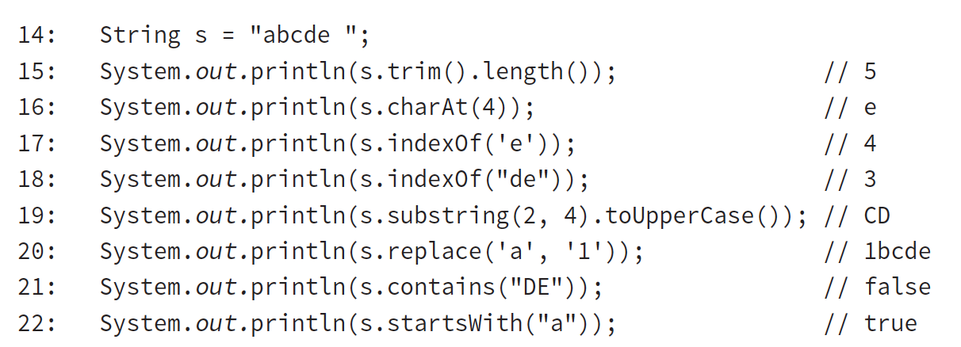
ex 5.14 String methods
Notes:
Line 15 shows that trim() removes any whitespace characters from the beginning and end of a String.
Line 16 reminds us that Java starts counting indexes with 0 instead of 1.
Lines 17 and 18 show that we can find the zero-based index of a character or a String.
Line 19 creates a smaller String from index 2 to right before index 4. It then uses method chaining to convert that String to capital letters.
Line 20 does a character replacement.
Lines 21 and 22 do a simple String search.

Slide 6
Since String is immutable, it is inefficient for when you are updating the value in a loop
StringBuilder is better for that scenario
StringBuilder is mutable - change in value and capacity
StringBuffer for thread safety

Slide 7
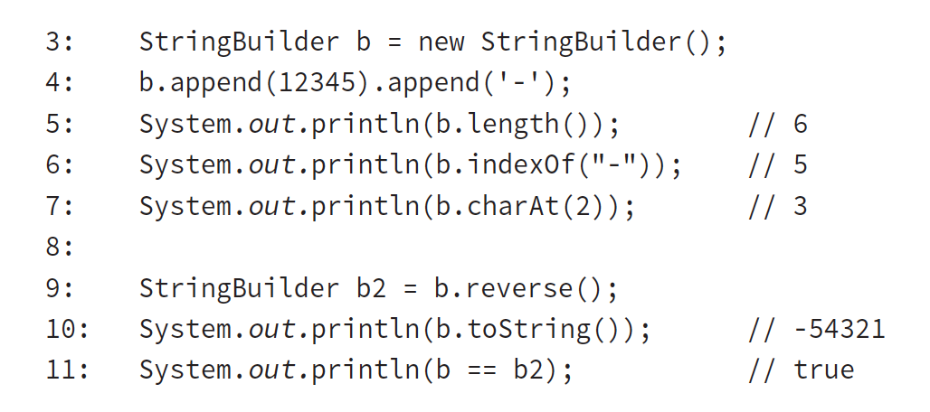
ex 5.15 StringBuilder methods
Notes:
Line 3 creates an empty StringBuilder.
Line 4 uses method chaining to make multiple method calls and appends two different types to the StringBuilder.
On line 5, there are six characters in b. Five are the numbers from the int and the sixth is the dash.
On line 6, the last index is 5 because Java starts counting indexes with 0.
Similarly, on line 7, the second index is the third character, which is 3.
On line 9, we reverse the StringBuilder and return a reference to the same object.
Line 10 prints this reversed value, and line 11 confirms that it is the same object.

Slide 8
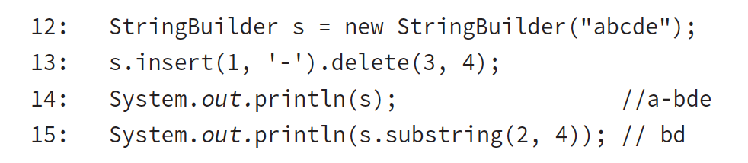
ex 5.16 StringBuilder chaining
Notes:
Line 13 uses chaining. We insert at the index that is right before the second character, b, making the string a-bcde. Then we delete from the third index until right before the fourth index, which happens to be only one character, c.
On line 15, we get the characters starting with index 2 and ending right before index 4. This is the two characters, bd.

Slide 9
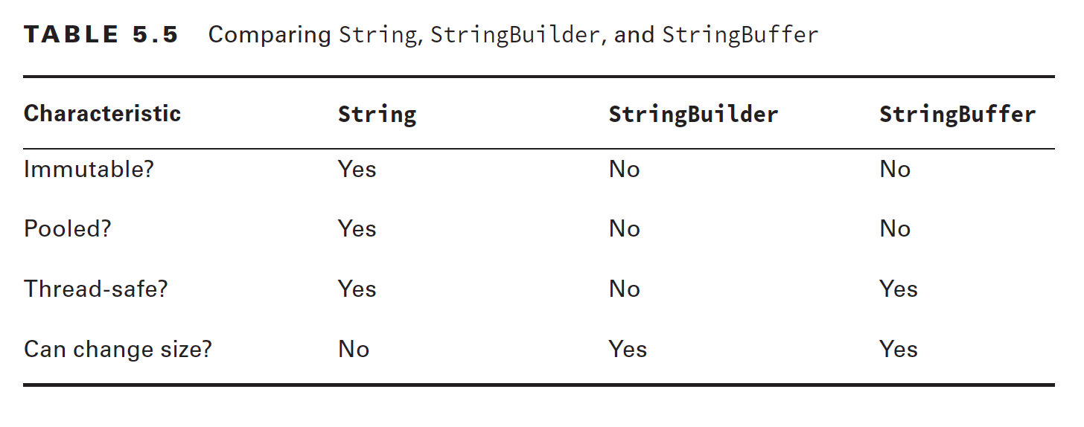

Slide 10
-END-

