Slide 1
using a resource bundle
A resource bundle contains the local specific objects to be used by a program.
It is like a map with keys and values.
Can be in a property file or a Java class
Notes:
Up until now, we’ve kept all of the strings from our program in the classes that use them.
Localization requires externalizing them to elsewhere. This is typically a property file, but it could be a resource bundle class.

Slide 2
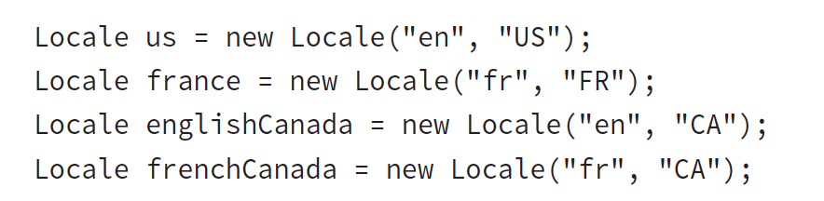
Zoo expansion - 3 more zoos
Zoo de La Palmyre in France
the Greater Vancouver Zoo in English-speaking Canada
Zoo de Granby in French-speaking Canada
Notes:
- We immediately realized that we are going to need to internationalize our program.
- Resource bundles will be quite helpful. They will let us easily translate our application to multiple locales or even support multiple locales at once. It will also be easy to add more locales later if we get zoos in even more countries interested.

Slide 3
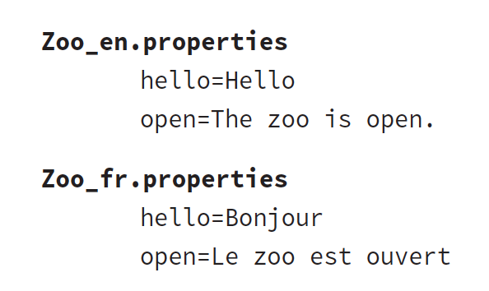
Creating a property file resource bundle
No need to create four different resource bundles
If no country-specific, Java will use language-specific resource bundle

Slide 4
See demo: _031_ZooOpenResourceBundle.java
Notes:
- Notice how much is happening behind the scenes here. Java uses the name of the bundle (Zoo) and looks for the relevant property file. You will see this again later in the chapter and learn how Java figures out which one to use.

Slide 5
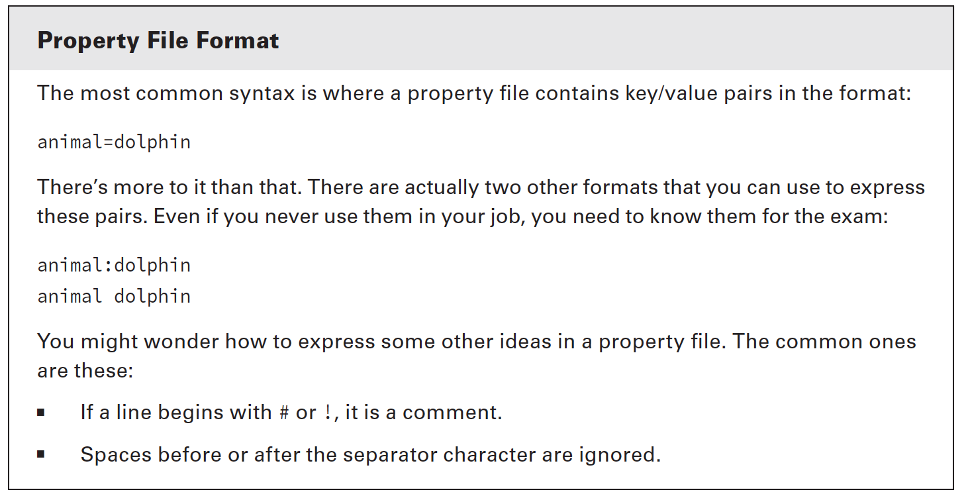

Slide 6
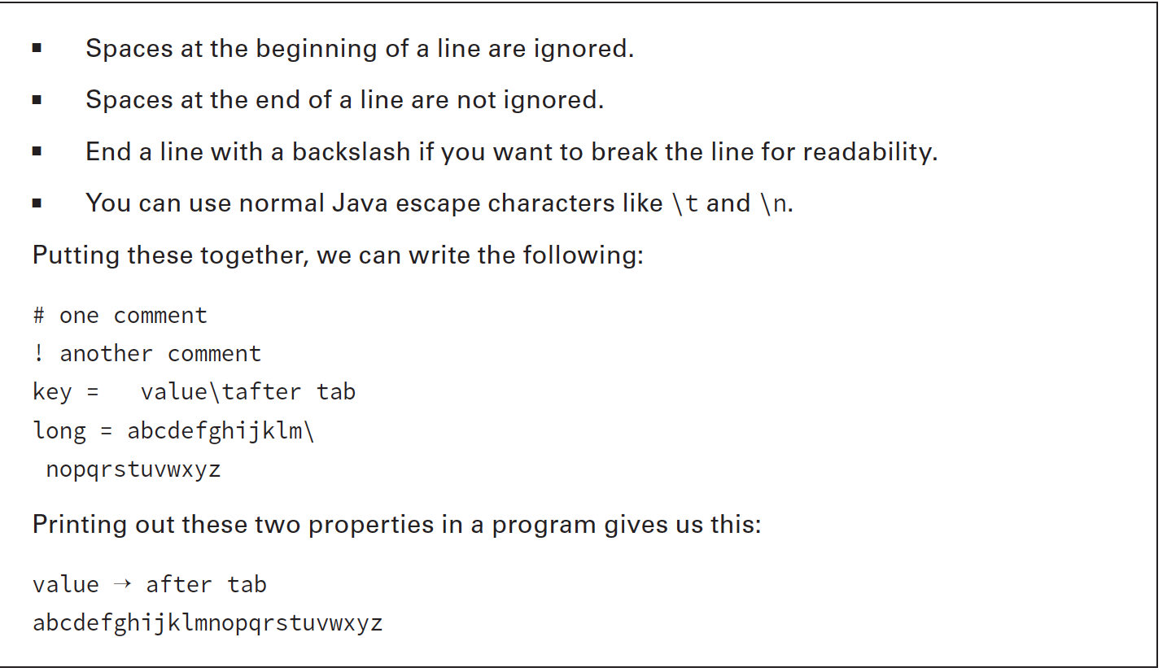

Slide 7
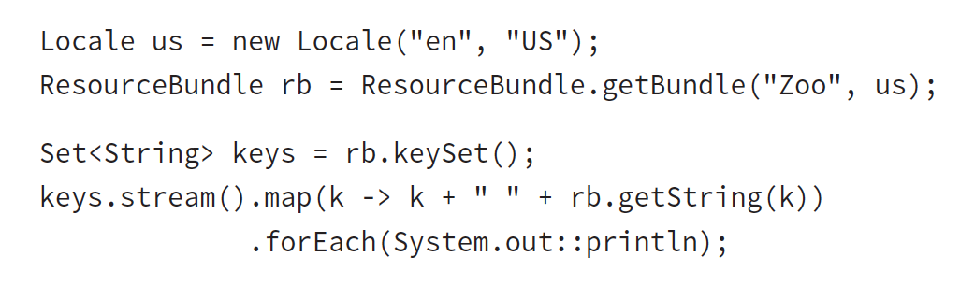
Looping through resource bundle to list all pairs:
Notes:
- And yes, we could have used a traditional for loop. You need to know both loops and functional programming for the exam, so we use both approaches throughout the book.

Slide 8
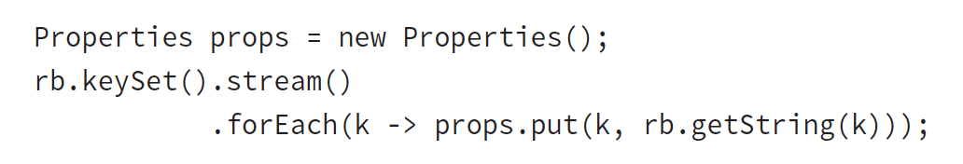
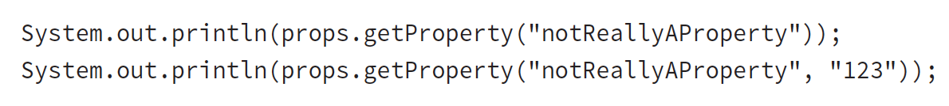
In addition to ResourceBundle, Java supports a class named Properties.
Properties has some additional features, including being able to pass a default.
Converting from ResourceBundle to Properties is easy:
Notes:
Properties is like a Map that you learned about in Chapter 3, “Generics and Collections.” It was written before Map existed, so it doesn’t use all of the same method names.
Note that the method called is getProperty(). There is also a get() method as we’d expect with any collection. Only getProperty() allows for a default value.

Slide 9
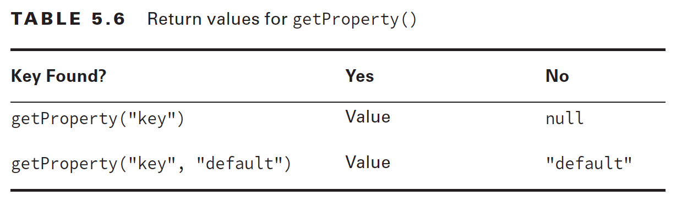

Slide 10
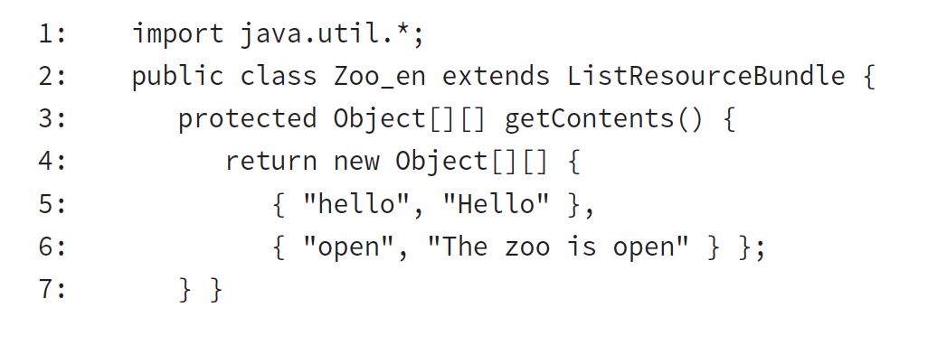
Creating a Java Class Resource Bundle
Most of the time Property file resource bundle is enough
Limitation of Property file: only String values are allowed
Java resource bundles allow any Java type as the value. Keys are strings regardless

Slide 11
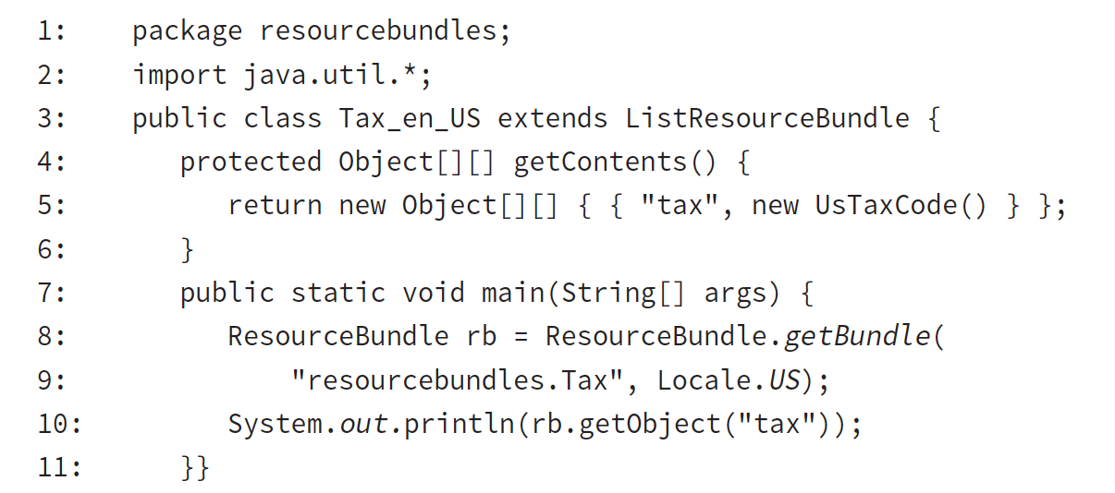
2 main advantages of Java resource bundle
You can use a value type that is not String
You can create the values of the properties at runtime
In our zoos, we realize we need to collect tax differently on each country
Notes:
Line 3 extends the ListResourceBundle so that we can define a resource bundle. This time, the class name specifies both the language code and country code.
Lines 4–6 show the method to declare the key/value pairs. This time, the value is not a String.
Lines 8–9 show that a resource bundle can be in a package. We just specify the name of the package before the name of the class.
Line 10 shows how to retrieve a non-String resource bundle

Slide 12
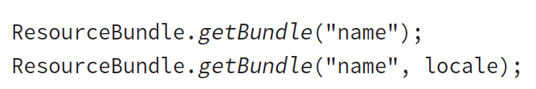
Determining which resource bundle to use
On the exam, there are two methods for getting a resource bundle:
The first one uses the default locale.
The exam either tells you what to assume as the default locale or uses the second approach.

Slide 13
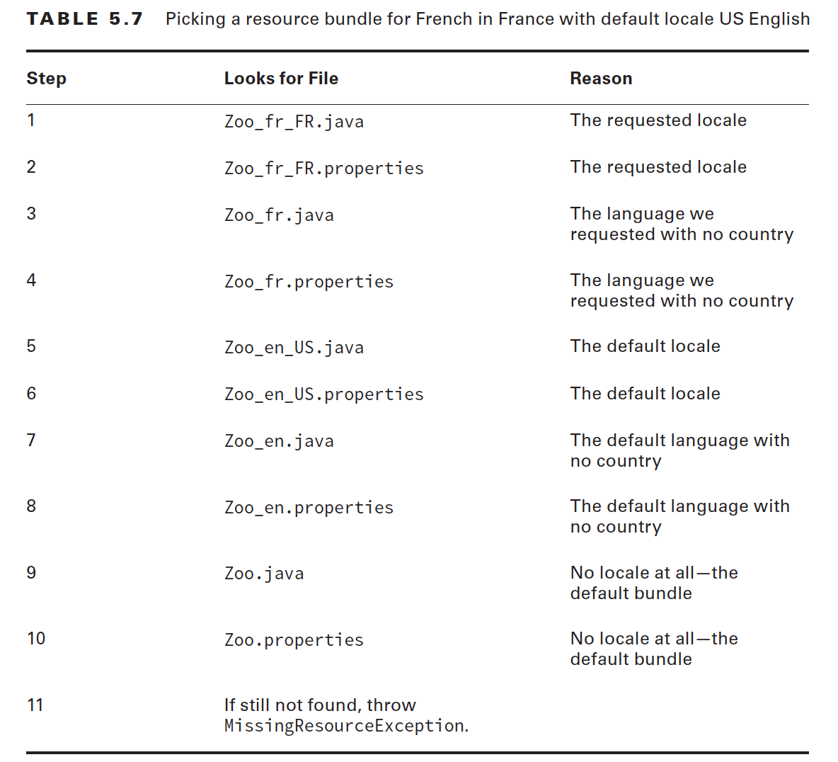

Slide 14
remembering the steps of determining the resource bundle
Always look for the property file after the matching Java class
Drop one thing at a time if there are no matches. First drop the country and then the language.
Look at the default locale and the default resource bundle last

Slide 15
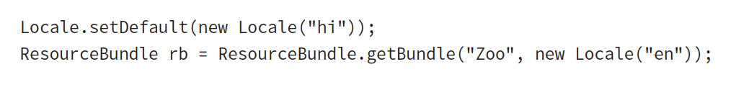
ex 5.17
How many files do you think Java would need to look for to find the resource bundle with the code?

Slide 16
Parent Resource Bundles (see ParentResourceBundle.java)

Slide 17
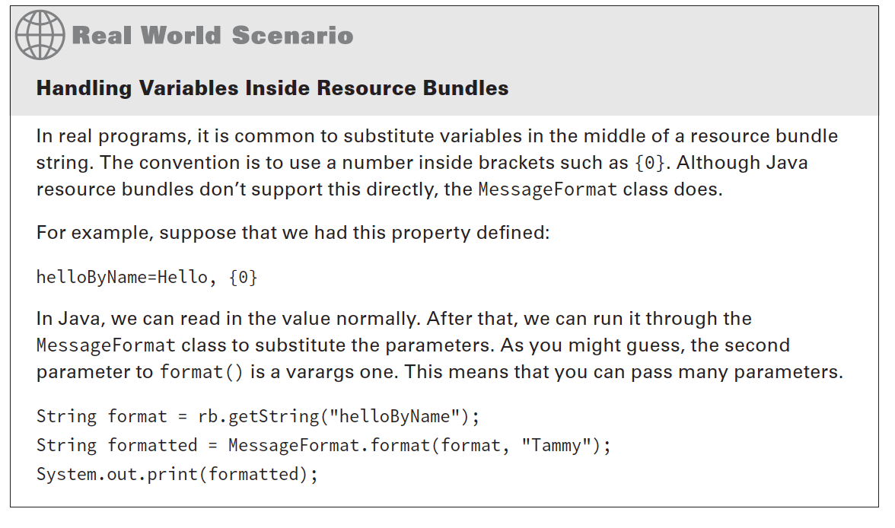

Slide 18
-END-

