Slide 1
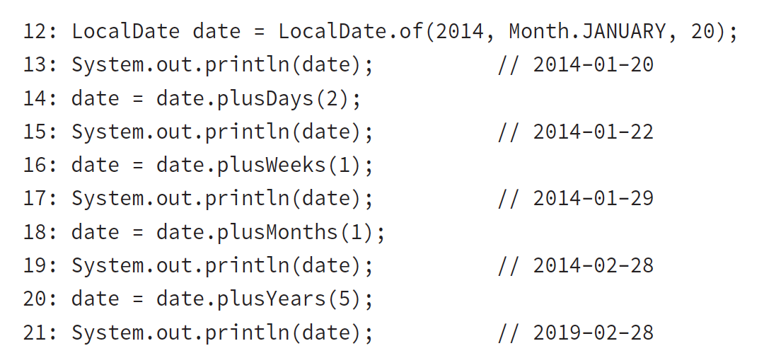
Manipulating dates and times
Adding to a date is easy. The date and time classes are immutable
Notes:
This code is nice because it does just what it looks like. We start out with January 20, 2014. On line 14, we add two days to it and reassign it to our reference variable.
On line 16, we add a week. This method allows us to write clearer code than plusDays(7). Now date is January 29, 2014.
On line 18, we add a month. This would bring us to February 29, 2014. However, 2014 is not a leap year. (2012 and 2016 are leap years.) Java is smart enough to realize that February 29, 2014, does not exist, and it gives us February 28, 2014, instead.
Finally, line 20 adds five years.

Slide 2
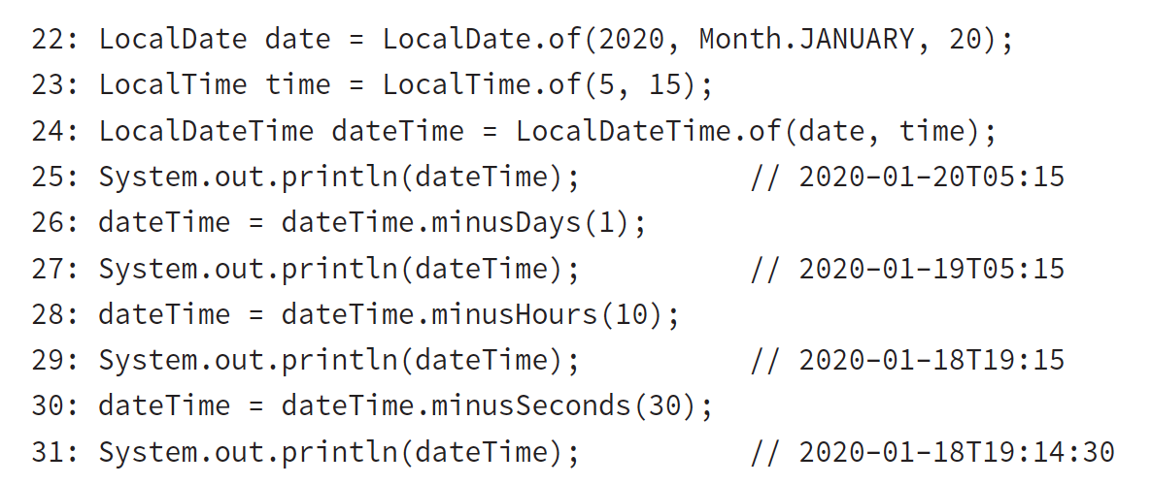
Easy methods to go backward in time
Notes:
Line 25 prints the original date of January 20, 2020, at 5:15 a.m.
Line 26 subtracts a full day, bringing us to January 19, 2020, at 5:15 a.m.
Line 28 subtracts 10 hours, showing that the date will change if the hours cause it to adjust, and it brings us to January 18, 2020, at 19:15 (7:15 p.m.).
Finally, line 30 subtracts 30 seconds. You can see that all of a sudden the display value starts showing seconds. Java is smart enough to hide the seconds and nanoseconds when we aren’t using them.

Slide 3
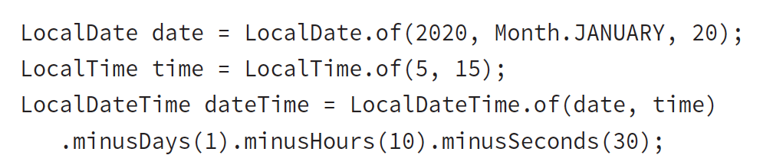
It is common for date and time methods to be chained:
Notes:
Line 25 prints the original date of January 20, 2020, at 5:15 a.m.
Line 26 subtracts a full day, bringing us to January 19, 2020, at 5:15 a.m.
Line 28 subtracts 10 hours, showing that the date will change if the hours cause it to adjust, and it brings us to January 18, 2020, at 19:15 (7:15 p.m.).
Finally, line 30 subtracts 30 seconds. You can see that all of a sudden the display value starts showing seconds. Java is smart enough to hide the seconds and nanoseconds when we aren’t using them.

Slide 4
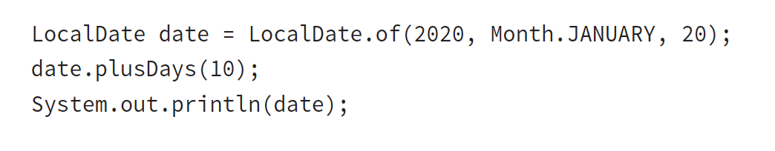
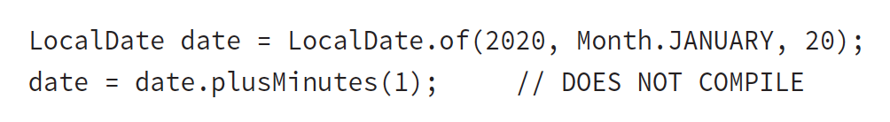
ex 5.3
What’s the output?
A.
B.
Notes:
It prints January 20, 2020. Adding 10 days was useless because the program ignored the result. Whenever you see immutable types, pay attention to make sure that the return value of a method call isn’t ignored. The exam also may test to see if you remember what each of the date and time objects includes.
LocalDate does not contain time. This means that you cannot add minutes to it.

Slide 5
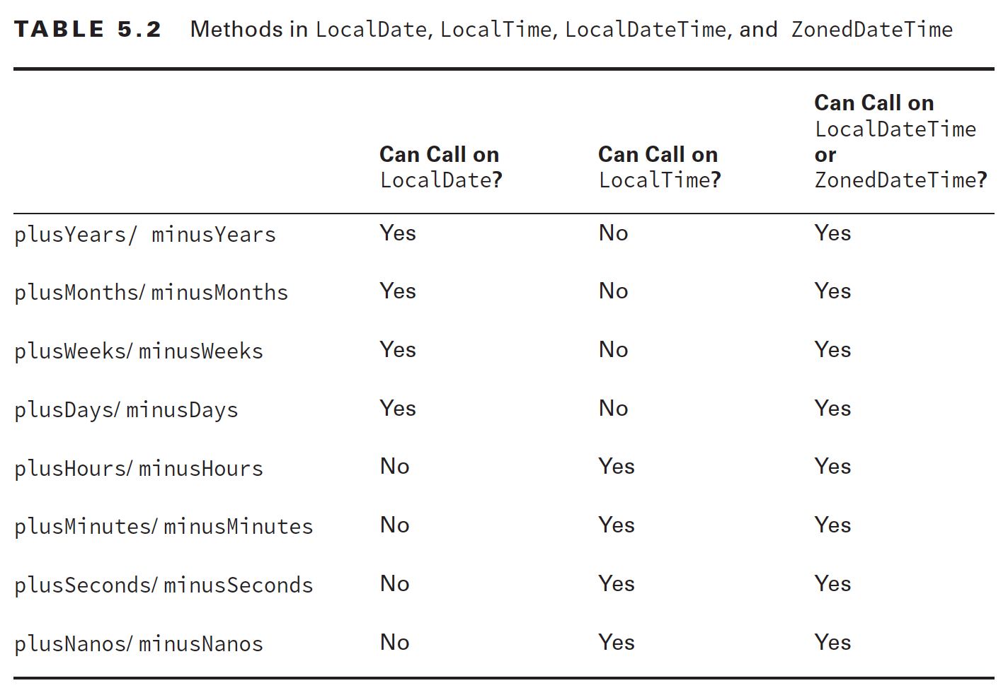
ex 5.4

Slide 7
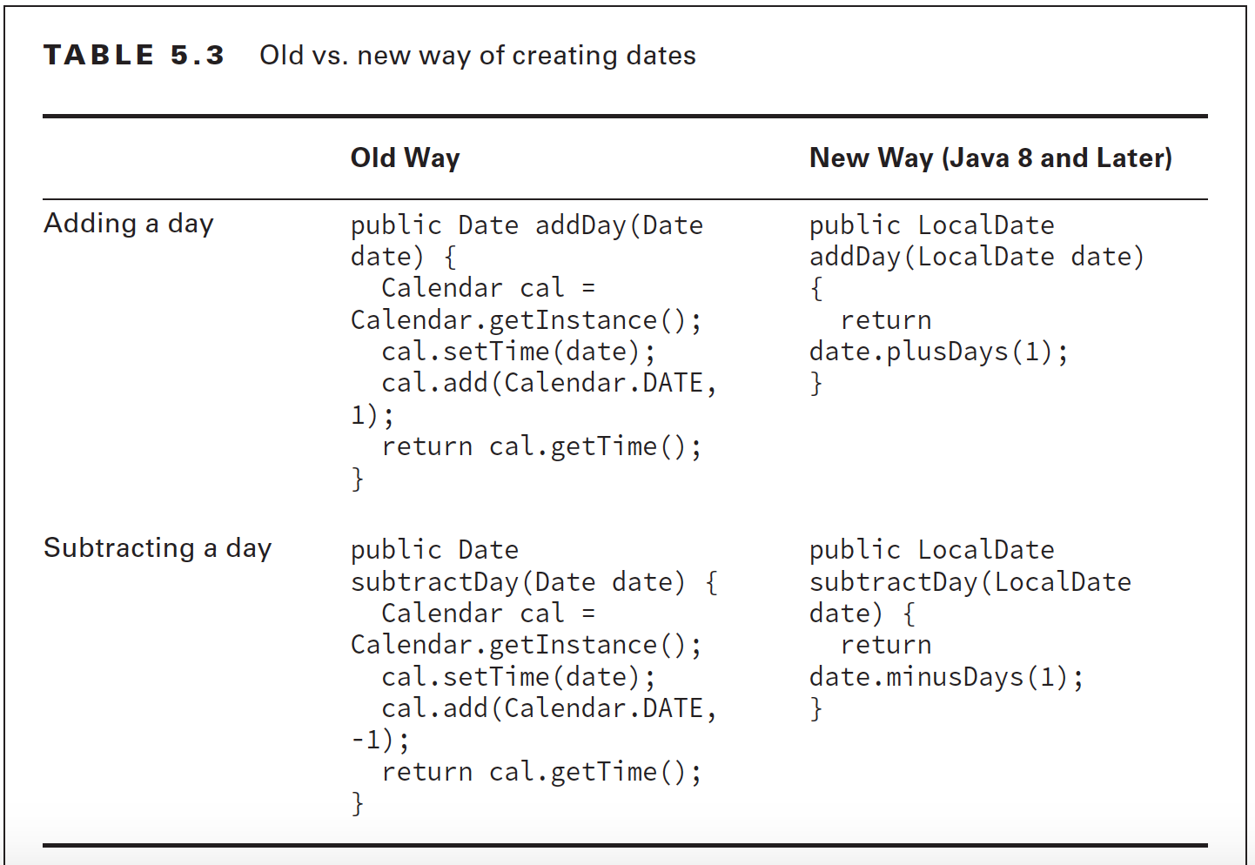

Slide 8
Working with Periods
Zoo enrichment system

Slide 9
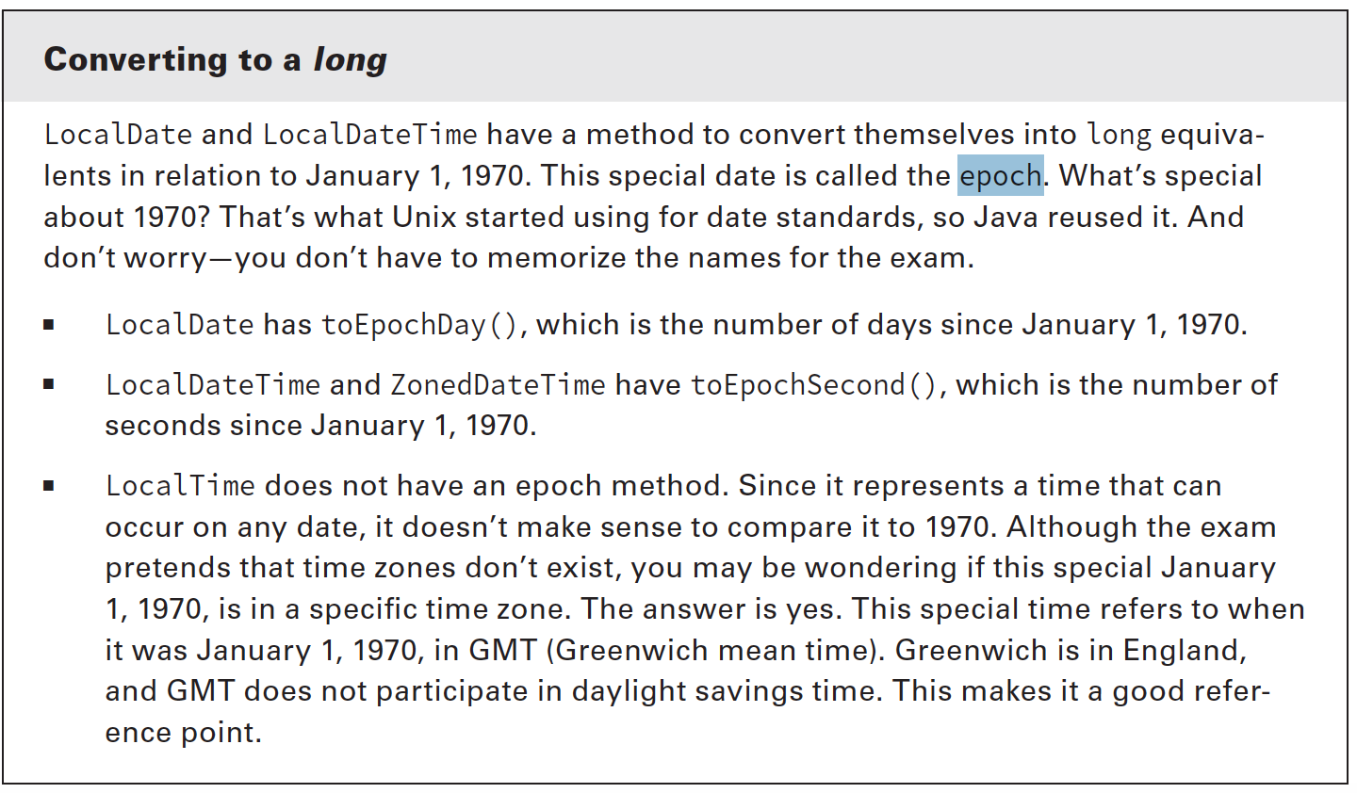

Slide 10
Luckily, Java has a Period class:
see demo _012_AnimalEnrichmentWithPeriod.java
Notes:
The method can add an arbitrary period of time that gets passed in. This allows us to reuse the same method for different periods of time as our zookeeper changes her mind.

Slide 11
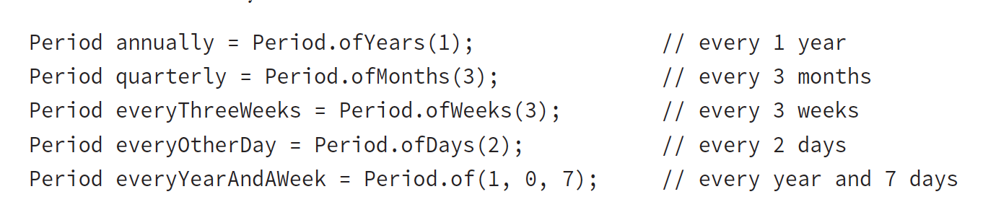
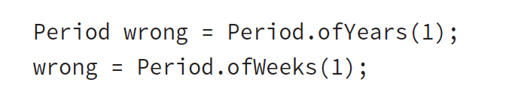
Five ways to create a Period class:
There’s a catch. You cannot chain creating methods when creating Period
The tricky code is really like writing the following:
Notes:
The following code looks like it is equivalent to the everyYearAndAWeek example, but it’s not. Only the last method is used because the Period of methods are static methods.

Slide 12
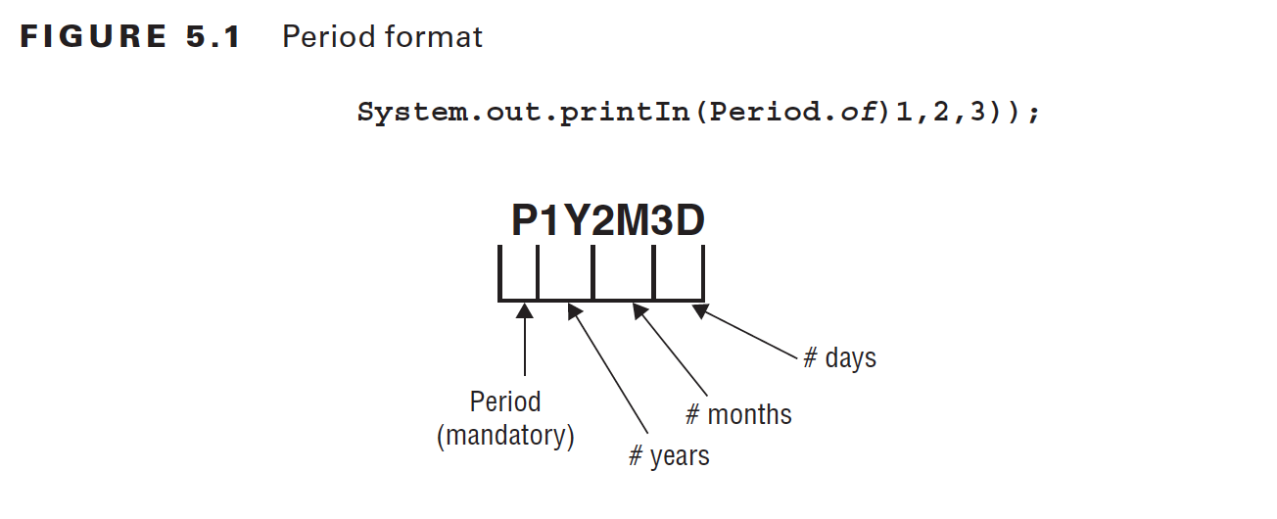
the P always start out the String to show it is a period followed by number of years, months, and days; zero ommitted
Notes:
As you might imagine, the actual period is stored in terms of years, months, and days. When you print out the value, Oracle displays any non-zero parts using the format shown

Slide 13
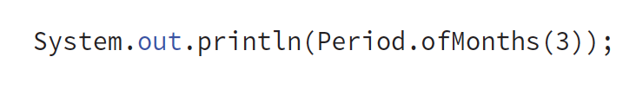

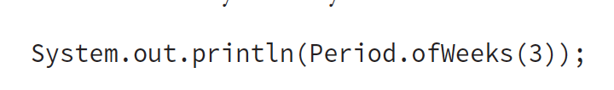
ex 5.5
What are the output?
A.
B.
C.
Notes:
A. The output is P3M. Remember that Java omits any measures that are zero.
B. The output is P20M47D. There are no years, so that part is skipped. It’s OK to have more days than are in a month. Also it is OK to have more months than are in a year. Java uses the measures provided for each.
C. This one outputs P21D. Remember that week is not one of the units a Period stores. Therefore, a week is converted to 7 days. Since we have 3 weeks, that’s 21 days.

Slide 14
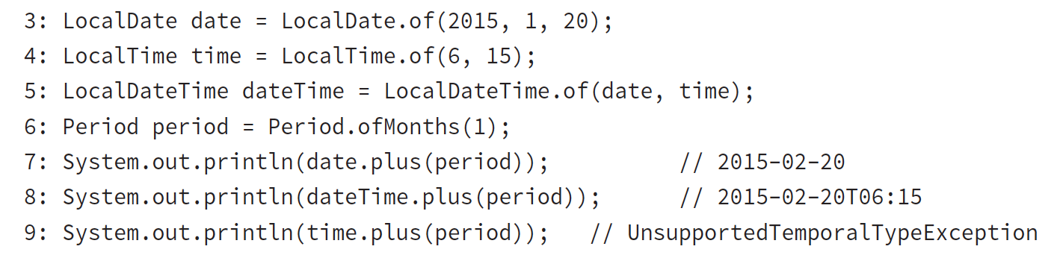
What objects can Period be used with
Notes:
Lines 7 and 8 work as expected. They add a month to January 20, 2015, giving us February 20, 2015. The first has only the date, and the second has both the date and time.
Line 9 attempts to add a month to an object that has only a time. This won’t work.
Java throws an exception and complains that we attempted to use an Unsupported unit: Months.

