Slide 1
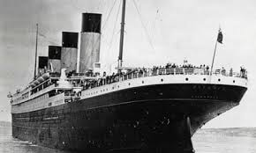
Who would survive? Predicting survival on the Titanic
- Machine Learning from Disaster -
By Shamika Kekulthotuwage Don

Slide 2
Overview
Problem Statement
Basic Data Exploration
Explanatory Data Analysis (EDA)
Data Processing
Model Development and Evaluation-Logistic Regression
Model Development and Evaluation (Extended)
Improving Accuracy
Feature Engineering
Cross Validation and Hyperparameter Tunning
Results Comparison-Choosing Best Model-Kaggle Score
Concluding remarks
References

Slide 3
Problem Statement
Using machine learning, create a model to predict which passengers survived the Titanic shipwreck.
The model should help answer the question: 'What types of passengers were more likely to survive?

Slide 4
Basic Data Exploration
Data Sets (Train-891 entries, Test-418 entries)
Definition | Key
Survival | 0=No, 1=Yes
Ticket Class (SES) | 1=1st (Upper), 2=2nd (Middle), 3=3rd (Lower)
Name | Including title
Sex | Male, female
Age in years
No. of of siblings / spouses
No. of parents / children
Ticket Number
Passenger Fare
Cabin Number
Port of Embarkation | C = Cherbourg, Q = Queenstown, S = Southampton

Slide 5
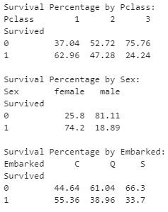
Basic Data Exploration
.head(), .info(), .nunique(), .describe()
Overall survival rates:
Missing values:
Survival rates by features (%):
Survived | 38.38%
Not Survived | 61.62%
Feature | Train | Test
Age | 177 | 86
Cabin | 687 | 327
Embarked | 2 | -
Fare | - | 1

Slide 6
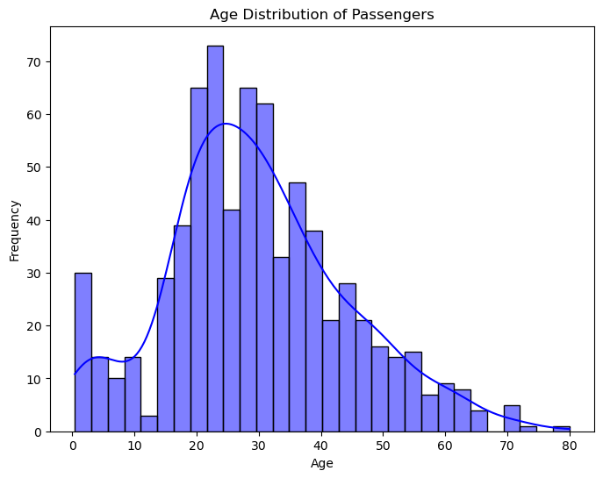
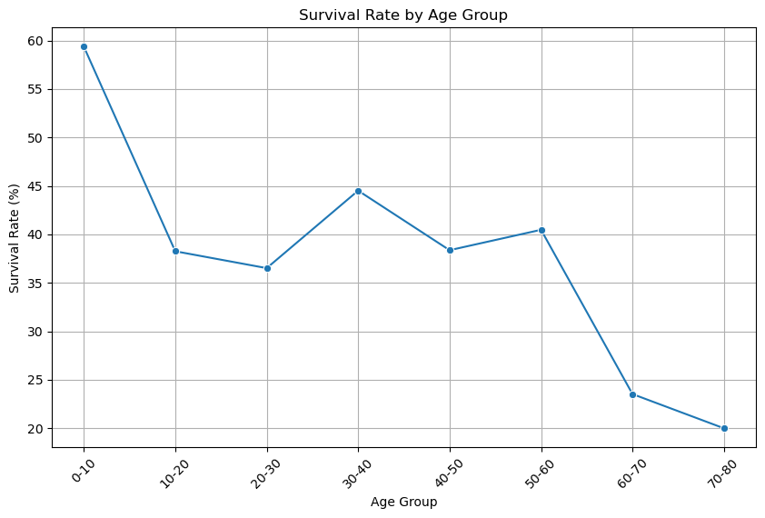
Explanatory Data Analysis (EDA)

Slide 7
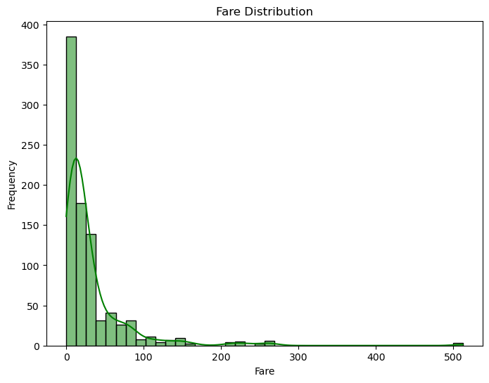
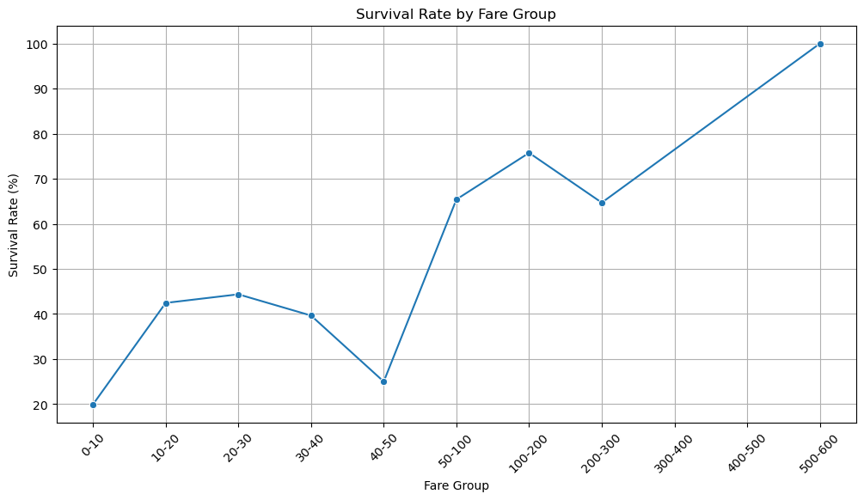
EDA-Fare

Slide 8
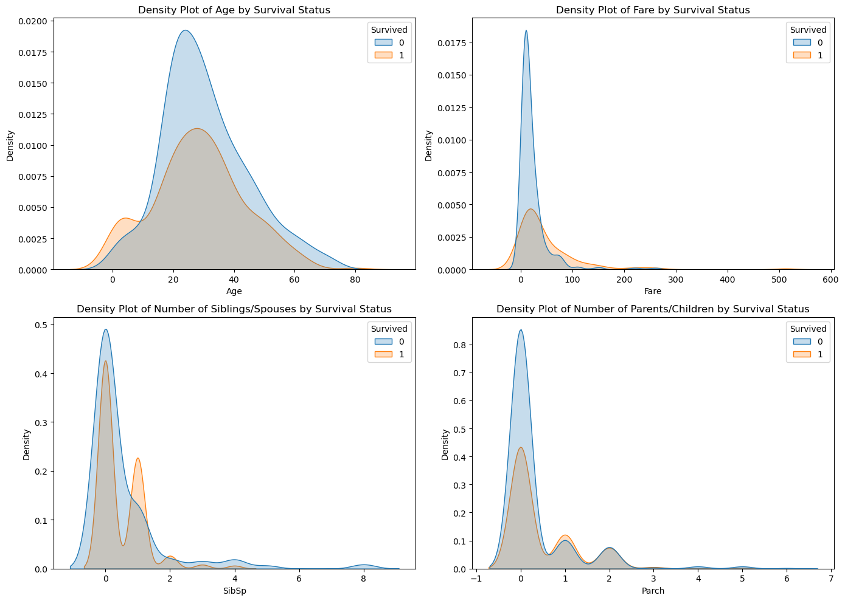
EDA -siblings/ spouses -parents/ children

Slide 9
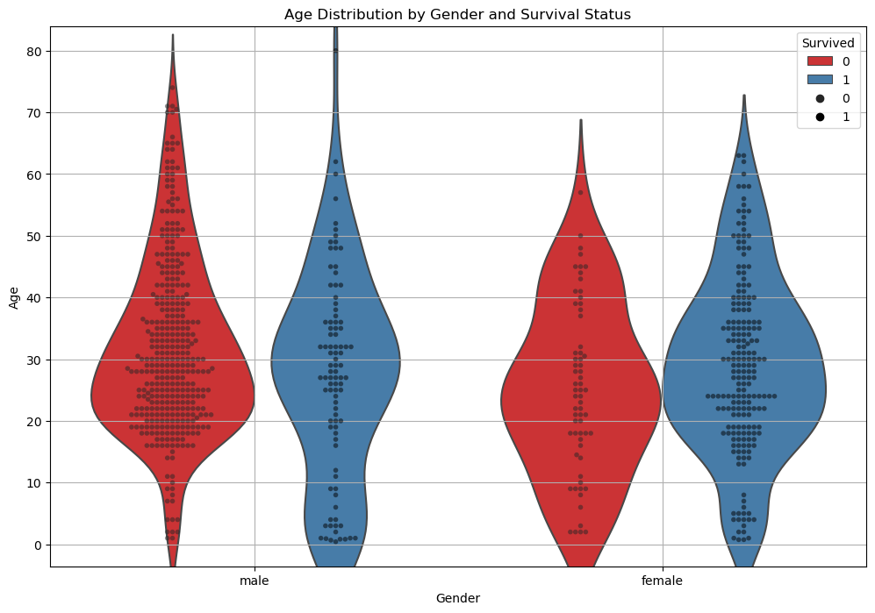
EDA- Survival Status by age and gender

Slide 10
Data Processing-V1
Missing data
Removed “Name”, “Ticket”
Encoded “Sex” and “Embarked” data
Feature | Train | Test | Handling Missing Values
Age | 177 | 86 | Replaced by “mode”
Cabin | 687 | 327 | Remove column
Embarked | 2 | - | Removed 2 rows
Fare | - | 1 | Replaced by “mode”

Slide 11
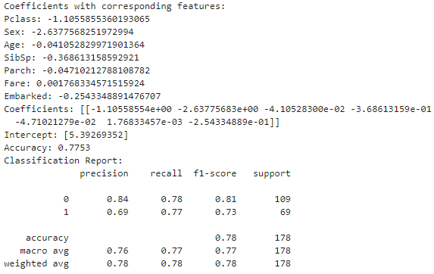
Model Development and Evaluation Logistic Regression-V1

Slide 12
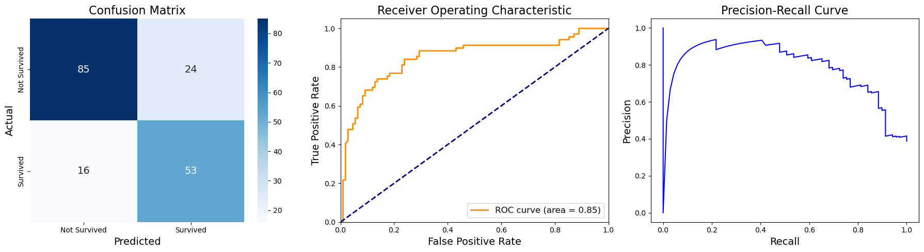
Logistic Regression-V1

Slide 13
Model Development and Evaluation (Extended)
Support Vector Classifier (SCV)
Extreme Gradient Boosting (XGBoost)
Random Forest

Slide 14
Improving Accuracy- Feature Engineering
V1
Introduced “Fare Groups” and “Age Groups” instead of “Age” and “Fare”
V2
Further reduced the number of categories in “Fare Groups”
Introduced new features:
Family Size=SibSp+Parch and grouped them to “Small”, “Medium” and “Large”
“Title” : categorised into “Mr”, “Mrs”,”Miss”,”Dr” by using regex patterns in “Name” feature
“LifePhase” categorised into “child”, “female_adult”, “male_adult” using “Sex” and “Age”
Replaced missing “Age” values using a predictive model instead of replacing missing “Age” values by mode

Slide 15
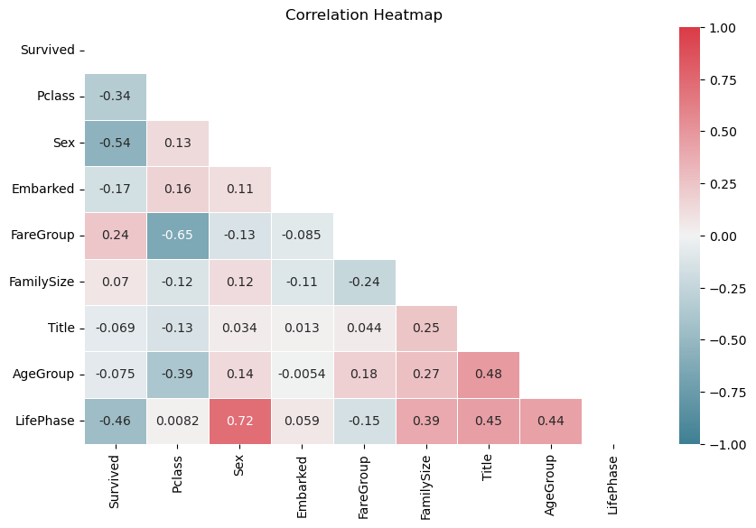
Correlation Heatmaps after Feature Engineering

Slide 16
Cross Validation and Hyperparameter Tunning
Executed Grid Search and Randomised Search algorithms with Cross Validation.
Not cost efficient
Improved accuracy wasn’t observed

Slide 17

Results Comparison-Choosing Best Model-Kaggle Score
Model | V1 |  | V2 |  | V3
 | Model accuracy | Public Score | Model accuracy | Public Score | Model accuracy | Public Score
Logistic Regression | 0.7753 | 0.76315 | 0.7697 | 0.74162 | 0.7978 | 0.75358
XgradientBoost | 0.8034 | 0.76555 | 0.7809 | 0.76076 | 81.46 | 0.75358
Support Vector Classifier(SVC) | 0.8 | 0.76555 | 0.8 | 0.76555 | 0.81 | 0.77511
Random Forest | 0.7753 | 0.77272 | 0.7978 | 0.77751 | 0.8371 | 0.78708

Slide 18
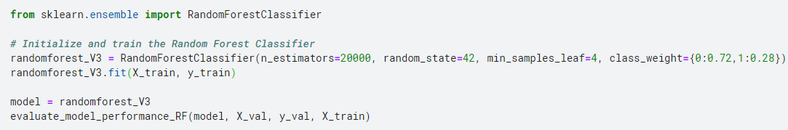
Random Forest Model
Increased no. of trees
Increased no. of samples in the leaves for model generalisation
Weighted class since more deaths than survivors

Slide 19
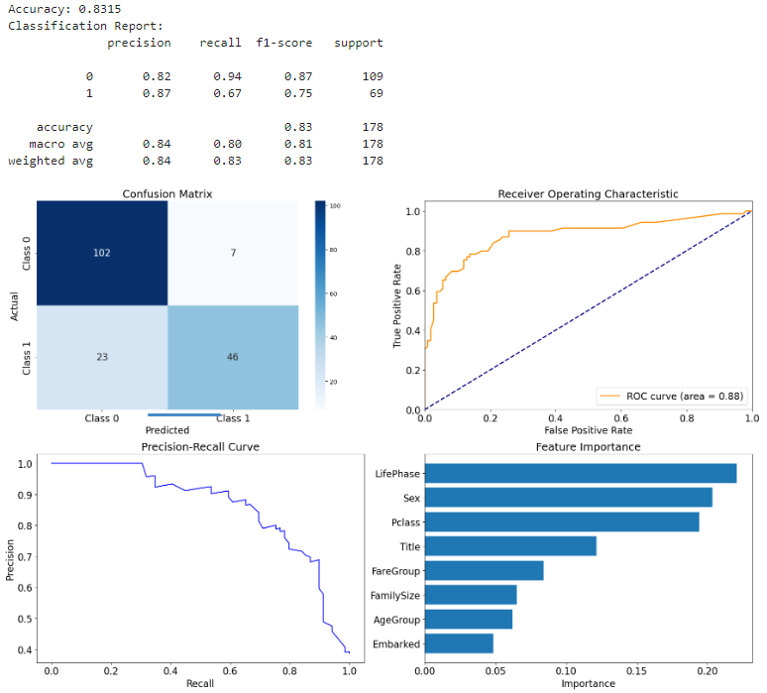
High Accuracy model-Random Forest

Slide 20
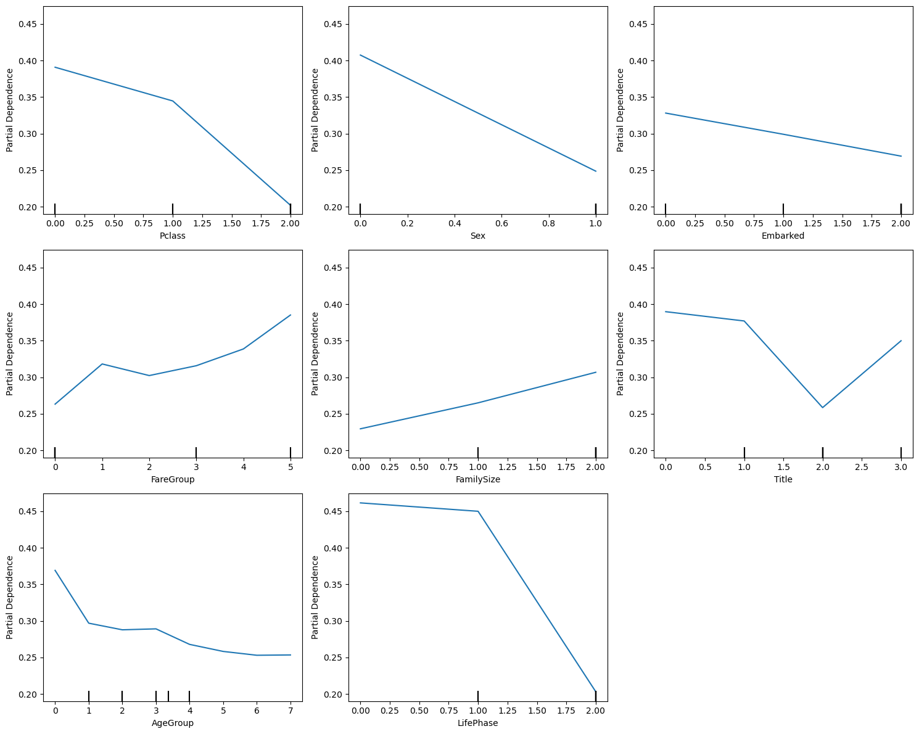




RF-Feature Category importance

Slide 21
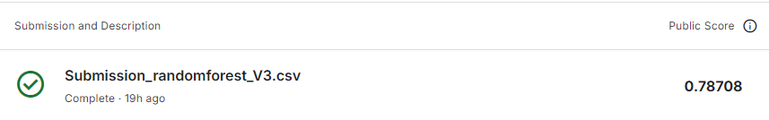
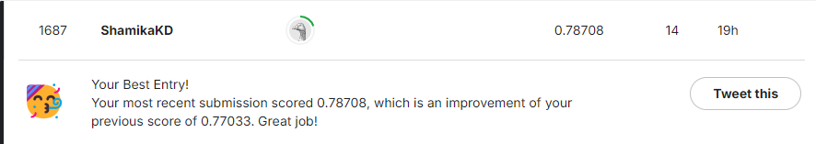
Concluding remarks
Random forest models is more promising than other models compared
You have a high chance to survive
First class
Female
Embarked from Cherbourg
High ticket fare
Small family
Master
Young
Child or female adult

Slide 22
References
Kaggle competition: https://www.kaggle.com/competitions/titanic/overview
Kaggle notebook (best model only): https://www.kaggle.com/code/shamikakd/notebook49fc7f6fb9/edit
Kaggle submissions/public score: https://www.kaggle.com/competitions/titanic/submissions
Feature engineering with Titanic data: https://triangleinequality.wordpress.com/2013/09/08/basic-feature-engineering-with-the-titanic-data/
High accuracy models developed by others:
http://www.philipkalinda.com/ds7.html

