Slide 1
Retrieval-Augmented Generation

Slide 2
What is a RAG?
A framework that combines the strengths of retrieval-based systems and generation-based models to produce more accurate and contextual relevant response
Simple Terms … efficient way to customize an LLM (model) with your own data

Slide 3
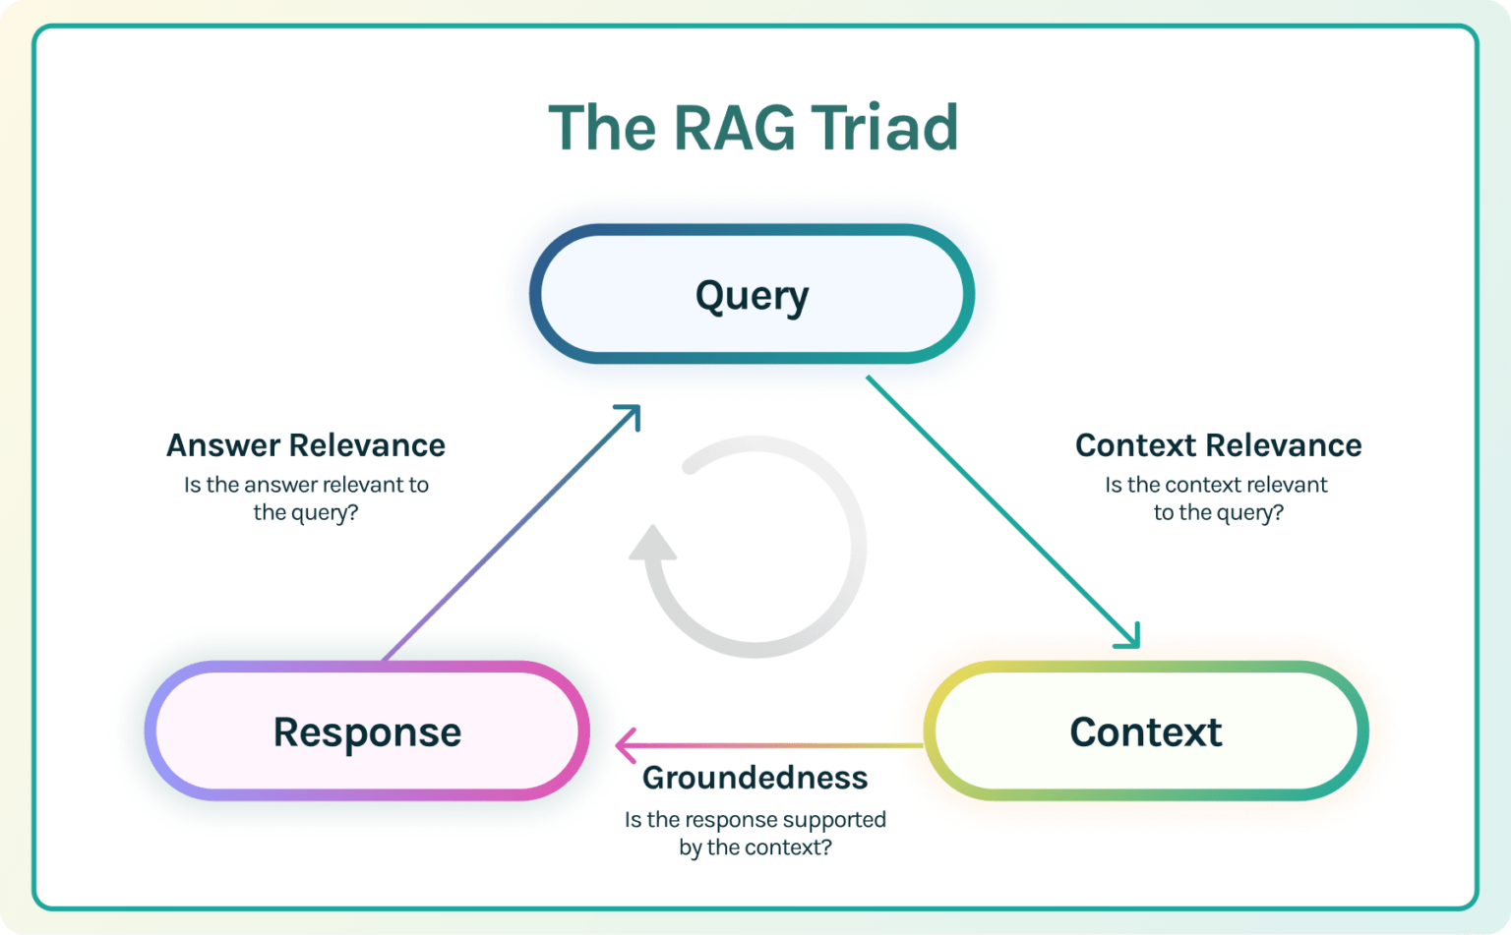

Slide 4
Main Components of RAG
Indexing: Cleaning, extracting data from docs and storing it in Vector Database
Retriever: Identifies and retrieves relevant documents
Generator: Takes retrieved docs and the input query to generate coherent and contextually relevant response.

Slide 5
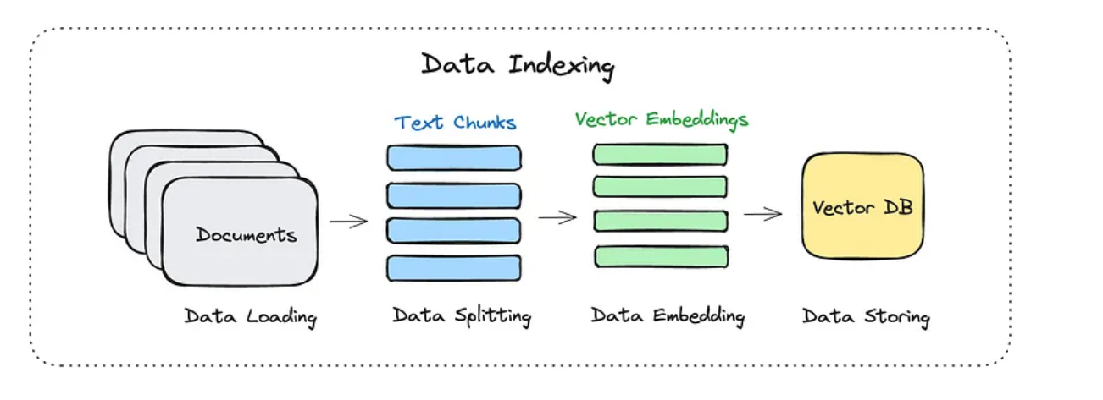
Naive RAG

Slide 6
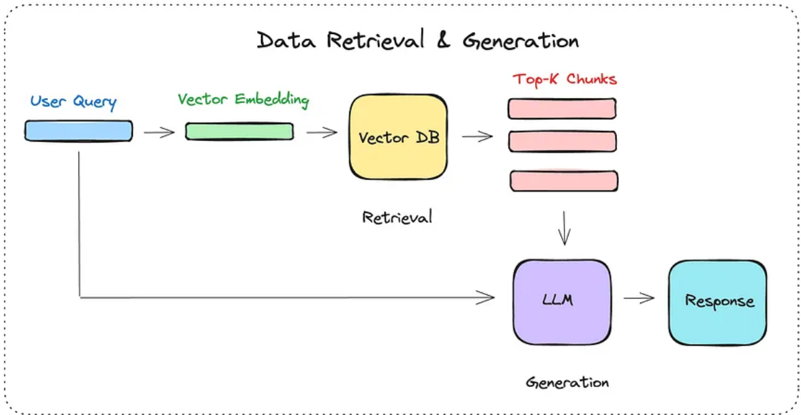
Naive RAG

Slide 7
Naive RAG Drawbacks/Challenges/Pitfalls
Limited contextual understanding
Inconsistent relevance and quality of retrieved documents
Poor integration between retrieval and generation
Inefficient handling of Large-Scale data
Lack of robustness and adaptability

Slide 8
Challenges at 3 level
Query
Retrieval
Generation

Slide 9
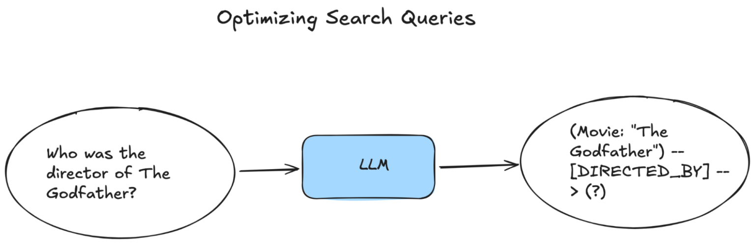
Converts user’s query into a format that is more understandable by the LLM and usable by retrievers.

Slide 10
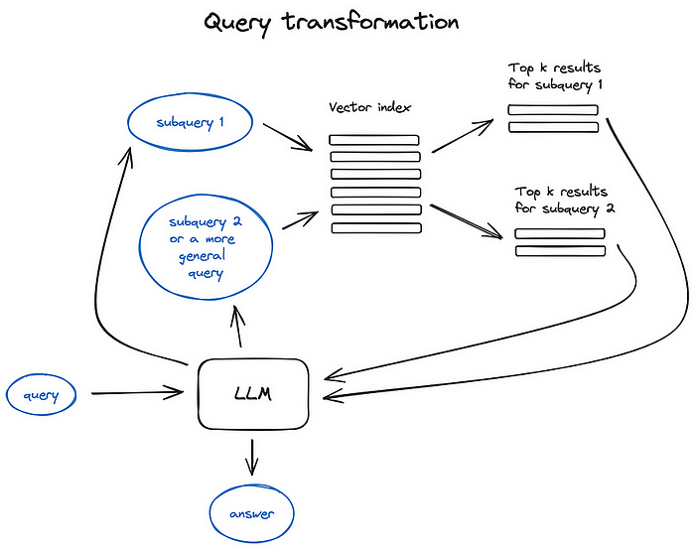
Modifies user queries to improve retrieval accuracy by rephrasing, expanding, or refining them before searching the knowledge base.

Slide 11
Query Transformation
Query Reformulation (Adding relevant keywords, synonyms, or entity variations)
User Query: "How does GPT-4 work?" Reformulated Query: "Explain the architecture and working mechanism of OpenAI's GPT-4 model.“
Query Decomposition (Rewriting the query in a clearer or more structured manner)
User Query: "How does fine-tuning differ from prompt engineering in LLMs?" Decomposed Queries:
"What is fine-tuning in large language models?"
"What is prompt engineering in large language models?"
"How do fine-tuning and prompt engineering compare?"

Slide 12
Query Transformation
Query Disambiguation (Clarifying vague terms based on context.)
User Query: "What is Python used for?" Disambiguated Query: "What are the applications of Python in data science, web development, and automation?“
Query Reduction (Summarization)
User Query: "Can you give me a detailed breakdown of all the differences between supervised, unsupervised, and reinforcement learning?" Reduced Query: "Differences between supervised, unsupervised, and reinforcement learning."

Slide 13
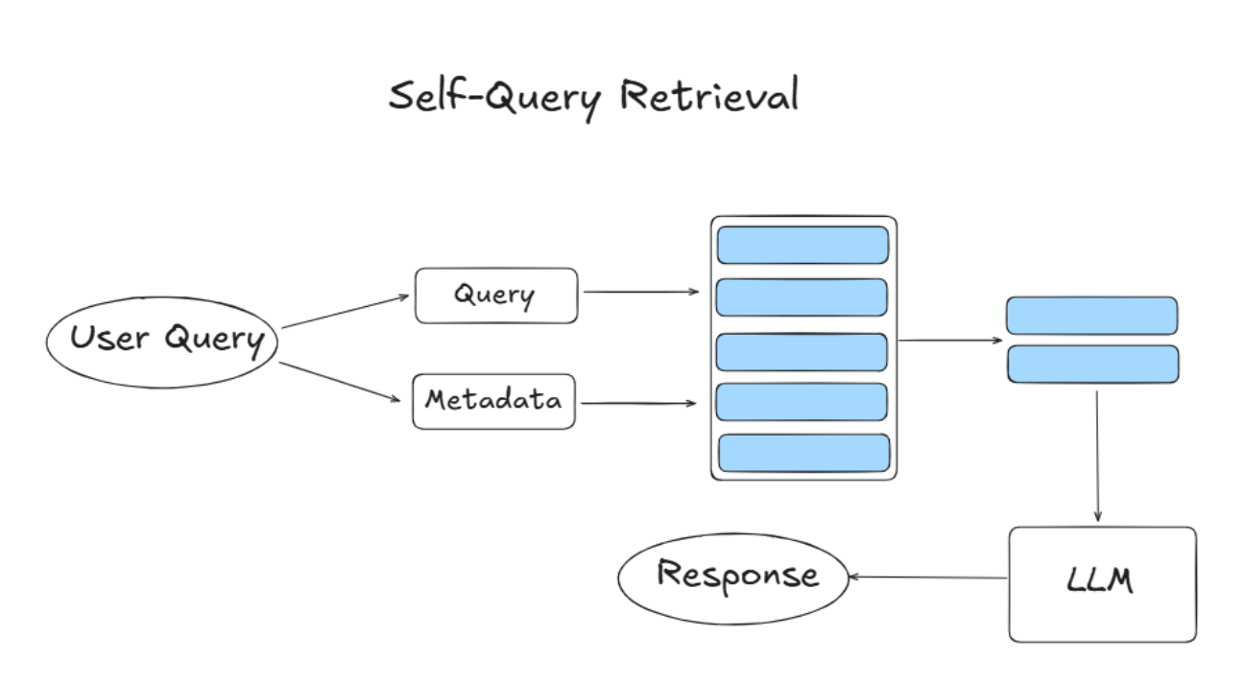
LLM generates follow-up queries based on the initial user query to retrieve more precise information.
metadata fields are defined for the documents in your vector store
for each user query Self-Query retrieval searches against the vector store using both semantic and metadata-based retrieval

Slide 14
What is Metadata?
Metadata refers to structured information about documents stored in a vector database that helps in filtering and retrieving relevant content efficiently.
Examples of Metadata in RAG:
Document Source: (e.g., "Research Paper," "Blog Post," "Internal Report")
Date Created: (e.g., "March 2024")
Author: (e.g., "John Cena")
Topic or Category: (e.g., "Machine Learning," "Healthcare")
Relevance Score: (e.g., "High," "Medium," "Low")
Keywords or Tags: (e.g., "Neural Networks, Transformer Models")

Slide 15
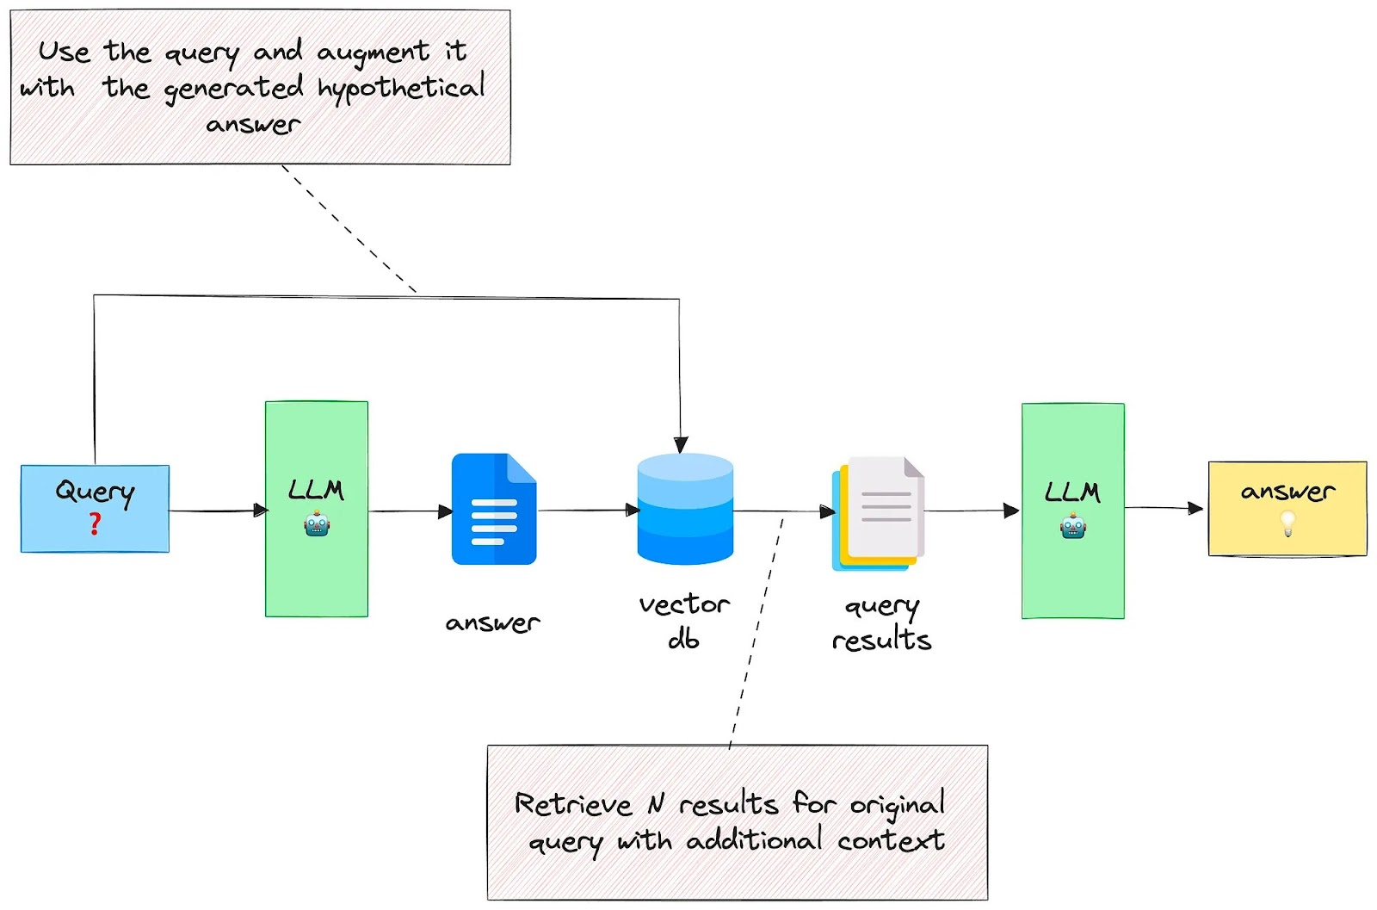
Query Expansion with generated answers
Generates potential answers first and then uses them as enriched queries for retrieval, often called Hypothetical Document Embeddings (HyDE) to improve search relevance

Slide 16
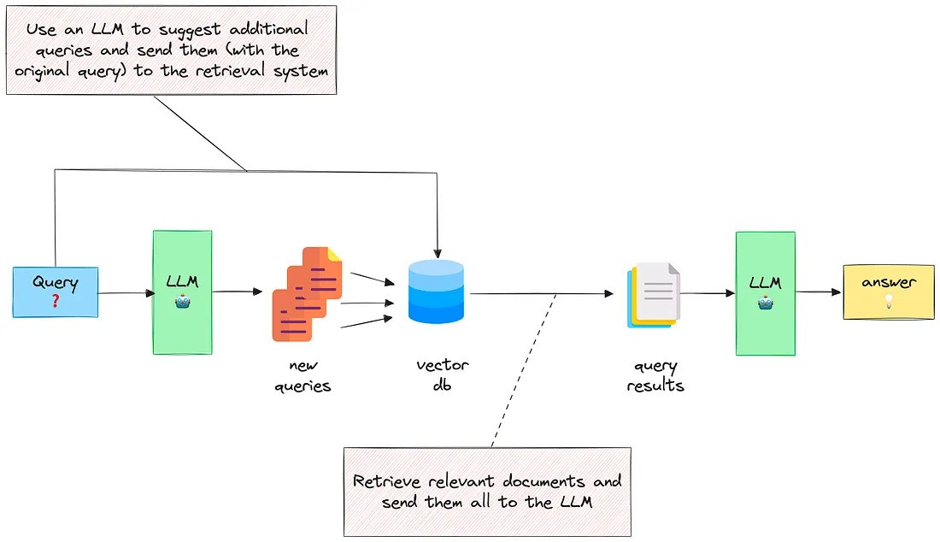
Query Expansion with generated new queries
Reformulates the original query by generating multiple alternative queries to retrieve more relevant documents.

Slide 17
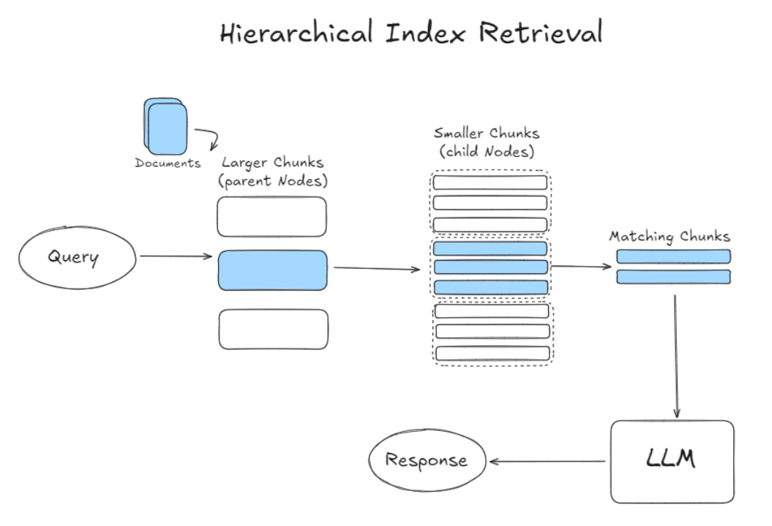
retrieval process begins with broader chunks followed by a more focused search within smaller chunks
minimizes the inclusion of irrelevant data
data is organized into a hierarchical structure, with information categorized and sub-categorized based on relevance and relationships

Slide 18
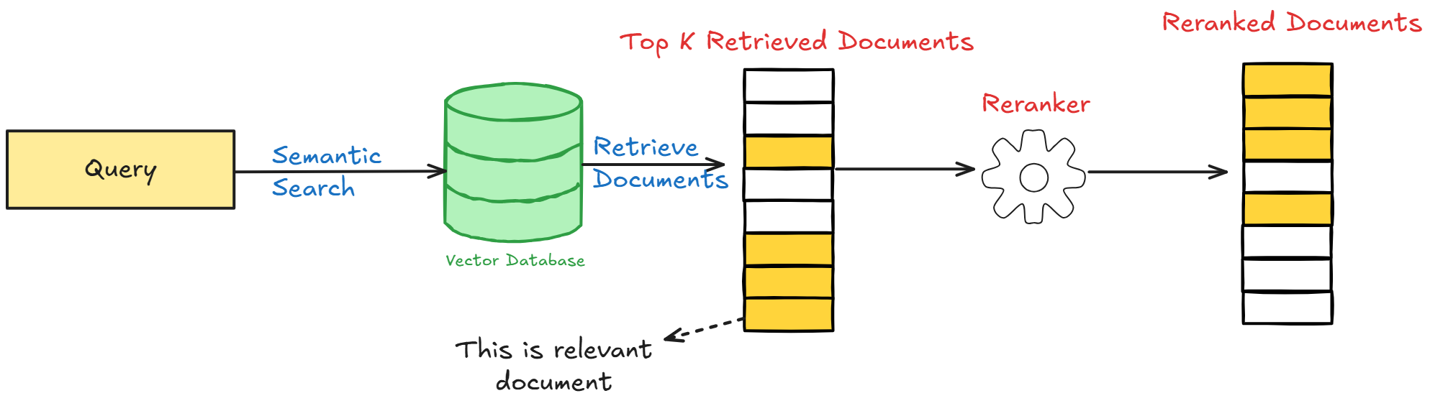
Re-ranking (Using Cross-encoder)
sorts the documents based on their relevance to the query.
re-evaluates retrieved documents by jointly encoding the query and document to assign a more accurate relevance score.

Slide 19
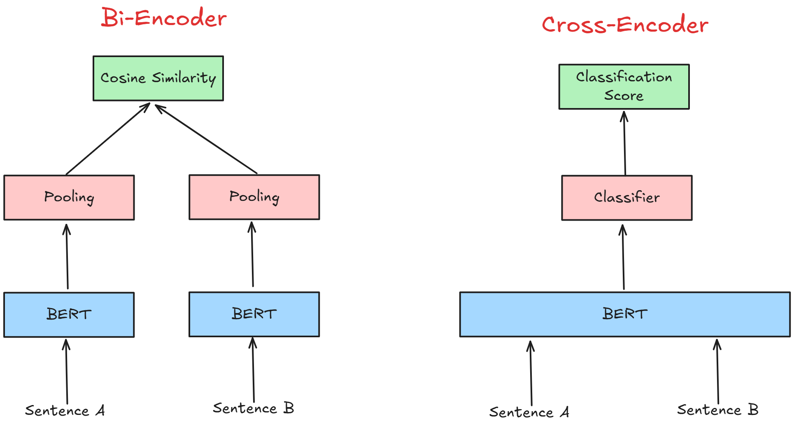

Slide 20
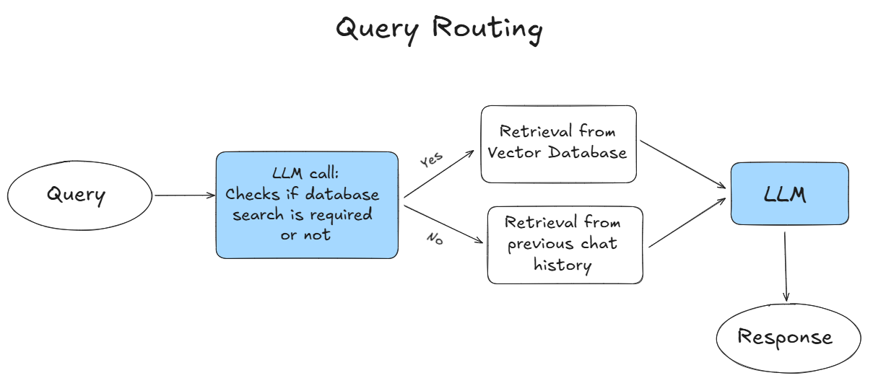
Directs user queries to the most relevant data source

Slide 21
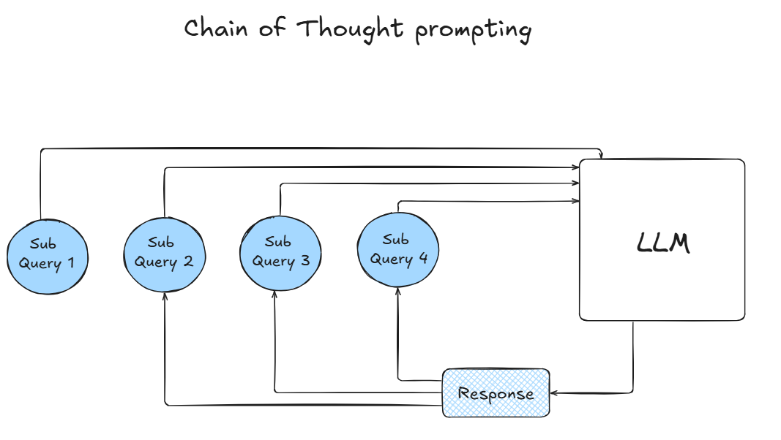
involves guiding your system through a logical sequence of steps or “thoughts” using Chain-of-Thought (CoT) Prompting
typically involves providing your model with examples of how to approach a specific type of query, where you demonstrate the thought process and intermediate steps required to arrive at a satisfactory answer.

Slide 22
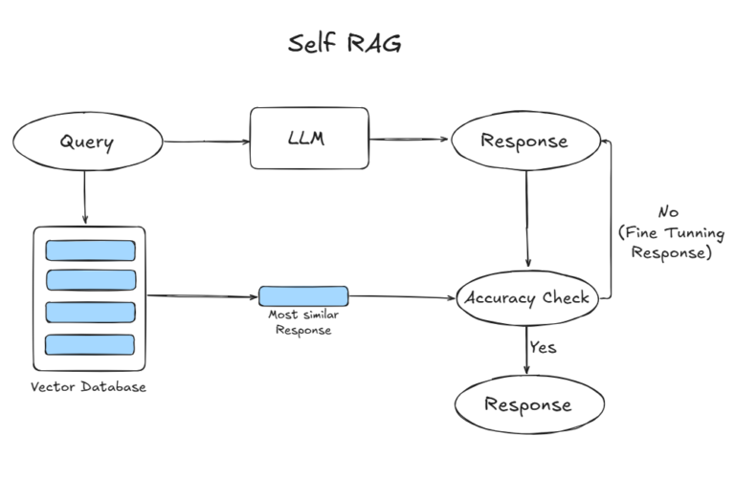
Refine its own retrieval and generation process by iterating on its outputs.
model doesn’t just rely on the initial retrieval but actively re-evaluates and adjusts its approach by generating follow-up queries and responses.
This iterative process allows the model to correct its own mistakes, fill in gaps, and enhance the quality of the final output.

Slide 23
Demo Time

Slide 24
Thank You

