Slide 1
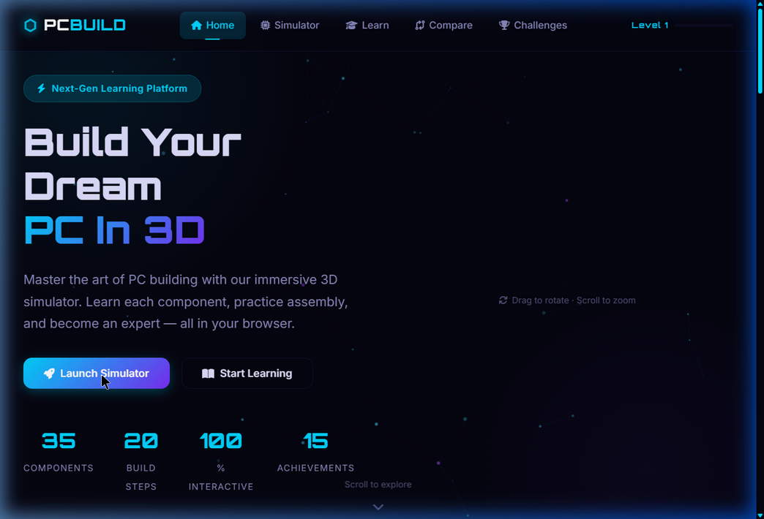
PC BUILD LEARNING
SIMULATOR
3D Interactive Web Application — Professional Technical Presentation
Built with Three.js · HTML5 · CSS3 · JavaScript
Three.js
OrbitControls
WebGL
GSAP
CSS Glassmorphism
March 2026 | Frontend Engineering & 3D Web Development
1 / 14

Slide 2
PROJECT OVERVIEW
📌 What Is It?
🎯 Project Goals
A fully browser-based, interactive 3D PC Building Simulator where users learn to assemble a computer step-by-step by interacting with real 3D hardware component models inside a virtual PC case — no installation required.
▸ Fully interactive 3D PC case with openable side panel
▸ Working camera controls (rotate, zoom, reset)
▸ All hardware components as clickable 3D objects
▸ Guided assembly simulation with snap-in animations
▸ Professional futuristic UI — fullscreen, tooltips, highlights
9
9
6
4
100%
Build Steps
3D Components
Camera Buttons
Pages
Browser-Based
⚠ Problems Fixed
✅ Solutions Implemented
✗ Case not interactive/openable
✗ Zoom/Reset/Fullscreen buttons broken
✗ Components not 3D objects
✗ OrbitControls not loading
✗ No tooltips or hover effects
✓ Full 3D case with animated glass panel hinge
✓ 6 working camera control buttons
✓ 9 distinct 3D hardware meshes
✓ Fixed CDN to jsdelivr.net
✓ 3D hover glow + floating tooltip DOM element
2 / 14

Slide 3
HOME PAGE — Landing & Navigation
⬡ PCBuild Logo
Brand identity with Orbitron font + animated hex icon
🧭 Navigation Bar
Home · Simulator · Learn · Compare · Challenges + Level indicator
🚀 Hero Section
Animated counters: 35 Components, 20 Steps, 100% Interactive
🎮 CTA Buttons
Launch Simulator (gradient glow) + Start Learning (outline)
✦ Particle BG
Canvas-based animated particle system (particles.js)
3 / 14

Slide 4
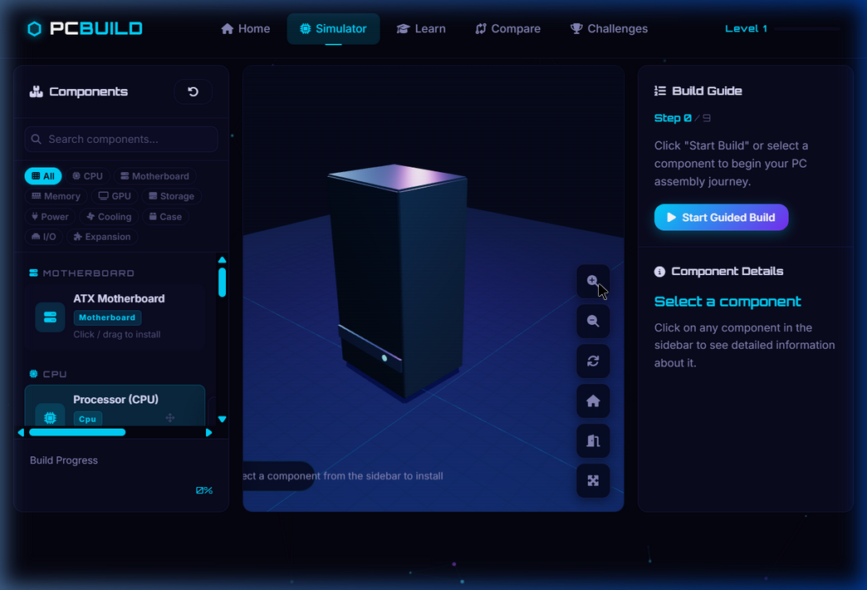
3D SIMULATOR — Full Page Layout
LEFT SIDEBAR
Component list, search bar, category filter pills, build progress bar
CENTER VIEWPORT
Three.js WebGL canvas — drag to rotate, scroll to zoom, click to select
RIGHT PANEL
Build Guide (Step 0/9) + Component Details with specs & tips
CONTROL BUTTONS
6 floating action buttons: Zoom±, Rotate, Reset, Case, Fullscreen
HINT OVERLAY
Context-aware bottom hint: 'Select a component from the sidebar to install'
4 / 14

Slide 5
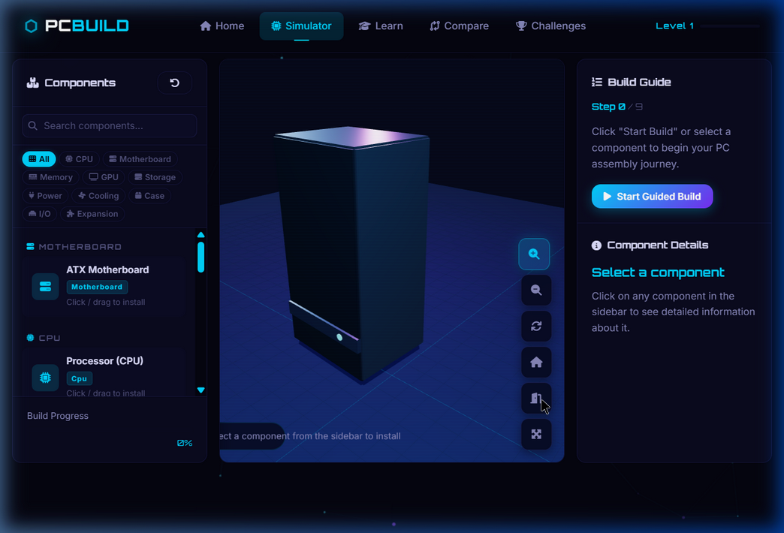
INTERACTIVE 3D PC CASE
▲ Case CLOSED (default)
▲ Case OPEN (glass panel swings on hinge)
▸ Dark steel ATX mid-tower body — 5 permanent walls + openable glass panel
▸ Tempered glass side panel with cyan LED border rotates on a hinge (−90°)
▸ Internal neon RGB strips (cyan + magenta) pulsing with sin() animation
▸ PSU shroud, motherboard tray, 9 brass standoffs, I/O backplate all modeled
▸ Front panel: USB ports, power button (glowing), I/O strip
▸ Top exhaust vent grilles + top/front RGB accent strips
▸ Subtle ambient case rotation animation when no components installed
5 / 14

Slide 6
WORKING CAMERA CONTROLS — OrbitControls
🔍+
Zoom In
Camera moves closer along view direction (18% step, respects minDistance=2)
🔍−
Zoom Out
Camera moves farther along view direction (18% step, respects maxDistance=22)
↺
Auto Rotate
OrbitControls.autoRotate=true, speed=1.5, button turns cyan when active
⌂
Reset Camera
Smooth lerp animation back to position (6,4,7), target (0,0,0) in 900ms
🚪
Case Toggle
Rotates sidePanelGroup.rotation.y from 0 → −90° with 9% per-frame lerp
⤢
Fullscreen
🔧 CDN Fix: Three.js + OrbitControls migrated from cdnjs/unpkg → cdn.jsdelivr.net/npm/three@0.128.0 to resolve the OrbitControls loading failure that made all controls non-functional.
Native requestFullscreen() API on #page-simulator, auto-resize on exit
6 / 14

Slide 7
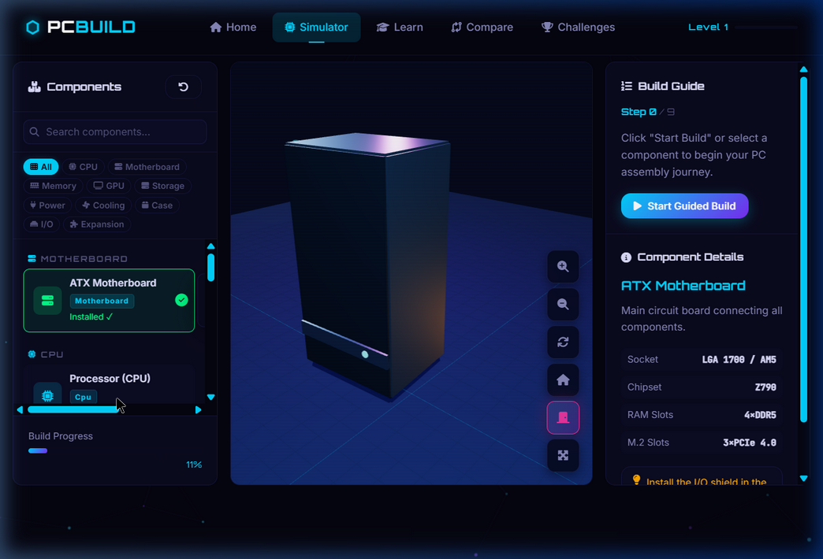
INTERACTIVE 3D HARDWARE COMPONENTS
ATX Motherboard
NVMe SSD
Green PCB, CPU socket, 4 RAM slots, 3 PCIe slots, VRM heatsinks, M.2 slot, chipset, I/O
M.2 form factor, NAND flash chips, controller chip, M-key connector
Processor (CPU)
HDD
Silver IHS with gold triangle marker, gold contact pads, blue laser-etched label
Full-height drive, spinning platter edge, SATA port, label
DDR5 RAM
CPU Cooler
2 sticks, purple RGB bar on top, heat spreader fins, gold bottom contacts
11 aluminum fins, 3 copper heat pipes, base plate, fan frame + spinning blades
GPU
Case Fan
3-fan shroud with spinning blades, RGB strip, backplate, PCIe bracket + connector
Square frame, 9 blades, ARGB ring glow, 4 corner mounts, hub in configured colour
PSU
Orange-labelled box, fan grill ring, modular cable sockets on rear
7 / 14

Slide 8
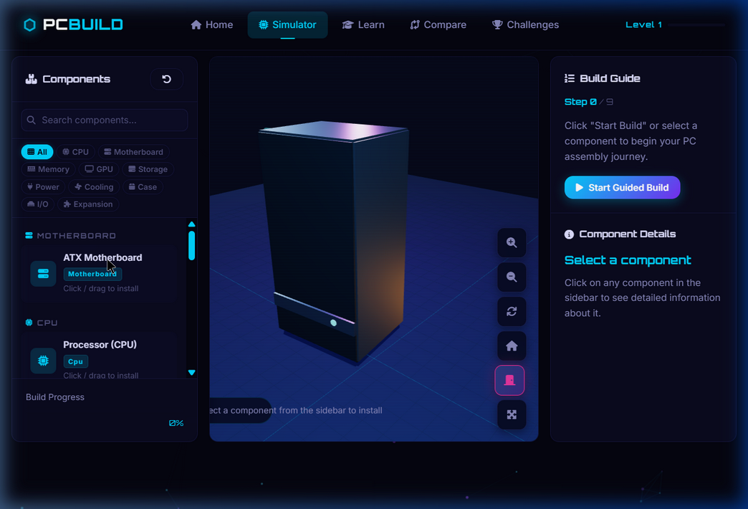
ASSEMBLY SIMULATION — Snap-In Animation
1
5
User Clicks Component
Drop Animation 900ms
Sidebar or 3D mesh click triggers handleComponentClick(id)
Cubic ease-in-out lerp: y drops, rotation.y sweeps, scale 0.4→1.0
2
6
Check Guided Mode
Snap & Flash
In guided mode, verifies correct order; shows warning if wrong
Green emissive flash for 700ms on installed mesh
3
7
Build Fresh 3D Mesh
Update UI
_buildMesh(comp) creates a new high-detail Three.js Group
Sidebar: green checkmark, progress bar %, Build Guide advances
4
Set Start Position
Places mesh at slotWorld.y + 5 (above case) with full scale
✅ Visual Feedback Chain: Canvas border flashes green (animation: assembly-success 0.7s) → Sidebar slot turns green with 'Installed ✓' → Right panel shows component specs → Build progress bar updates.
8 / 14

Slide 9
HOVER HIGHLIGHTS, TOOLTIPS & RAYCASTING
🧿 Three.js Raycasting
▸ Mouse position normalized to NDC coords (−1 to +1)
▸ raycaster.setFromCamera(mouse, camera) casts a ray
▸ intersectObjects(installedMeshes, recursive=true)
▸ Traverses up parent chain to find root componentId
▸ mousemove: cyan glow + DOM tooltip shown at cursor
▸ click: triggers _simClickCallback → shows specs panel
💡 Hover Highlight System
▸ _setEmissive(mesh, 0x00d4ff, 0.65) recursively sets all children
▸ Previous hover mesh de-highlighted before new one is set
▸ Cursor changes to 'pointer' on hover, '' (default) on miss
💬 Floating DOM Tooltip
▸ Position: fixed DOM element, pointer-events: none
▸ Shows: Component Name (cyan) + 1-line description
▸ Glassmorphism: backdrop-filter blur + cyan border glow
▸ Opacity transitions: 0 → 1 on hover, 1 → 0 on leave
9 / 14

Slide 10
TECHNOLOGY STACK & ARCHITECTURE
Three.js r128
OrbitControls
HTML5 / CSS3
3D engine (WebGL renderer, Scene, Camera, Geometry, Material)
Camera interaction (rotate, zoom, pan, damping, autoRotate)
Single-page app (5 pages, glassmorphism, CSS custom properties)
Vanilla JavaScript
GSAP 3.12
CSS Glassmorphism
No framework (ES6 classes, requestAnimationFrame, IntersectionObserver)
Scroll animations (ScrollTrigger, animate-in classes)
UI panels (backdrop-filter, RGBA, blur, border glow)
Web Fullscreen API
localStorage
Font Awesome 6
requestFullscreen() webkitRequestFullscreen() auto-resize on exit
Persistent state (progress, achievements, fastest build time)
Icon set (navigation, buttons, component icons)
10 / 14

Slide 11
FILE ARCHITECTURE & CODE STRUCTURE
📄 index.html
500 lines
📜 simulator.js
956 lines
▸ Single-page application with 5 page <main> sections
▸ Added: sim-case-toggle + sim-fullscreen buttons
▸ Fixed: CDN from cdnjs/unpkg → cdn.jsdelivr.net
▸ Step counter updated: / 9 (was / 20)
▸ PCSimulator class — completely rewritten v3.0
▸ _buildPCCase(): 50-part 3D ATX case group
▸ _buildMesh(): 9 distinct component mesh builders
▸ toggleCasePanel(), zoomIn/Out(), resetView() with lerp
▸ Raycasting, hover, tooltip, install animation
📜 app.js
1109 lines
🎨 style.css
2000 lines
▸ initSimulatorUI(): wires all 6 control buttons
▸ Fullscreen API with change event + resize listener
▸ Case toggle: icon + title + active-class swap
▸ installComponent callback: canvas flash effect
▸ Step total updated: 9 steps
▸ Enhanced .sim-ctrl-btn: hover slideX, glow shadow
▸ #sim-case-toggle.active: pink/accent active state
▸ #sim-fullscreen.active: purple active state
▸ .sim-canvas-container::after: scanline overlay
▸ @keyframes assembly-success: green border pulse
11 / 14

Slide 12
UI / UX DESIGN SYSTEM — Futuristic Dark Theme
Colour Palette
Typography
Orbitron
Display / Logo / Headings
#00D4FF
#7B2FF7
#FF2D95
Primary Cyan
Secondary Purple
Accent Pink
Inter
Body / UI text / Paragraphs
#00FF88
#FFAA00
#0A0A20
Success Green
Warning Gold
Surface Card
JetBrains Mono
Code / Spec values / Mono
#050510
#E0E0FF
#8888BB
Background
Text Light
Text Dim
Animations & Effects
▸ Case Panel Hinge
sidePanelGroup.rotation.y lerped 9% per frame → −90° open
▸ Button Hover Slide
translateX(−3px) + cyan glow shadow on .sim-ctrl-btn:hover
▸ Component Drop
900ms cubic ease-in-out: y from +5 drop, rotation sweep, scale 0.4→1
▸ Scanline Overlay
::after repeating-linear-gradient 4px cyan scanlines (1.2% opacity)
▸ Green Install Flash
emissive 0x00ff88 intensity 1.0 → 0 in 700ms setTimeout
▸ RGB Glow Pulse
sin(t*2.2) drives emissiveIntensity of internal case neon strips
▸ Canvas Border Pulse
@keyframes assembly-success: inset box-shadow 0→0.8→0 in 700ms
▸ Fan Spin
rotation.z += 0.055 per frame on all _spinMeshes groups
12 / 14

Slide 13
BEFORE vs AFTER — Technical Comparison
Feature
BEFORE (v2.0)
AFTER (v3.0)
PC Case
Wire-frame edges only, not interactive
Full 50-part 3D model, glass panel opens on hinge
OrbitControls
Failed to load (unpkg CDN broken)
Fixed CDN → works perfectly, full damping + limits
Zoom Buttons
Called camera.position.multiplyScalar()
Proper dir-vector zoom with min/max clamping
Reset Camera
Instant jump to (8,6,8) — jarring
Smooth 900ms lerp animation back to position
Fullscreen
Button existed but had no handler
Native Fullscreen API + resize + icon toggle
Case Toggle
Did not exist
New button: smooth hinge animation, pink active state
Components
Hidden (visible=false) until install
9 distinct detailed meshes; snap-in from above
Tooltip
Browser title= attribute only
Custom glassmorphism DOM tooltip, fade in/out
Hover Effect
Basic emissive on some meshes
Recursive emissive + cursor change + tooltip trigger
Canvas Feedback
No visual install feedback
Green border pulse animation (assembly-success)
Fan Animation
rotation.z on parent group (buggy)
Dedicated _spinMeshes array, correct sub-group spin
CDN URLs
cdnjs r128 Three + unpkg OrbitControls
cdn.jsdelivr.net/npm/three@0.128.0 — both files
13 / 14

Slide 14
CONCLUSION & KEY ACHIEVEMENTS
✓ Fully Functional 3D Simulator
Professional-grade Three.js scene with PBR materials, lights, OrbitControls, and animation loop.
✓ Interactive Hardware Education
9 distinct 3D component meshes teach real PC hardware via hover, click, snap, and guided build.
✓ All Camera Controls Working
6-button control panel: zoom, rotate, reset (animated lerp), fullscreen, case toggle — all verified.
✓ Openable 3D PC Case
Tempered glass side panel smoothly swings open on a virtual hinge revealing internal components.
✓ Professional UI/UX Design
Dark futuristic theme, glassmorphism, scanlines, RGB strips, tooltips, and smooth animations throughout.
✓ No External Dependencies Added
Pure Three.js + vanilla JS — no React, no Vue, no build step. Works in any modern browser.
PC Build Learning Simulator v3.0 · Three.js WebGL · Vanilla JS / HTML5 / CSS3 · March 2026
14 / 14

