Slide 1

Exploratory Data Analysis
By: Keith D. Smith
May 28, 2024

Slide 2
Agenda
Executive Summary
Problem Statement
Approach
EDA
EDA Summary
Recommendations

Slide 3
Problem Statements
1. The avg. Price/Km varies between different cities.
2. The Price/km is higher for one company compared to the other.
Higher-income customers travel further
The mode of payment varies by city
5. There is a difference in the avg. cost of trips between the two companies
6. The gender of customers influences the distance traveled and price charged
7. The cost of the trip is seasonal

Slide 4
Approach
1. One-way Anova
T-test
Pearson’s R
Chi-square Test
Anova

Slide 5
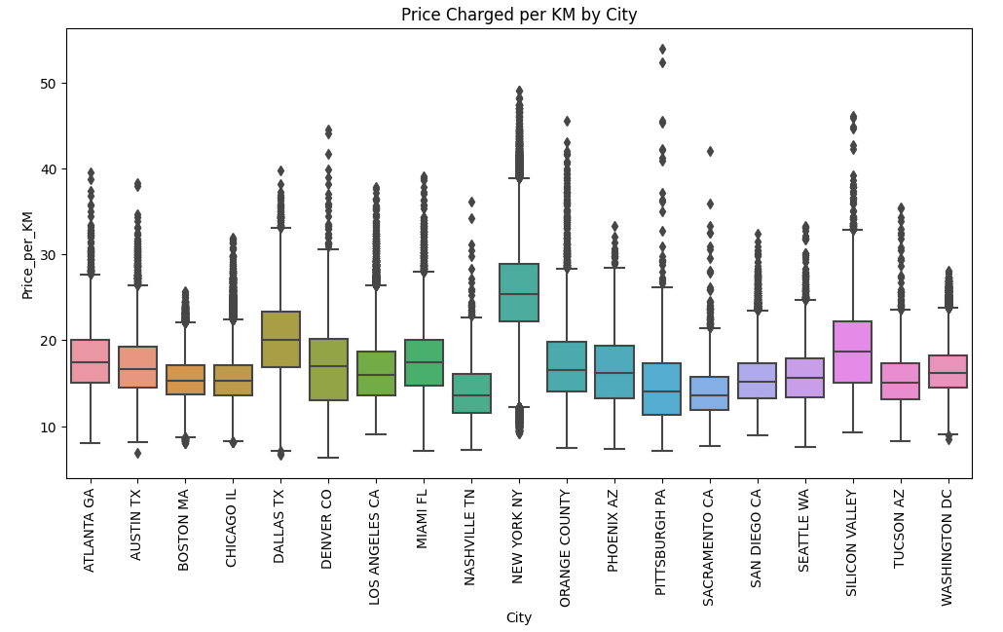
The Average Price charged per Km varies significantly between different cities
Test | P-Value
One-Way Anova | 0.0
The p-value of .00 is less than the alpha of .05. There is a statistically significant difference in the average price charged per kilometer between different cities.

Slide 6
The Average Price charged per Km varies significantly between different cities
Test | P-Value
T-test | 0.0
The p-value of .00 is less than the alpha of .05. This indicates a statistically significant difference in the price charged per kilometer between the two companies. .

Slide 7
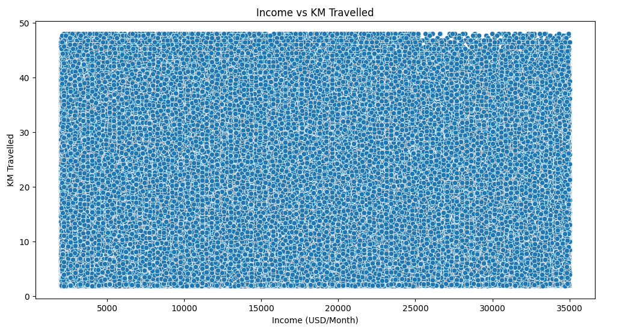
Higher income customers tend to travel longer distances
Test | Value
Pearson’s R | -0.005
There is not a linear relationship between the income of customers and the distance they travel.

Slide 8
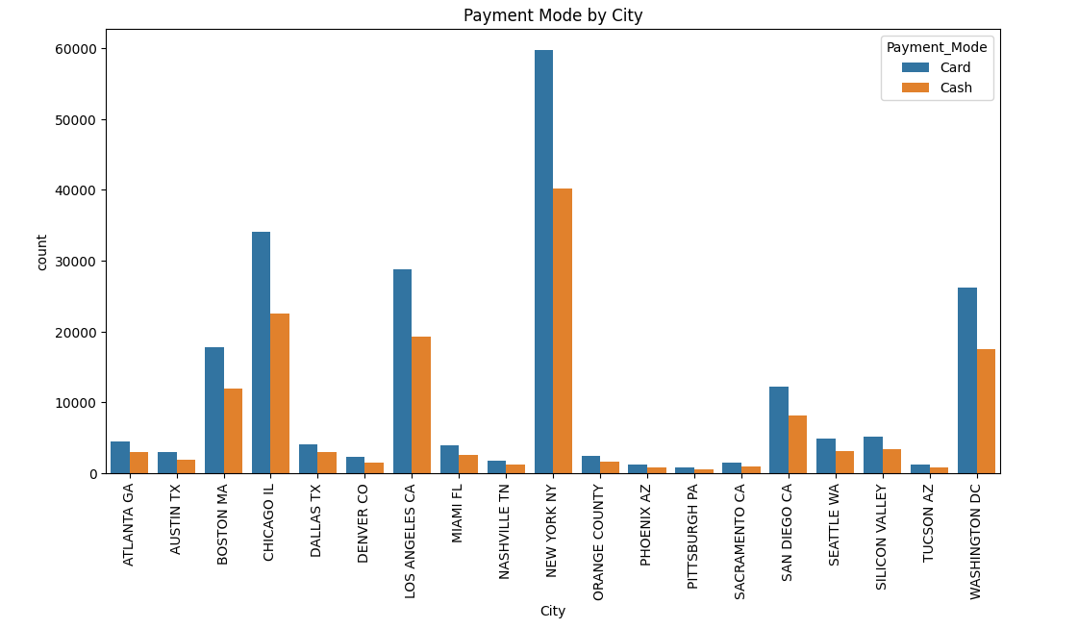
The mode of payment varies significantly by city
Test | P-Value
Chi-square | 0.104
The p-value is 0.104, which is greater than 0.05. This indicates that there is no statistically significant difference in the mode of payment across different cities.

Slide 9
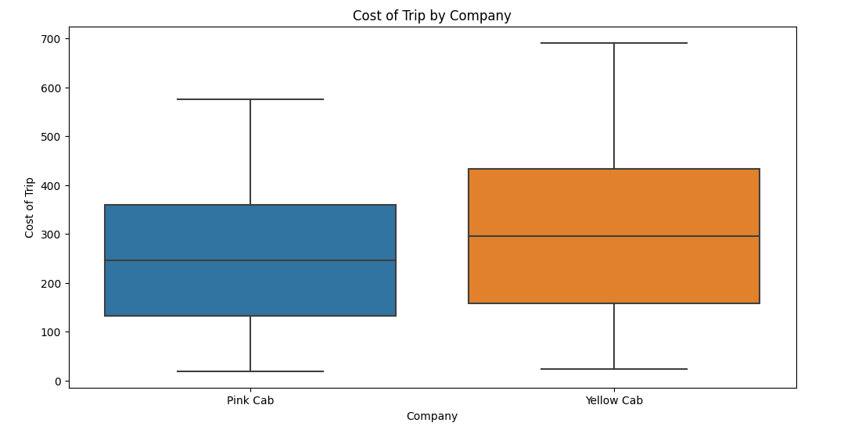
There is a difference in the average cost of trips between the two companies
Test | P-Value
T-test | 0.0
The p-value is 0.0, which is less than 0.05. This indicates a statistically significant difference in the average cost of trips between the two companies.

Slide 10
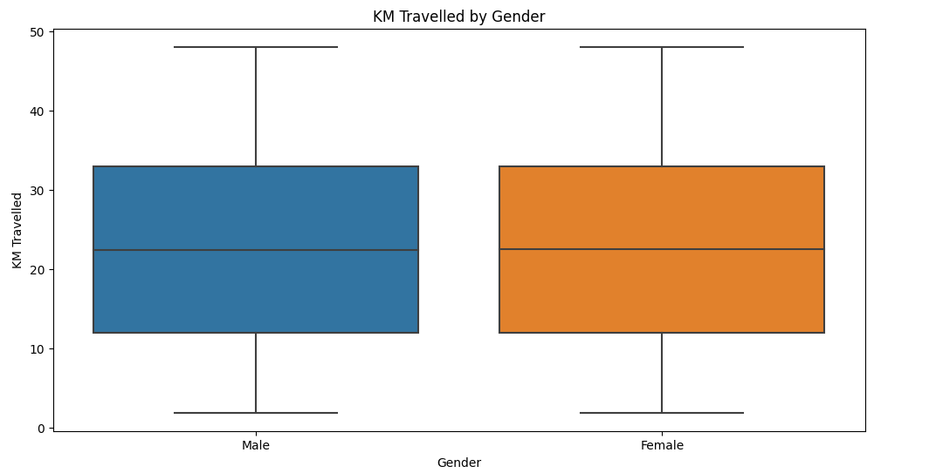
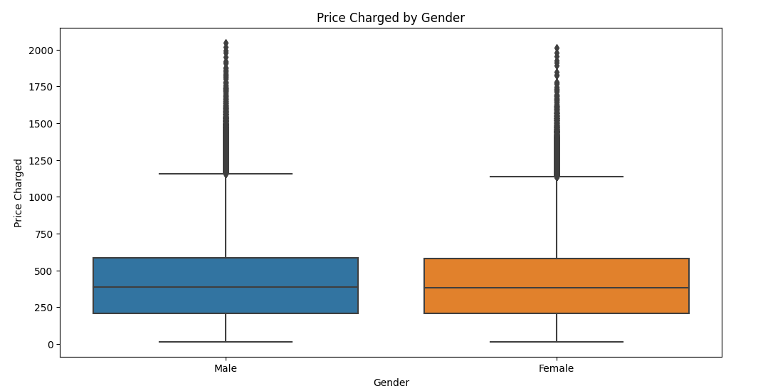
The gender of customers influences the distance traveled and price charged
Test | P-Value
T-test | 0.418
The p-value is 0.418, which is greater than 0.05. This indicates no statistically significant difference in the distance traveled between genders.
Test | P-Value
T-test | 0.0
The p-value is very close to 0, which is less than 0.05. This indicates a statistically significant difference in the price charged between genders.

Slide 11
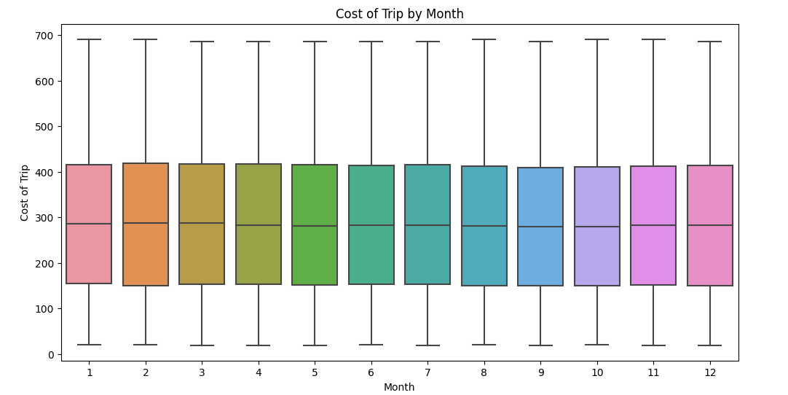
The cost of the trip is seasonal
Test | P-Value
T-test | 0.0
The p-value is very close to 0, which is less than 0.05. This indicates that there is a statistically significant seasonal variation in the cost of trips.

Slide 12
EDA Summary
No Missing Data
Outliers need to be clarified
Yellow Cab has a higher average cost per trip
Yellow Cab is more expensive per Km than Pink Cab
Cab revenue is seasonal by month
Gender has no association with the price charged
City has no association with mode of payment
Income has no correlation with distance traveled
City is associated with the avg. price per kilometer

Slide 13
Recommendations
Determine if outliers should be included in models.
Prepare data for time-series modeling.
Model data via interpretable models to determine revenue for Pink Cab and Yellow Cab.

Slide 14
Thank You

