Slide 1

Best Practices for Azure SQL Database
Sumit Sarabhai
Sr. Consultant, Data & AI
Microsoft

Slide 2
Agenda
Business Continuity and Disaster Recovery
Security
Monitoring
Maintenance
Application Characterstics

Slide 3
BCDR
Business continuity and disaster recovery abilities enable you to continue your business, as usual, in case of a disaster.
The disaster could be a database level event (for example, someone mistakenly drops a crucial table)
The disaster could be a datacenter level event (regional catastrophe, for example a tsunami).

Slide 4
BCDR.. Options?
Geo Restore
Geo Restore allows you to recover the database to a different region from backup
RPO: 1 Hour
Data Loss!
ERT: Depends on the size of the database, location of backup, tier etc.
Free!!
Active Geo-Replication
It creates a geo-replicated secondary copy of your original database in another region.
Enable Auto-Failover group
Manual failover requires continuous monitoring
RPO: 5 seconds
No Data Loss
ERT: 30 seconds
$$$
Notes:
https://docs.microsoft.com/en-us/azure/sql-database/sql-database-manage-after-migration

Slide 5
BCDR.. How do I choose?
Think about how much it’s going to cost you if you lose the data in last 60 minutes or have your database offline for 24 hours. Compare it with the extra cost of configuring geo replication.
You can apply different DR solutions for different databases. Databases for an online payment system? Yes, please configure geo replication and failover groups! Databases where you store recipes you found from internet? Nah.
You can change your mind and switch between these two anytime.
Notes:
https://azure.microsoft.com/en-us/blog/azure-sql-databases-disaster-recovery-101/

Slide 6
BCDR… Anything else?
Do DR drills and document all the steps. Always prepare and plan for the worst.
Create a failover server in a secondary region and pre-configure all security objects including logins, users, and certificates. It will save you some time from the recovery.
If you are using encryption keys in Azure key vault to protect your data, backup your keys!
Active geo-replication can also be used to provide better query performance for read-only queries to geographically dispersed users.
Notes:
https://azure.microsoft.com/en-us/blog/azure-sql-databases-disaster-recovery-101/

Slide 7
Security
Layers of Security:
Identity and Authentication (SQL Auth and AAD Auth)
Monitoring (Auditing and Threat Detection)
Protecting Actual Data (TDE and Always Encrypted)
Controlling Access to Sensitive and Privilege Data (RLS and Dynamic Data Masking)
Azure Security Center: offers centralized security management across workloads running in Azure, on-premises, and in other clouds.

Slide 8
Security
Authentication
Use Azure AD authentication instead of SQL authentication in order to make the environment safer by avoiding password leaks.
Limit Access to databases:
Firewall Rules: By default, all connections and databases inside the logical server are disallowed
Service Endpoints: Allow you to expose your critical Azure resources only to your own private virtual network in Azure.
Reserved IPs: Provision reserved IPs for your VMs, and whitelist those specific VM IP addresses in the server firewall settings.
Database Auditing
Turn ON Auditing to track database events.
Avoid both server level and database level auditing, keep only server level auditing if you wish to audit all DBs.
Customize audited events as per your requirements using Powershell or REST API
Notes:
https://docs.microsoft.com/en-us/azure/sql-database/sql-database-manage-after-migration
https://docs.microsoft.com/en-us/azure/sql-database/sql-database-auditing#subheading-8
https://docs.microsoft.com/en-us/azure/sql-database/sql-database-auditing#subheading-7

Slide 9
Security
Threat Detection
Act upon security or policy violations discovered by Auditing very easily – SQL Injection detection
Runs multiple algorithms in the background and acts on the potential security violations
Encryption
Enable Always Encrypted feature for protecting your sensitive data in-flight and at rest.
Key Management
Use Azure Key Vault to protect the keys – AE or TDE.
Regularly rotate encryption keys. The rotation frequency should align with both your internal organization regulations and compliance requirements.
Security Traffic
Express Route: extend your corporate network into the Azure platform over a private connection.
Notes:
https://docs.microsoft.com/en-us/azure/sql-database/sql-database-manage-after-migration
With threat detection, you get the ability to act upon security or policy violations discovered by Auditing very easily. You don’t need to be a security expert to address potential threats or violations in your system. Threat detection also has some built-in capabilities like SQL Injection detection. SQL Injection is an attempt to alter or compromise the data and a quite common way of attacking a database application in general. SQL Database Threat Detection runs multiple sets of algorithms which detect potential vulnerabilities and SQL injection attacks, as well as anomalous database access patterns (such as access from an unusual location or by an unfamiliar principal). Security officers or other designated administrators receive an email notification if a threat is detected on the database. Each notification provides details of the suspicious activity and recommendations on how to further investigate and mitigate the threat. To learn how to turn on Threat detection, see: Enable SQL Database Threat Detection.

Slide 10
Monitoring & Maintenance
SQL Database is Intelligent in the sense that:
It uses the historical trends and recorded metrics and statistics to proactively help you monitor
Maintain your database, so that your application runs optimally always.
Three facets of Monitoring:
Performance monitoring and optimization.
Security optimization.
Cost optimization.

Slide 11
Monitoring & Maintenance
Performance Monitoring Alerts
Create Alerts and Take Action
Azure Automation Service
Logic App
Automatic Tuning
Enable this option if needed, to auto-tune your workload based on the performance of your existing queries.
FORCE PLAN
CREATE INDEX
DROP INDEX
Query Performance Insights
Historical data retention for performance analysis, drill down and resource utilization
Requires Query Store

Slide 12
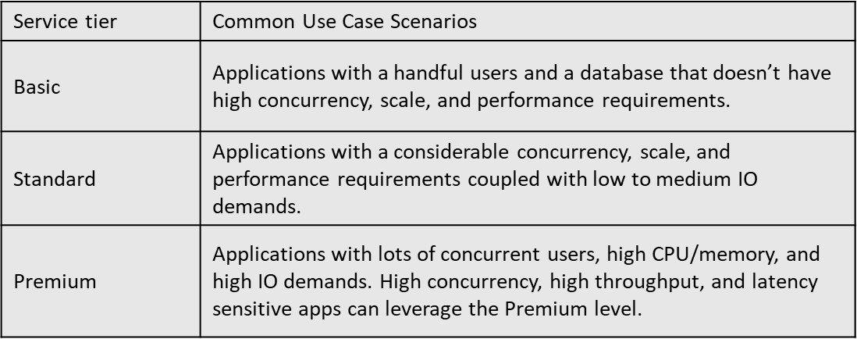
Monitoring & Maintenance
Performance Tier
Start with Standard Tier (S1/S2) based on the requirements and then monitor resource consumption to scale the tier up and down using Azure Alerts.

Slide 13
Monitoring & Maintenance
Database Integrity Check
You can run DBCC CHECKDB, at will.
By default, SQL DB handle the data corruption automatically.
Backups are tested using CHECKDB.

Slide 14
Application Characteristics
Retry Logic for Transient Errors
If the error is transient, retry to open a connection.
Do not directly retry a SQL statement that failed with a transient error. Instead, establish a fresh connection, and then retry the statement.
The retry logic must ensure that either the entire database transaction finished or that the entire transaction is rolled back.
A batch program (after work hours) can afford to be very patient with long time intervals between its retry attempts.
A user interface program must not retry every few seconds, because that policy can flood the system with requests.

Slide 15
Application Characteristics
Chatty Behavior
Chatty applications make excessive data access operations that are sensitive to network latency
Modify these kinds of applications to reduce the number of data access operations to the SQL database.
Improve application performance by using techniques like batching ad-hoc queries or moving the queries to stored procedures to reduce network roundtrips.
Sub-optimal Data Access Pattern
For read intensive workloads, consider reducing round trips against the Azure SQL Database by caching data on the client side with the Azure Caching service (Redis Cache) or another caching technology.
Databases with Intensive Workload
Scale the workload across multiple databases using Database Sharding or Functional Partitioning

Slide 16

References
https://docs.microsoft.com/en-us/azure/sql-database/sql-database-manage-after-migration#security-and-compliance
https://docs.microsoft.com/en-us/azure/sql-database/sql-database-connectivity-issues#retry-logic-for-transient-errors
https://docs.microsoft.com/en-us/azure/sql-database/sql-database-advisor
https://docs.microsoft.com/en-us/azure/sql-database/sql-database-query-performance
https://docs.microsoft.com/en-us/azure/sql-database/sql-database-insights-alerts-portal
https://github.com/anthonychu/azure-content/blob/master/articles/sql-database/sql-database-troubleshoot-common-connection-issues.md

Slide 17


