Slide 1

My Actual Topic… Lets Go Elastic… Elasticity in SQL Azure
Elastic Pools
Elastic Jobs
Elastic Queries
Elastic Pool is a collection of Azure SQL databases grouped together for saving cost.
Elastic Database Jobs helps run one or more T-SQL scripts in parallel across large number of DB’s.
Elastic Queries allows to perform cross-database queries to access remote tables.
Before talking further on Elasticity a quick 5 mins walk through on Azure SQL Databases.

Slide 2
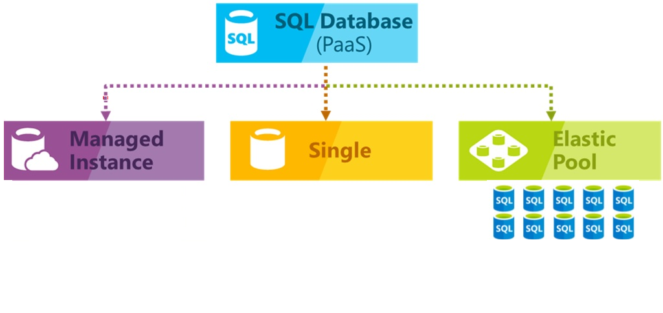
Azure SQL Databases (5 minutes walk through)

Slide 3

Azure SQL Databases

Slide 4

Azure Elastic Pool
SQL Database elastic pools are simple, cost-effective solution for managing and scaling multiple databases that have varying and unpredictable usage demands.
The databases in an elastic pool are on a single Azure SQL Database server and share a set number of resources at a set price.
A common application pattern is to provision a single database for each customer. But different customers have different
varying and unpredictable usage patterns, and it is difficult to predict resource requirements of each individual DB user.
Two Challenges are
Over provision resources based on peak usage and pay more
Under provision to save cost, but it may lead to performance issues for the database during high loads
Elastic pools solve this problem by ensuring that databases get the performance resources they need when they need it.

Slide 5
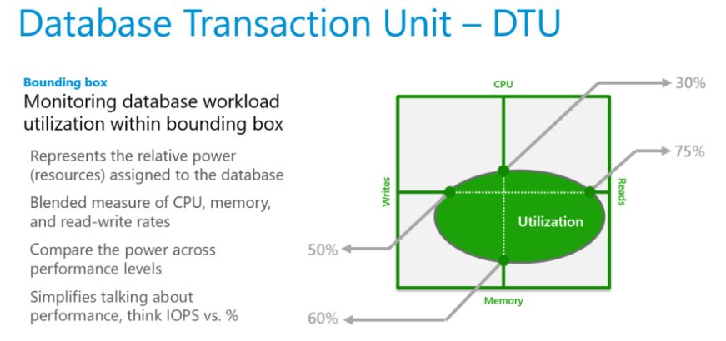
Azure Elastic Pool… Discussion on DTU before eDTU?
Before discussing eDTU, a quick understanding on DTU.
What is a DTU?
Database Transaction Unit (DTU) describes the capacity of a performance level of Basic, Standard, and Premium databases.
DTUs are based on a blended measure of CPU, Memory, Reads and Writes. As DTUs increase, the power offered by the performance level increases.
A performance level with 5 DTUs has five times more power than with 1 DTU.
DTU Quota applies to the server and not to individual database.
Each server has maximum of 1600 DTU’s.

Slide 6
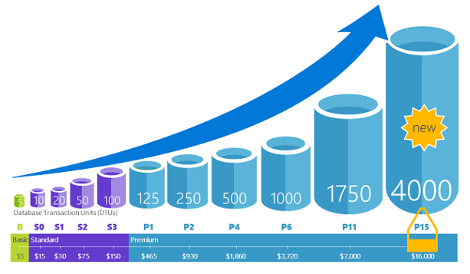
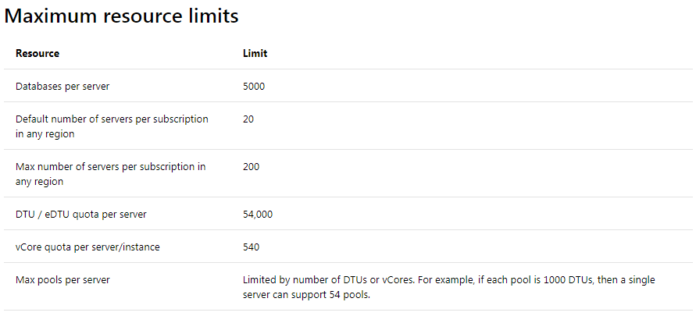
Azure Elastic Pool… DTU?
DTU across Service Tiers:
Database Transaction Unit (DTU) describes the capacity of a performance level of Basic, Standard, and Premium databases.
DTUs are based on a blended measure of CPU, Memory, Reads and Writes. As DTUs increase, the power offered by the performance level increases.
A performance level with 5 DTUs has five times more power than 1 DTU.
DTU Quota applies to the server and not to individual database.
Each server has maximum of 54,000 DTU’s.
For Updated Service Tier Information:
https://azure.microsoft.com/en-in/pricing/details/sql-database/single/

Slide 7
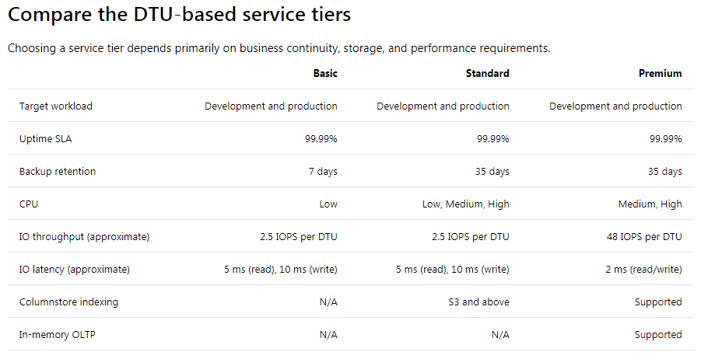
Azure Elastic Pool… DTU?

Slide 8
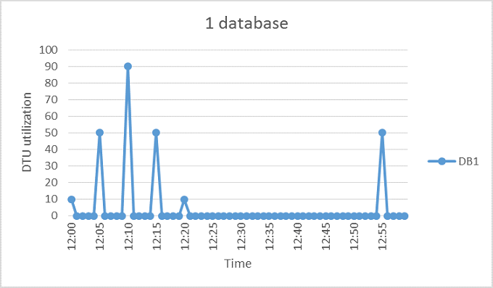
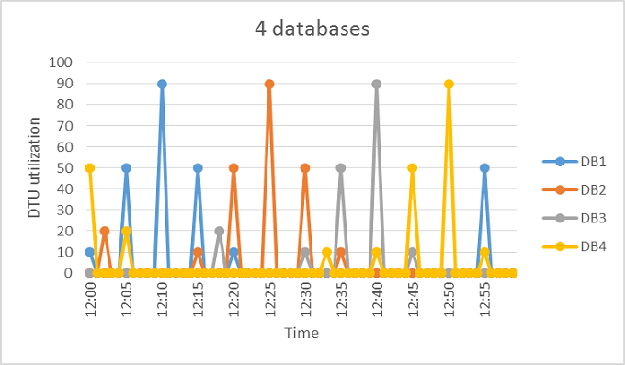
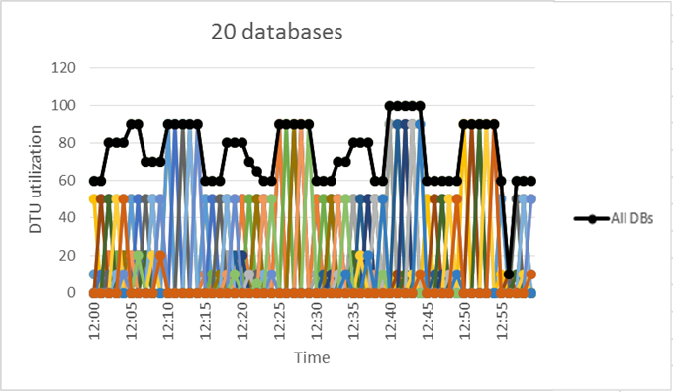
Azure Elastic Pool… Now its eDTU time?
The aggregate DTU utilization across all 20 databases is illustrated by the black line and it never exceeds 100DTU.
That means 20 databases can share 100 eDTU’s.
This results in a 20x reduction in DTUs and 13x price reduction compared to placing each of the databases in S3

Slide 9
Azure Elastic Pool… Pricing Facts of eDTU…
This example of 20 databases pooling is ideal for following reasons:
There are large differences between peak utilization and average utilization per database.
The peak utilization for each database occurs at different points in time.
eDTUs are shared between many databases.
eDTU unit price for a pool is 1.5x greater than the DTU unit price for single DB, it is so because pool eDTUs can be shared by many databases and fewer total eDTUs are needed.
At least two S3 databases or at least 15 S0 databases are needed for 100 eDTU pool to be more cost-effective.
Estimating eDTUs: (For DTU-based Purchasing Model)
MAX(<Total DBs X Avg DTU utilization per DB>, <Number of concurrently peaking DBs X Peak DTU utilization per DB>)

Slide 10


Azure Elastic Pool… Equity To Equality

Slide 11
Azure Elastic Jobs
SQL Database elastic pools are simple, cost-effective solution for managing and scaling multiple databases that have varying and unpredictable usage demands.
The databases in an elastic pool are on a single Azure SQL Database server and share a set number of resources at a set price.
A common application pattern is to provision a single database for each customer. But different customers have different
varying and unpredictable usage patterns, and it is difficult to predict resource requirements of each individual DB user.
Two Challenges are
Over provision resources based on peak usage and pay more
Under provision to save cost, but it may lead to performance issues for the database during high loads
Elastic pools solve this problem by ensuring that databases get the performance resources they need when they need it.

Slide 12
Azure Elastic Queries
SQL Database elastic pools are simple, cost-effective solution for managing and scaling multiple databases that have varying and unpredictable usage demands.
The databases in an elastic pool are on a single Azure SQL Database server and share a set number of resources at a set price.
A common application pattern is to provision a single database for each customer. But different customers have different
varying and unpredictable usage patterns, and it is difficult to predict resource requirements of each individual DB user.
Two Challenges are
Over provision resources based on peak usage and pay more
Under provision to save cost, but it may lead to performance issues for the database during high loads
Elastic pools solve this problem by ensuring that databases get the performance resources they need when they need it.

Slide 13

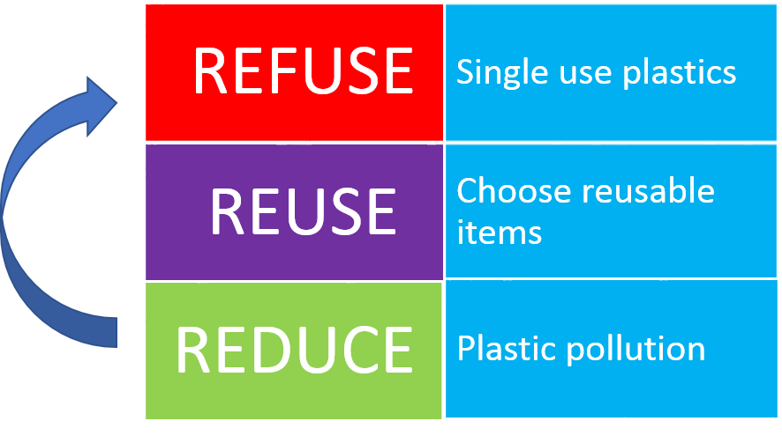
Please Don’t Forget your 3 giveaways on Plastic

