Slide 1
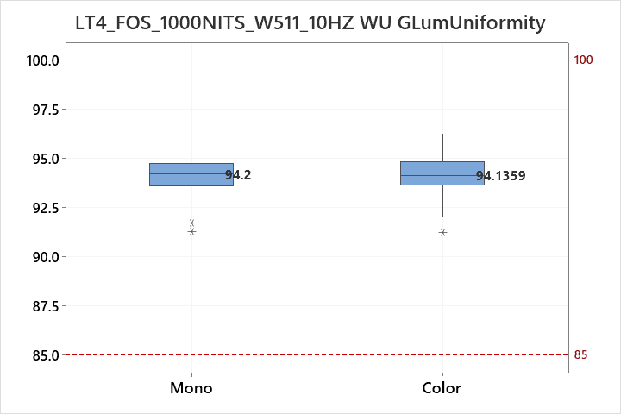
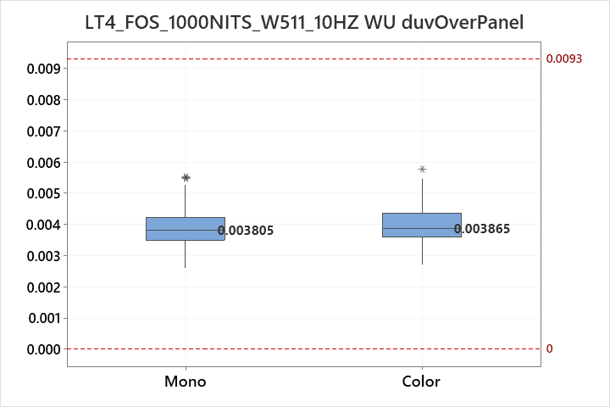
Prepared: IT VH Part 4
MidOLED Dev Team Date: 2023.09.19
1000NITS_W511_dY&duv
Line 1
Line 2
Line 3
Line 4

