Slide 1
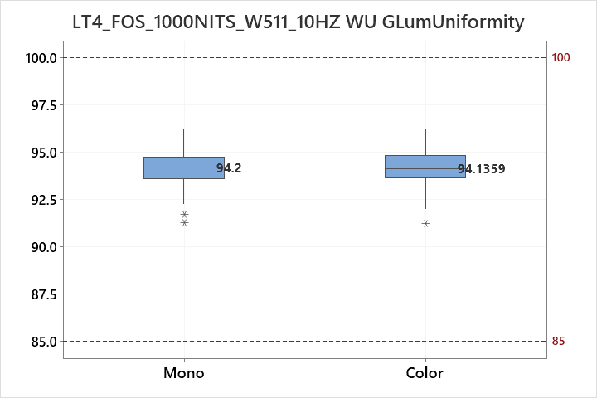
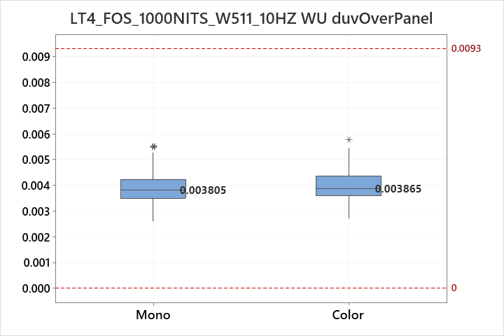
Prepared: IT VH Part 4
MidOLED Dev Team Date: 2023.09.19
1000NITS_W511_dY&duv
No issue

Slide 2
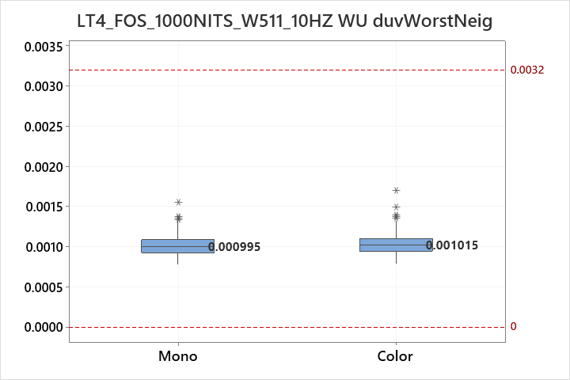
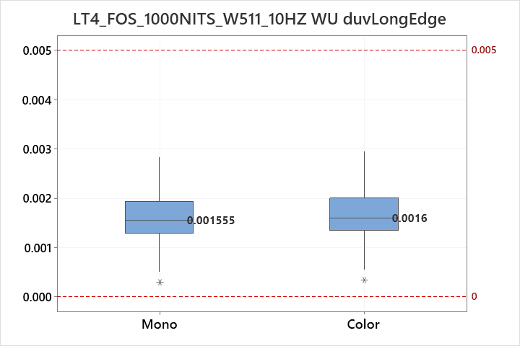
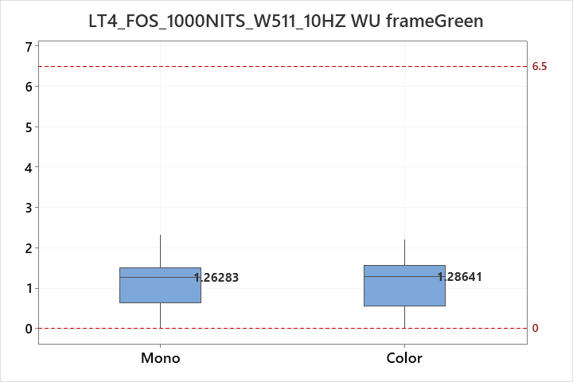
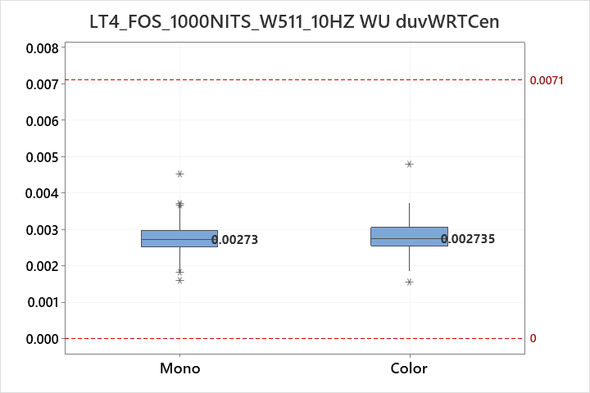
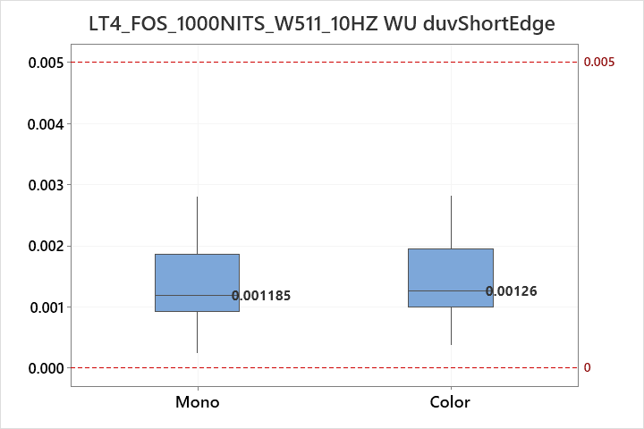
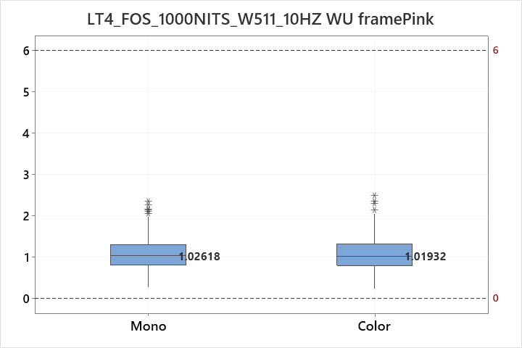
Prepared: IT VH Part 4
MidOLED Dev Team Date: 2023.09.19
1000NITS_W511 WU
No issue

Slide 3
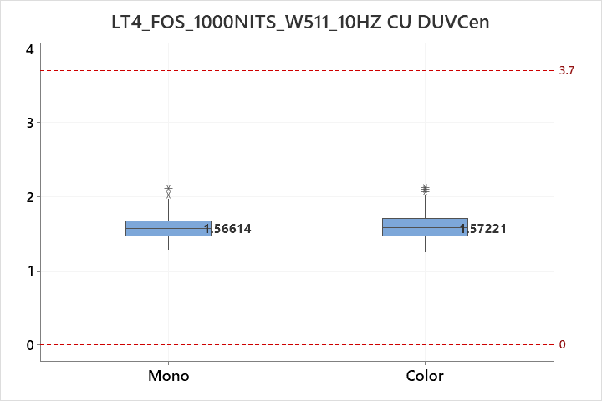
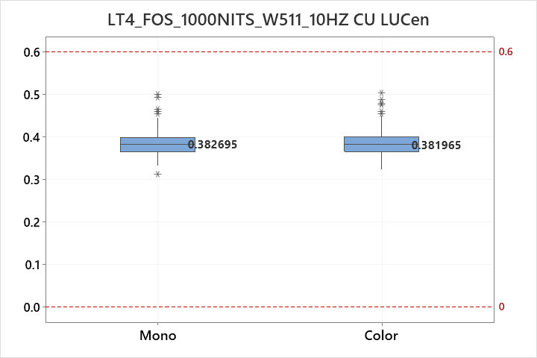
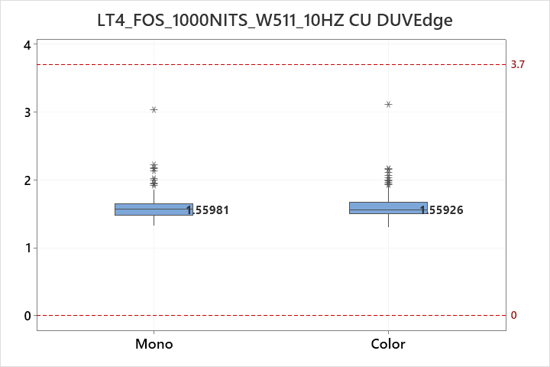
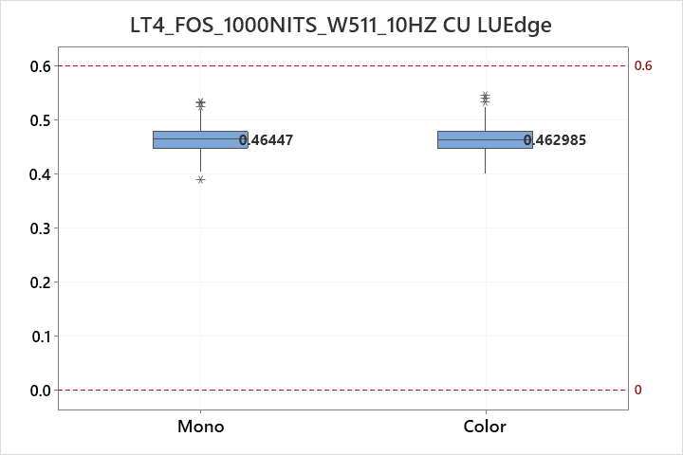
Prepared: IT VH Part 4
MidOLED Dev Team Date: 2023.09.19
1000NITS_W511 CU
No issue

Slide 4
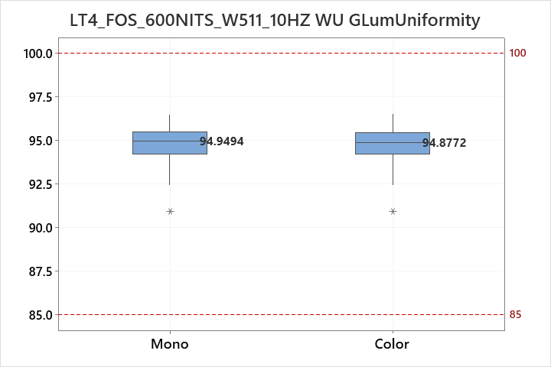
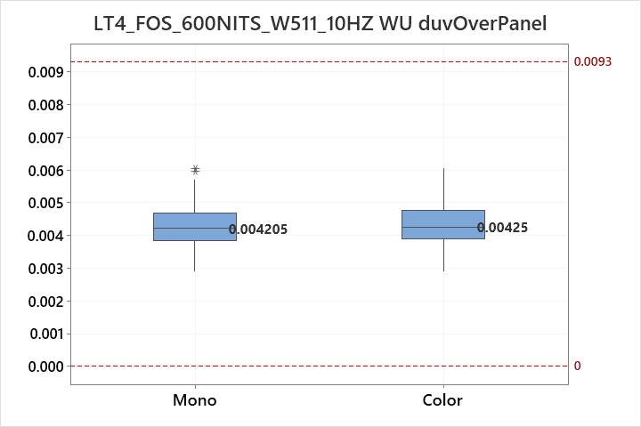
Prepared: IT VH Part 4
MidOLED Dev Team Date: 2023.09.19
600NITS_W511 dY&duv
No issue

Slide 5
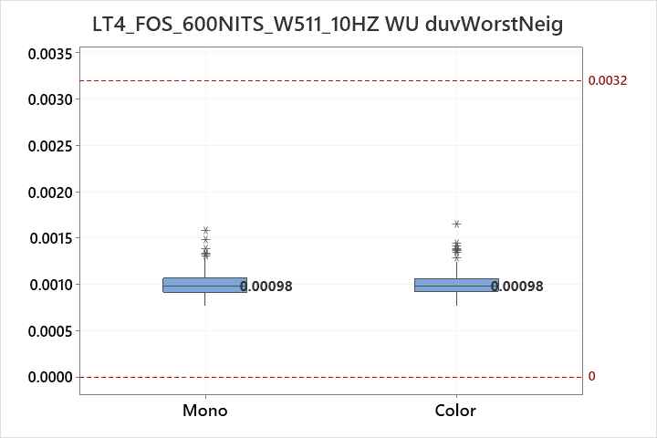
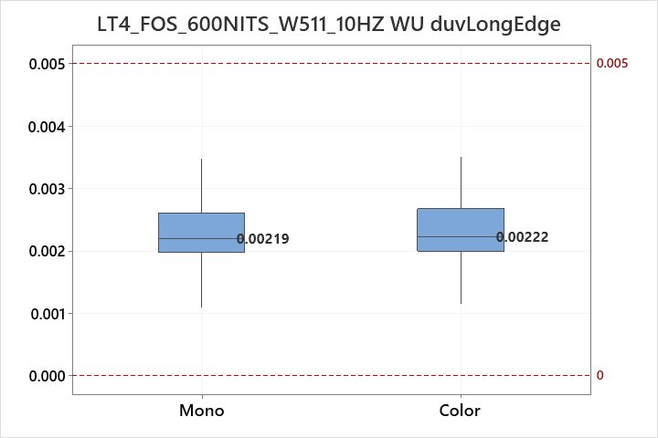
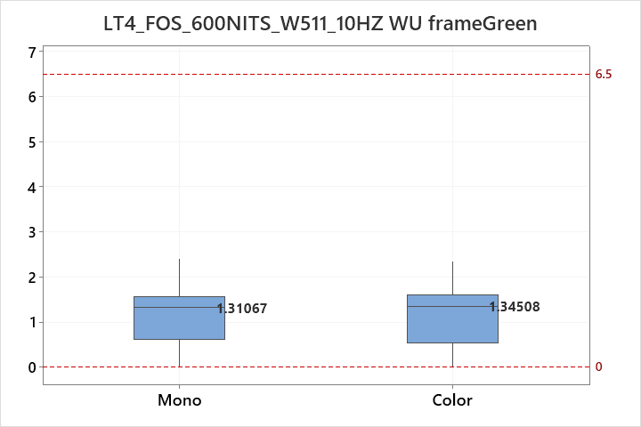

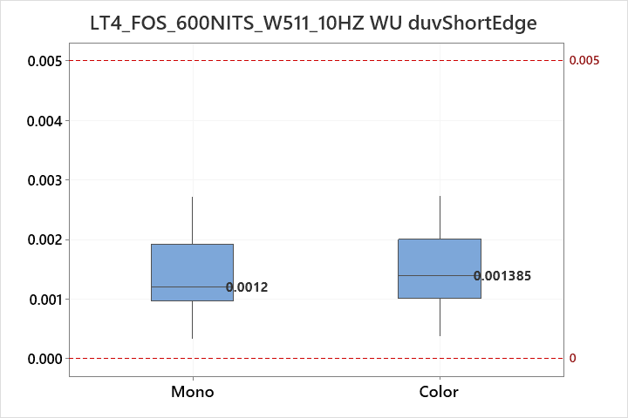
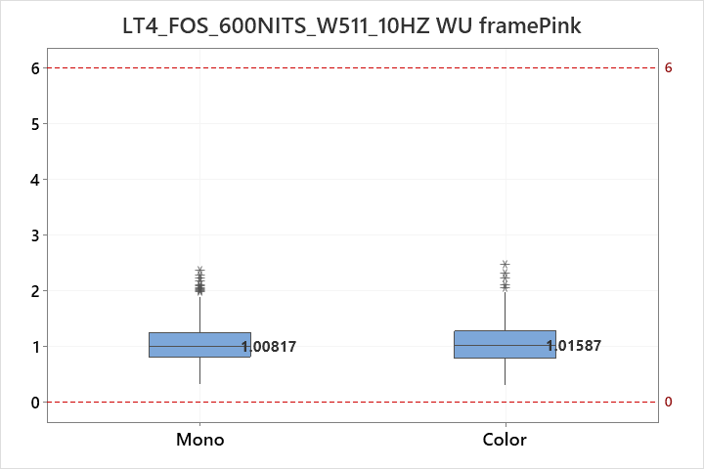
Prepared: IT VH Part 4
MidOLED Dev Team Date: 2023.09.19
600NITS_W511 WU
No issue

Slide 6
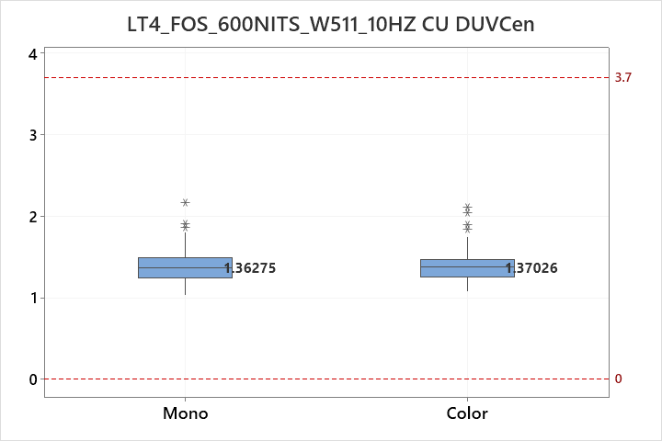
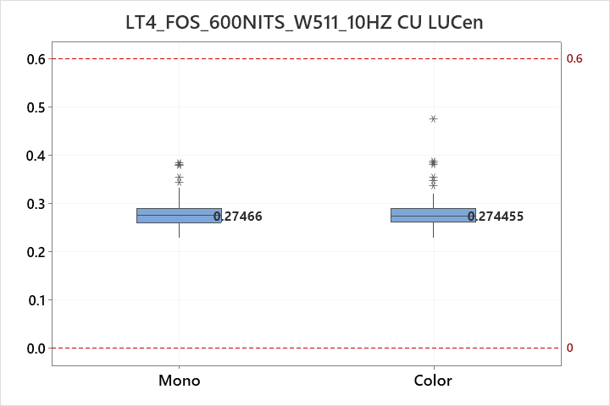
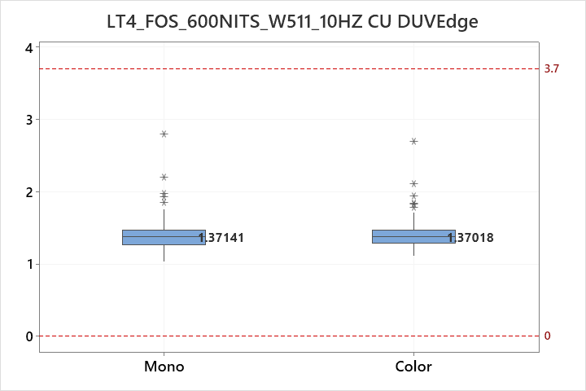
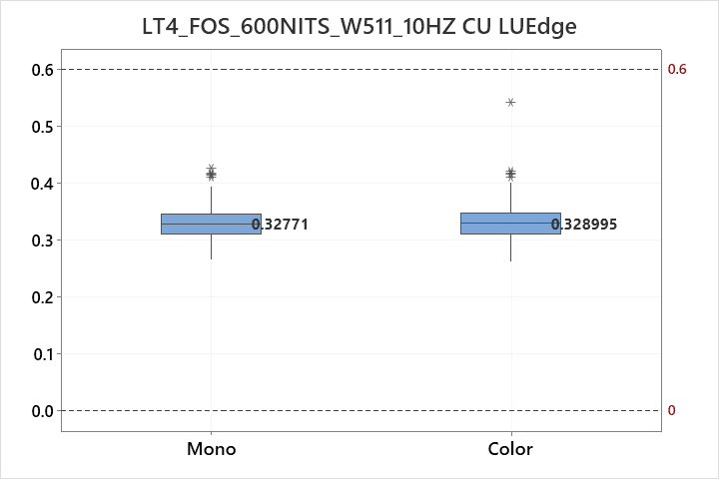
Prepared: IT VH Part 4
MidOLED Dev Team Date: 2023.09.19
600NITS_W511 CU
No issue

Slide 7
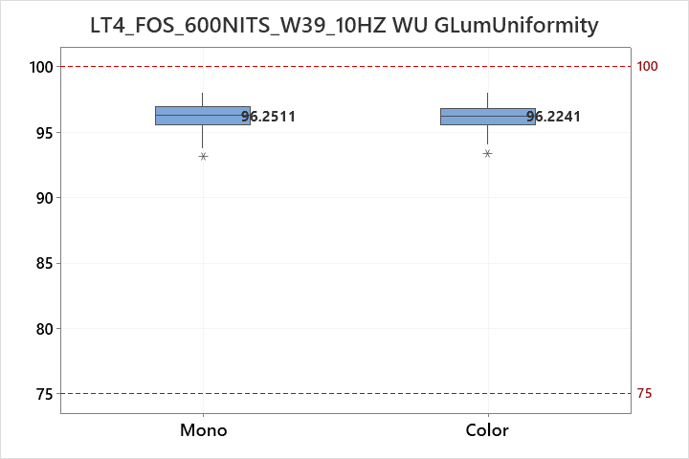
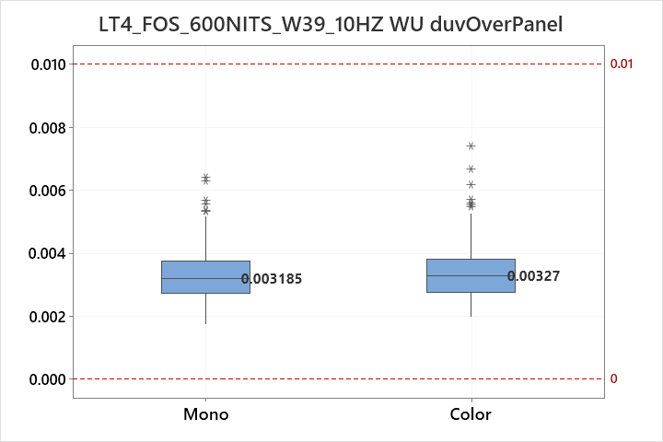
Prepared: IT VH Part 4
MidOLED Dev Team Date: 2023.09.19
600NITS_W39 dY&duv
No issue

Slide 8
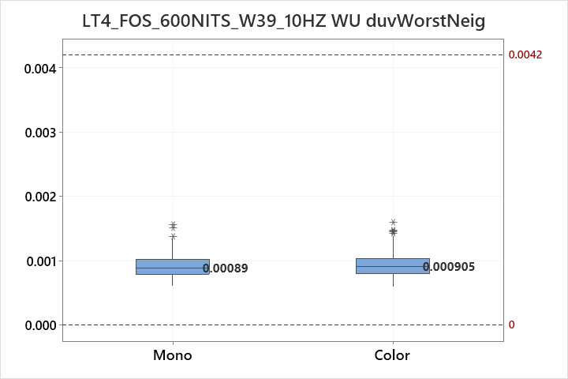
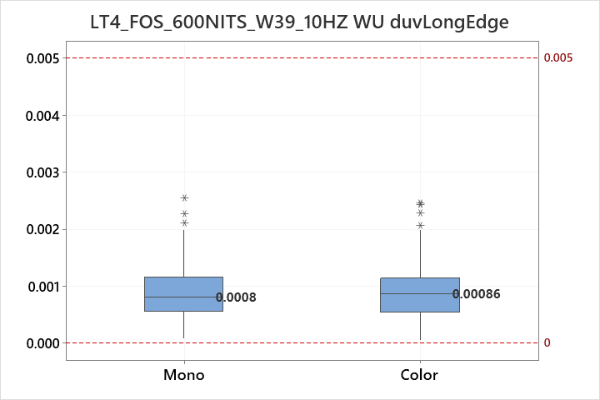
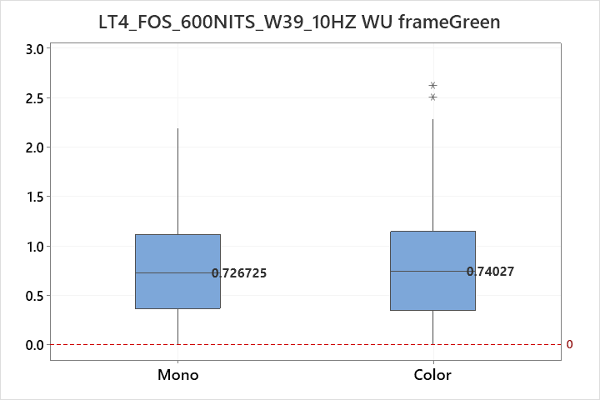
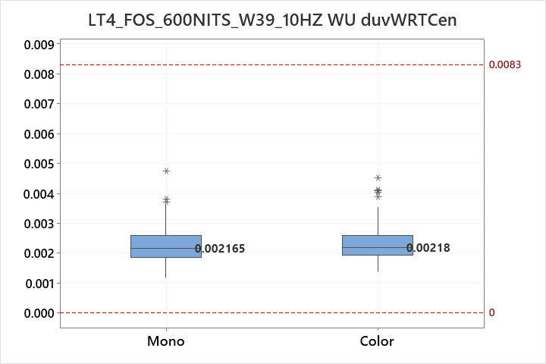
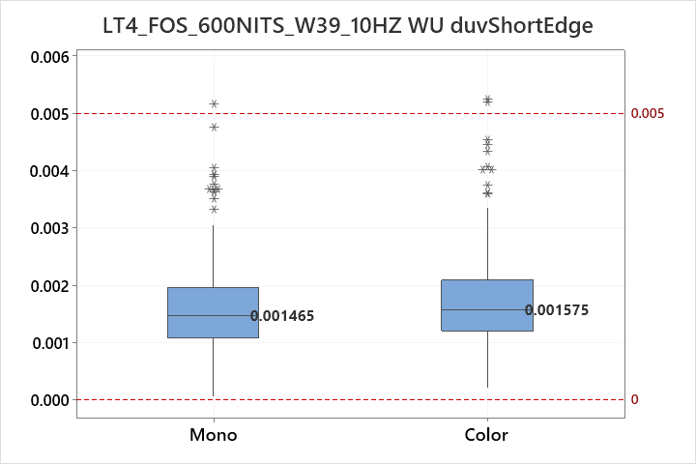
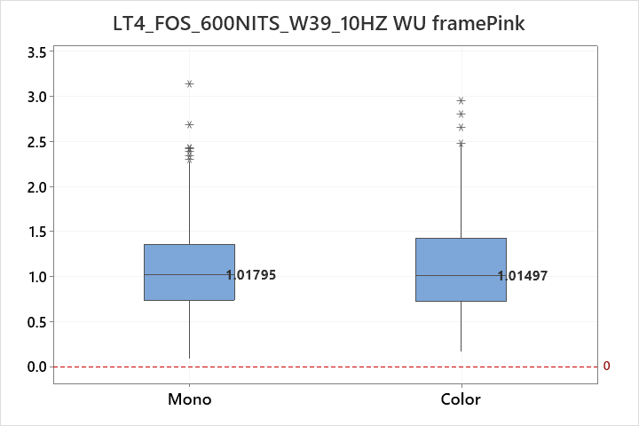
Prepared: IT VH Part 4
MidOLED Dev Team Date: 2023.09.19
600NITS_W39 WU
No issue

Slide 9
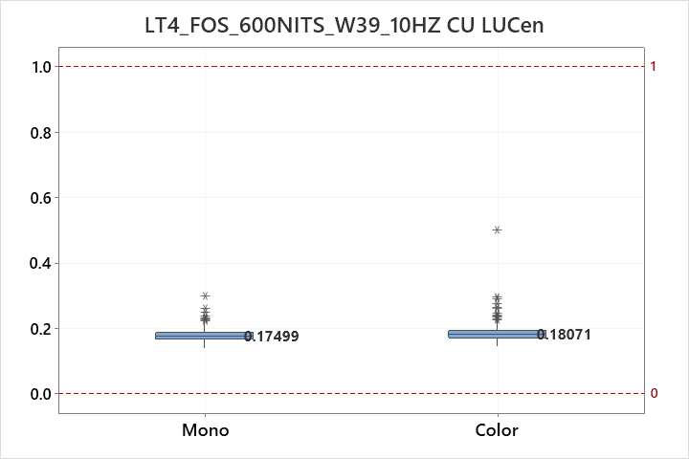
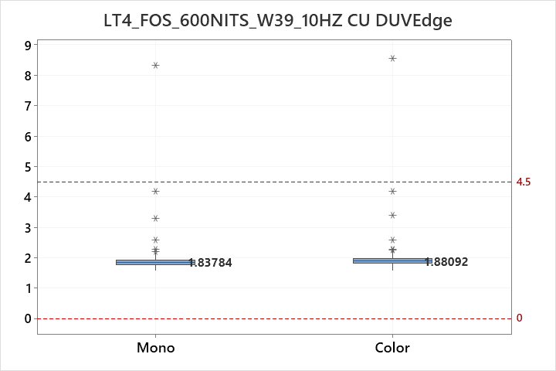
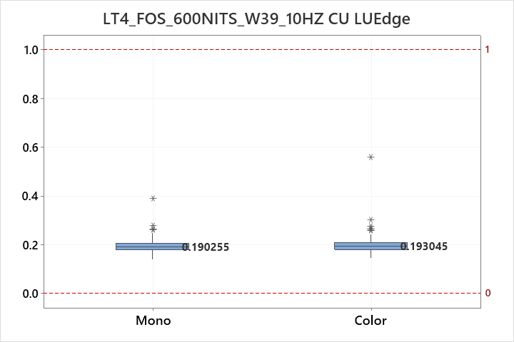
Prepared: IT VH Part 4
MidOLED Dev Team Date: 2023.09.19
600NITS_W39 CU
No issue

Slide 10

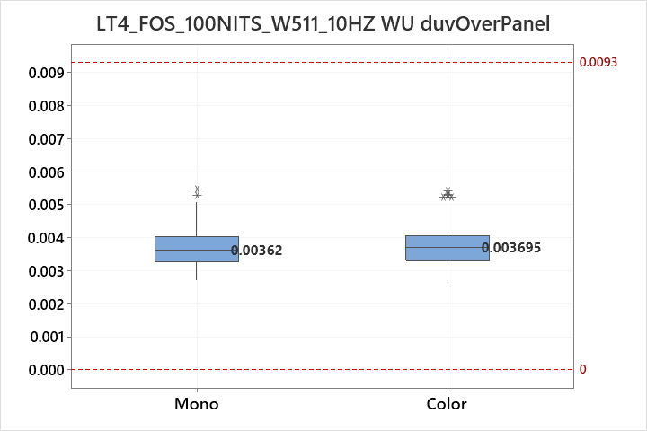
Prepared: IT VH Part 4
MidOLED Dev Team Date: 2023.09.19
100NITS_W511 dY&duv
No issue

Slide 11
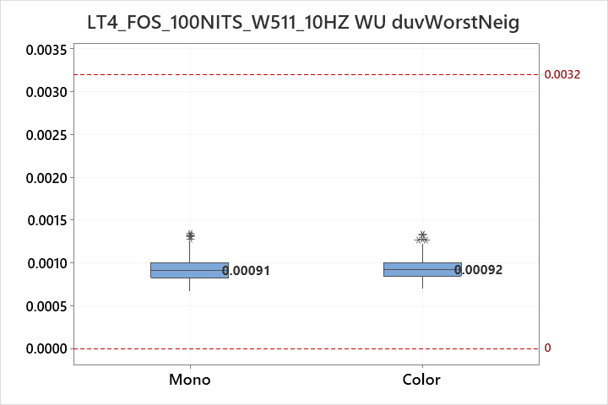
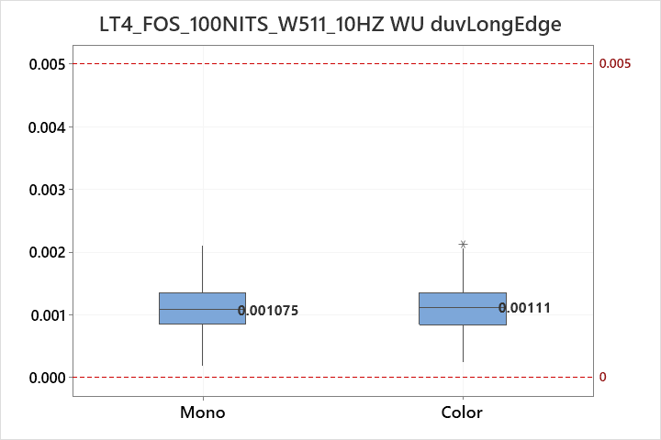
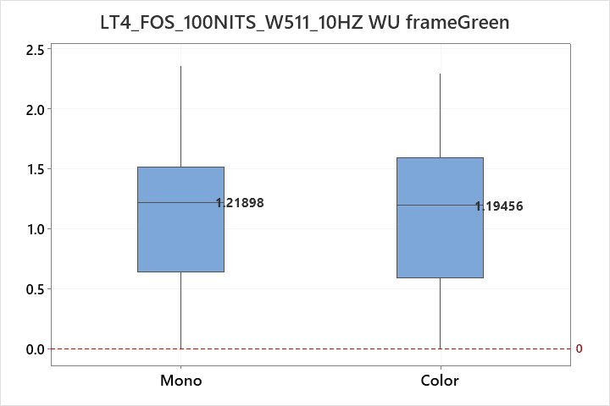
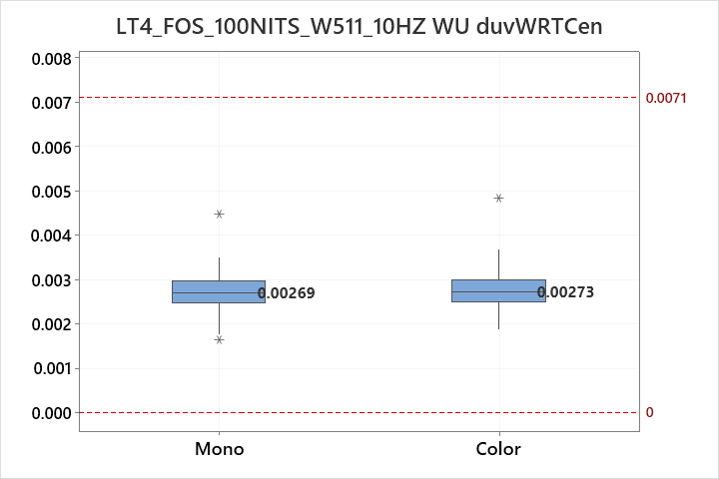
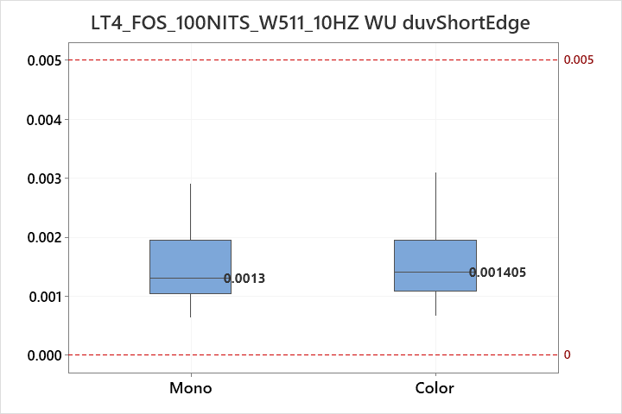
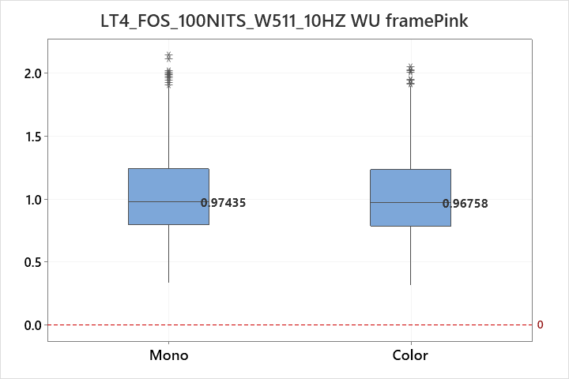
Prepared: IT VH Part 4
MidOLED Dev Team Date: 2023.09.19
100NITS_W511 WU
No issue

Slide 12
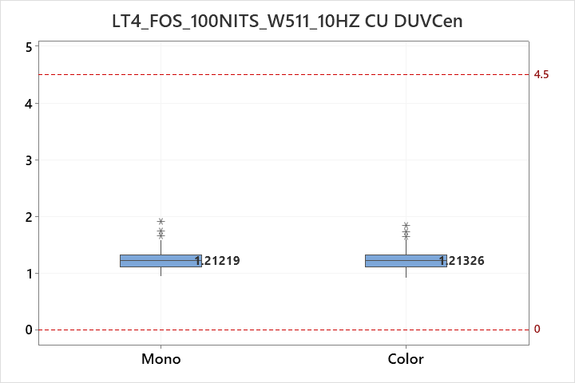
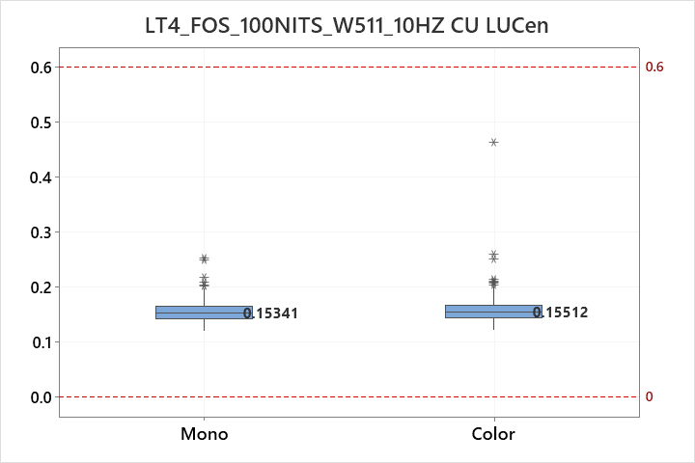
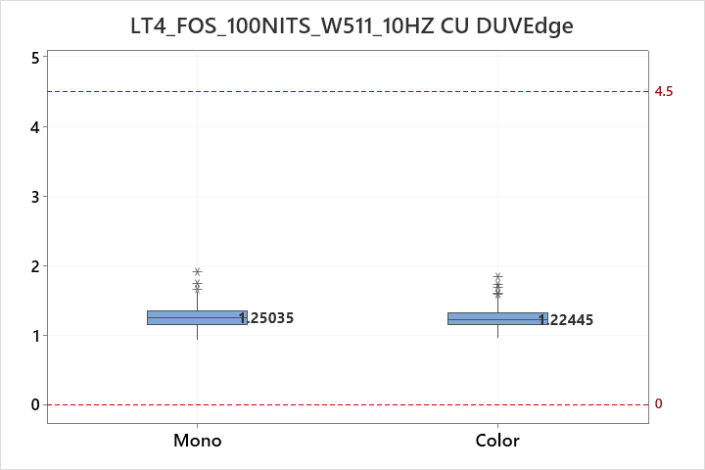
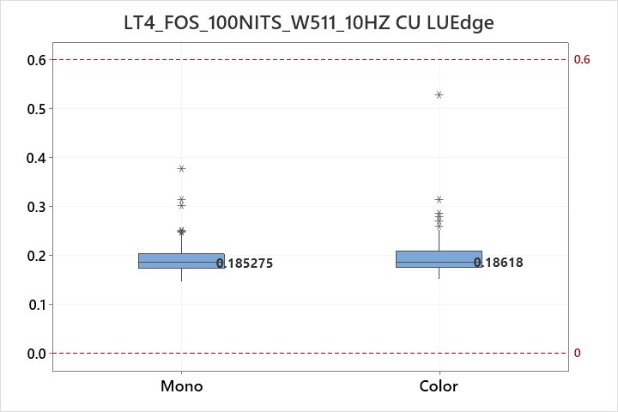
Prepared: IT VH Part 4
MidOLED Dev Team Date: 2023.09.19
100NITS_W511 CU
No issue

Slide 13
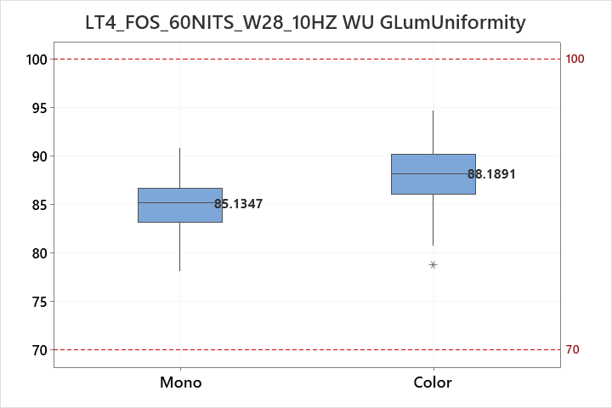
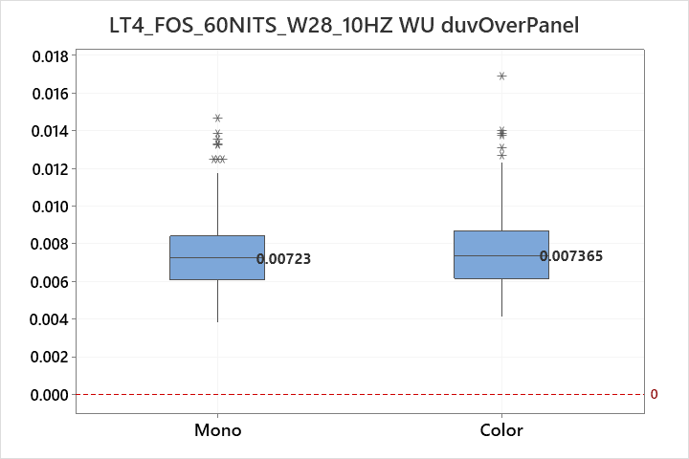
Prepared: IT VH Part 4
MidOLED Dev Team Date: 2023.09.19
60NITS_W28 dY&duv
Mono have lower performance than Color

Slide 14
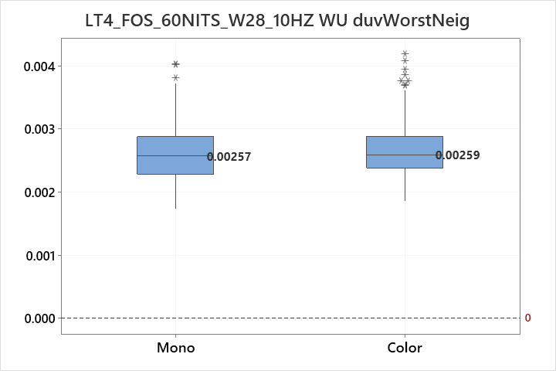
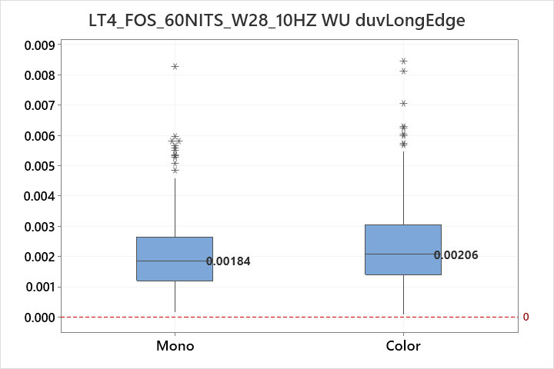
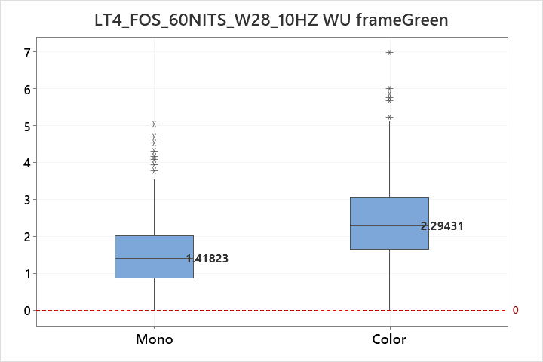



Prepared: IT VH Part 4
MidOLED Dev Team Date: 2023.09.19
60NITS_W28 WU
No issue

Slide 15




Prepared: IT VH Part 4
MidOLED Dev Team Date: 2023.09.19
60NITS_W28 CU
No issue

Slide 16


Prepared: IT VH Part 4
MidOLED Dev Team Date: 2023.09.19
30NITS_W39 dY&duv 120hz
Mono have lower performance than Color

Slide 17






Prepared: IT VH Part 4
MidOLED Dev Team Date: 2023.09.19
30NITS_W39 WU 120hz
No issue

Slide 18




Prepared: IT VH Part 4
MidOLED Dev Team Date: 2023.09.19
30NITS_W39 CU 120hz
No issue

Slide 19


Prepared: IT VH Part 4
MidOLED Dev Team Date: 2023.09.19
10NITS_W65 dY&duv
Mono have lower performance than Color

Slide 20






Prepared: IT VH Part 4
MidOLED Dev Team Date: 2023.09.19
10NITS_W65 WU
Mono have lower performance than Color

Slide 21




Prepared: IT VH Part 4
MidOLED Dev Team Date: 2023.09.19
10NITS_W65 CU
No issue

Slide 22


Prepared: IT VH Part 4
MidOLED Dev Team Date: 2023.09.19
10NITS_W31 dY&duv
Mono have lower performance than Color

Slide 23





Prepared: IT VH Part 4
MidOLED Dev Team Date: 2023.09.19
10NITS_W31 WU
Mono have lower performance than Color

Slide 24




Prepared: IT VH Part 4
MidOLED Dev Team Date: 2023.09.19
10NITS_W31 CU
No issue

Slide 25



Prepared: IT VH Part 4
MidOLED Dev Team Date: 2023.09.19
100NITS_W31 Sandy Mura
No issue

