Slide 1
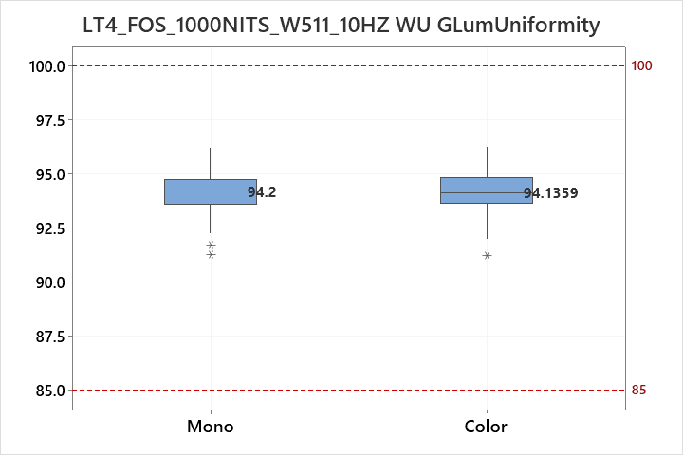
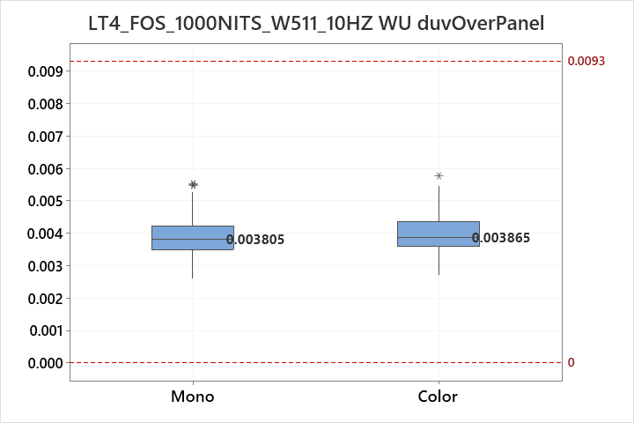
Prepared: IT VH Part 4
MidOLED Dev Team Date: 2023.09.19
1000NITS_W511_dY&duv
No issue
Object | PUC Machine | N
Mono | 300nits capture + DLL 4.0.5.15 | 236
Color | Mono + Color Cam at RGB 31/43 | 236

Slide 2
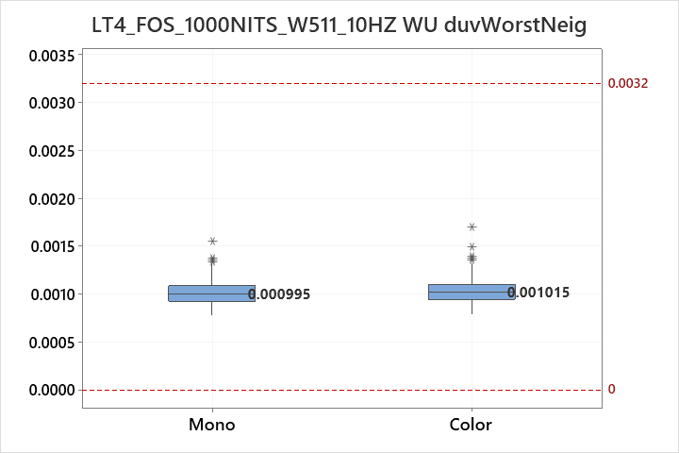
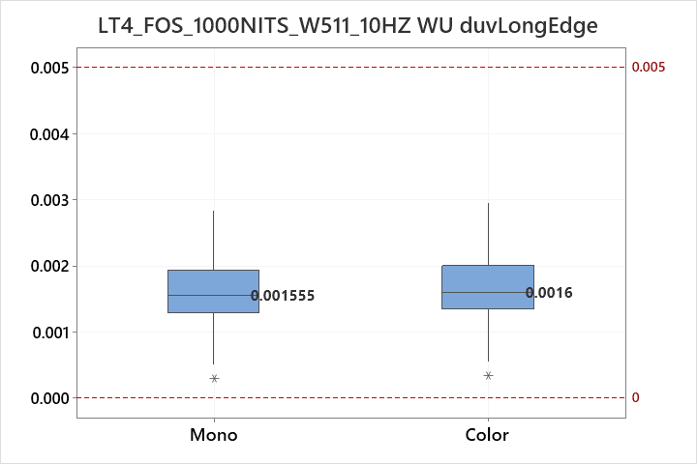
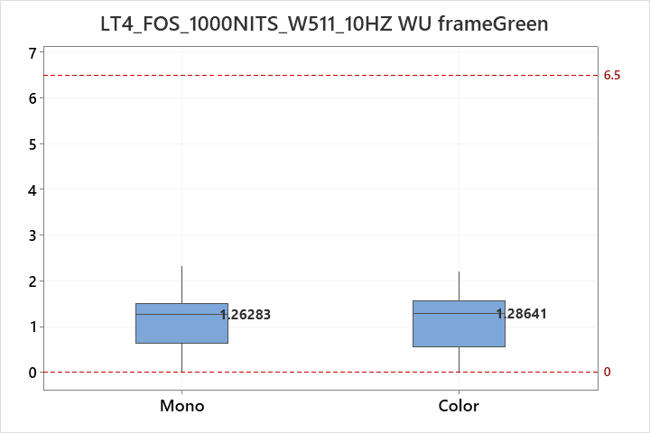
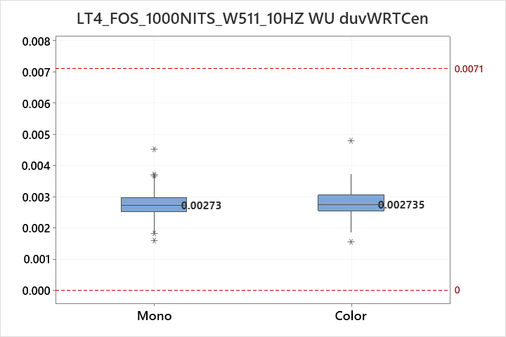
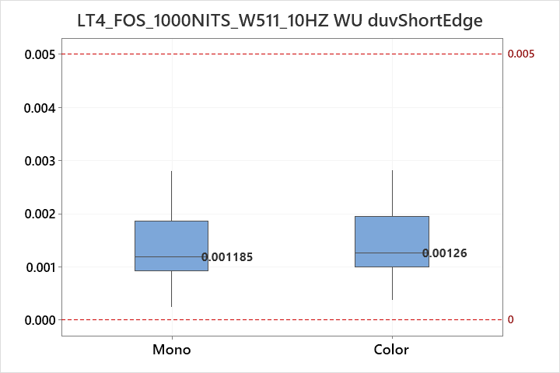
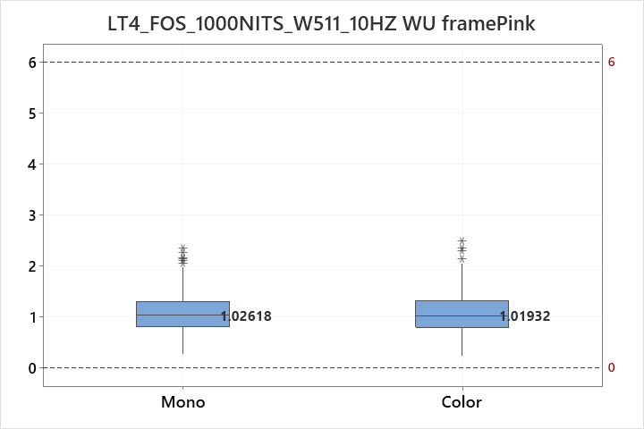
Prepared: IT VH Part 4
MidOLED Dev Team Date: 2023.09.19
1000NITS_W511 WU
No issue
Object | PUC Machine | N
Mono | 300nits capture + DLL 4.0.5.15 | 236
Color | Mono + Color Cam at RGB 31/43 | 236

