Slide 1
Covid 19 Fake NEWS
Building a NLP Classifier to predict Misinformation

Slide 2
Problem Statement
Covid 19 is proving to be a unique challenge for our society, most particularly because of the amount of misinformation being shared through both Social media and state-affiliated media.
The purpose of this project is to use known misinformation and build an aPI that accepts a news title and predicts whether the title is likely to be misinformation.

Slide 3
Data Sources
Poynter.org has been gathering a database of known pieces of misinformation regarding the Covid-19 Pandemic, which is fact checked and available
https://www.poynter.org/ifcn-covid-19-misinformation/
Reddit.com has a rigorously policed r/coronavirus subreddit which has, among its rules, “keep information quality high” and removes posts which violate this rule.
https://www.reddit.com/r/Coronavirus/wiki/rules
The World Health Organizations Covid-19 Mythbusters page
https://www.who.int/emergencies/diseases/novel-coronavirus-2019/advice-for-public/myth-busters

Slide 4

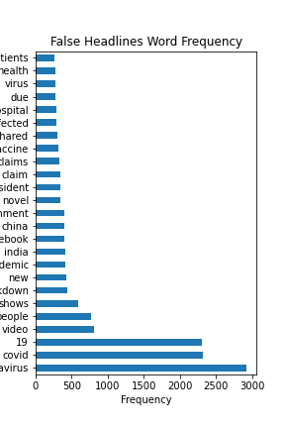
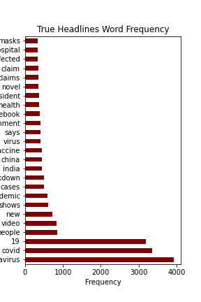
Most Common Words in Headlines
When examining word Counts alone, we do not show a large variation between the Two main categories.

Slide 5
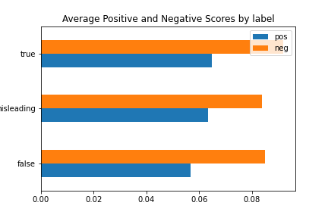
VADER Sentiment Analysis

Slide 6
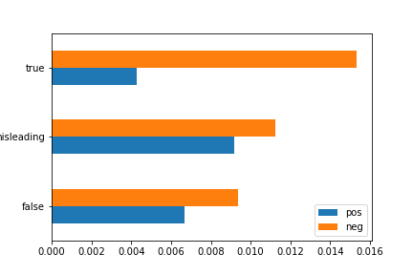
Custom Sentiment Analysis
Positive Words
'brave','great', 'improve', 'amazing','decrease','strong','safe', 'clean', 'happy','love', 'enjoy','accomplish','achieve', 'good', 'negative', 'cure', 'support','effective','save', 'open'
Negative Words
‘infected','violence','terrible','worse','death','fake', 'illegal', 'destroy', 'aggressive','enemy','crash', 'bad','false','rude','disappointed','positive','crisis','increase'

Slide 7

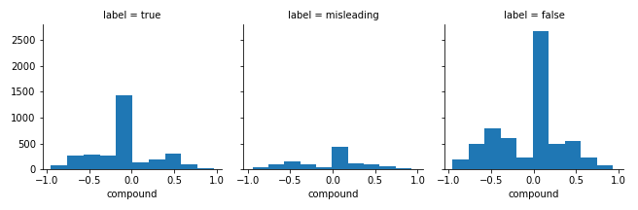
Sentiment Analysis- Compound Score Distribution by Target Column Category

Slide 8
Models Built:
Count Vectorized Logistic Regression
Train: 99.41 %
Test: 91.01 %
Count Vectorized Multinomial Naïve Bayes
Train: 94.11 %
Test: 89.26 %
Count Vectorized Random Forest
Train: 75.27 %
Test: 75.30 %
TF-IDF Vectorized Logistic Regression
Train: 99.49%
Test: 90.93 %
TF-IDF Vectorized Multinomial Naïve bayes
Train: 94.55 %
Test: 89.91 %
Bagging Classifier
Train: 98.89%
Test: 86.64 %
ADABoost:
Train: 91.59 %
Test: 86.53 %
TF-IDF Vectorized Random Forest
Train: 91.97 %
Test: 85.89 %
Baseline:
59.89 %

Slide 9
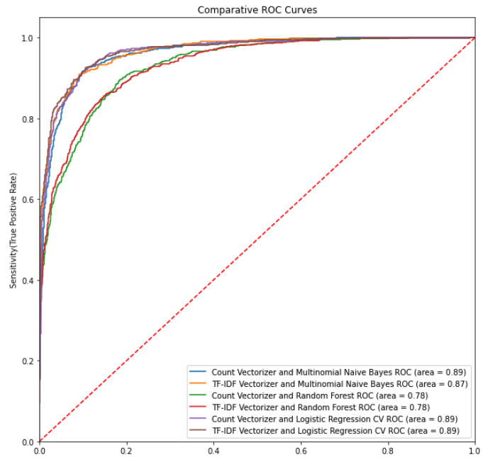
Model Selection

Slide 10
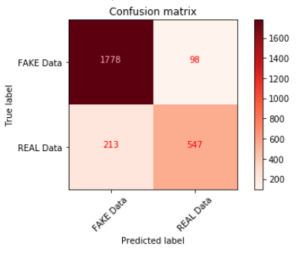
Production Model Confusion Matrix

Slide 11
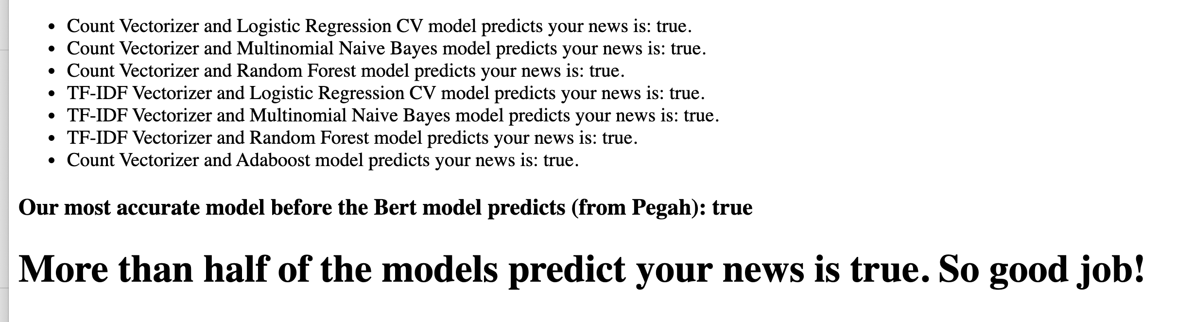
API Demonstration

Slide 12
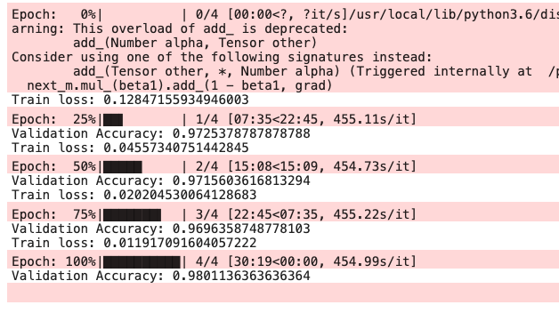
BERT Improvements
As a side project we ran the dataset through a preset workflow to implement a BERT NLP model
Train:
Test Score:
97.25 %
96.96 %

Slide 13
Recommendations for Future Research
Data, data, data!
Our ‘true’ data is based primarily on the assumption that the moderators of the r/coronavirus are doing a good job of removing misinformation
Integrate BERT into API
following the workflow on google collab we were able to generate an effective model, however the deployment of our API using the existing models gave comparable if slightly less accurate models that can be compared side by side
Deploy API to Heroku to make the model available to the public

